Slide 1
Topocloning SHAREseq libs
Continue to debug the GGGGGGs in index 1

Slide 2
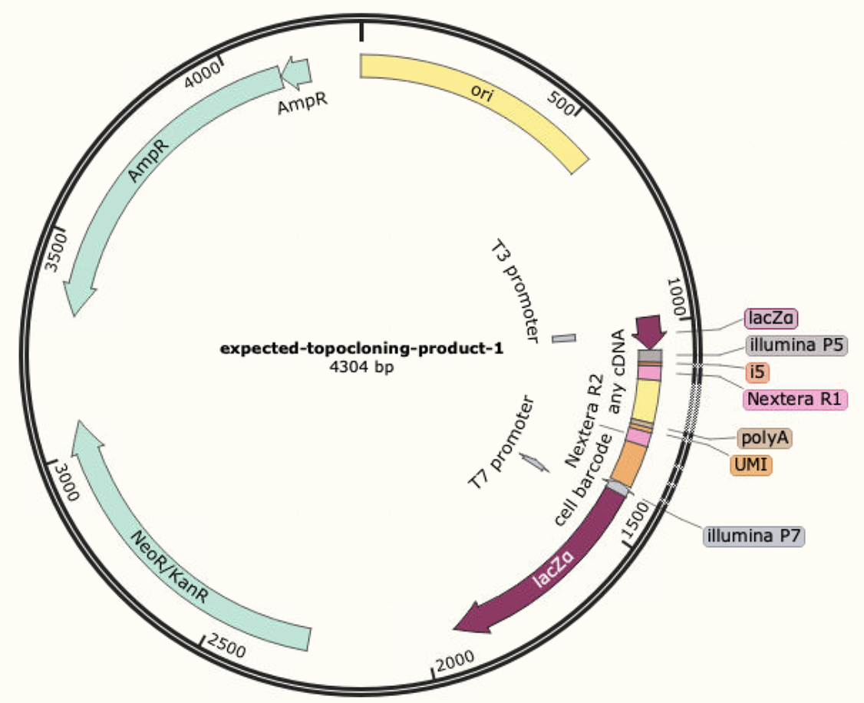
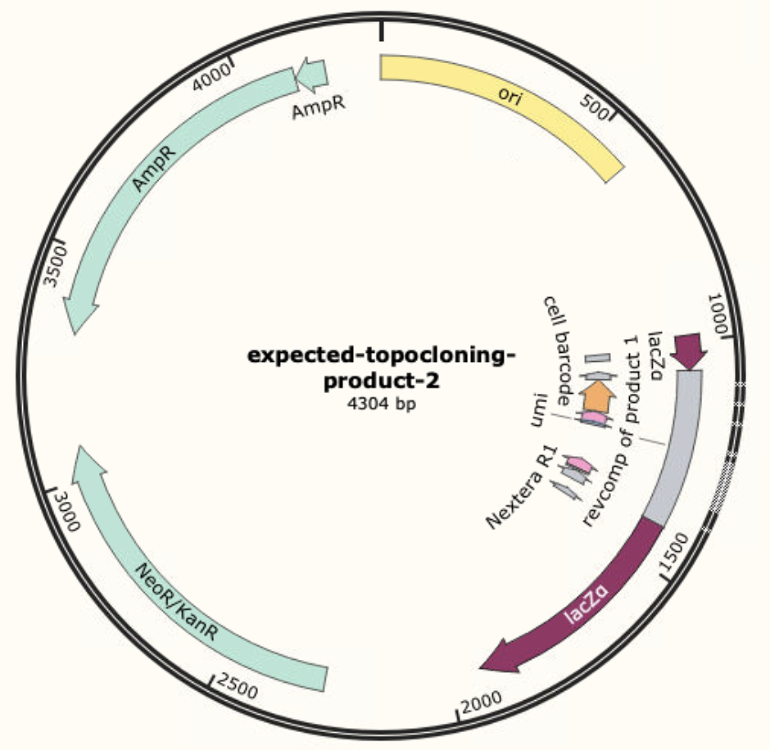
Expected product
OR

Slide 3
Samples
SL2 – lung batch 1 ATAC
SL18 – lung batch 1 RNA
BL193 – A549 ATAC
BL201 – A549 RNA

Slide 4
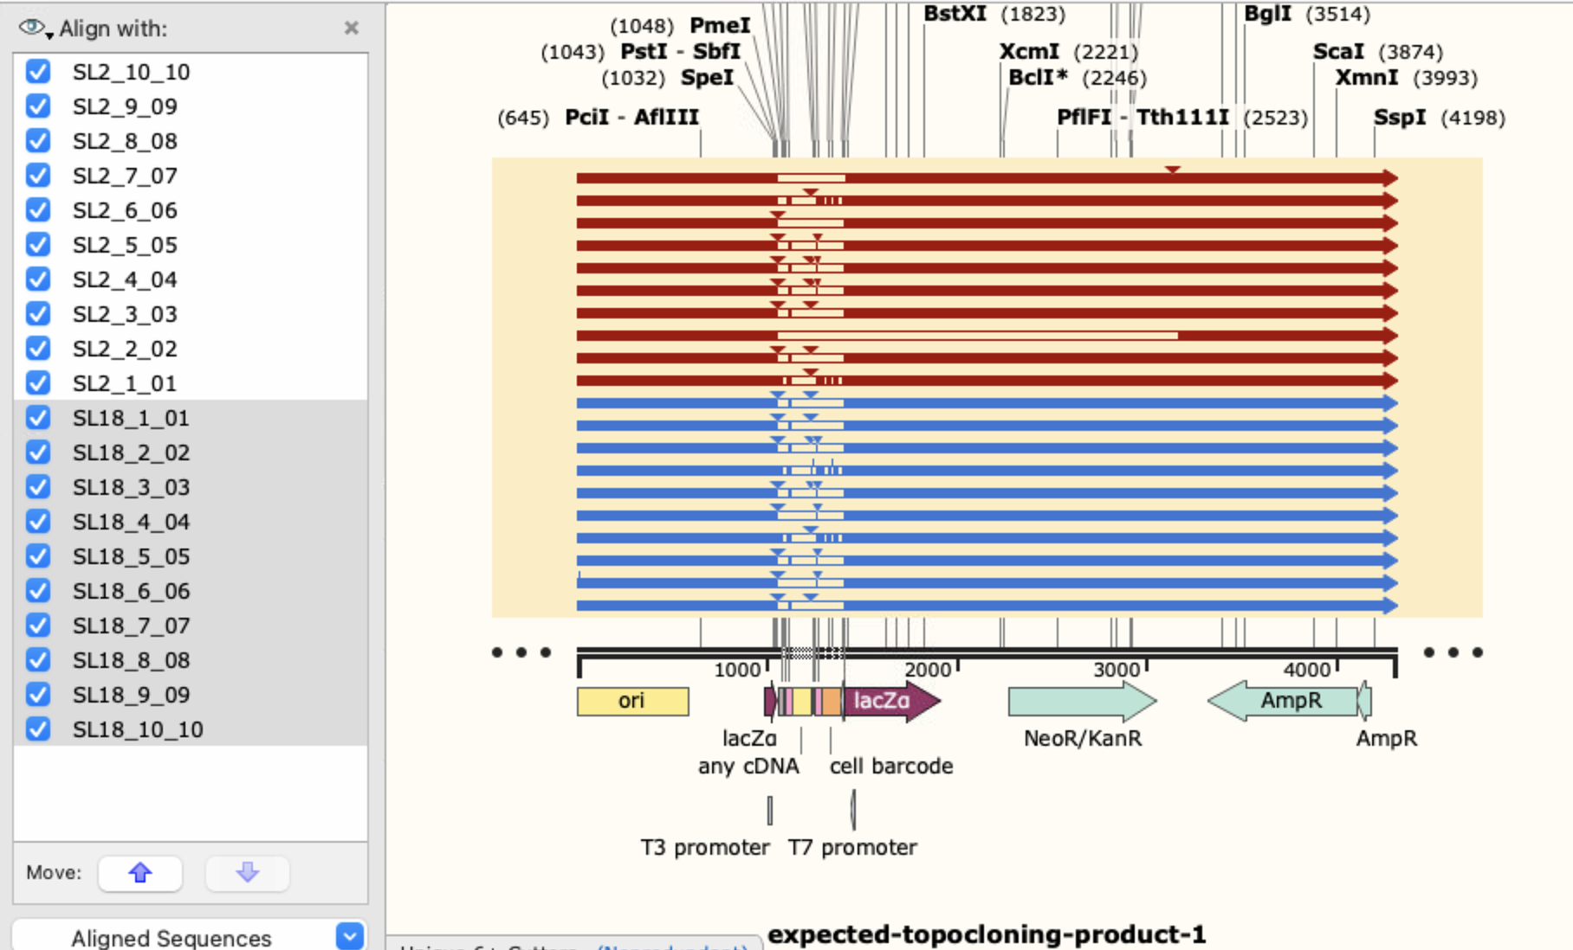
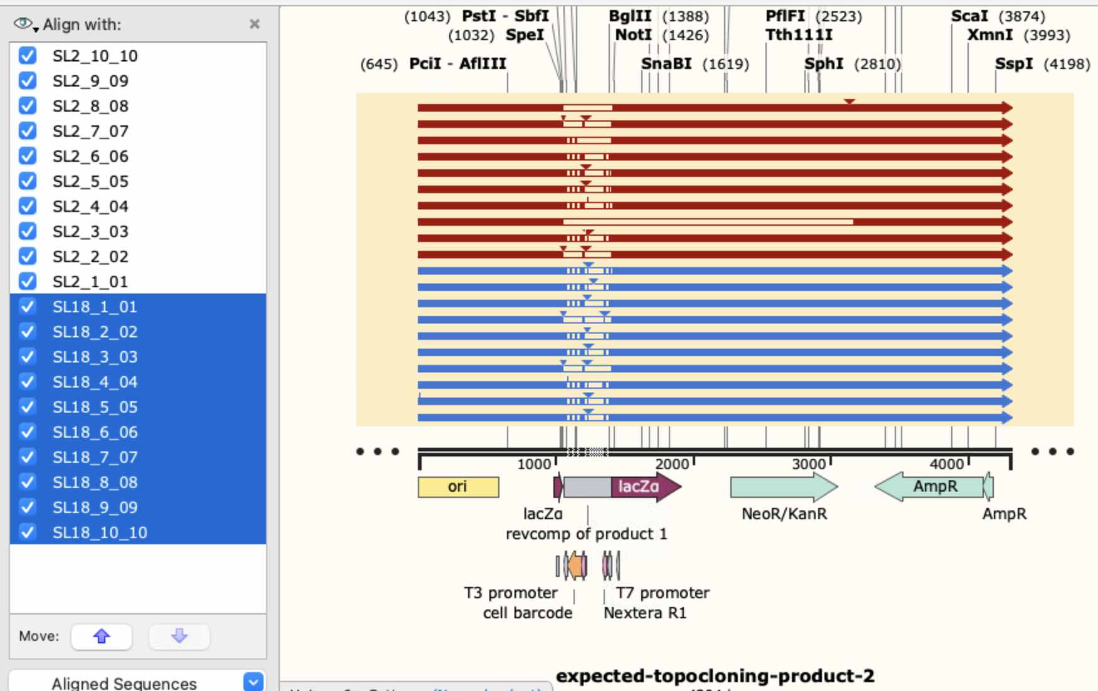
Alignment lung samples

Slide 5
Aligning to product 1
P5 -> P7
Aligning to product 2 P7 -> P5
Solid color - matched
The distinctive 3 vertical stripes is the linker sequences in cell barcode

Slide 6
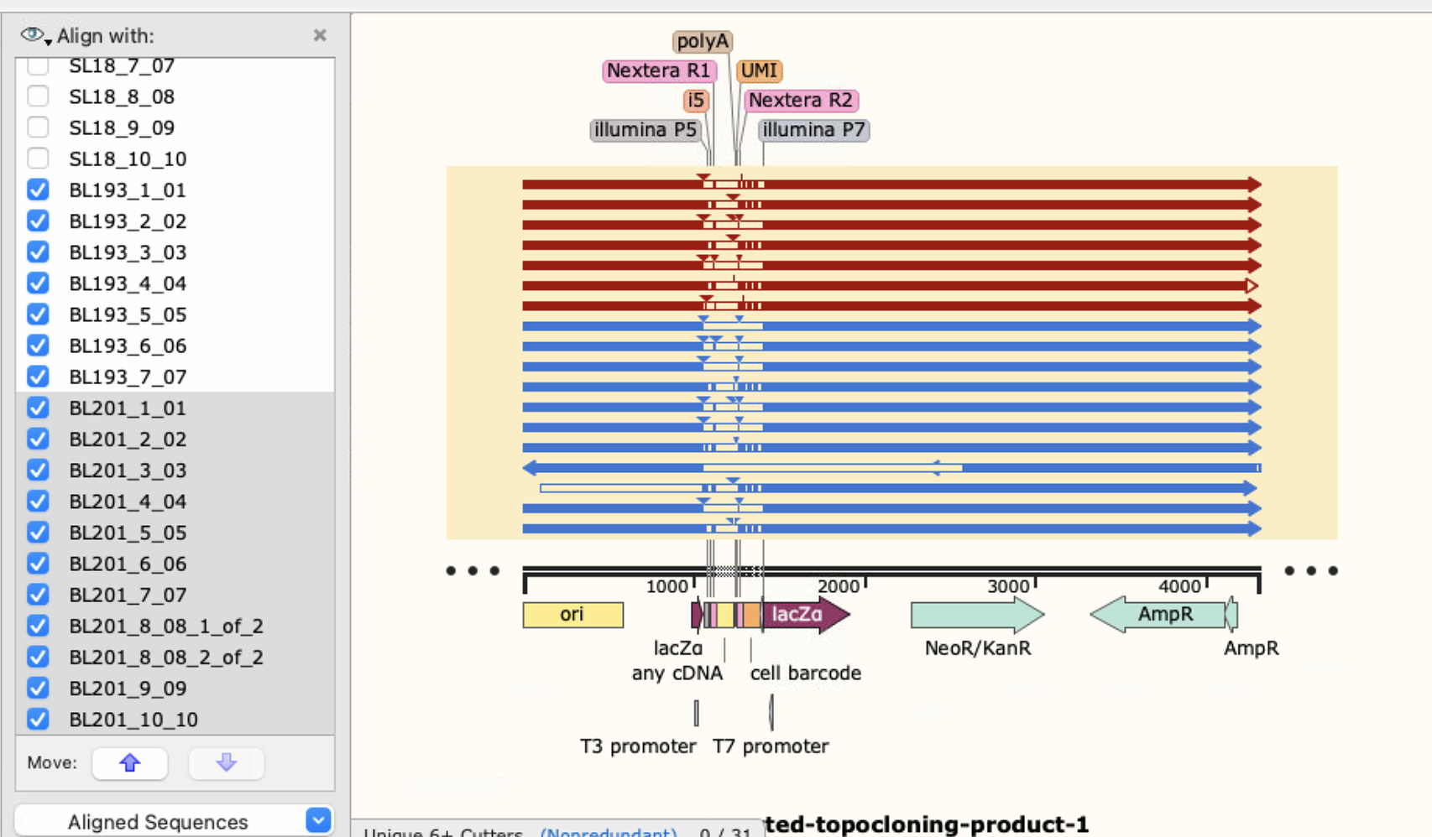
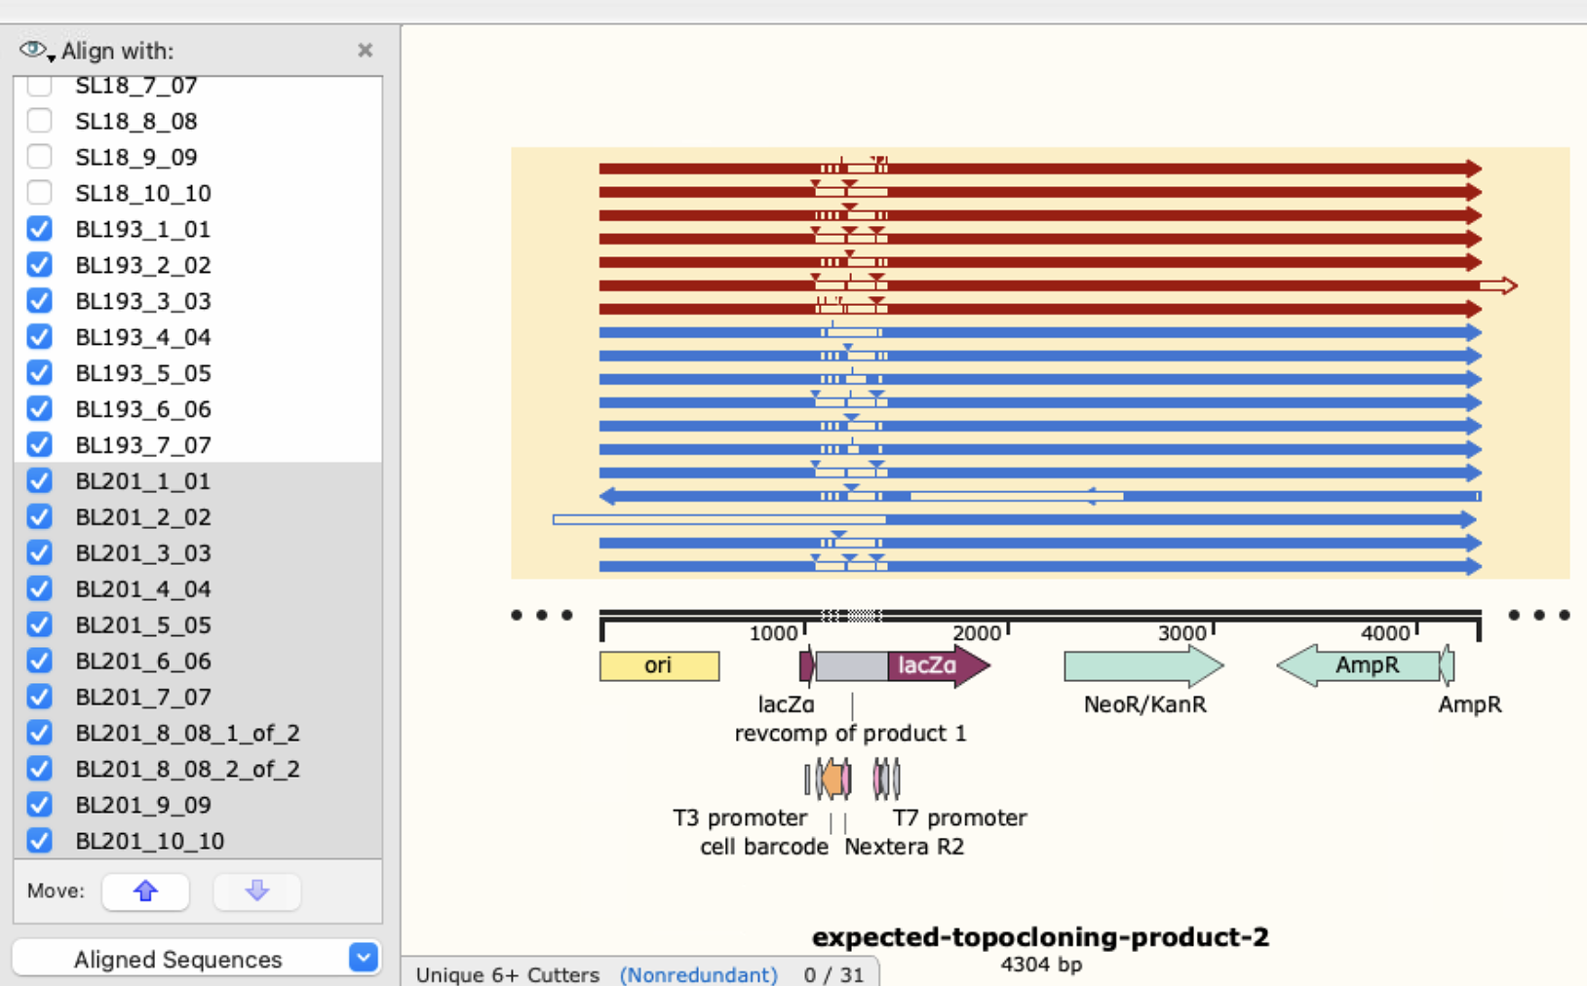
Alignment A549 samples

Slide 7



