Slide 1
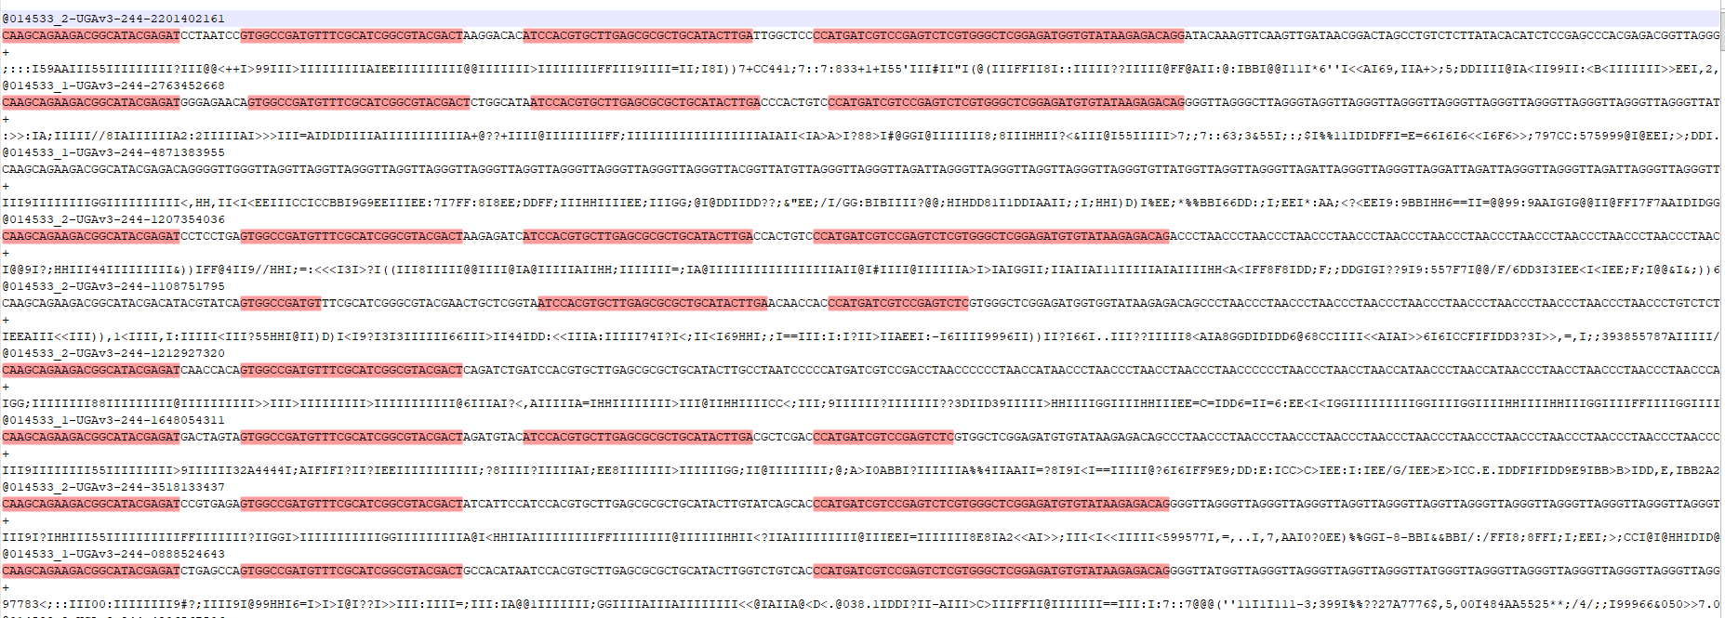
Reads:

Slide 2
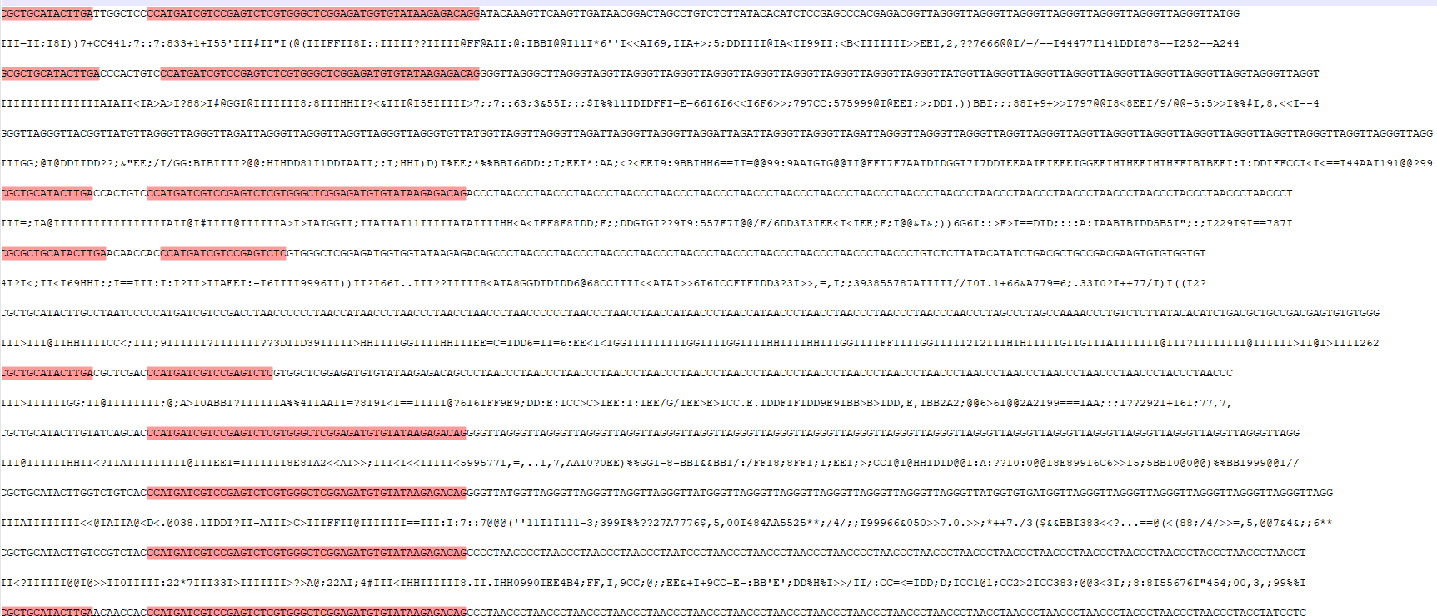
Reads:
Barcodes are OK, but after that we have a lot of the reads that are just copies of ACCCTA or GGGTTA, or similar strings

Slide 3
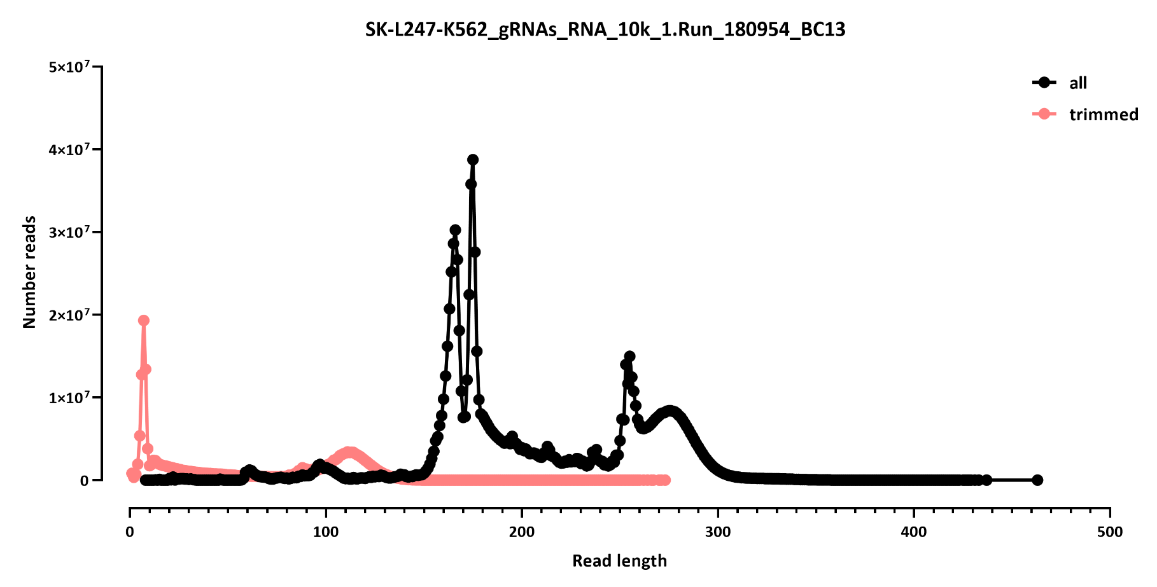
Raw reads: 1,068,543,849 reads
Reads remaining after trimming: 242,809,543

Slide 4
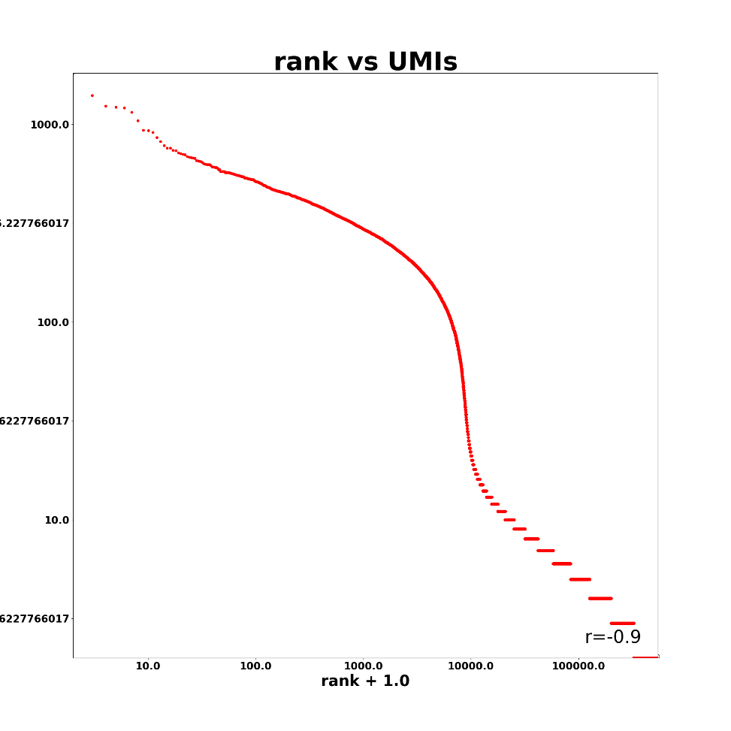
Mapping stats:

