Slide 1
Dataset stats ATAC
After within-barcode dedupping, L068:
hg38:
Unique: 5,603,984
Complexity: 0.79
mm10:
Unique: 6,687,622
Complexity: 0. 84
After within-barcode dedupping L069:
hg38:
Unique: 7,080,002
Complexity: 0.78
mm10:
Unique: 7,622,660
Complexity: 0. 83

Slide 2
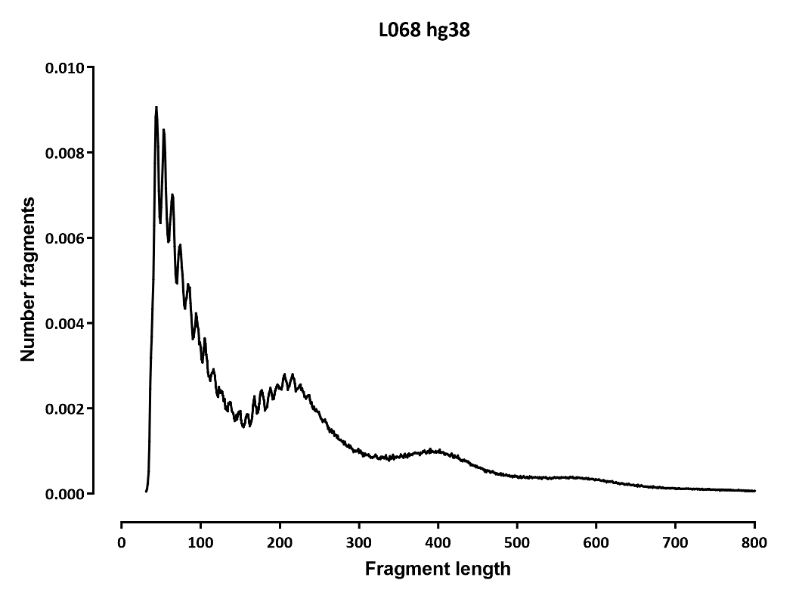
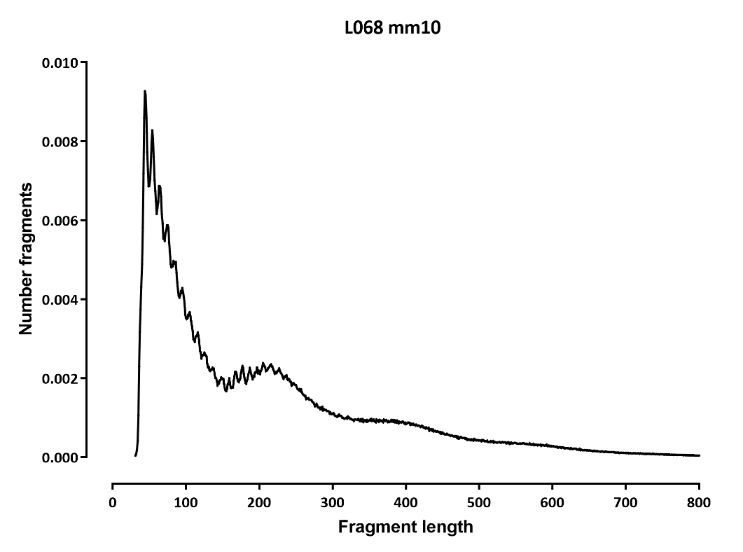
Fragment length distribution

Slide 3
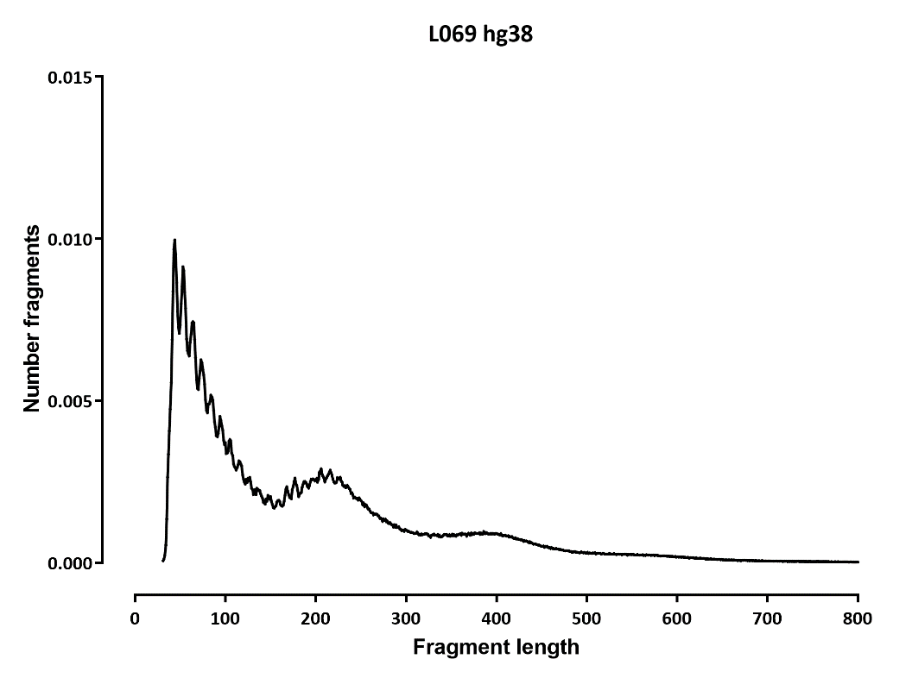
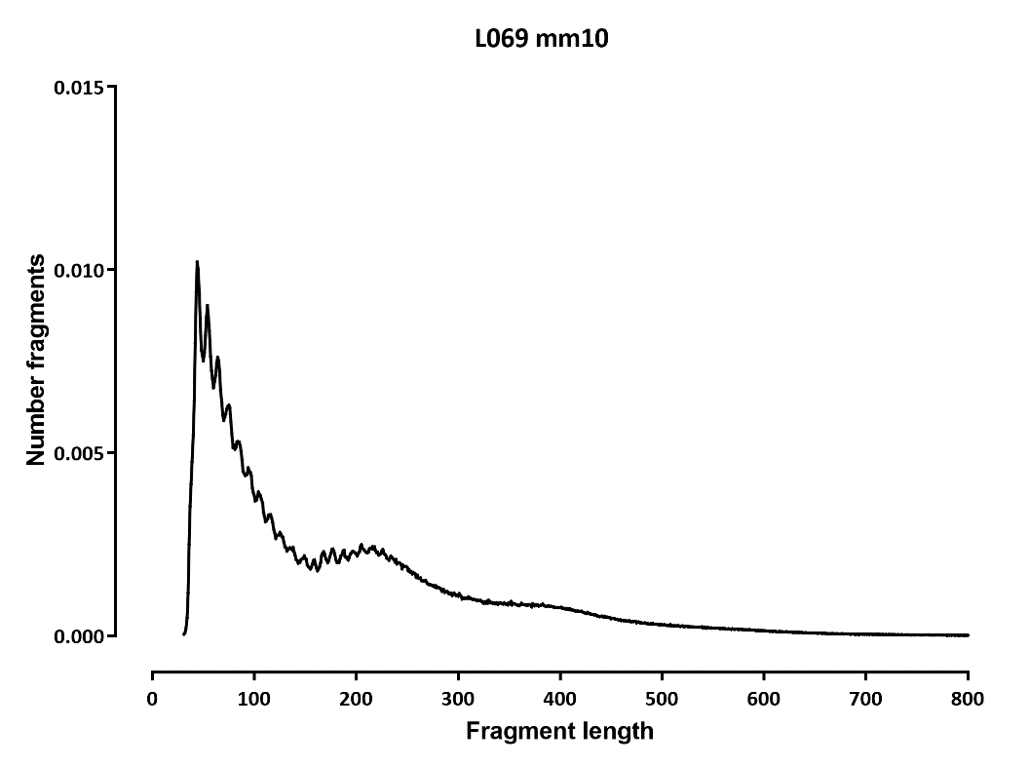
Fragment length distribution

Slide 4
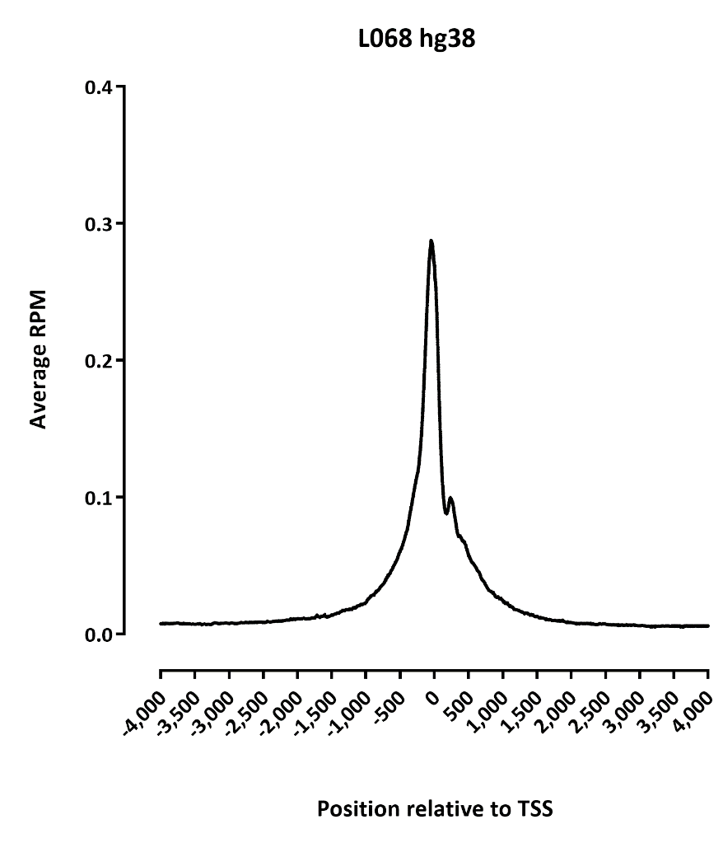
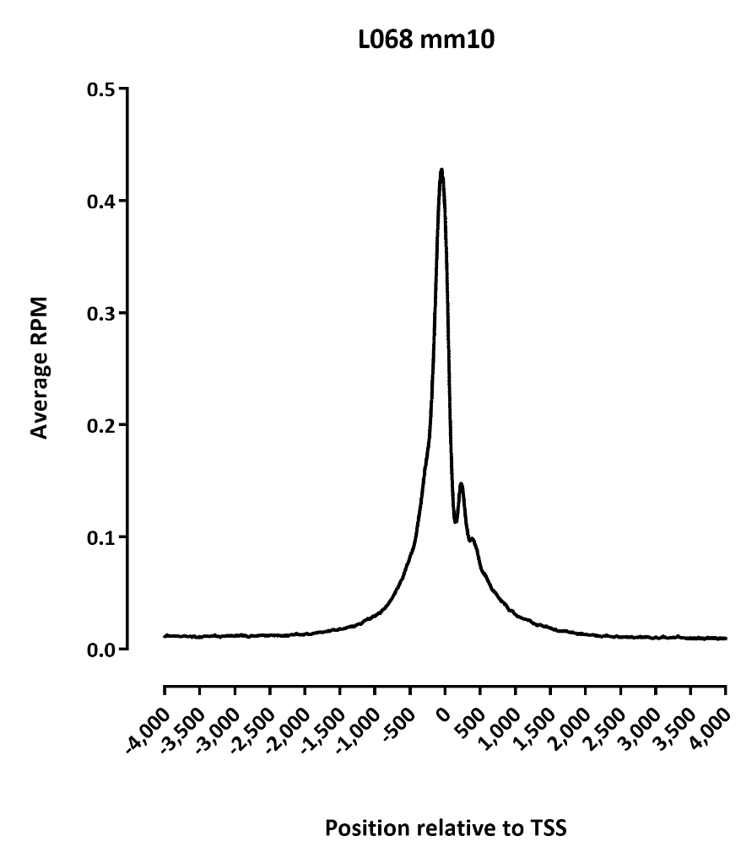
TSS profile

Slide 5
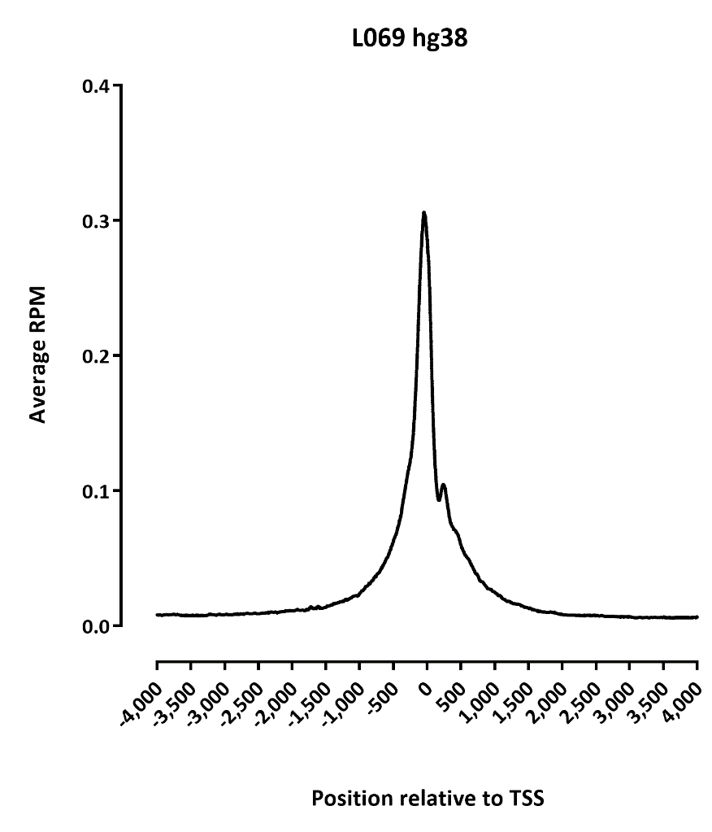
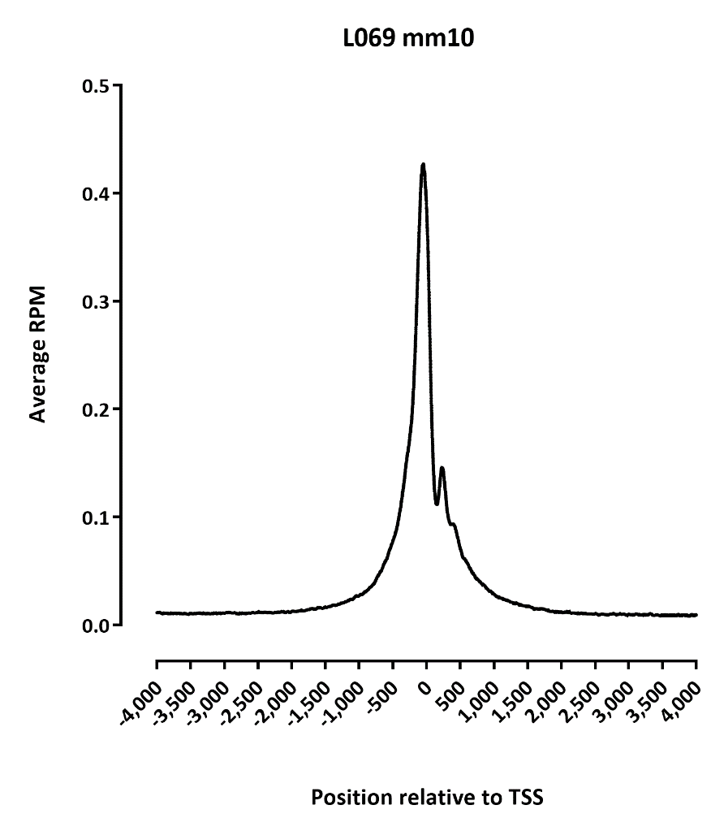
TSS profile

Slide 6
Dataset stats RNA

Slide 7
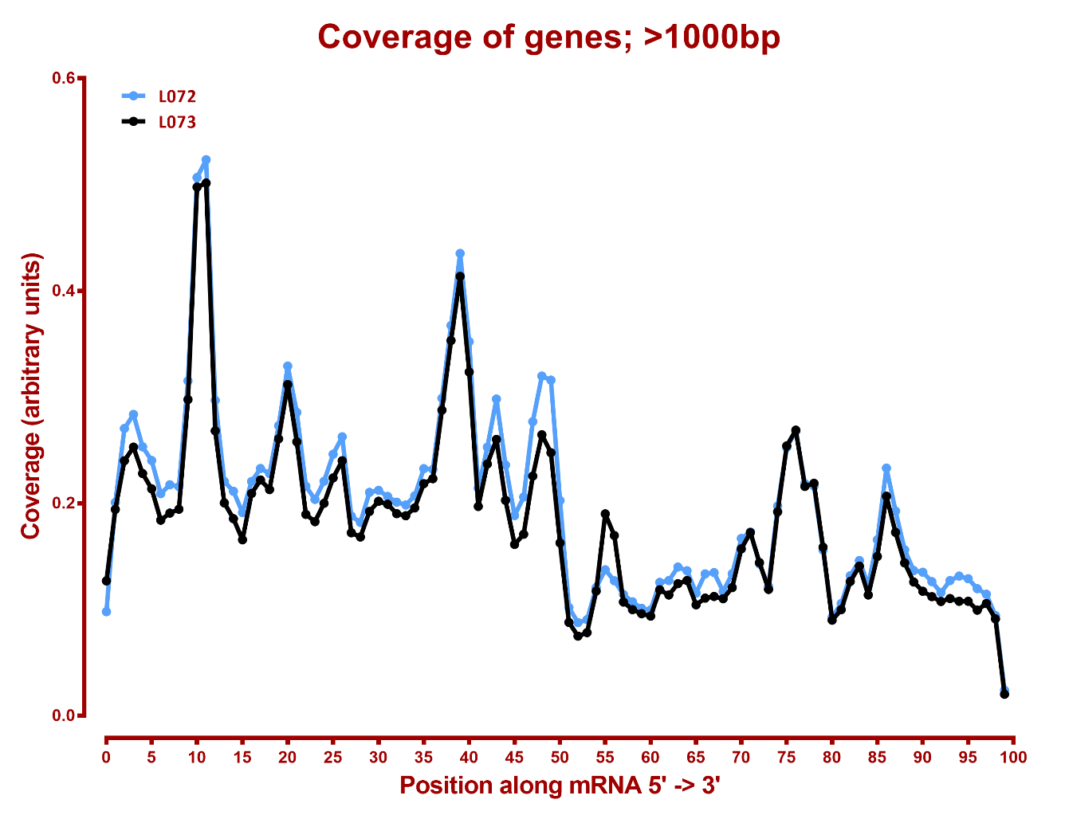
5’-3’ mRNA coverage hg38

Slide 8
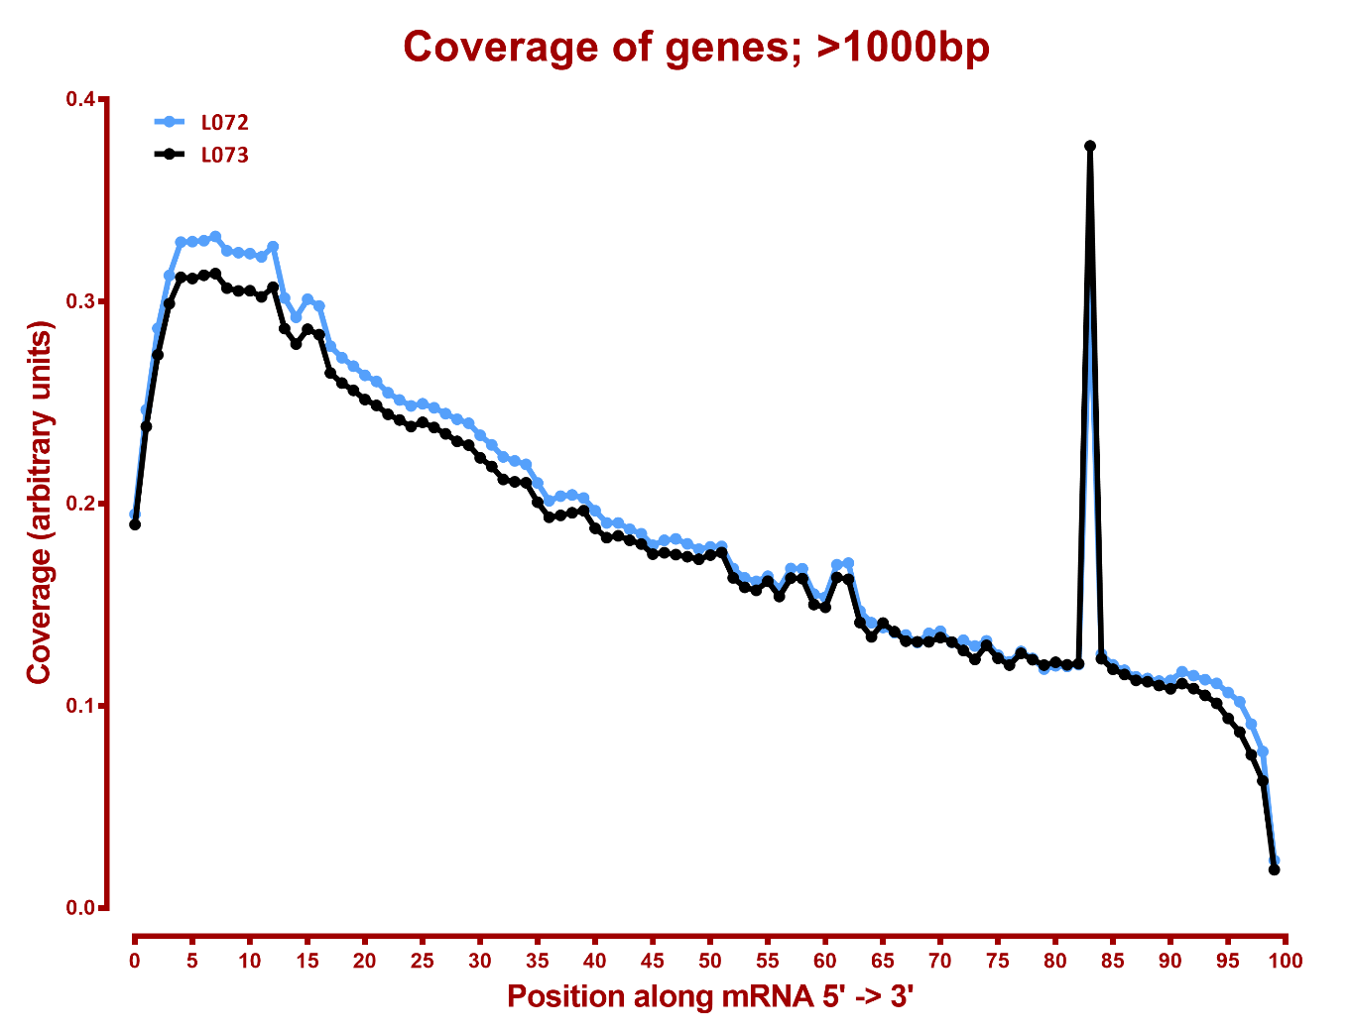
5’-3’ mRNA coverage mm10

Slide 9
ATAC single-cell level summary:
L068
#fragments | hg38 | mm10
<10 | 153,946 | 162,440
10-100 | 5,830 | 8,827
100-500 | 47 | 45
500-1,000 | 10 | 3
1,000-5,000 | 390 | 216
5,000-10,000 | 141 | 283
>10,000 | 4 | 10
10000
L069
#fragments | hg38 | mm10
<10 | 188,398 | 191,741
10-100 | 9,057 | 10,612
100-500 | 52 | 62
500-1,000 | 2 | 1
1,000-5,000 | 475 | 303
5,000-10,000 | 160 | 306
>10,000 | 11 | 2
10000 |  | 1
1,030 cells 1,244 cells
(>1,000 fragments)

Slide 10
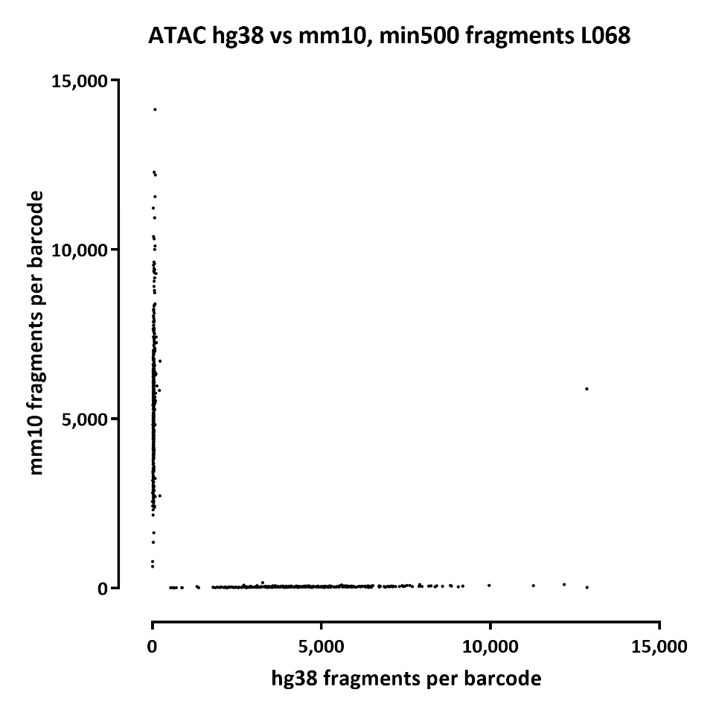

ATAC single-cell level summary:

Slide 11
RNA single-cell level summary:
 | hg38 | mm10 | hg38 | mm10
#UMIs | L072 |  | L073
0-10 | 242,066 | 238,065 | 262,821 | 258,869
10-50 | 30,560 | 28,918 | 37,171 | 33,918
20-50 | 14,794 | 13,756 | 16,873 | 15,455
50-100 | 3,725 | 3595 | 4,033 | 3612
100-200 | 1084 | 1052 | 1209 | 930
200-500 | 287 | 295 | 372 | 356
500-1000 | 379 | 415 | 496 | 469
>1000 | 720 | 624 | 719 | 672

Slide 12
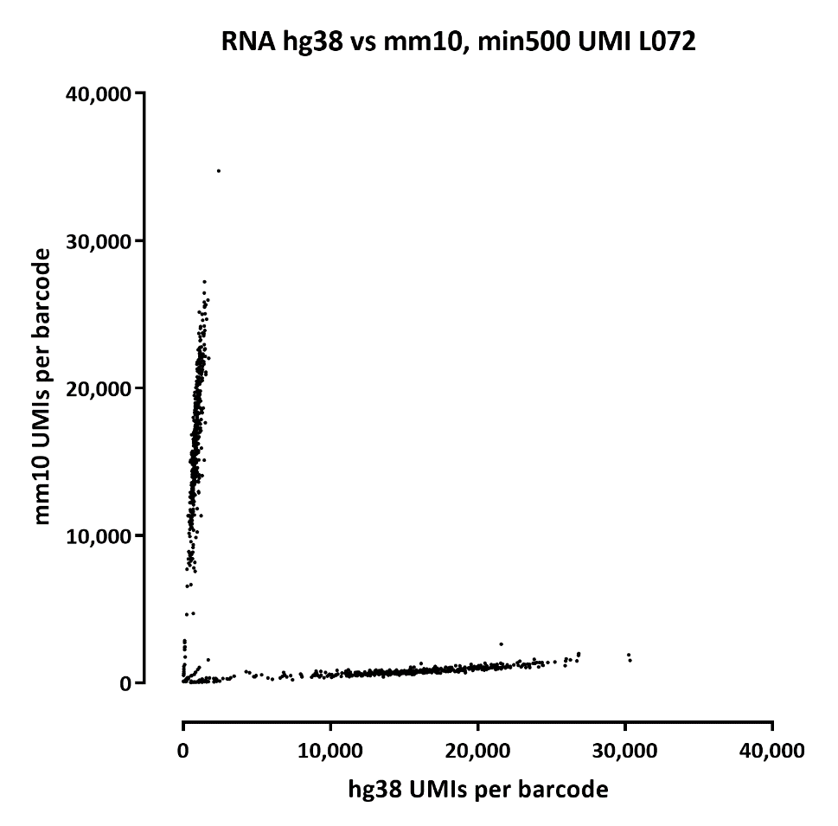
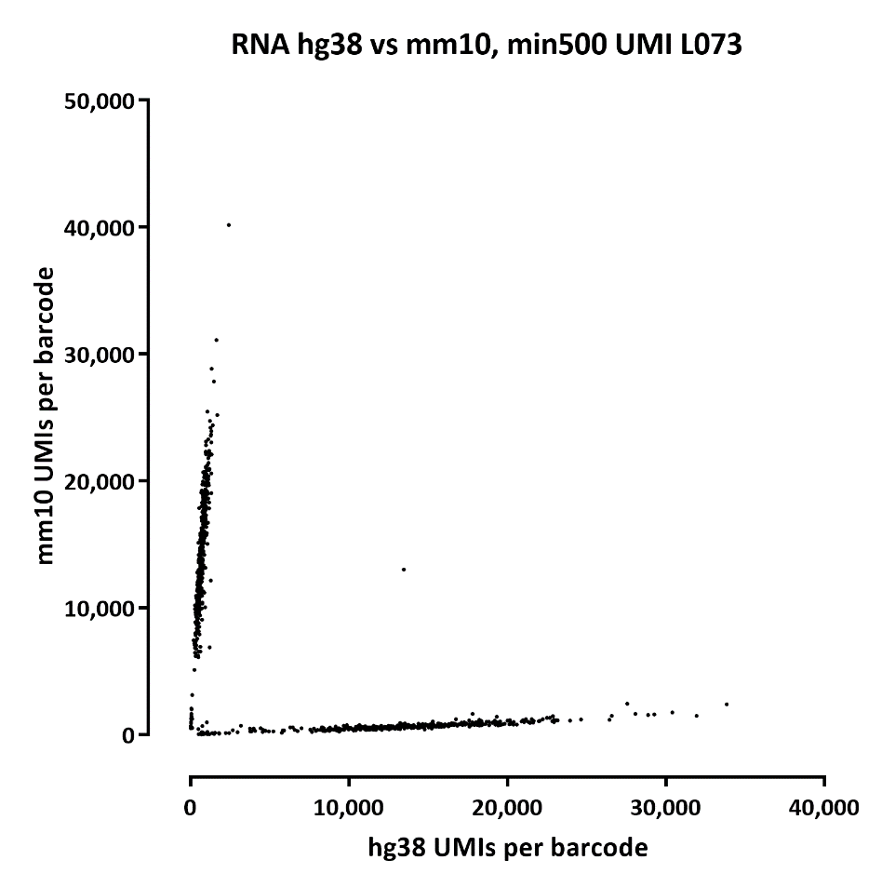
RNA single-cell level summary:

Slide 13
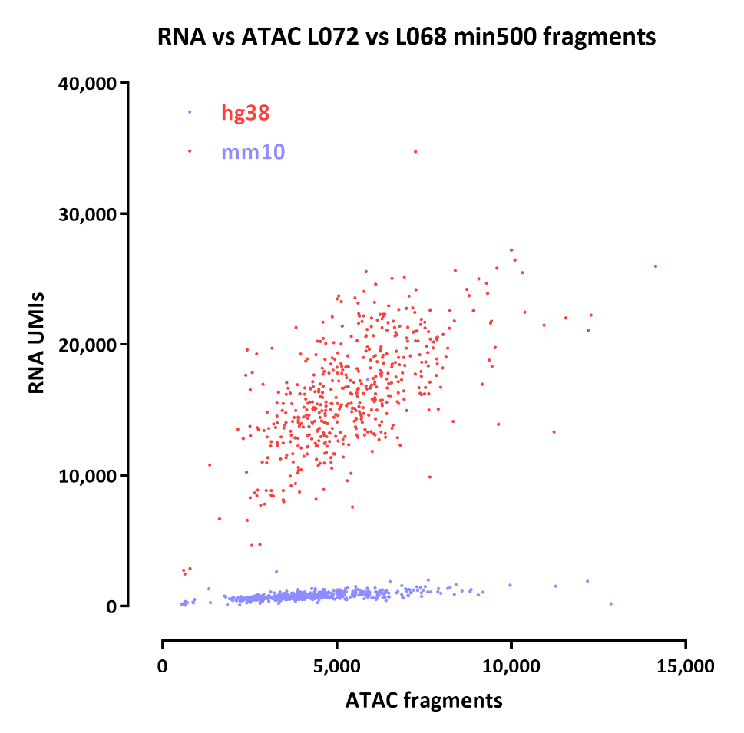
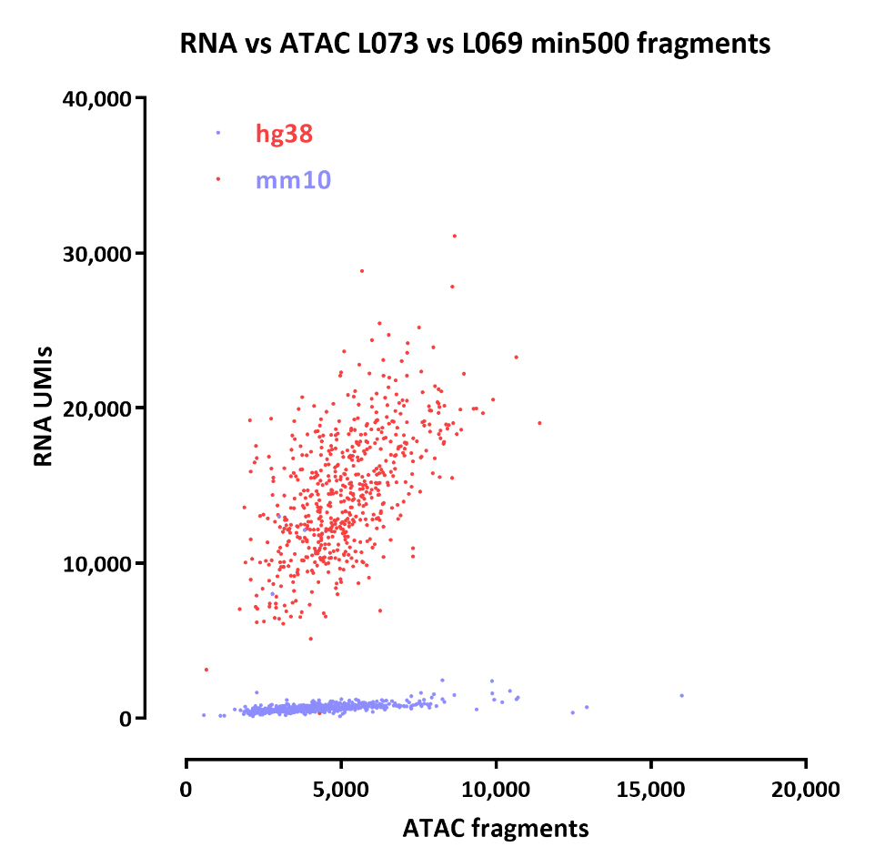
RNA vs ATAC

