Slide 1
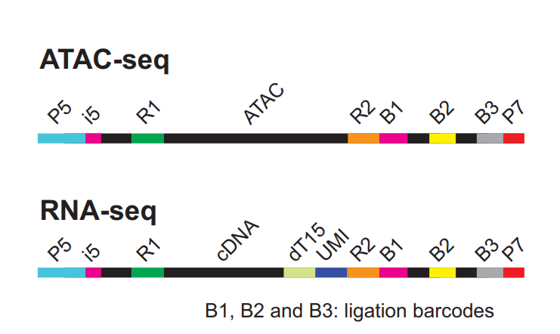
Expected library structure:
30bp R1
30bp R2
99bp i7/I1
8bp i5/i2
99bp i7/I1
8bp i5/i2
30bp R2
30bp R1

Slide 2
Dataset stats ATAC
After within-barcode dedupping:
hg38:
Unique: 14,769,090
Complexity: 0.84
mm10:
Unique: 26,671,864
Complexity: 0.78

Slide 3
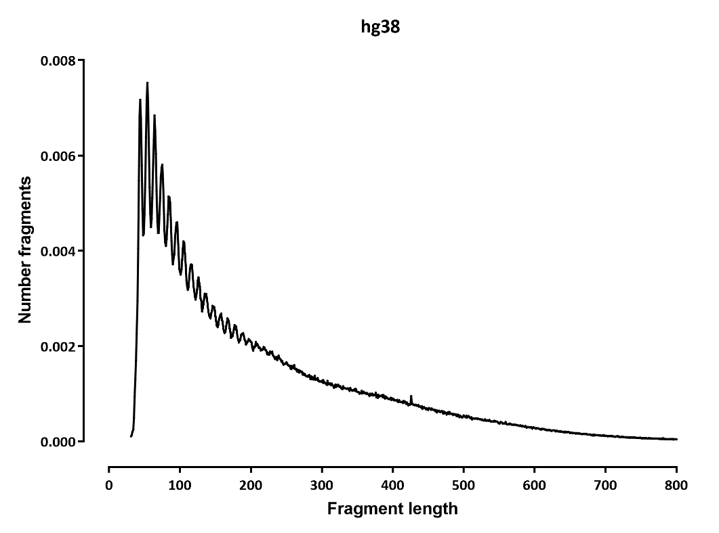
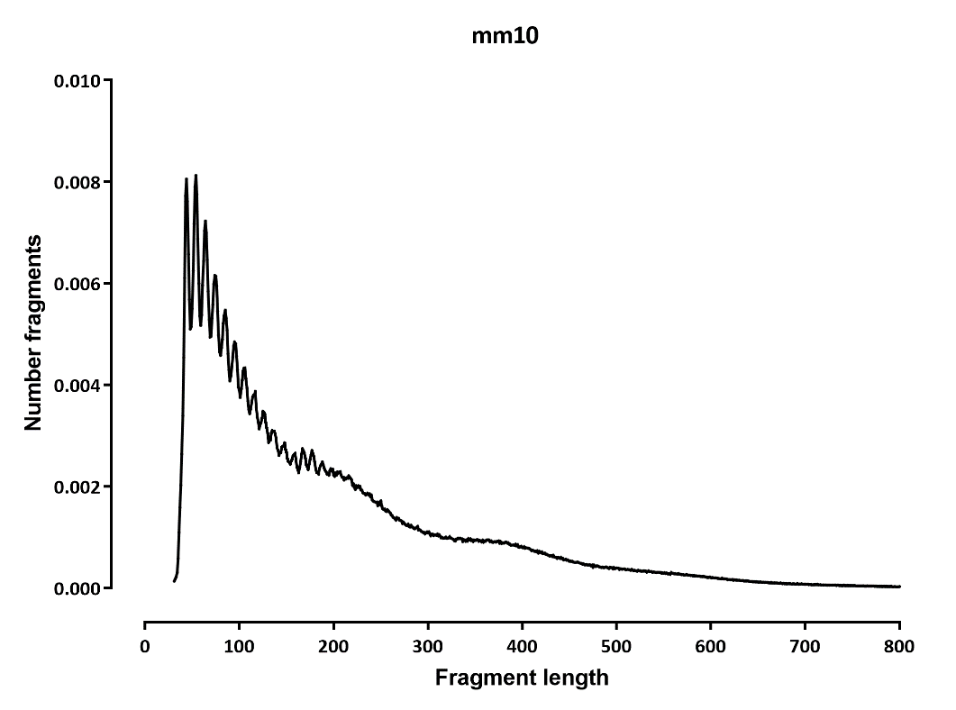
Fragment length distribution

Slide 4
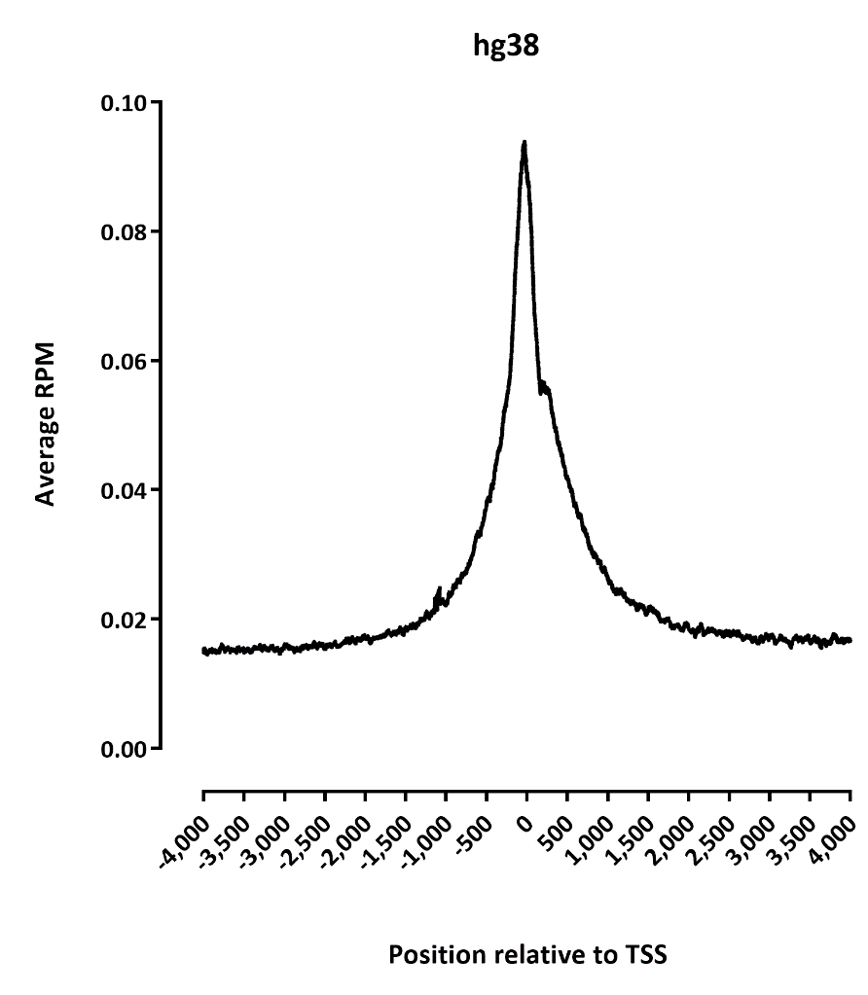
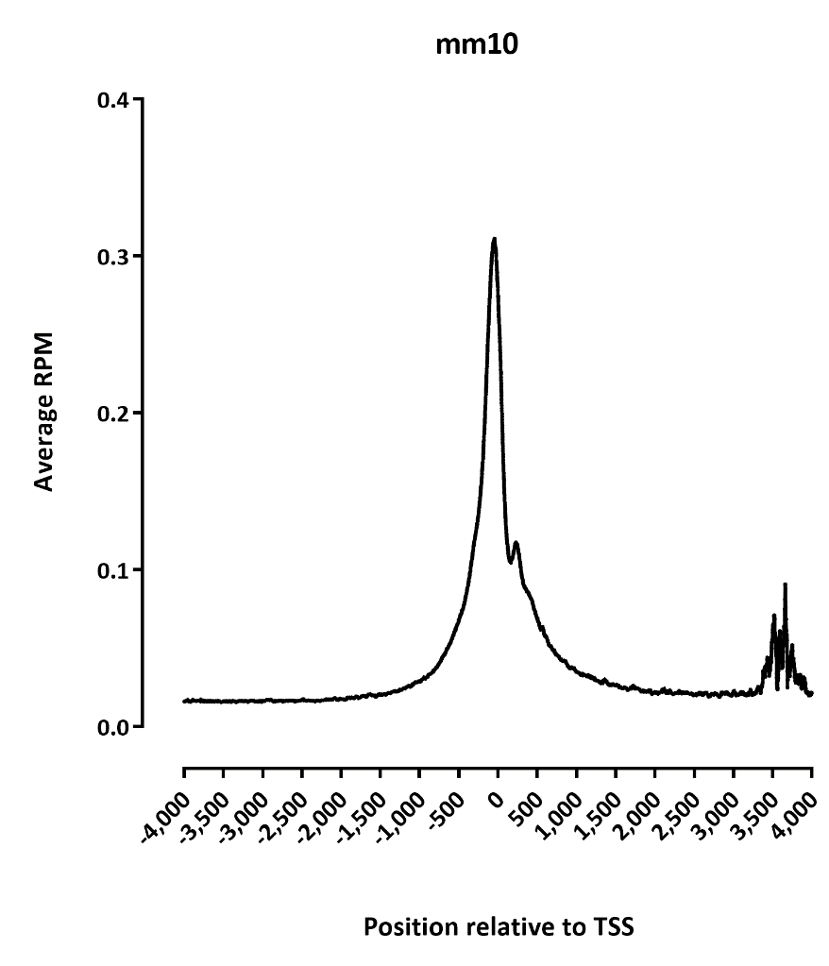
TSS profile

Slide 5
Dataset stats ATAC
Dataset stats RNA
Note: the second end should really not align at all, it’s 10bp UMI + 15bp oligo-dT + 5bp of actual sequence
average alignment length for end1 is 29bp
average alignment length for end2 is 24bp

Slide 6
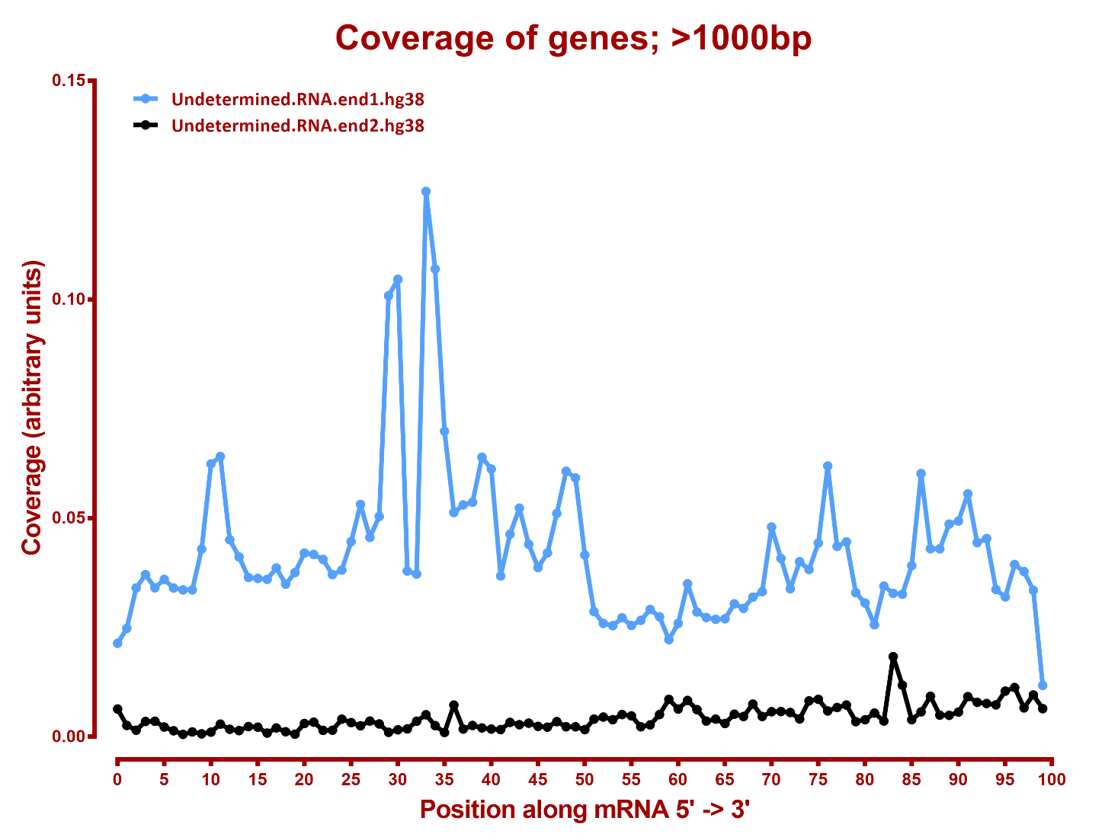
5’-3’ mRNA coverage

Slide 7
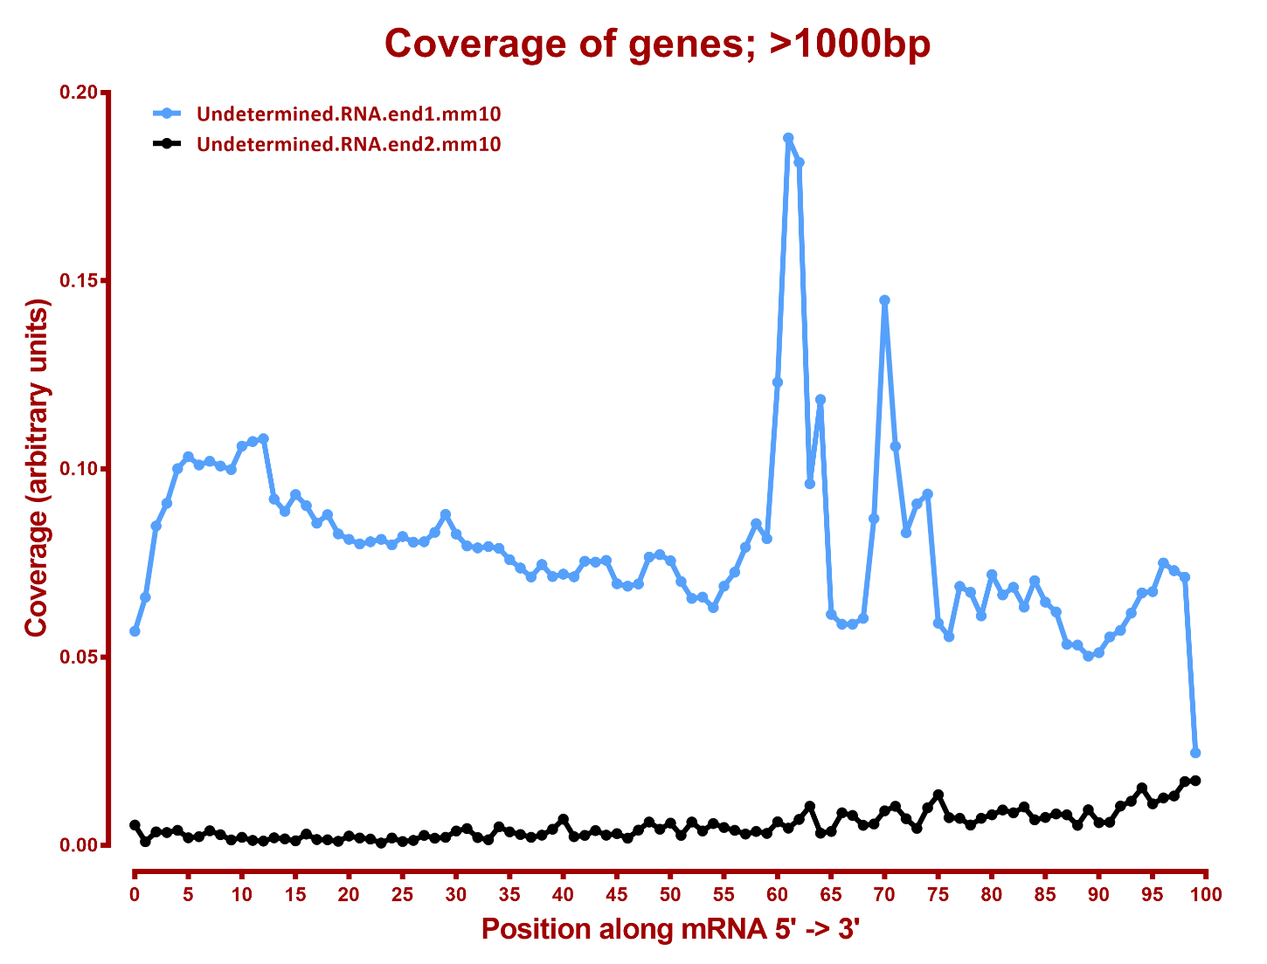
5’-3’ mRNA coverage

Slide 8
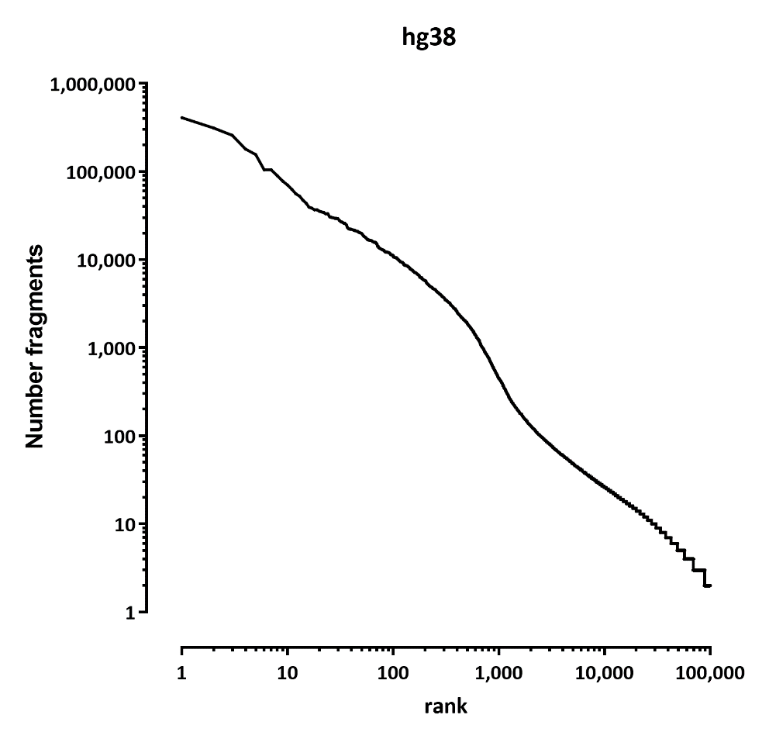
ATAC single-cell level summary:
# fragments | hg38 | mm10
<10 | 223,510 | 288,179
10-100 | 28,192 | 48,020
100-500 | 1,521 | 2,937
500-1,000 | 259 | 306
1,000-5,000 | 476 | 451
5,000-10,000 | 112 | 242
>10,000 | 110 | 236

Slide 9
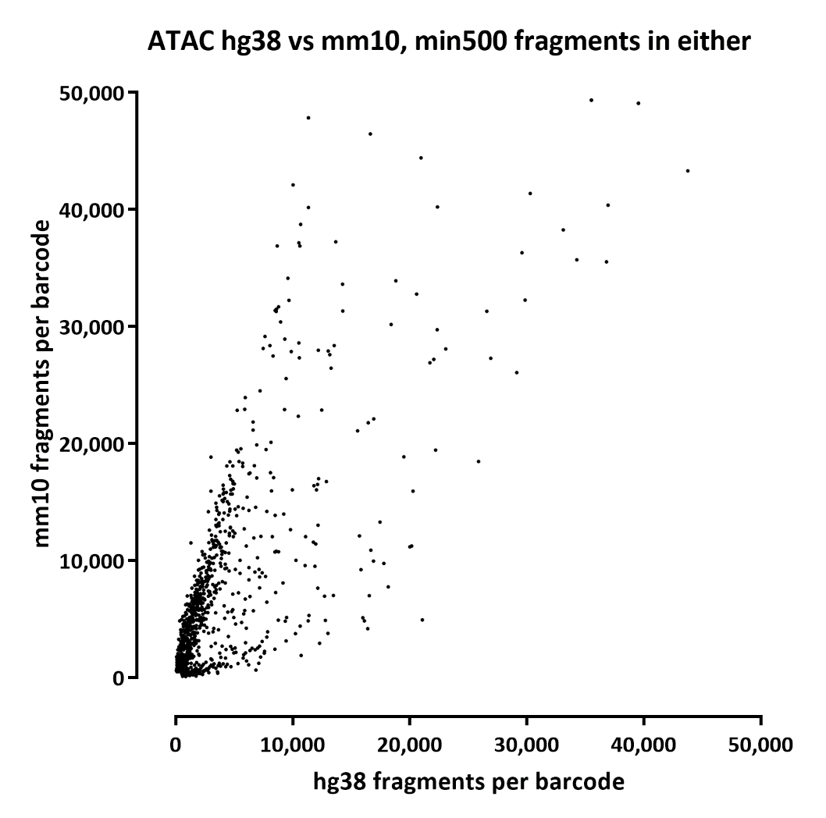
ATAC single-cell level summary:

Slide 10
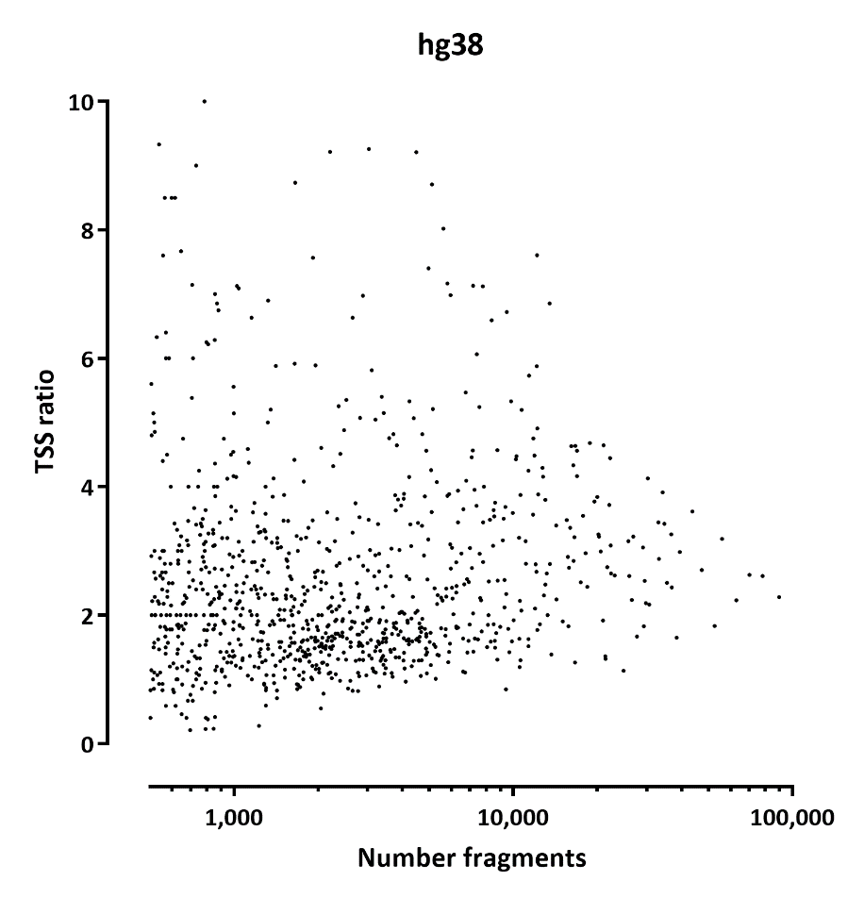
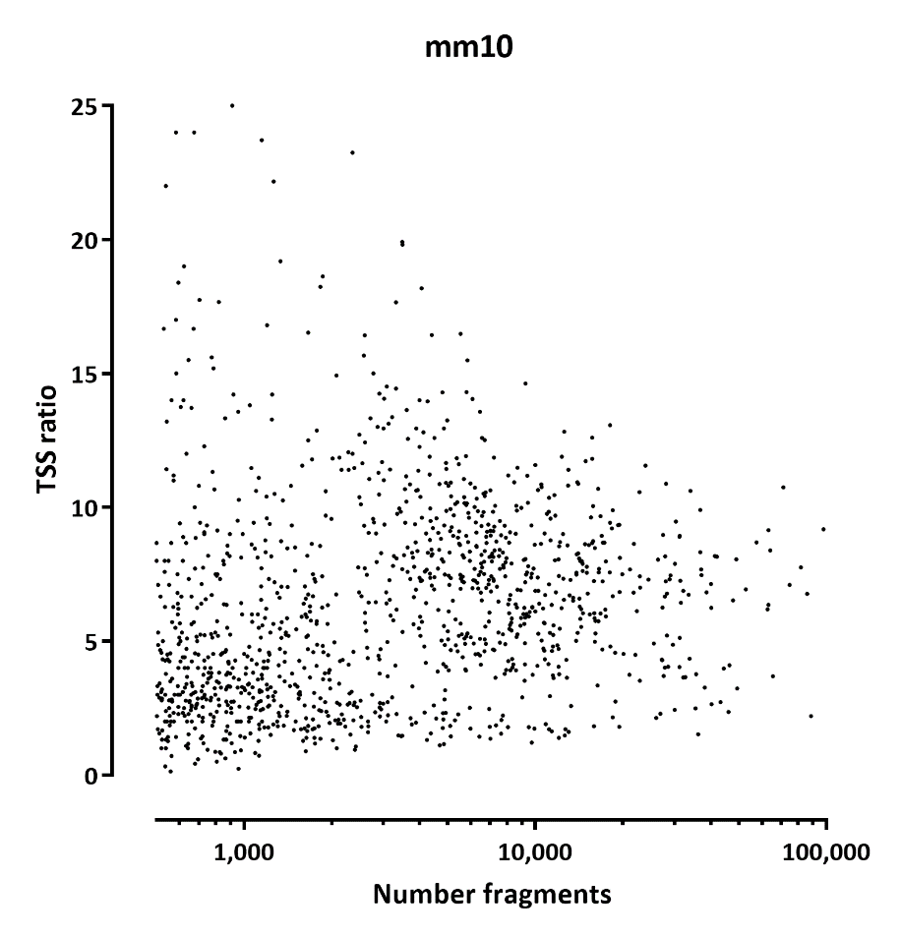
ATAC single-cell level summary:

Slide 11
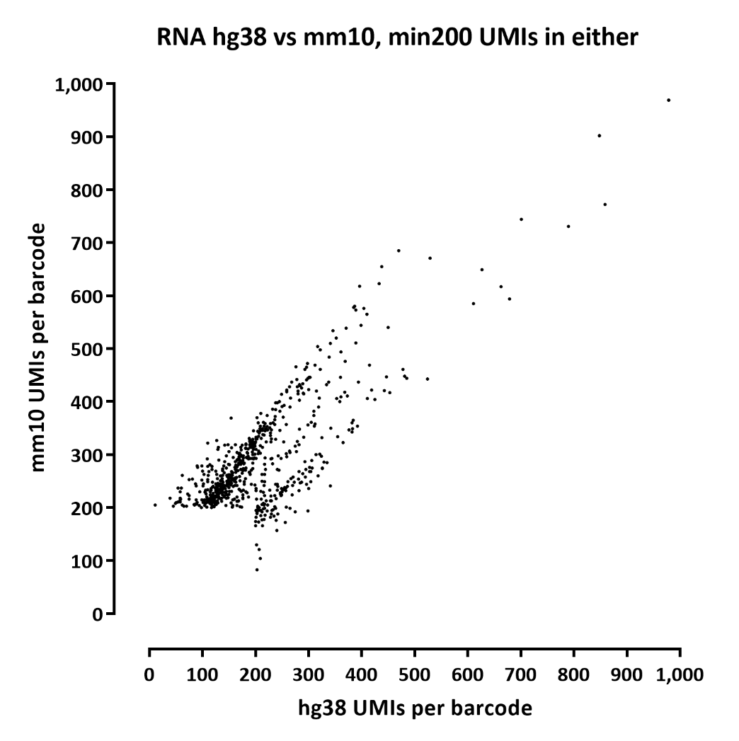
RNA single-cell level summary:
 | read1 | read2 | read1 | read2
#UMIs | hg38 |  | mm10
0-10 | 204,389 | 179,891 | 339,373 | 142,732
10-20 | 9,288 | 6,417 | 26,804 | 3,996
20-50 | 4,985 | 2,759 | 14,694 | 1,709
50-100 | 1,737 | 833 | 3,447 | 610
100-200 | 949 | 546 | 1,172 | 435
200-500 | 293 | 241 | 633 | 192
500-1000 | 11 | 12 | 27 | 11
>1000 | 0 | 0 | 0 | 0

Slide 12
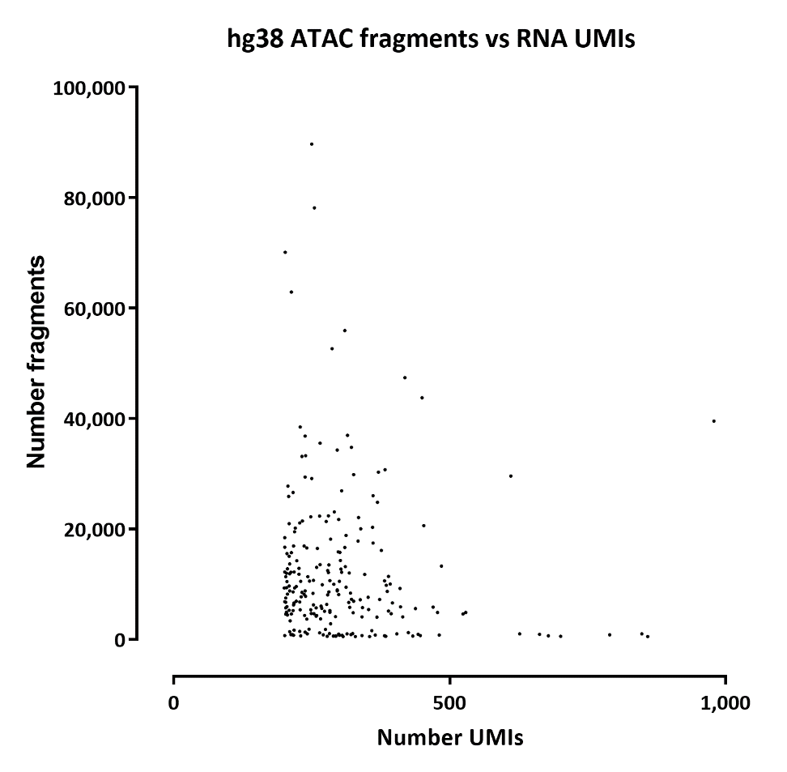
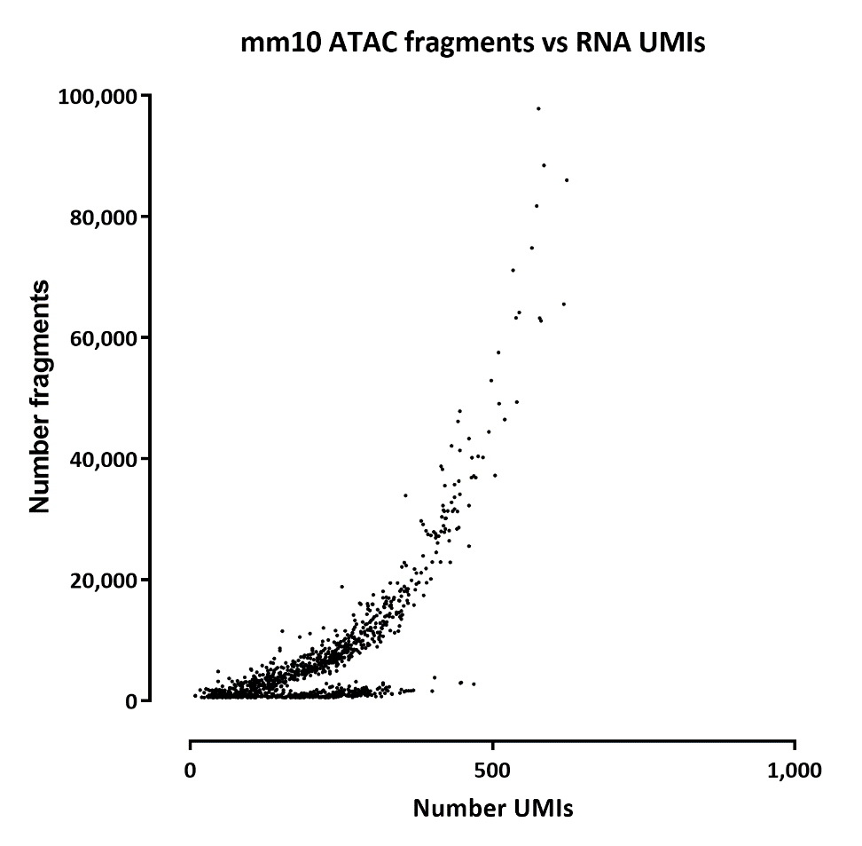
RNA vs ATAC single-cell level summary:

Slide 13
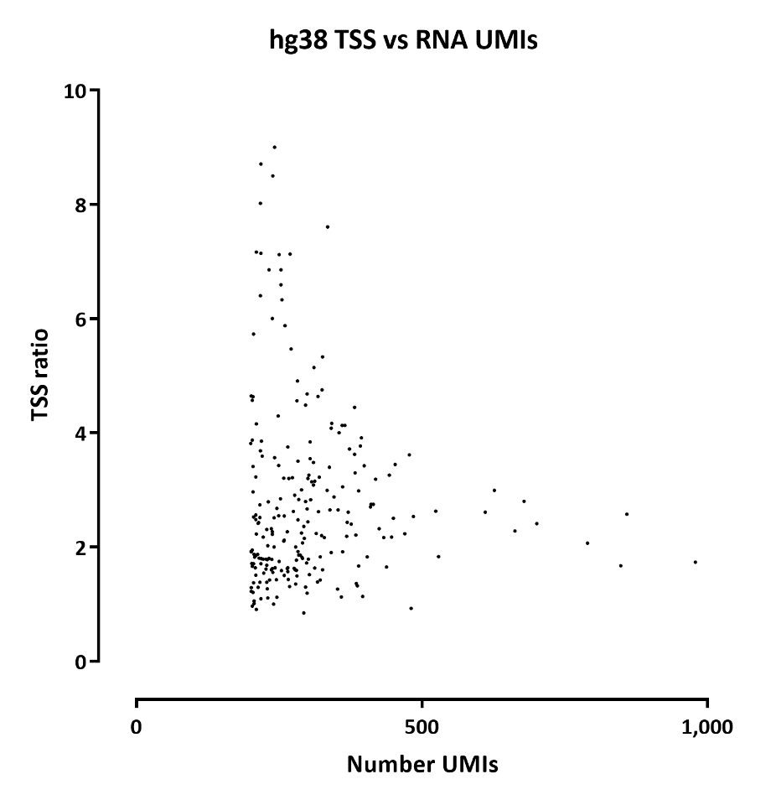
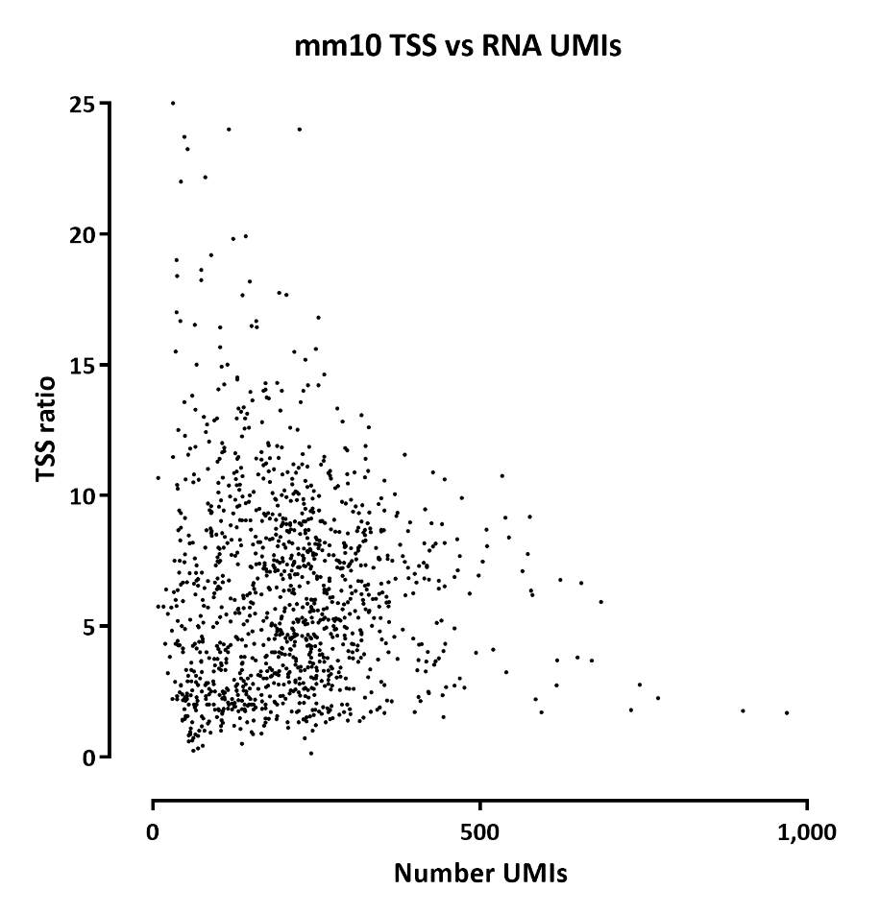
ATAC single-cell level summary:

