Slide 1
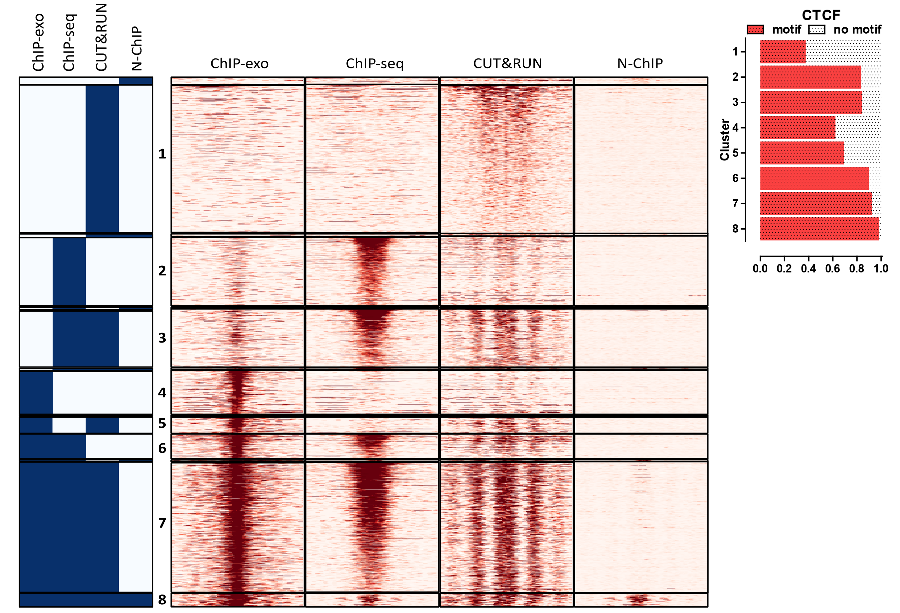
CTCF

Slide 2
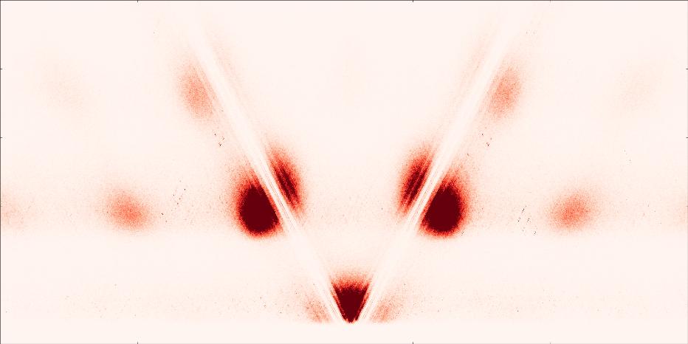
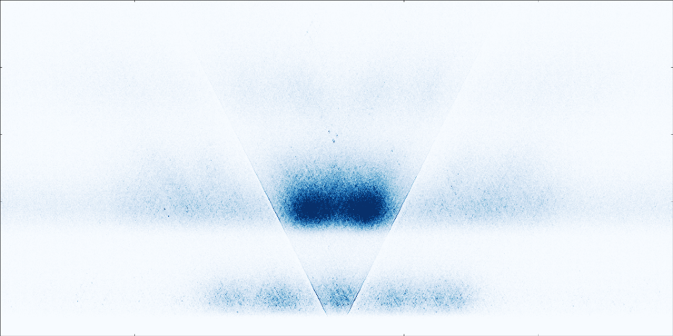
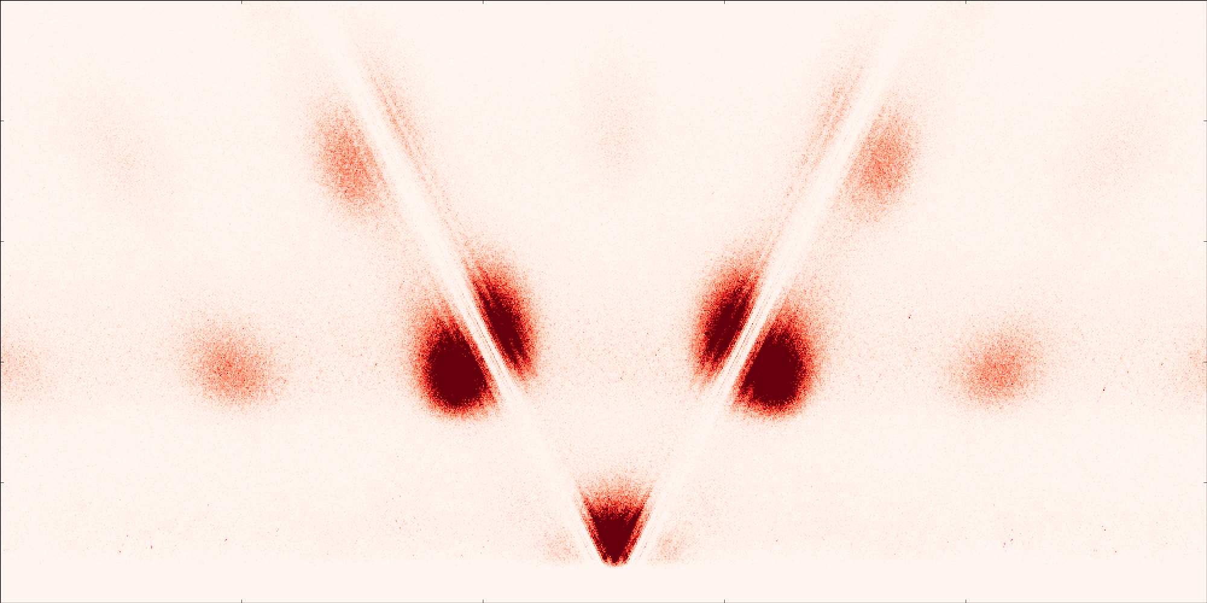

CTCF
motif-centered
MACS2 peak call-centered
500
ChIP-common sites
with motif
ChIP-common sites
with motif
0
CUTnRUN-only sites
with motif
CUTnRUN-only sites
no motif
-500 0 500

Slide 3
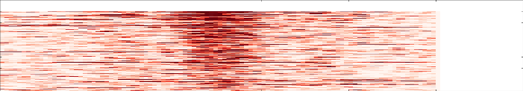
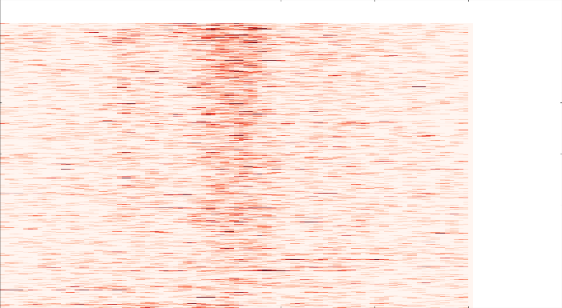

GATA1
 | number peaks |  |  |  |  |  |  |  | fraction
 | ChIP peak |  | no ChIP peak |  |  |  | ChIP peak | no ChIP peak | ChIP peak |  | no ChIP peak
 | motif | no motif | motif | no motif |  |  |  |  | motif | no motif | motif | no motif
ENCODE K562 GATA1 | 6,328 | 8,277 |  |  |  | ENCODE K562 GATA1 | 1.00 | 0.00 | 0.43 | 0.57 | n/a | n/a
GATA1_1_100_250k_neb | 511 | 558 | 117 | 525 |  | GATA1_1_100_250k_neb | 0.62 | 0.38 | 0.48 | 0.52 | 0.18 | 0.82
GATA1_1_2500_250k_neb | 213 | 261 | 22 | 167 |  | GATA1_1_2500_250k_neb | 0.71 | 0.29 | 0.45 | 0.55 | 0.12 | 0.88
GATA1_1_2500_50k_neb | 595 | 568 | 101 | 476 |  | GATA1_1_2500_50k_neb | 0.67 | 0.33 | 0.51 | 0.49 | 0.18 | 0.82
GATA1_1_500_250k_neb | 1,678 | 1,613 | 788 | 2,064 |  | GATA1_1_500_250k_neb | 0.54 | 0.46 | 0.51 | 0.49 | 0.28 | 0.72
GATA1_1_500_50k_neb | 65 | 111 | 9 | 82 |  | GATA1_1_500_50k_neb | 0.66 | 0.34 | 0.37 | 0.63 | 0.10 | 0.90
common sites ChIP-only sites CUT&RUN only sites

Slide 4
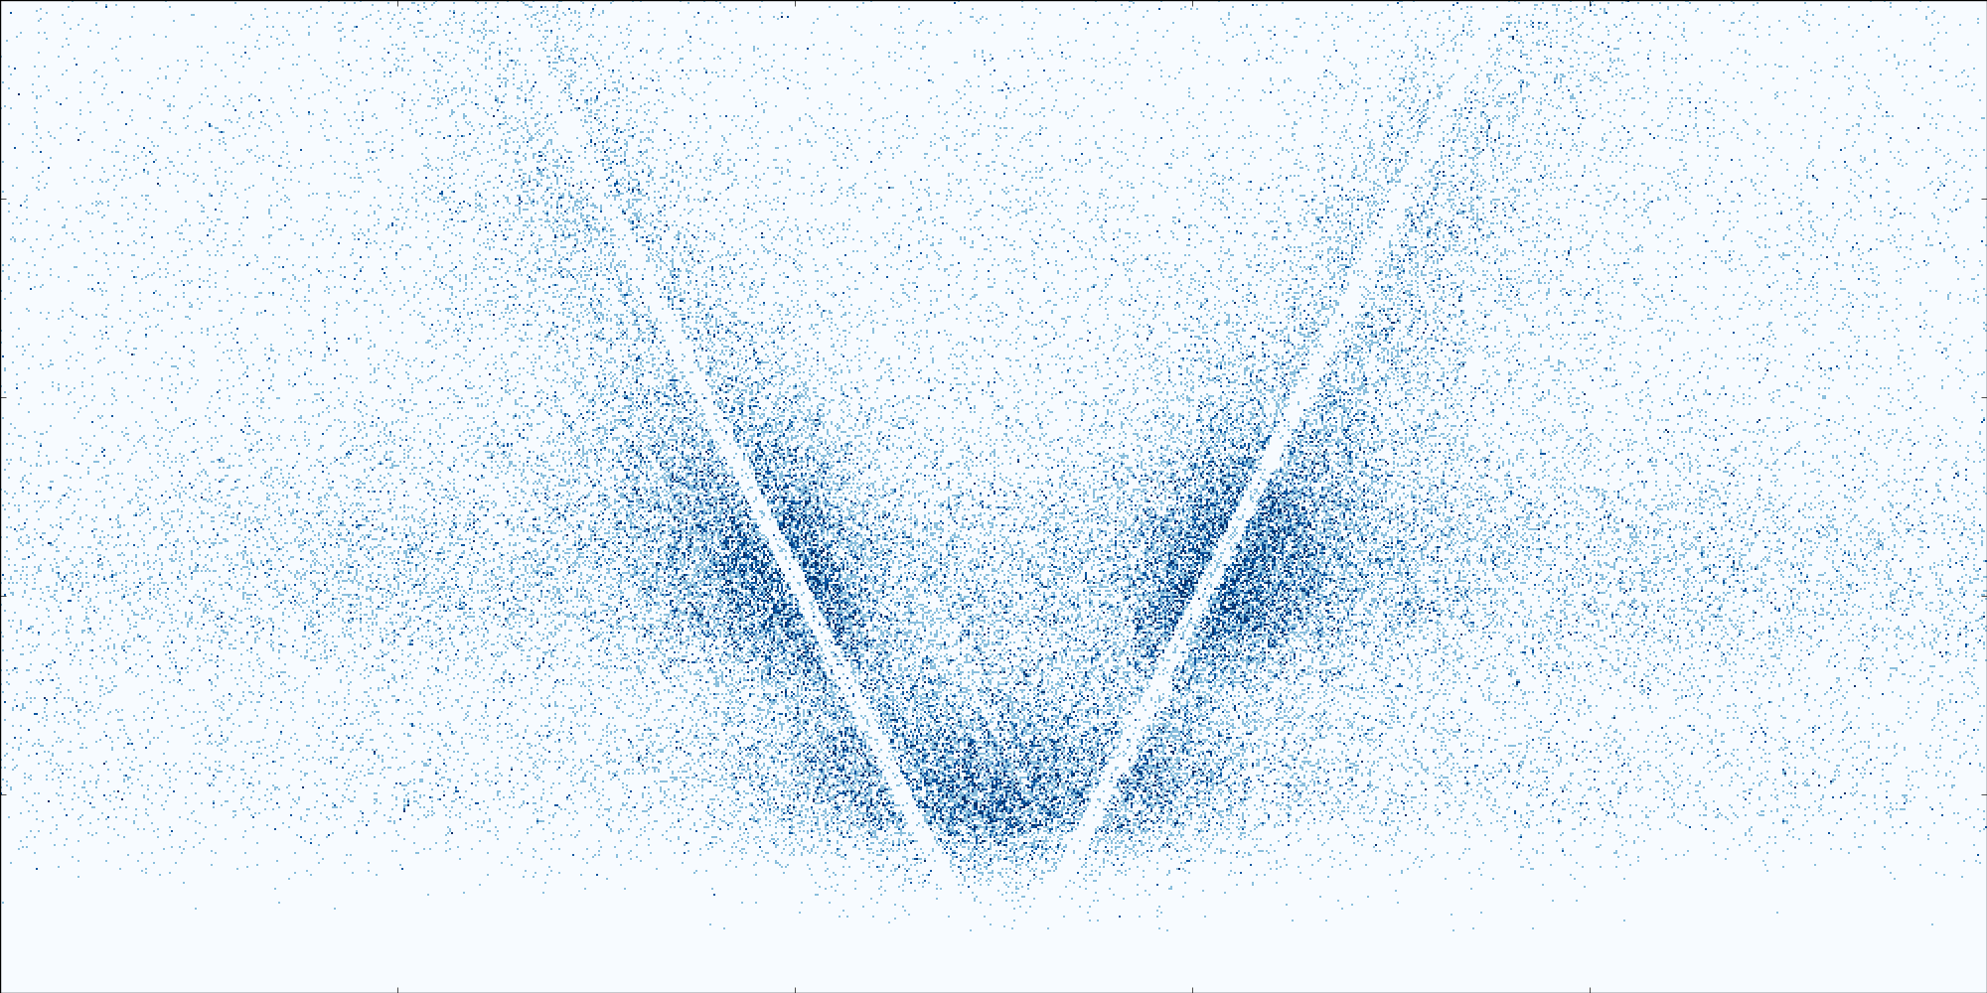
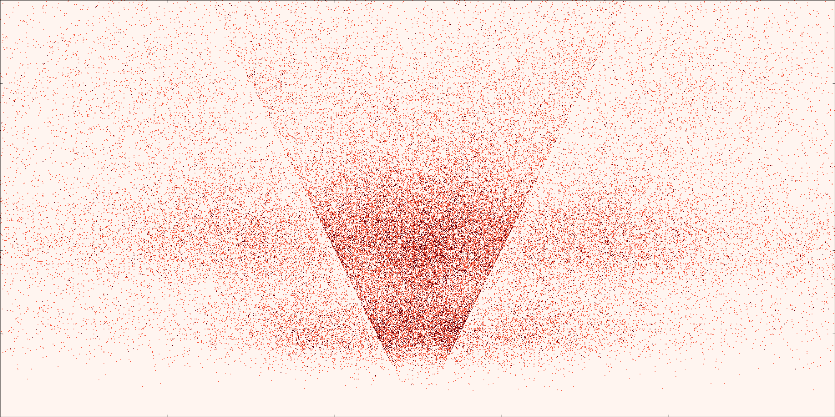
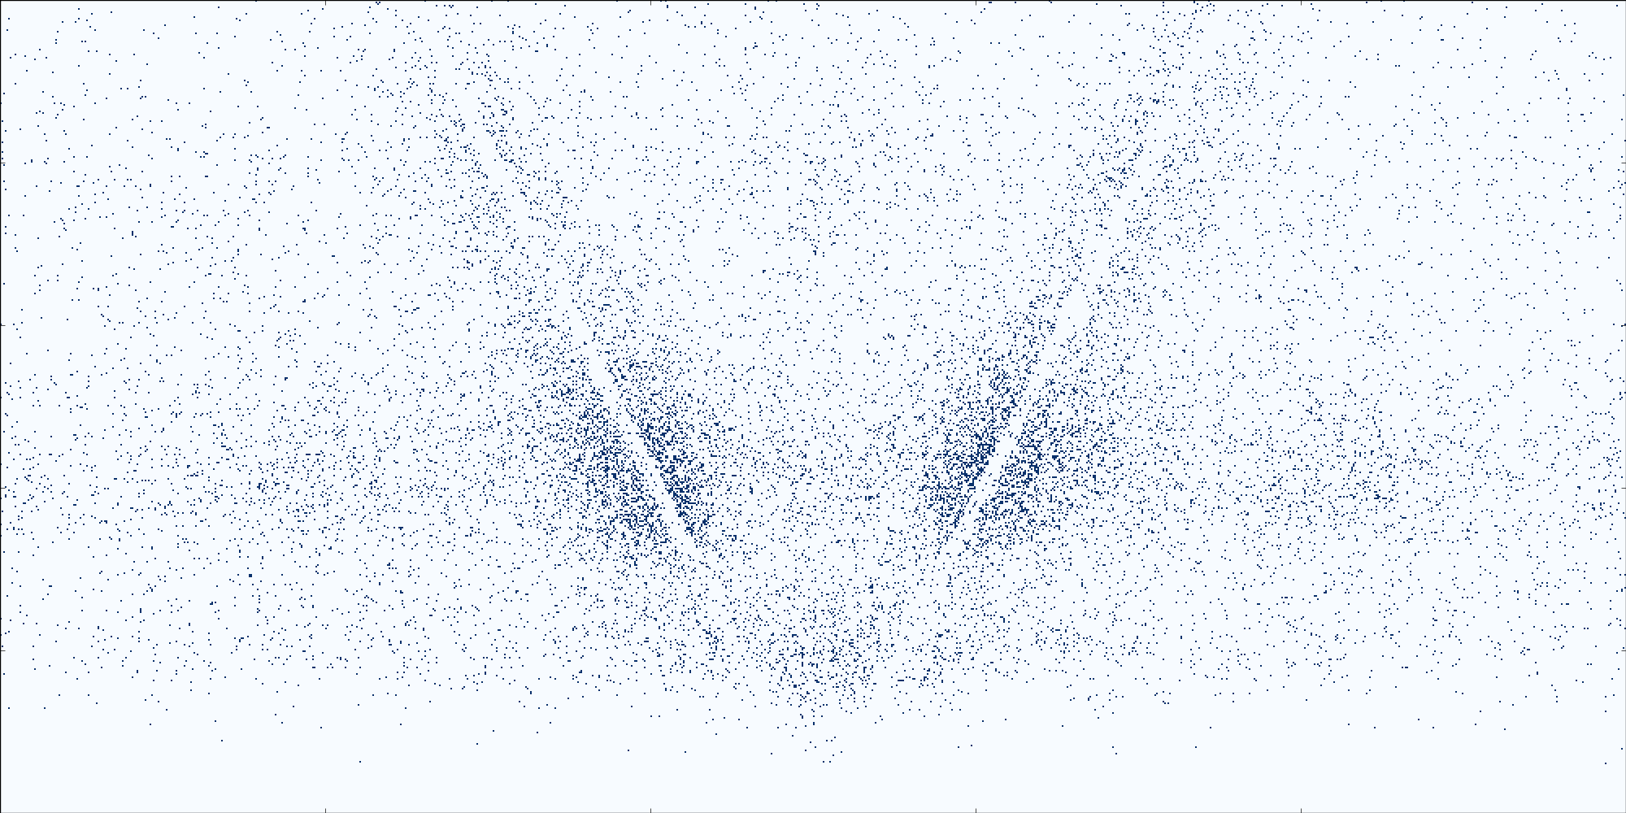
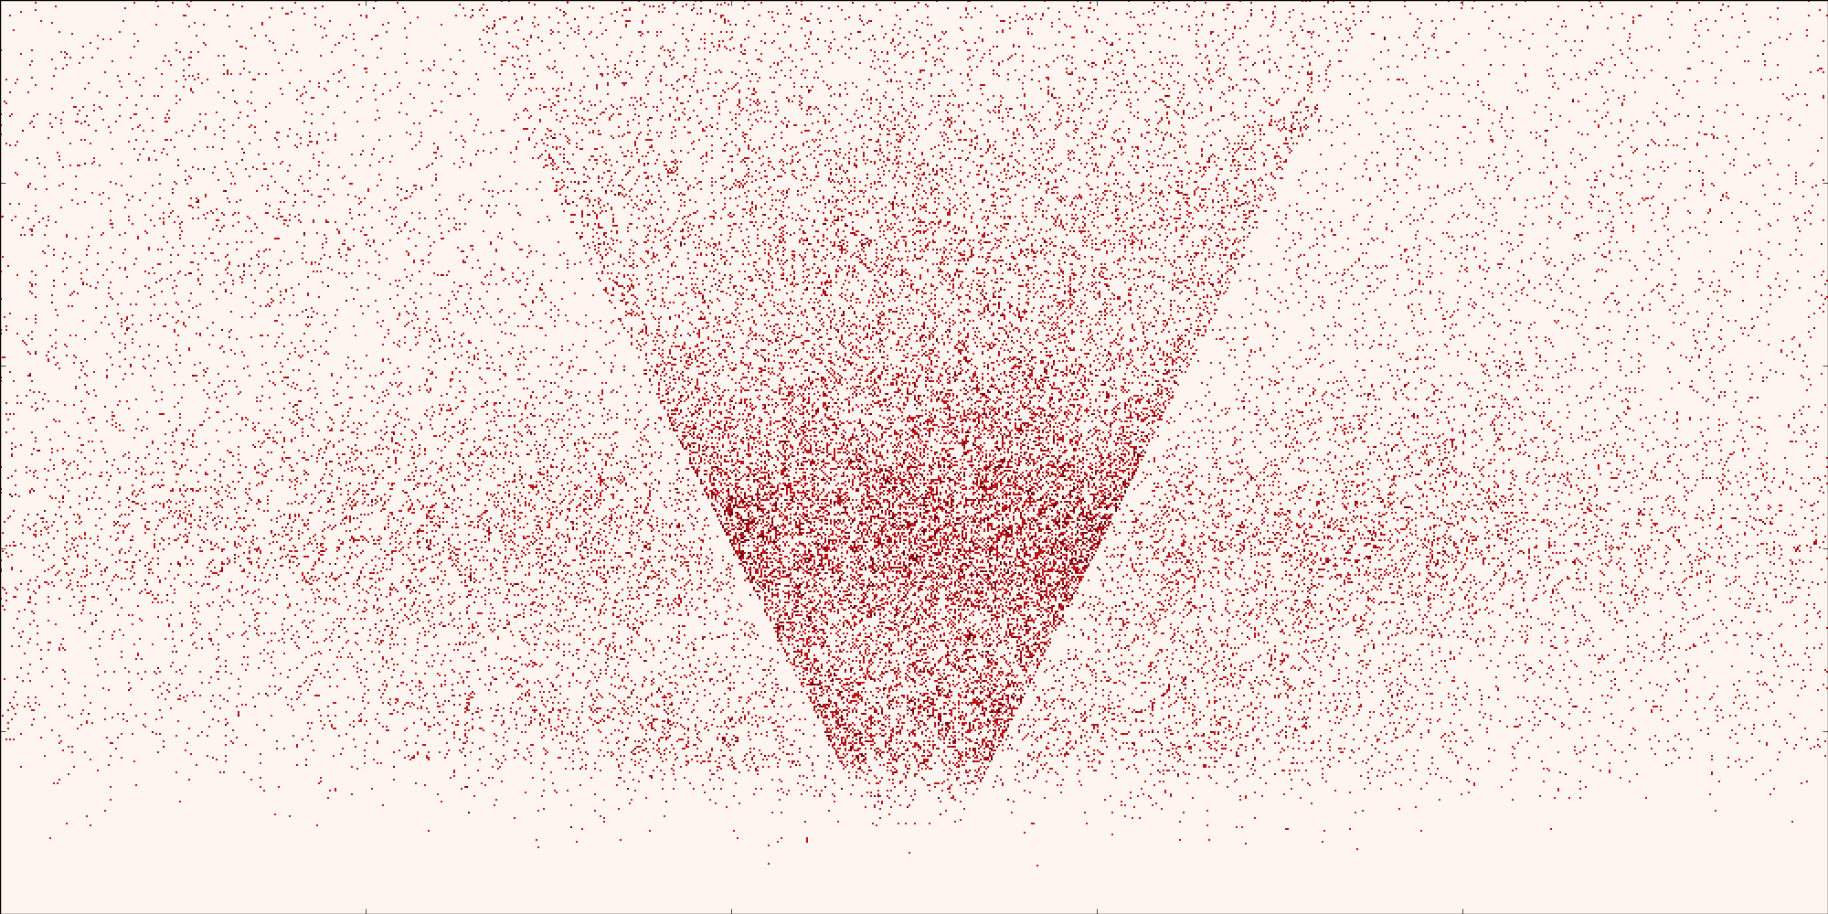
GATA1
motif-centered
MACS2 peak call-centered
500
ChIP-common sites
with motif
ChIP-common sites
with motif
0
CUTnRUN-only sites
with motif
CUTnRUN-only sites
no motif
-500 0 500

Slide 5
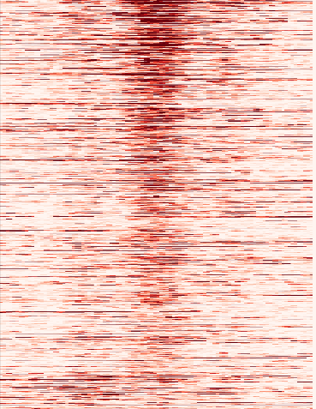
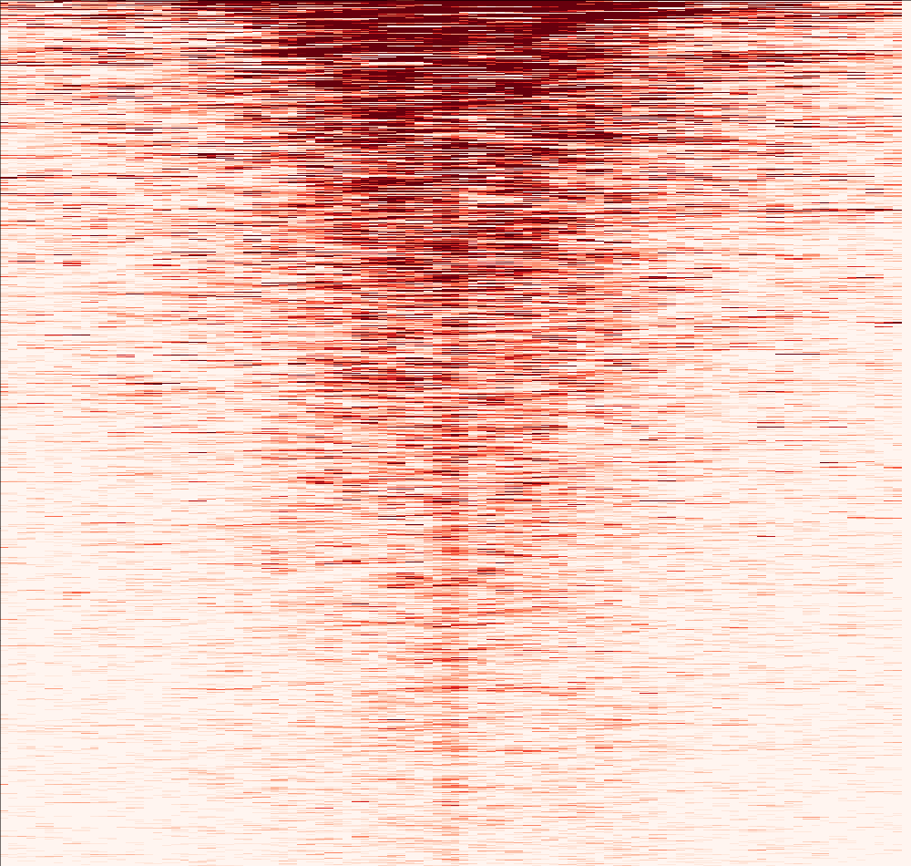
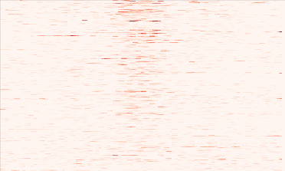
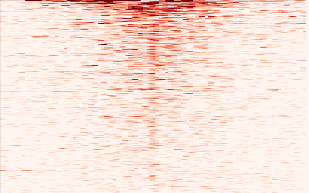
MAX
ChIP-centered
CUT&RUN-centered
Common sites:
ChIP-only
CUT&RUN-only

Slide 6
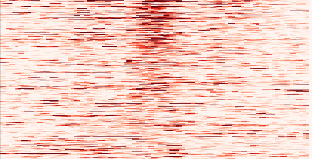
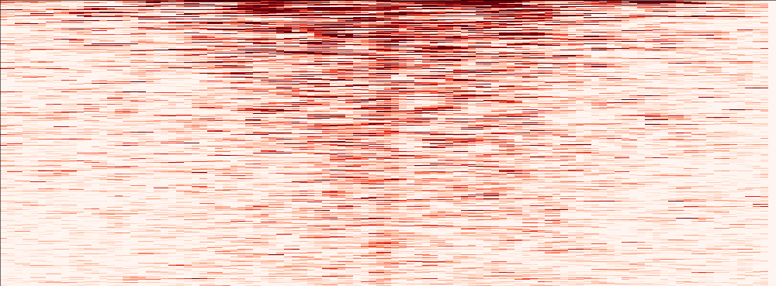
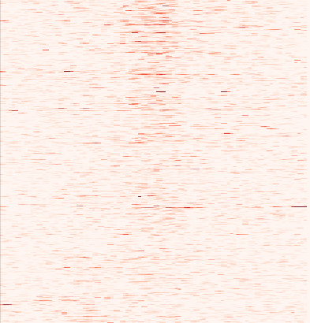
MYC
ChIP-centered
CUT&RUN-centered
Common sites:
ChIP-only
CUT&RUN-only

