Slide 1


LONG-RANGE SINGLE MOLECULE MAPPING OF ACCESSIBLE CHROMATIN IN EUKARYOTES
GEORGI K. MARINOV
GREENLEAF & KUNDAJE LABS
January 10th 2019

Slide 2
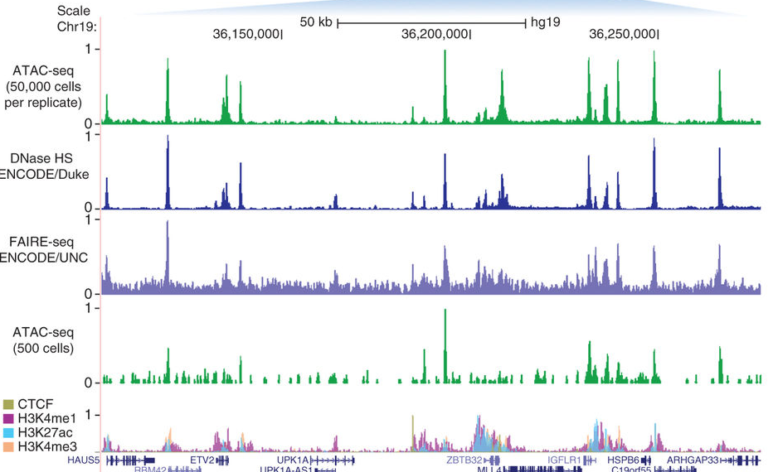
ACCESSIBLE CHROMATIN LANDSCAPE IN MAMMALS
Buenrostro et al. 2013

Slide 3
QUESTIONS:
Is the accessibility of distant open chromatin regions independently regulated or are they correlated?
What is the distribution of open chromatin states within the population?
Note: scATAC does not answer these questions because of sparseness, noise and diploidy
or

Slide 4
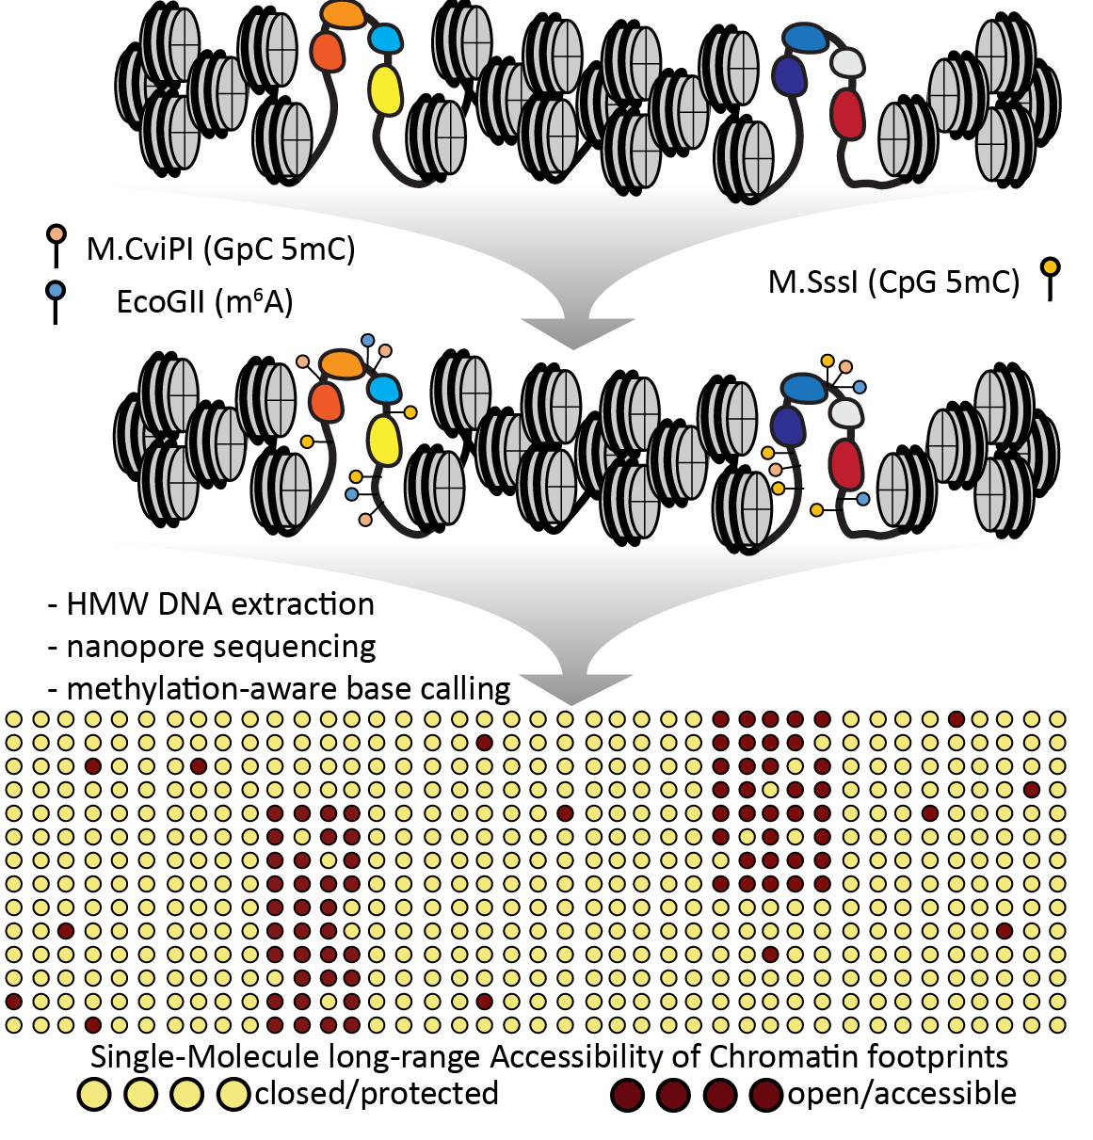
SINGLE-MOLECULE LONG READ ACCESSIBLE CHROMATIN MAPPING
SMAC-SEQ

Slide 5
PILOT STUDY IN YEAST

Slide 6
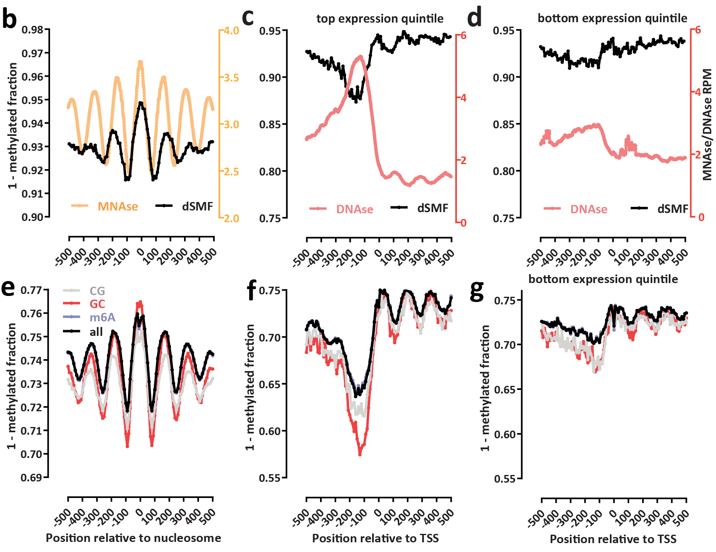
KNOWN FEATURES OF ACCESSIBLE CHROMATIN ARE REPRODUCED

Slide 7
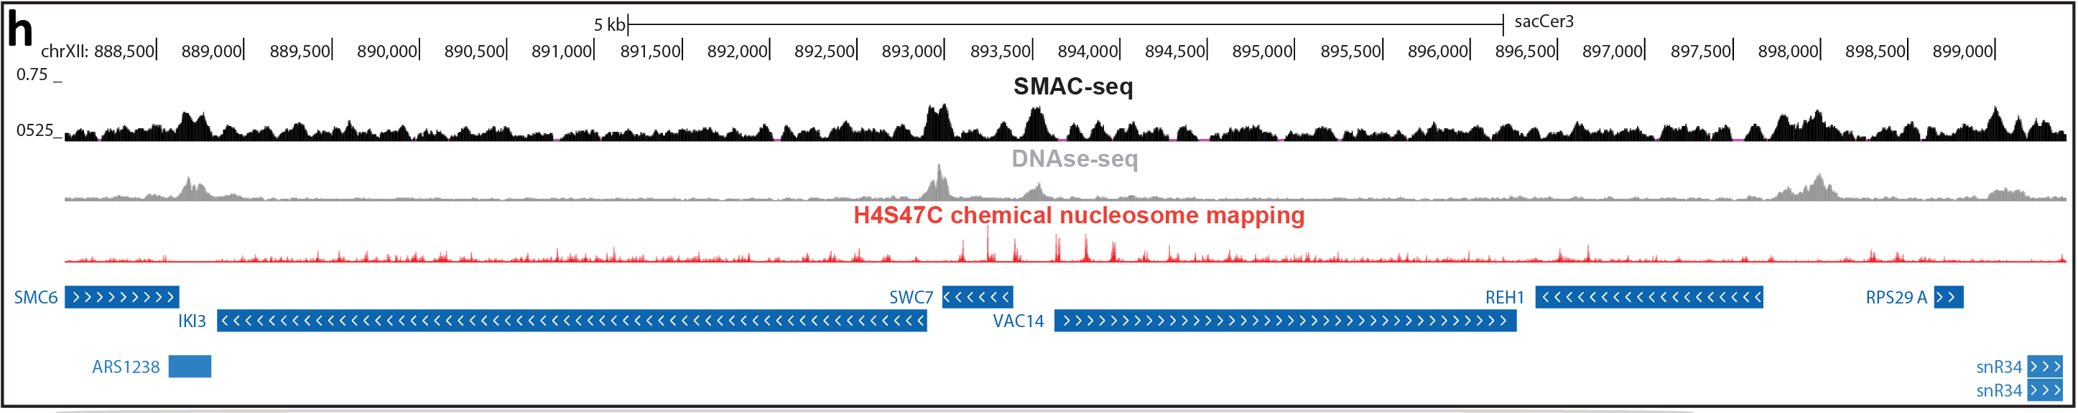
SIMULTANEOUS MAPPING OF OPEN CHROMATIN AND NUCLEOSOMES

Slide 8
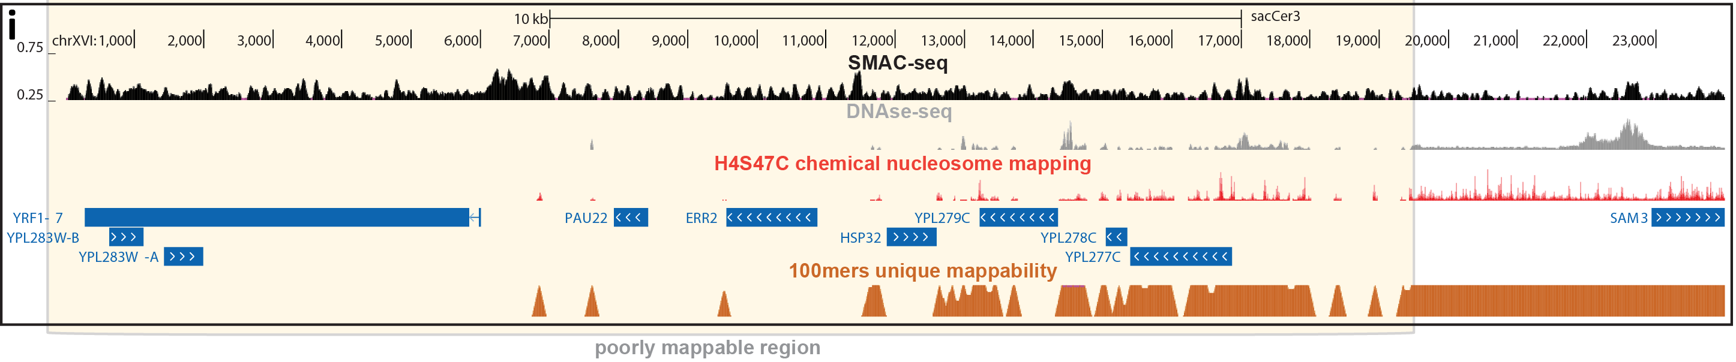
MAPPING OF OPEN CHROMATIN AND NUCLEOSOMES IN REPEATS

Slide 9
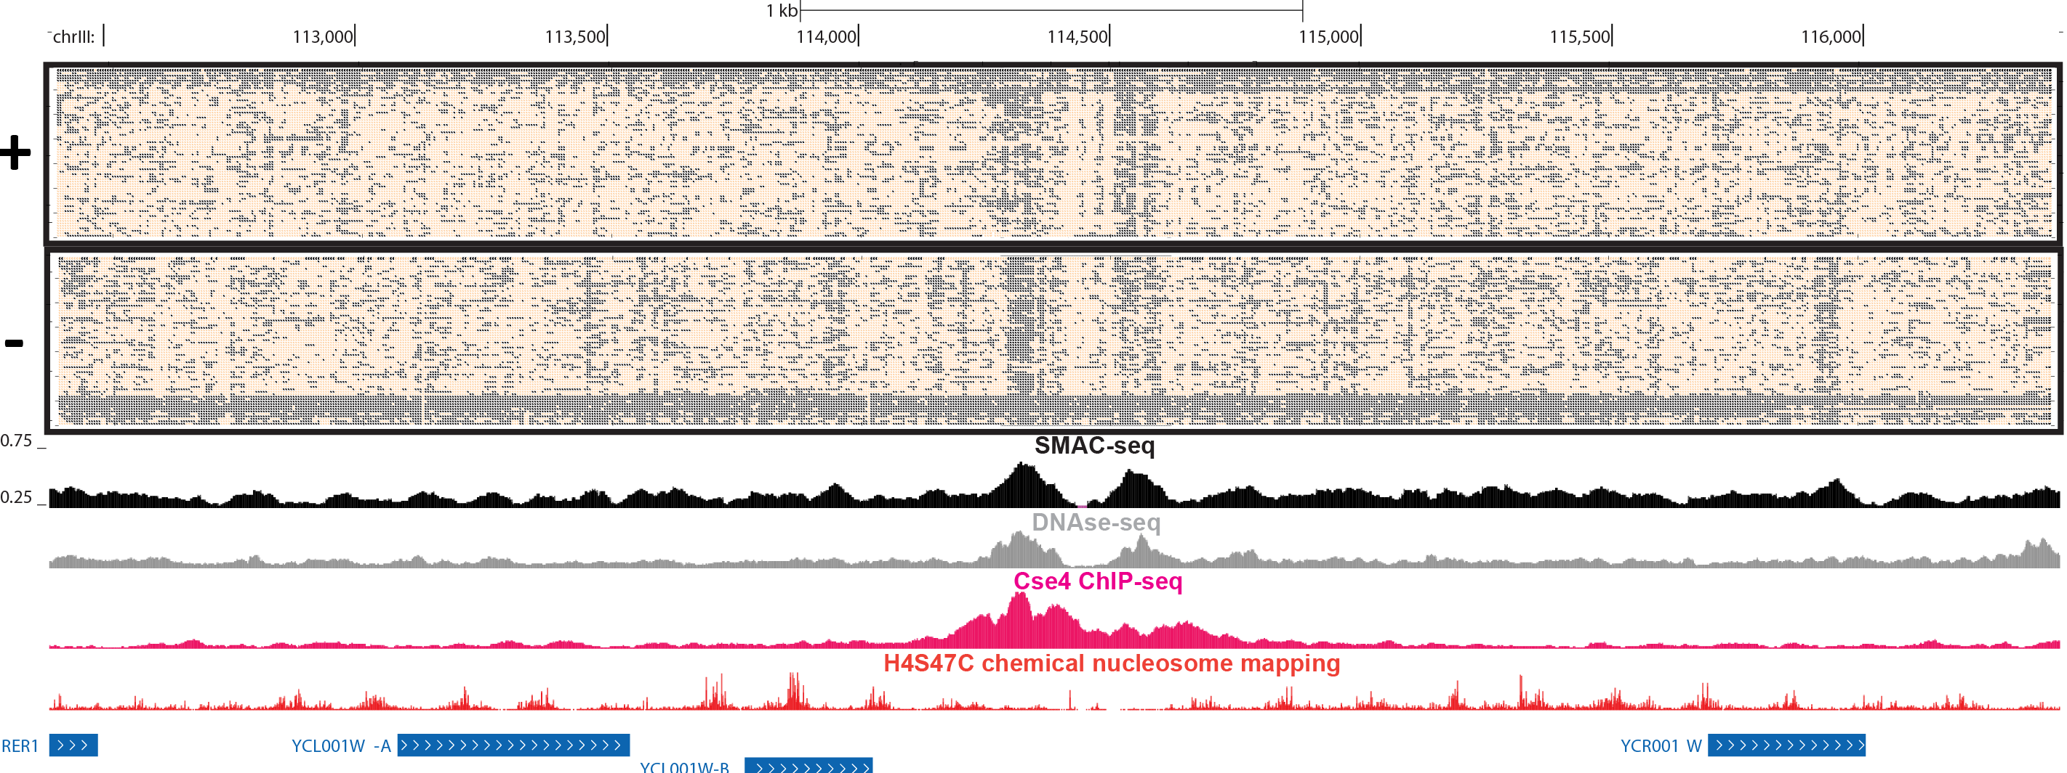
A SINGLE-MOLECULE POPULATION-SCALE VIEW OF CHROMATIN STATES

Slide 10
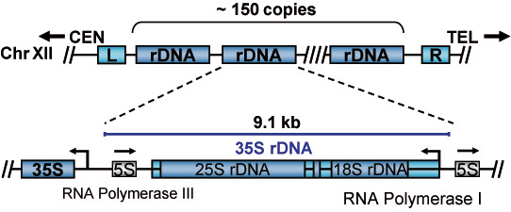
RIBOSOMAL DNA CASE STUDY
Not uniquely mappable
Present in arrays of 150-200 copies in the genome (but the whole arrays are not included in the genome assembly)
Extremely highly transcribed and thought to be almost devoid of chromatin when active

Slide 11
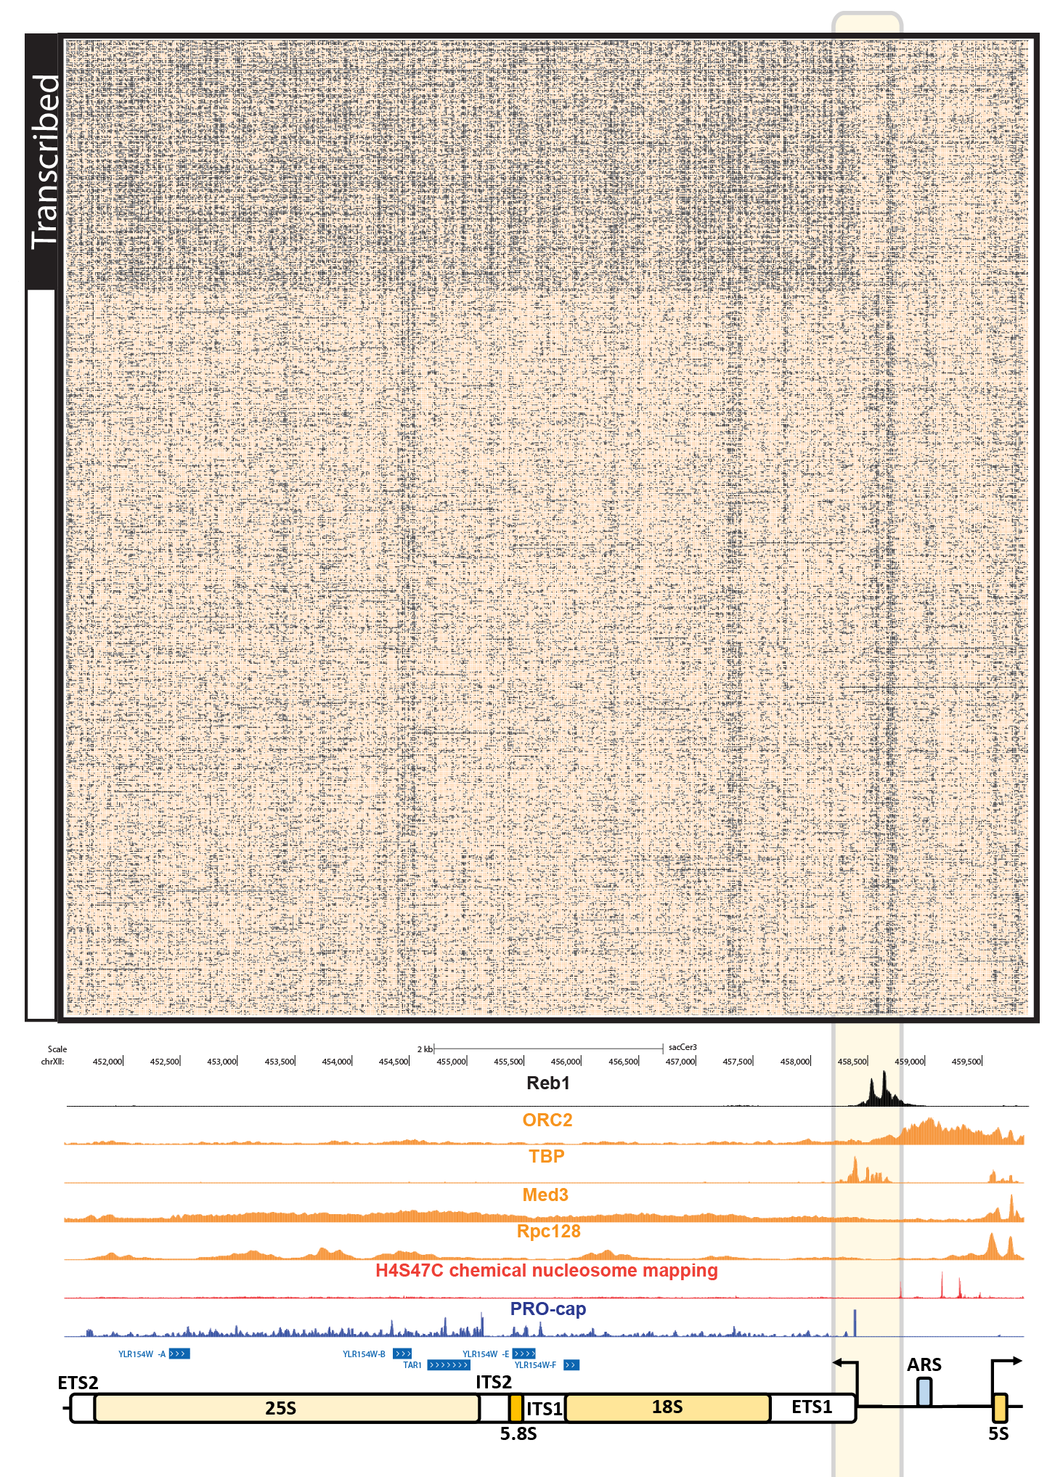
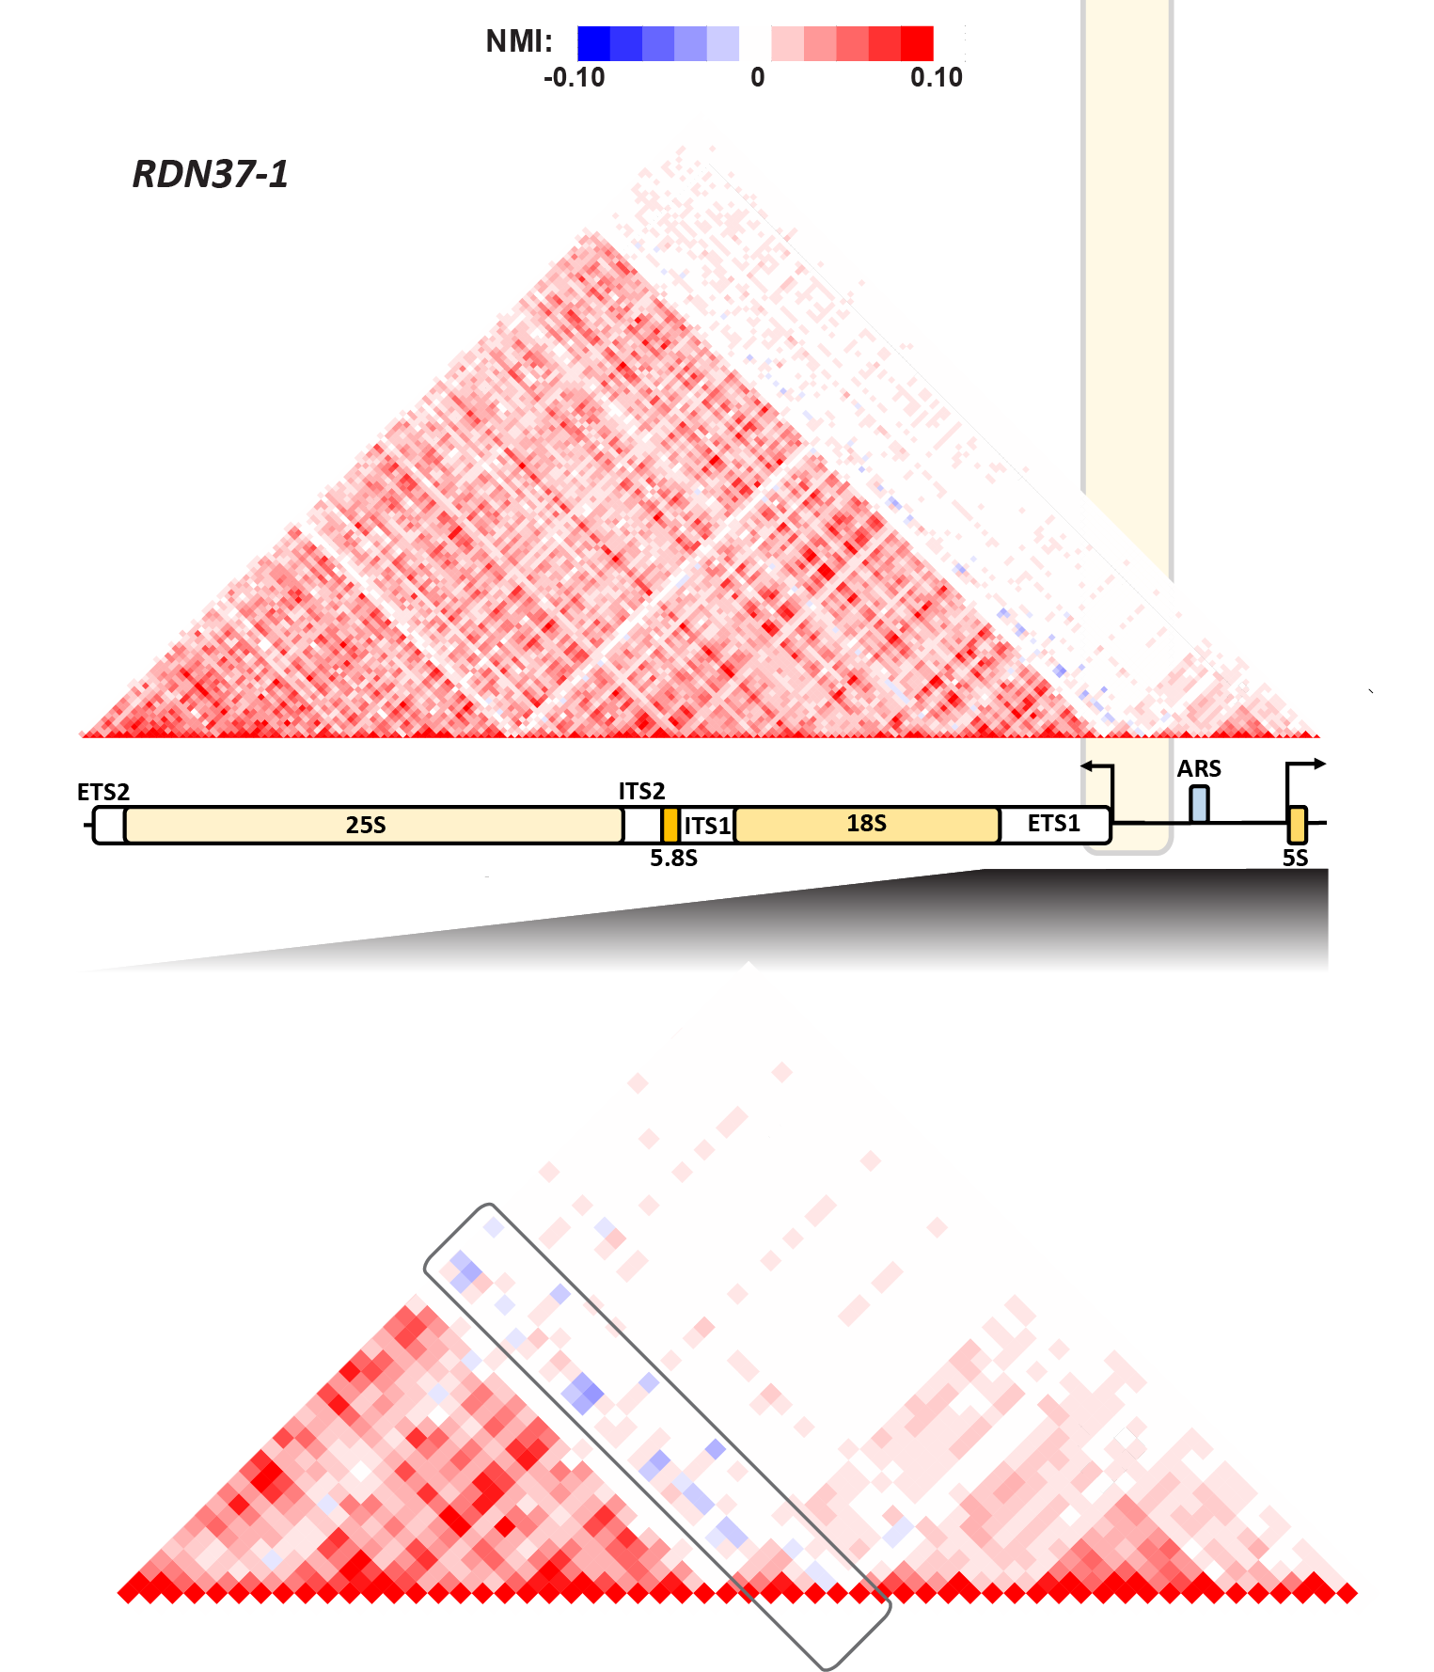

Slide 12
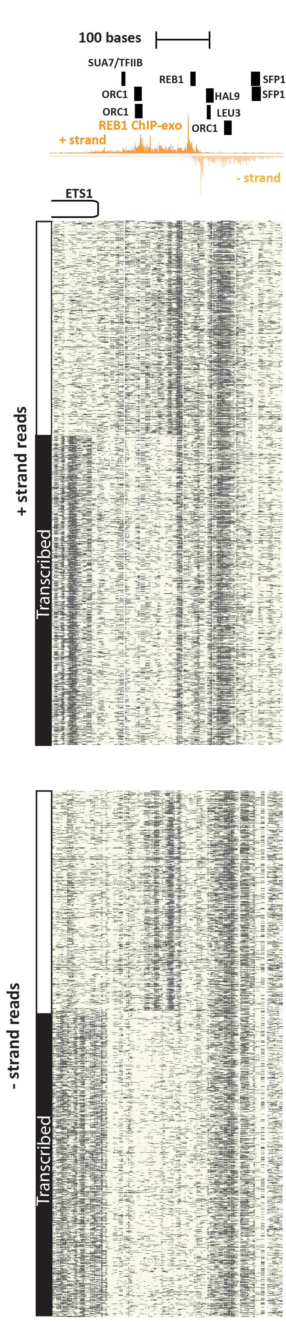
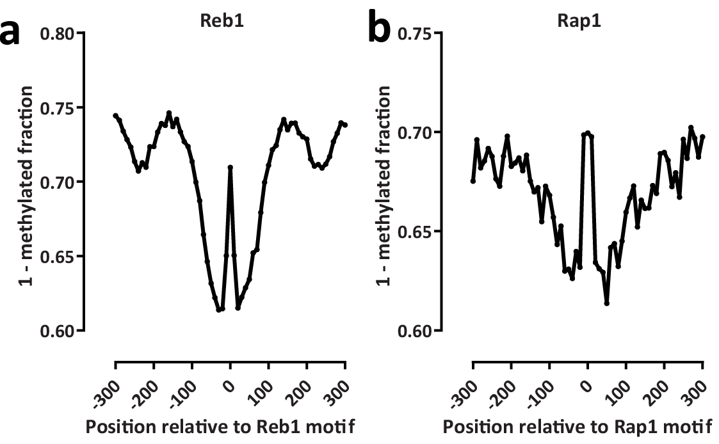
TRANSCRIPTION FACTOR FOOTPRINTING

Slide 13
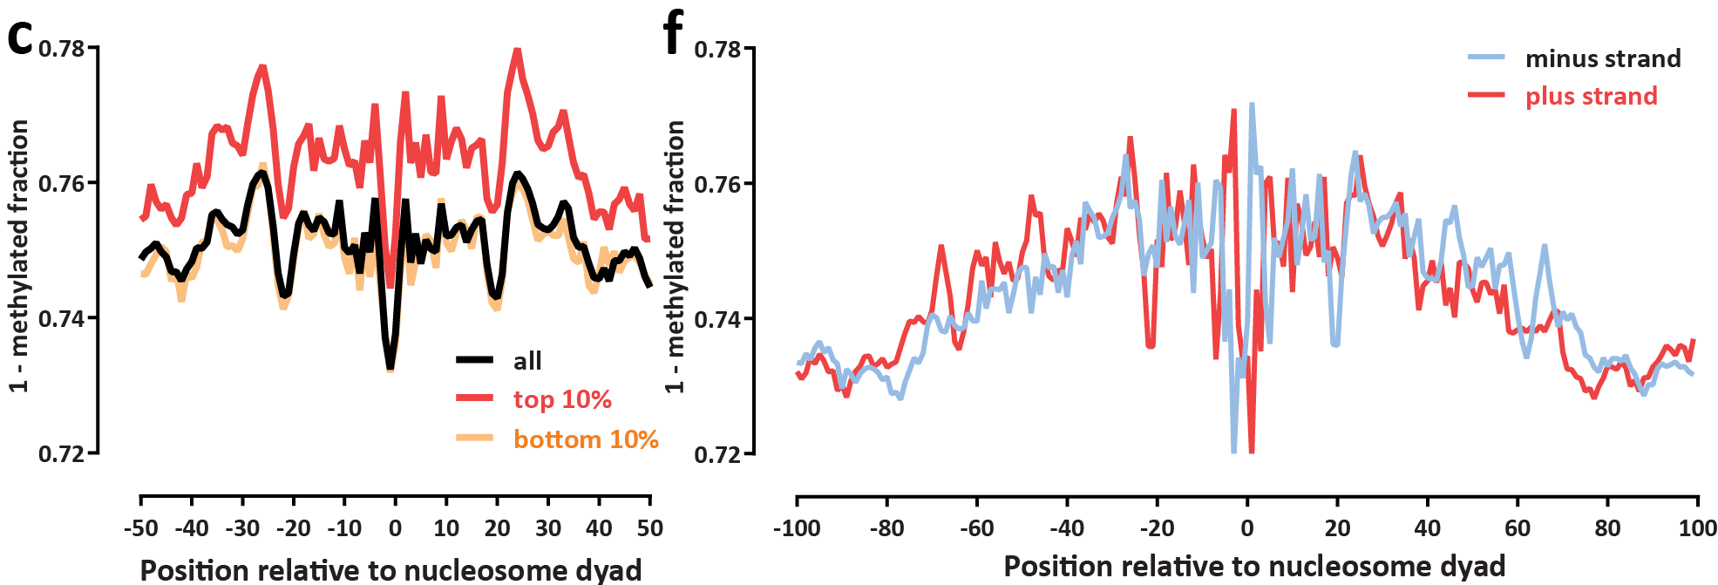
FINE-SCALE NUCLEOSOME OCCUPANCY FEATURES

Slide 14
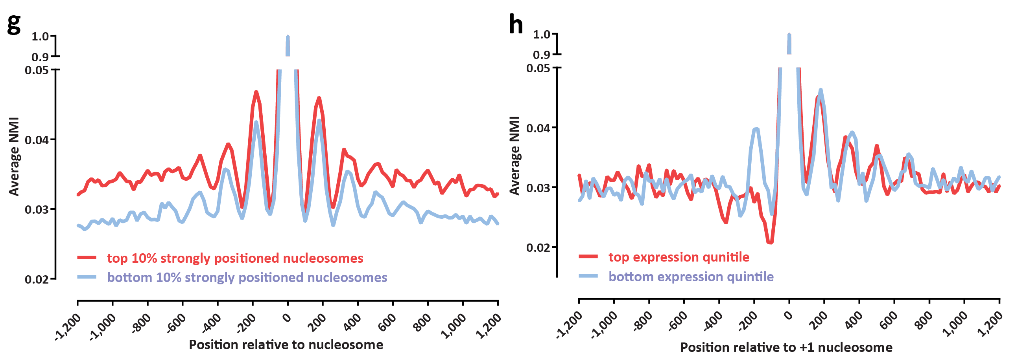
LOCAL ACCESSIBILITY/PROTECTION CORRELATIONS

Slide 15
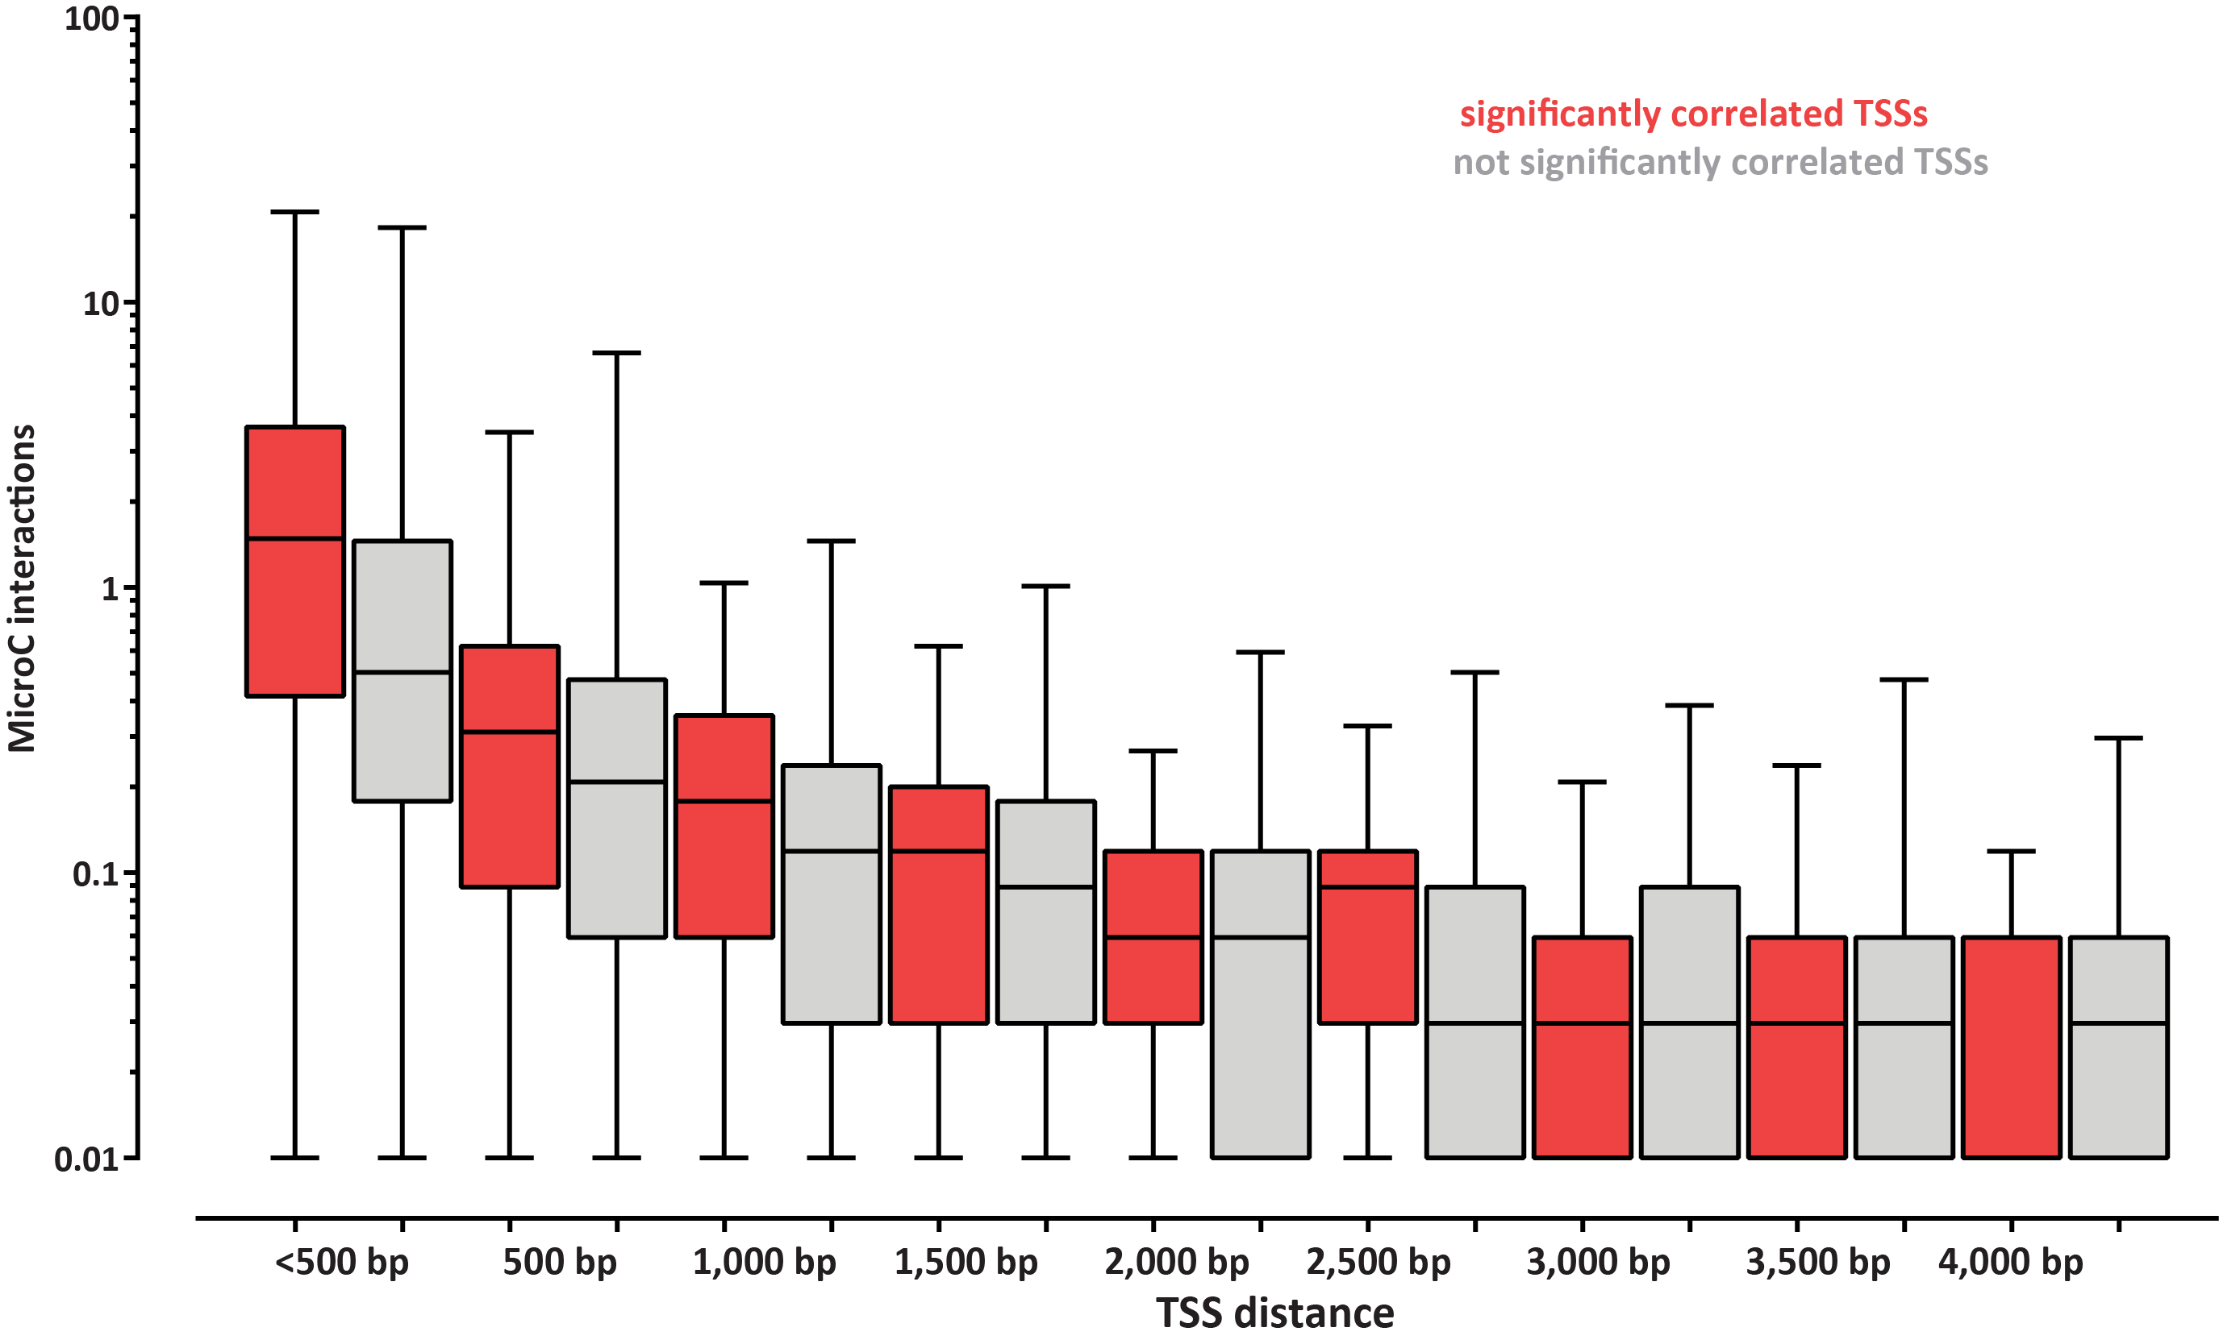
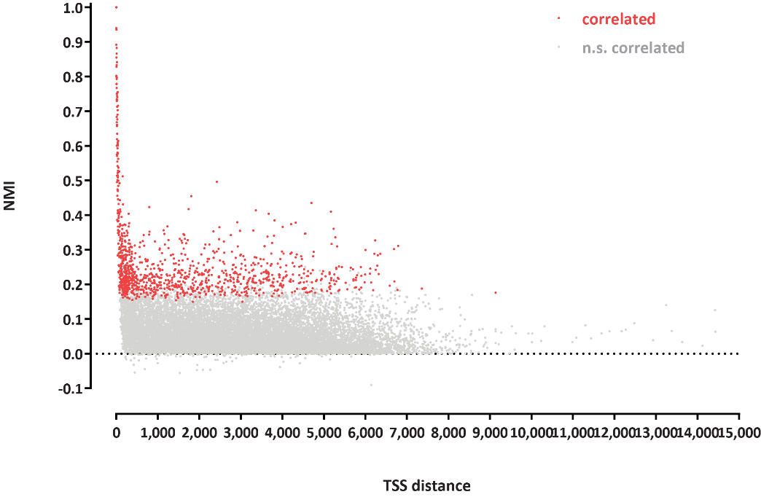
GLOBAL ACCESSIBILITY/PROTECTION CORRELATIONS

Slide 16
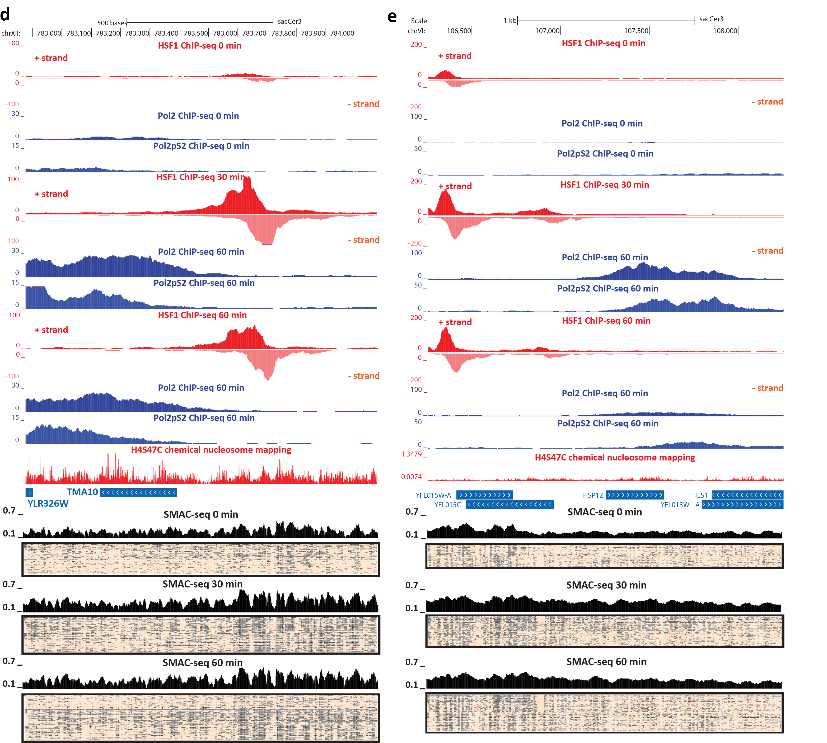
CHROMATIN DYNAMICS DURING THE YEAST STRESS RESPONSE

Slide 17
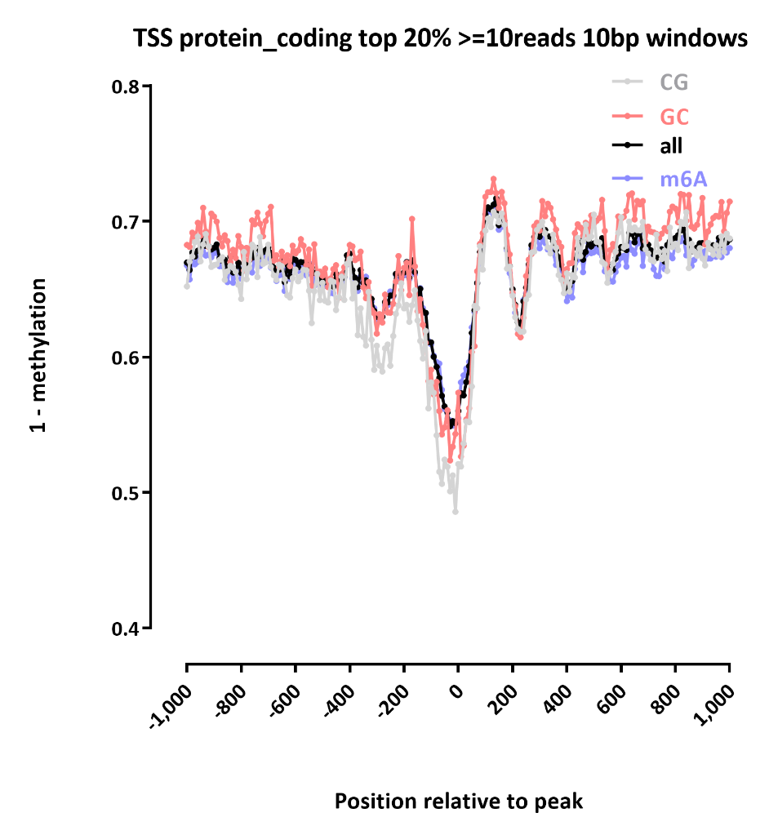
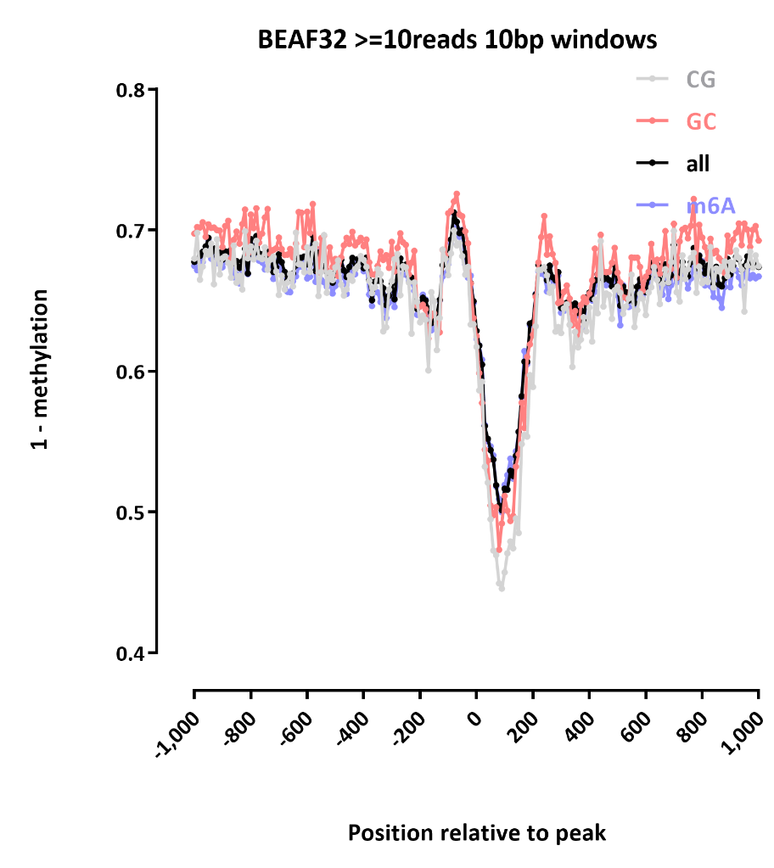
SMAC-SEQ IN DROSOPHILA
Top 20% expressed genes in S2 cells
BEAF32 peaks
Position relative to TSS
Position relative to peak

Slide 18




ACKNOWLEDGEMENTS
Zohar Shipony
William Greenleaf
Anshul Kundaje
Matthew P. Swaffer
Nasa A. Sinott-Armstrong

