Slide 1
DNA ZOO ATAC PAPERS DICUSSION 2022/07/29

Slide 2
CURRENT DNAZOO DATA SUMMARY

Slide 3
ATAC-seq data summary:
- 120 species (118 + human and mouse)
- Libraries generated for 118
Sequenced for 77
Aligned against official release: 16
Aligned against draft/pre-release: 23
Any alignment: 39

Slide 4
PREVIOUS ENCODE WORK

Slide 5
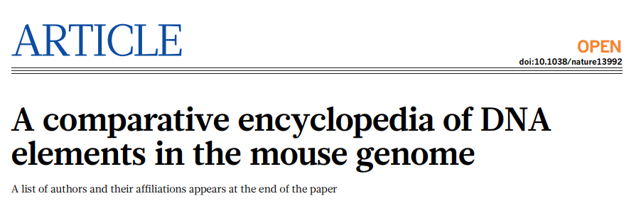
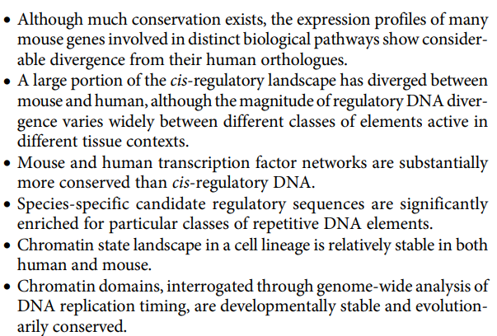
Previous ENCODE work

Slide 6
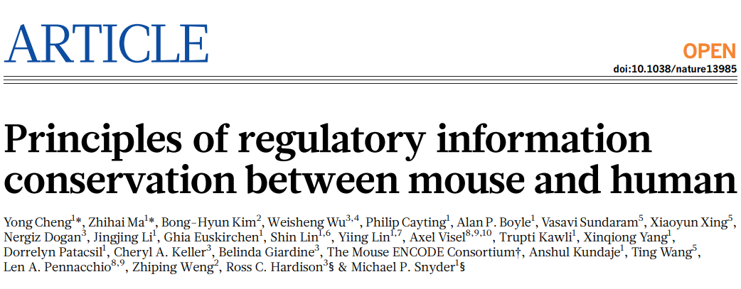

Slide 7
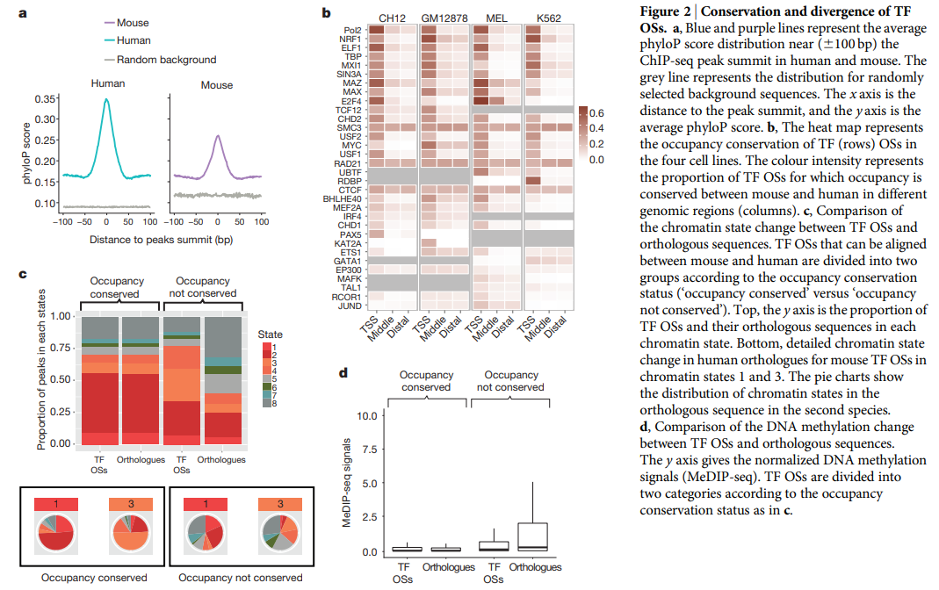

Slide 8
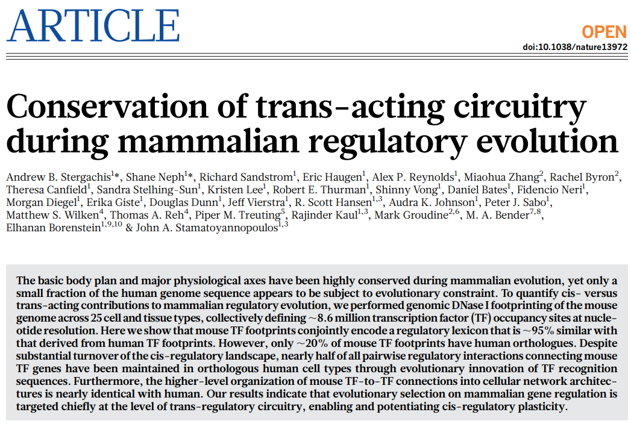

Slide 9
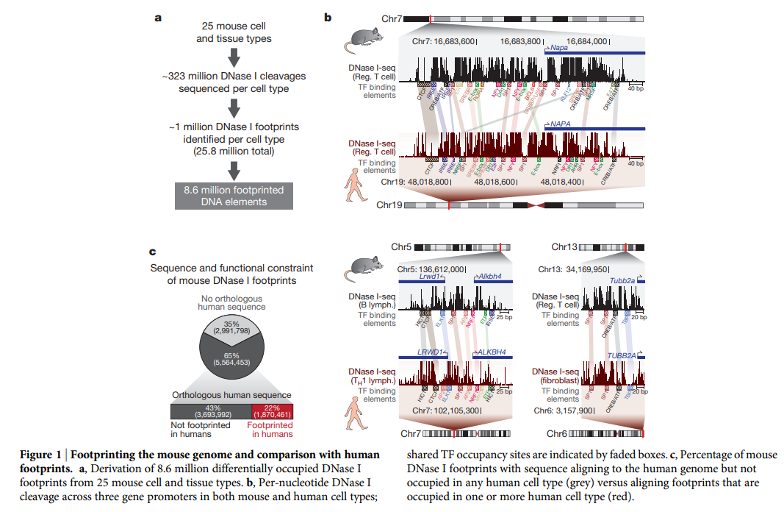

Slide 10
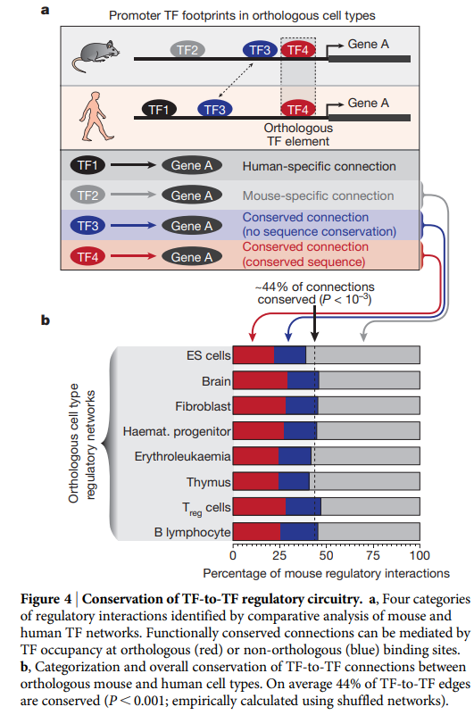

Slide 11
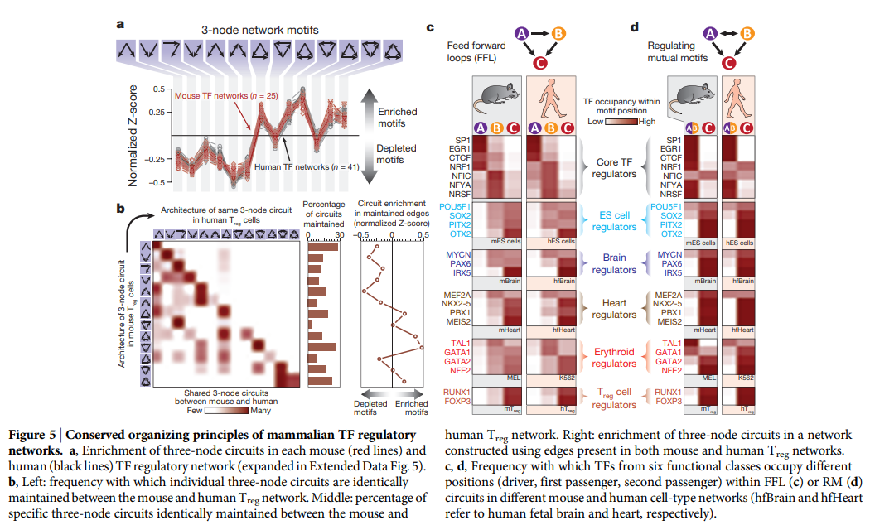

Slide 12
PREVIOUS NON-ENCODE WORK

Slide 13
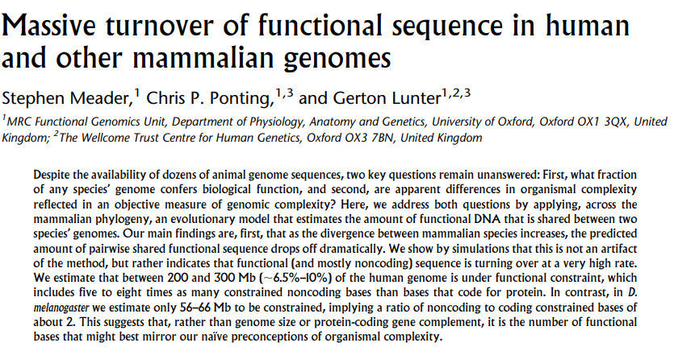
Massive turnover at the sequence level

Slide 14
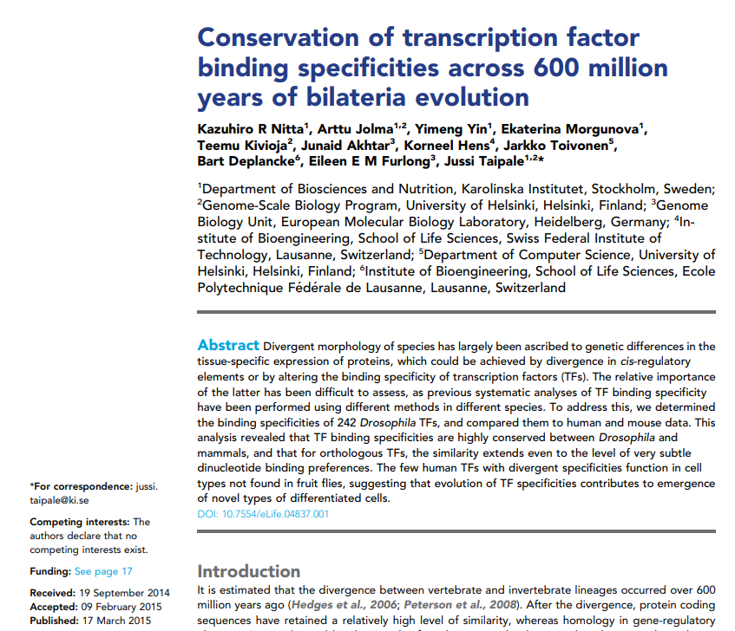
Deep conservation of TF motifs

Slide 15
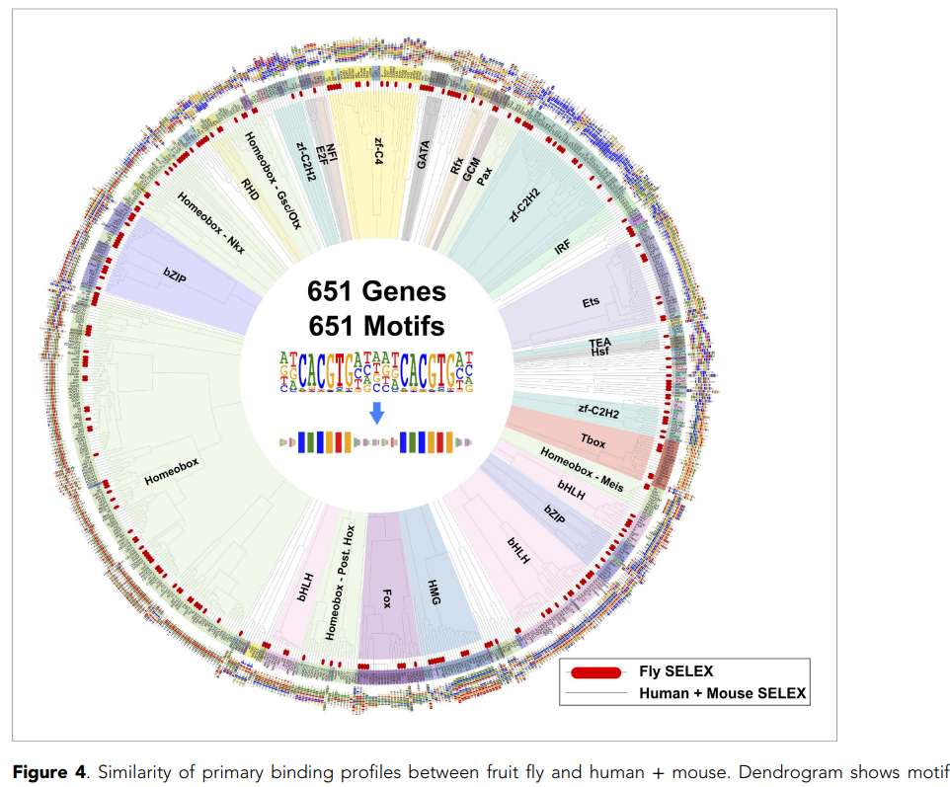

Slide 16
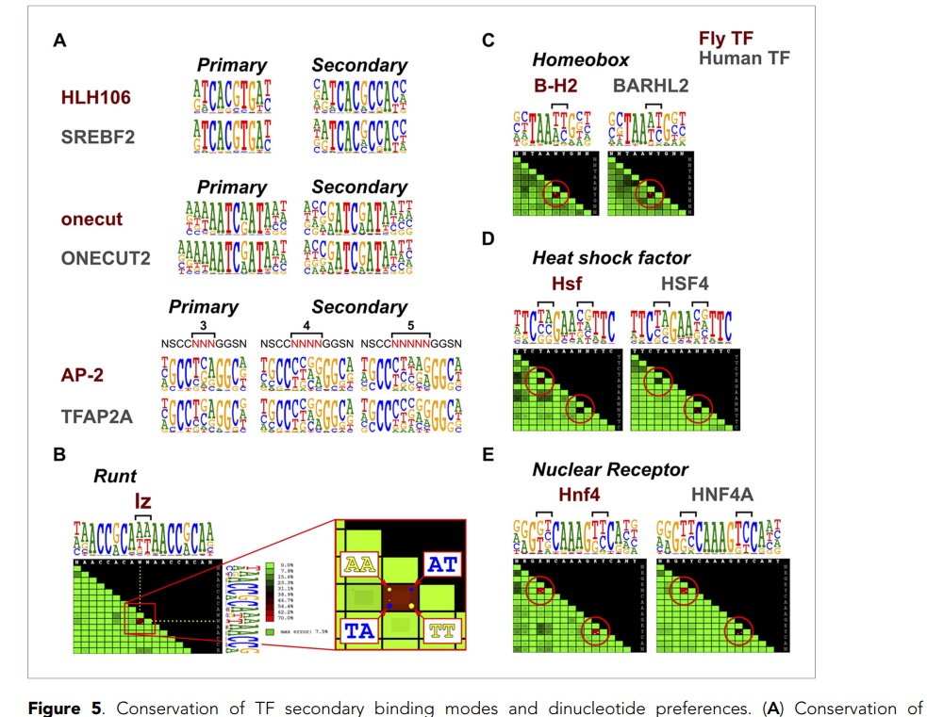

Slide 17
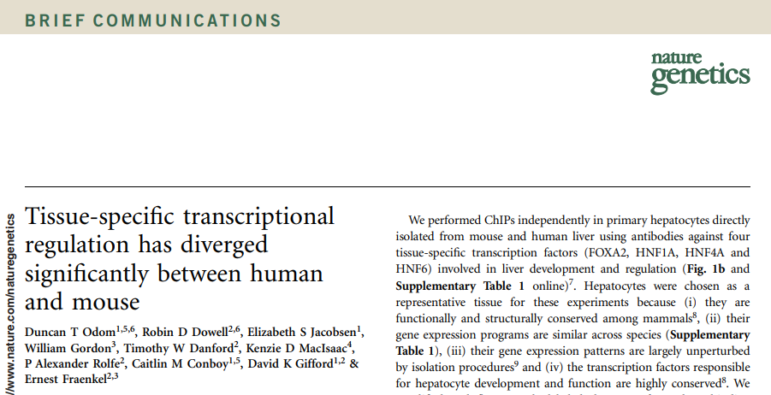
Comparative functional genomics
2007

Slide 18
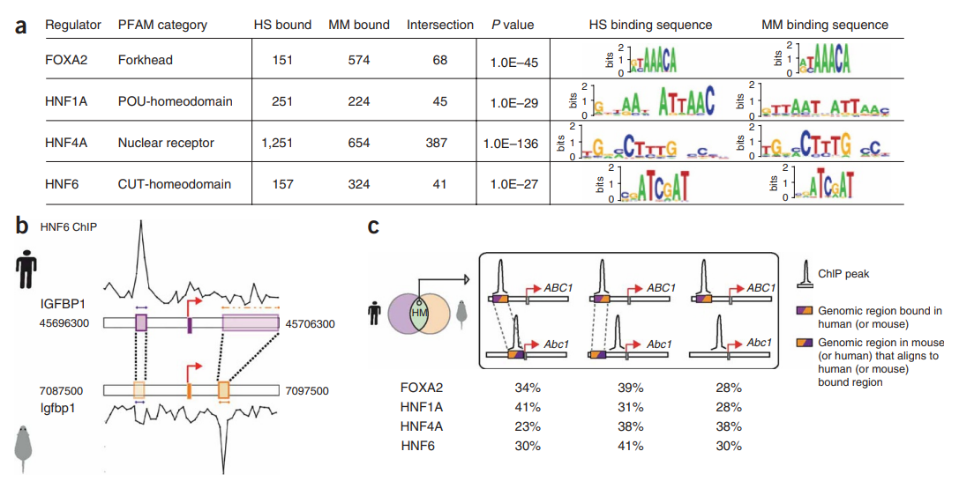

Slide 19
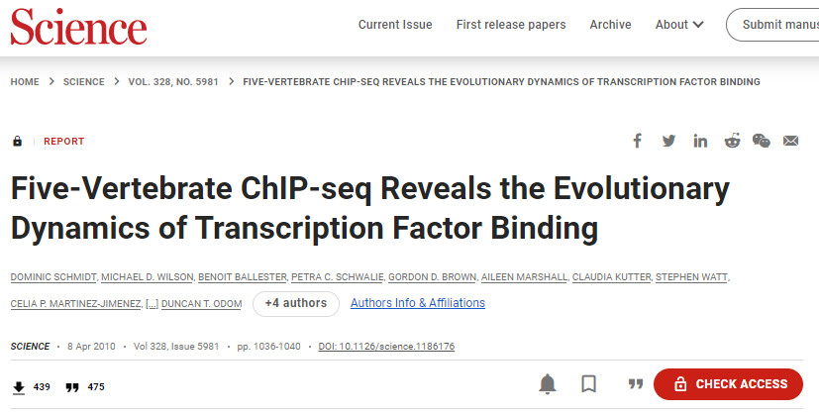
2010

Slide 20
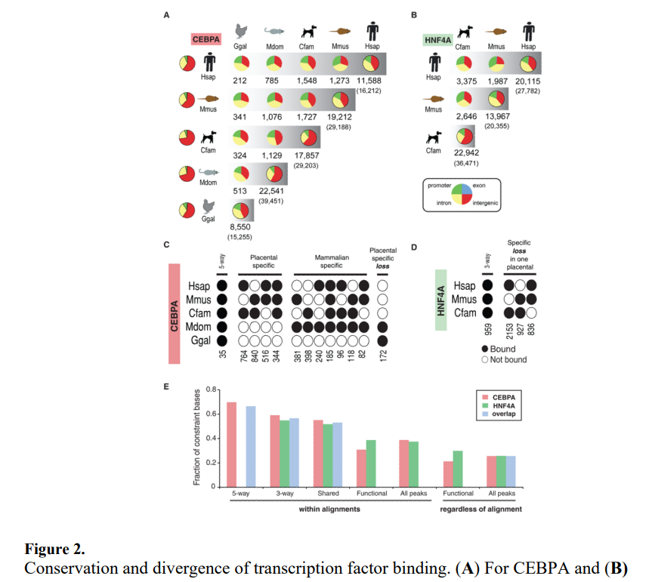

Slide 21
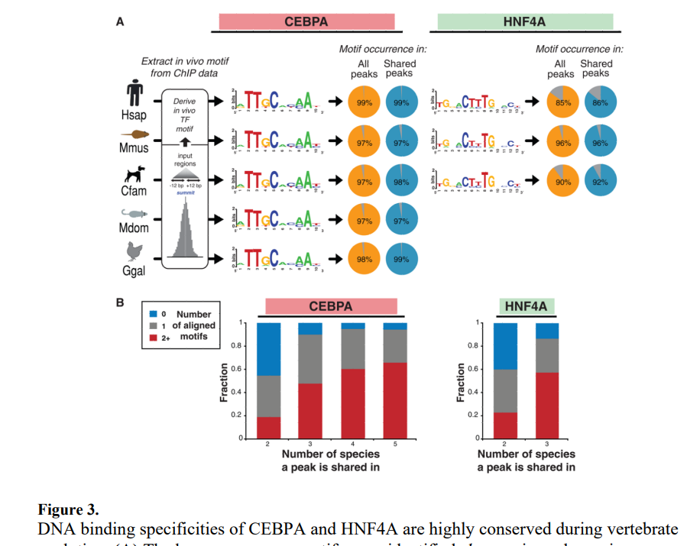

Slide 22
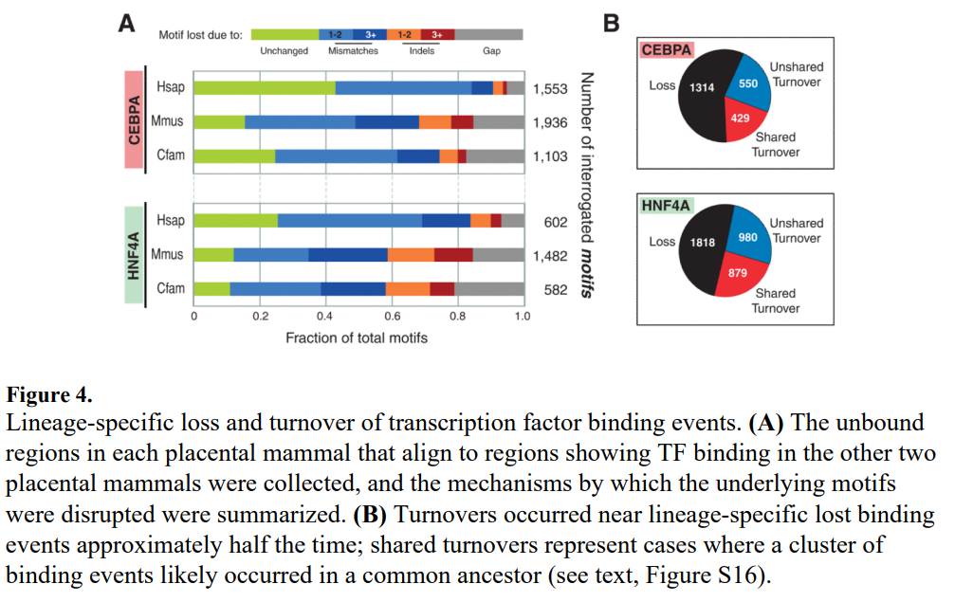

Slide 23
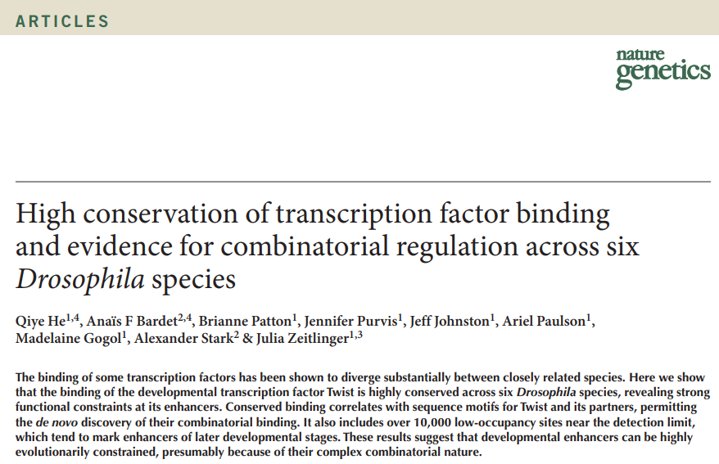
2011

Slide 24
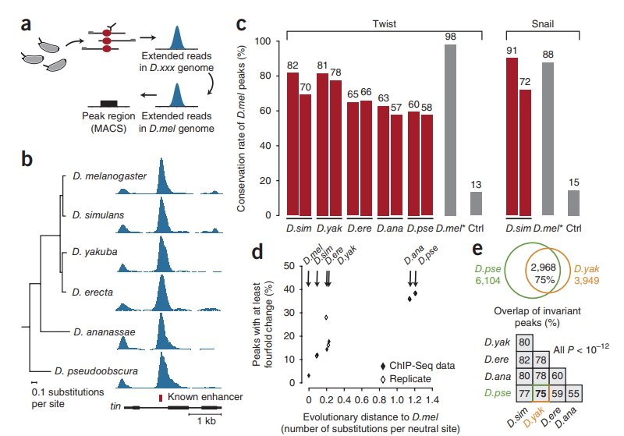

Slide 25
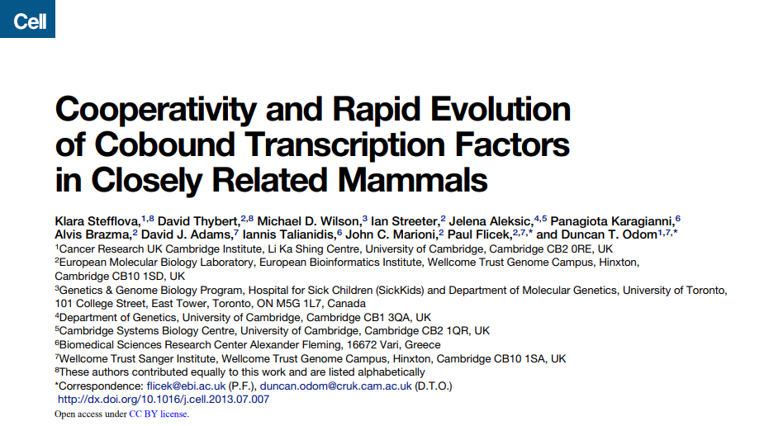
2010

Slide 26
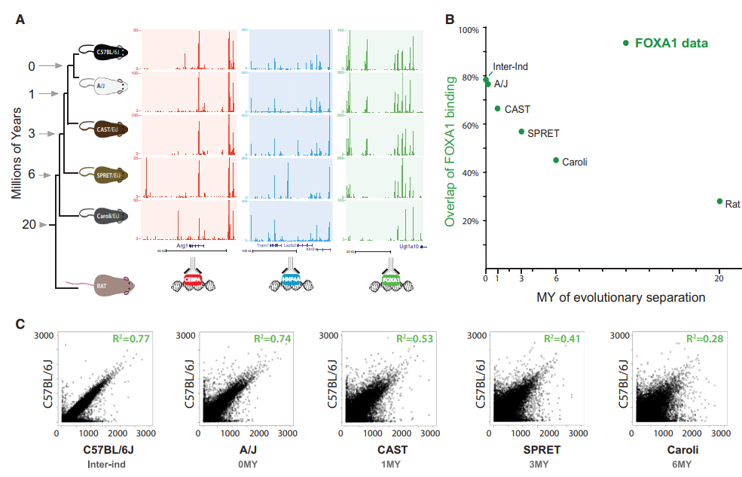

Slide 27
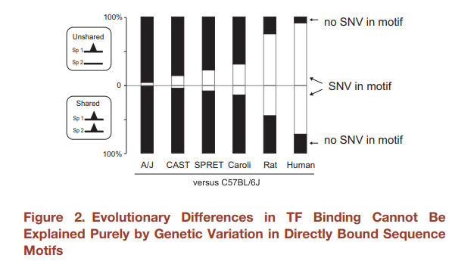

Slide 28
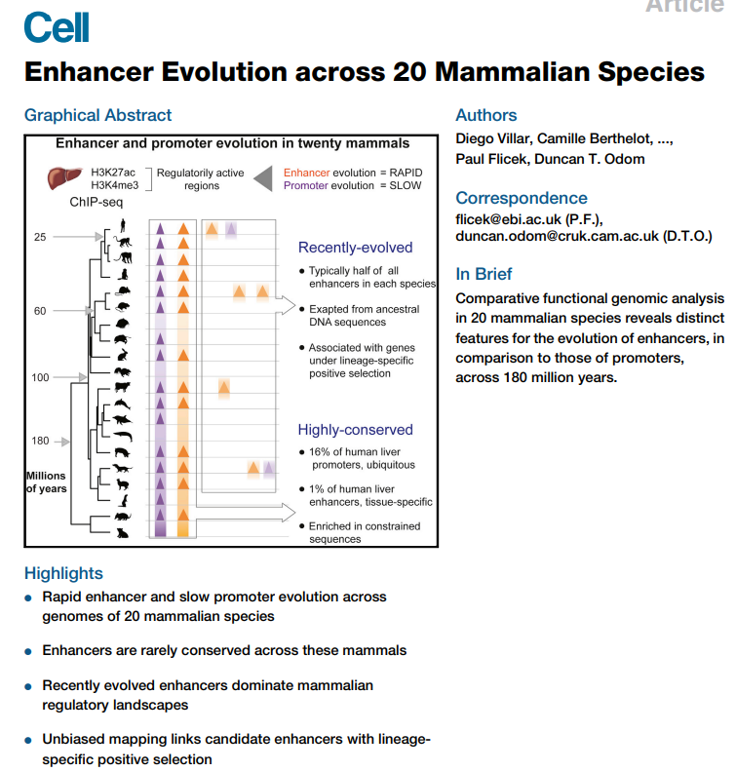
2015

Slide 29
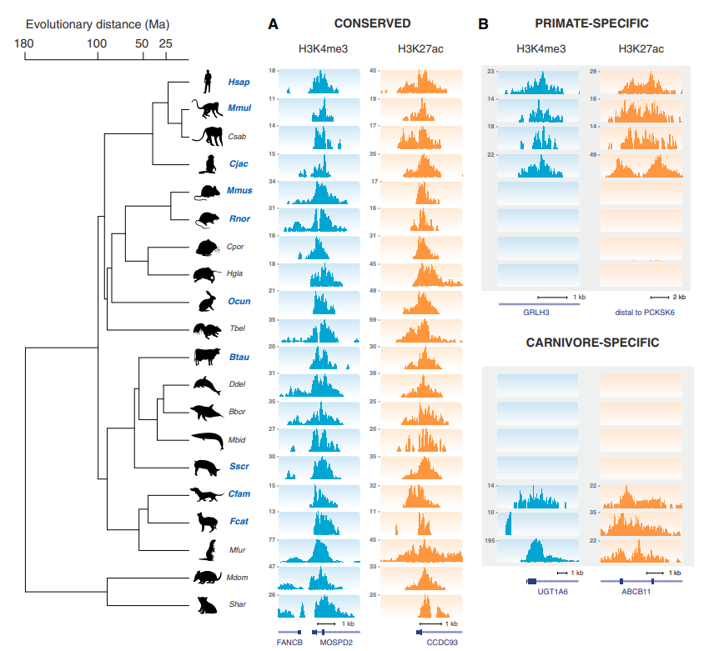

Slide 30
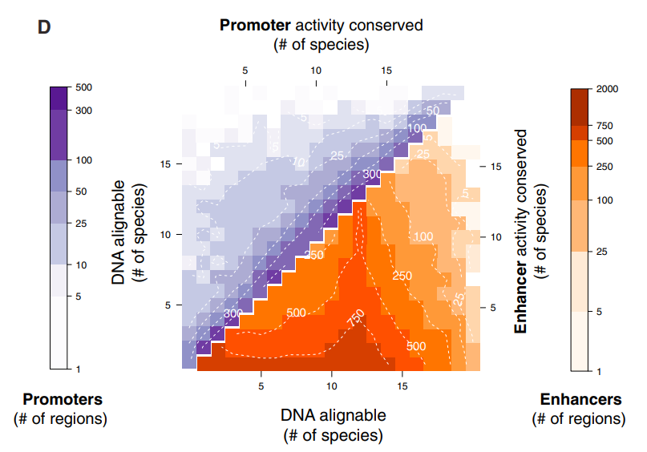

Slide 31
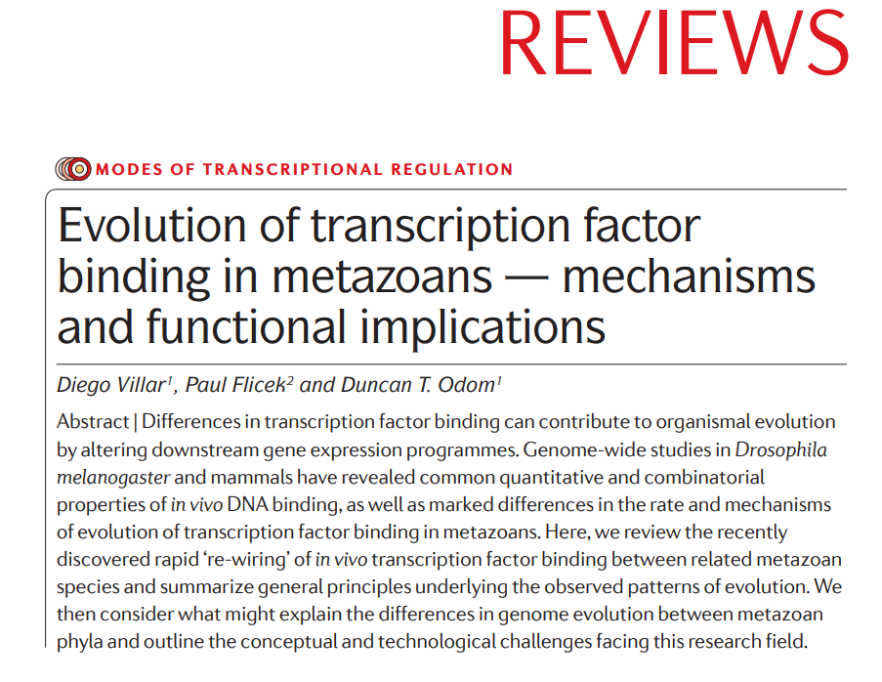
Rate of evolution

Slide 32
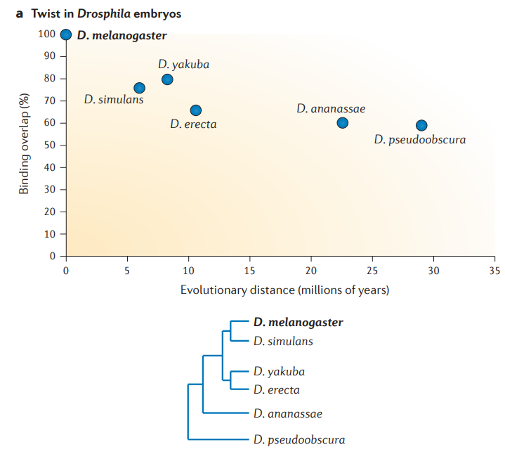
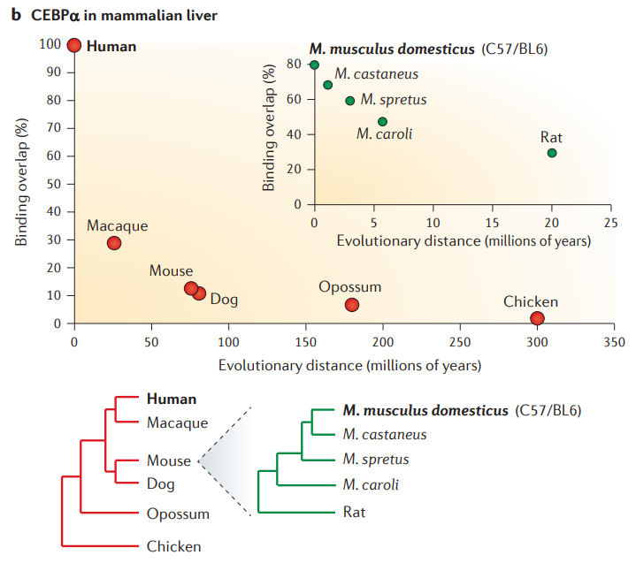

Slide 33
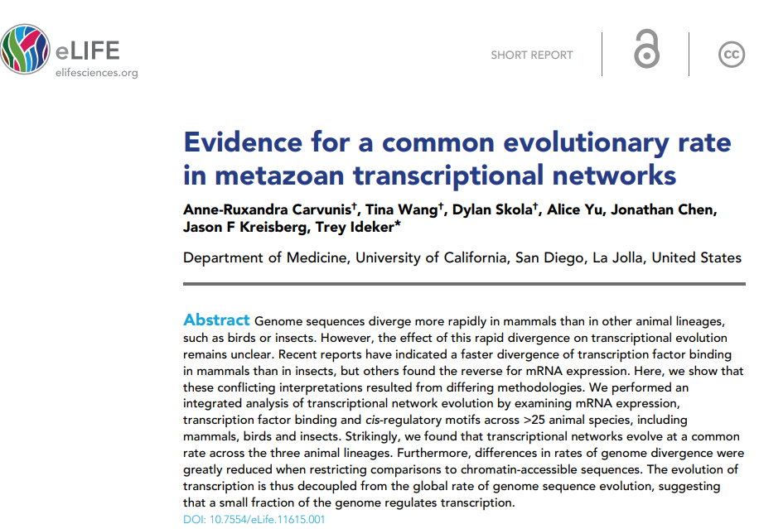

Slide 34
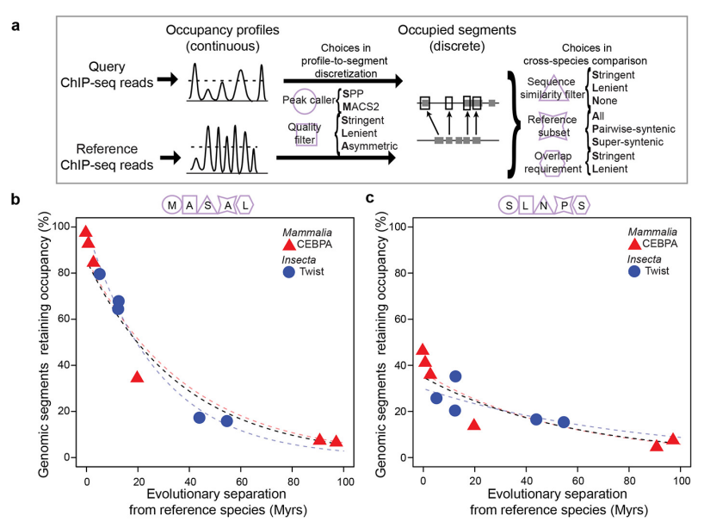

Slide 35
CURRENT DNAZOO DATA SUMMARY

Slide 36
ATAC-seq data summary:
- 120 species (118 + human and mouse)
- Libraries generated for 118
Sequenced for 77
Aligned against official release: 16
Aligned against draft/pre-release: 23
Any alignment: 39

Slide 37
WHAT TO DO WITH THE DATA

Slide 38
Current proposal:
Individual, methodologically or otherwise focused projects are completed using a portion of the data as it is already or becomes available in the future
ATAC vs. Hi-C
Aman’s modelling efforts
Etc.
Eventually we also have a big all-encompassing study that uses all the data and makes grand comparisons across the mammalian tree-of-life

Slide 39
CRE-level conservation
-- identify the conserved and divergent sets of fibroblast CREs of across all species
-- degree of enhancer and promoter conservation
-- how much conservation of number of CREs associated with a gene vs. their location
-- how many changes in location of homologous CREs (distance, position, orientation vs. cognate TSSs, etc.)
-- rate of CRE turnover as a function of evolutionary distance
-- (split by Enh, Prom, Ins, etc.)

Slide 40
Reference-guided analysis of TF footprints
The references are human, where we have/will have the ENCODE TFs atlases and the ChromBPNet atlas, and to a lesser extent mouse, which will provide a reference set of occupied and footprinted motifs
-- One thing to focus on separately is the analysis of CTCF site evolution
-- Gain/Loss/Conservation of individual sites
-- Changes in the motifs, the spacing between ZFs, etc.
-- What changes and conservation of motif number, type and orientation do we see at conserved TAD boundaries?
-- And at non-conserved TAD boundaries
-- Second thing to focus on separately is REST/NRSF.
-- Gain/Loss/Conservation of individual sites
-- Around which genes is it most conserved?
-- internal spacing changes?

Slide 41
-- Third thing is ZNFs, which should have changed a lot, and will become progressively more difficult to analyze the further one gets from human, but this is the interesting part:
-- how far back does the conservation of motifs and footprints go for each?
-- how plastic are individual motifs?
-- rate of evolution vs. evolutionary distance for each.
The ZNF paper is the starting resources for that.
-- Fourth, we try to assess occupied and footprinted motif conservation at the sequence and footprint levels for all the ENCODE TFs.
-- rate of evolution vs. evolutionary distance for each TF

Slide 42
Repeats
-- Which repeats are accessible
-- What TF motifs can be seen footprinted there?
This will require a separate processing, and we should be seeing a lot of difference as different mammals have different repeat classes.

Slide 43
Grammar conservation
This is ChromBPNet-based and focuses on evolution within homologous CREs.
-- overall sequence level conservation as a function of evolutionary time
-- motif content conservation
-- motif conservation at the sequence level
-- importance score motif conservation
-- footprinted motif conservation, i.e. is the footprint as opposed to the presence of the motif conserved
-- core analysis, taking the set of motifs highlighted by importance scores and footprints:
-- how much conservation of combinations of motifs with a CRE do we see as a function of time?
-- how much are different properties conserved -- orientation, positioning, number motifs, etc.
-- which combinations of such motifs are most constrained?
-- do we see them preferentially in certain types of CREs or around particular genes?

Slide 44
What is needed next:
-- Sequence all ATAC
-- Assemblies for all species
-- Finalized whole genome alignments against at least human.
-- Further suggestions for analysis, etc.?

