Slide 1
Mapping stats

Slide 2
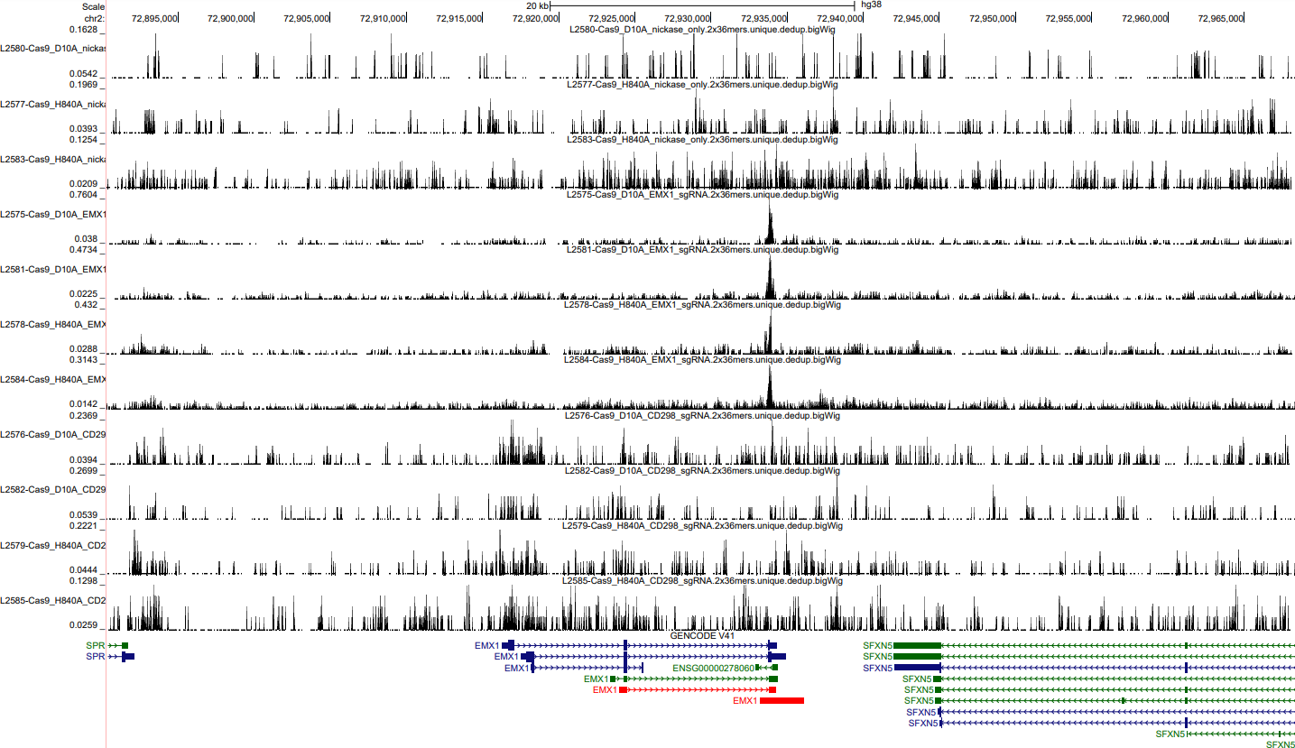
EMX1

Slide 3
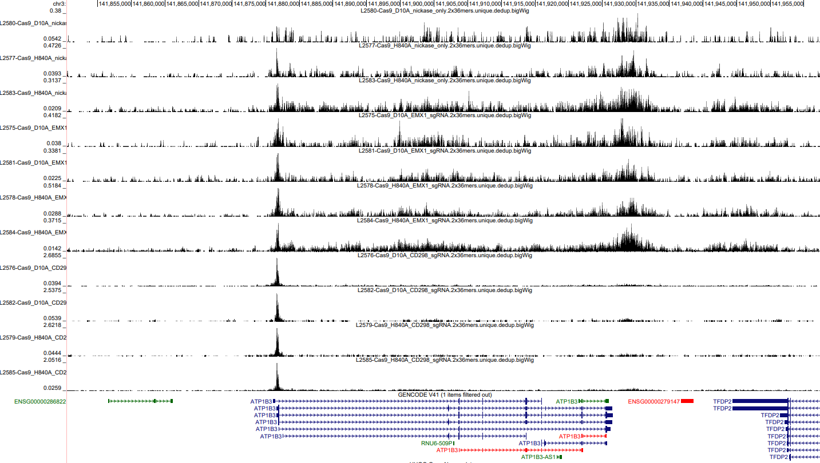
CD298

Slide 4
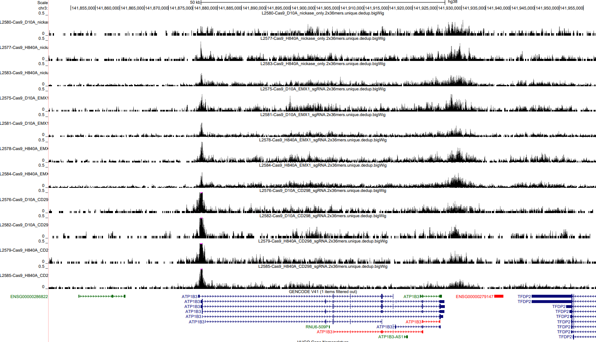
CD298 equal scale

Slide 5
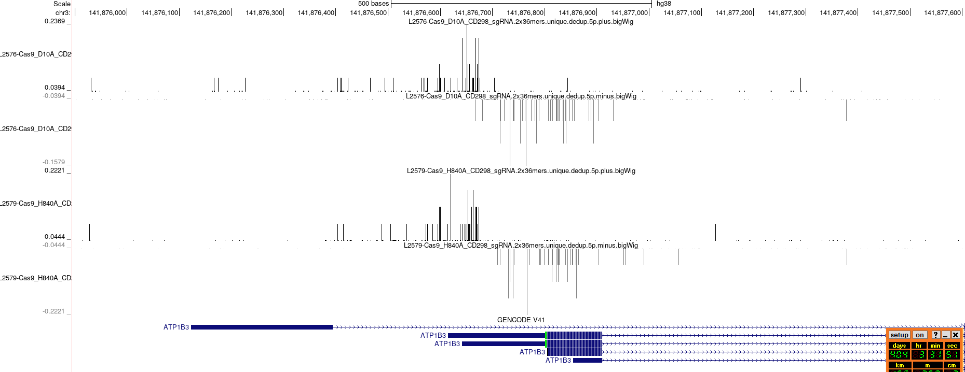
Side note on 5’ ends:
While we can see cut sites with the active Cas9, the nick is not visible in the dsDNA prep. It might be if we do ssKAS-seq

