Slide 1
Data and deep learning modeling summary:
Ran BPNet models on Oct4 and Sox2 ChIP-seq mouse ES datasets (GSE44286)
Ran both models on 5’ ends and on coverage; the latter seem to work a better in this case
Importance scoring using DeepLIFT
The top 4 tracks are the importance scores and the predicted ChIP-seq profiles for the two strands
The other tracks show the actual data
Also shown is the FIMO map of all CIS-BP motifs for mm10
All sites are shown as a constant 400bp window, but a 2kb region centered on those windows is to be used for PCR

Slide 2
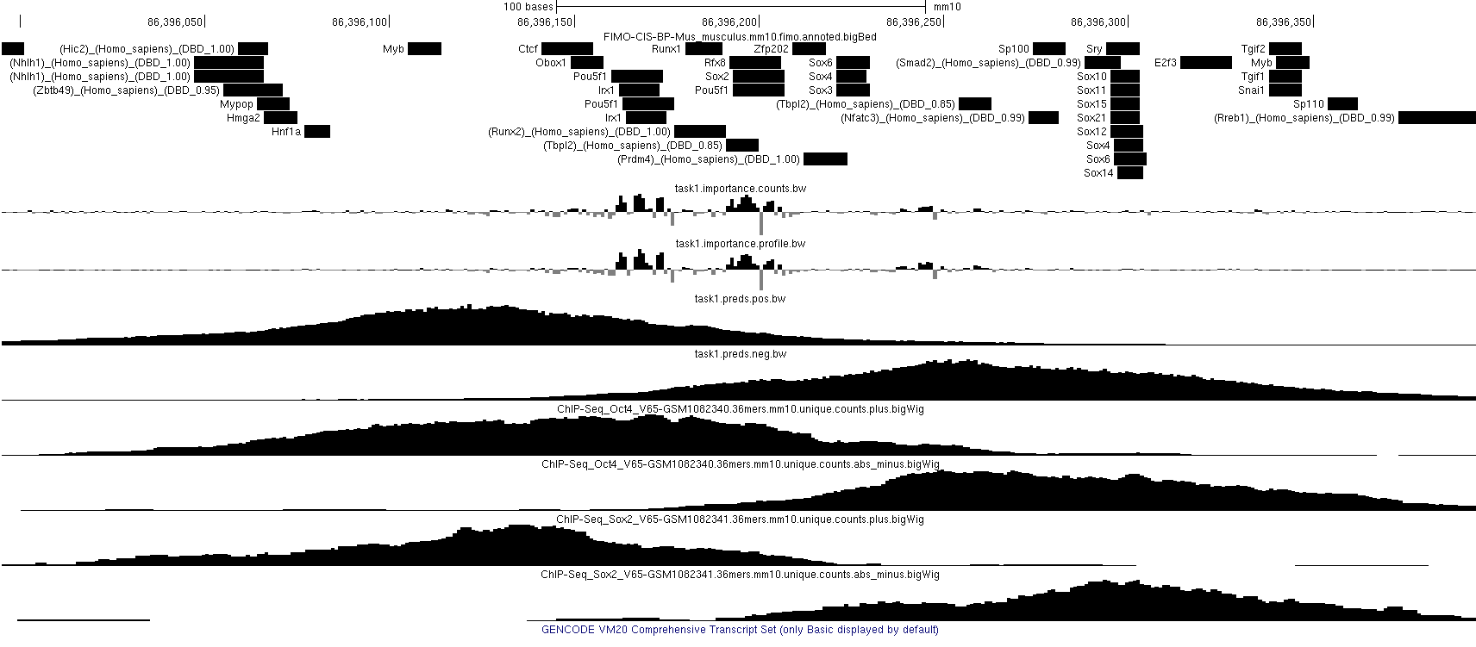

Slide 3
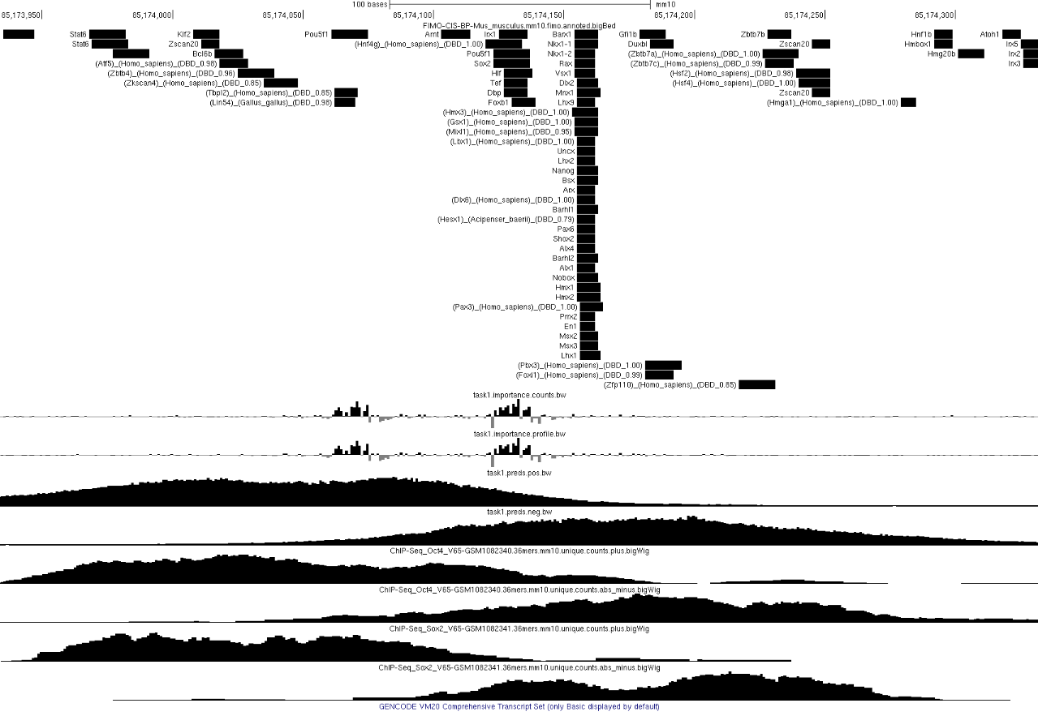

Slide 4
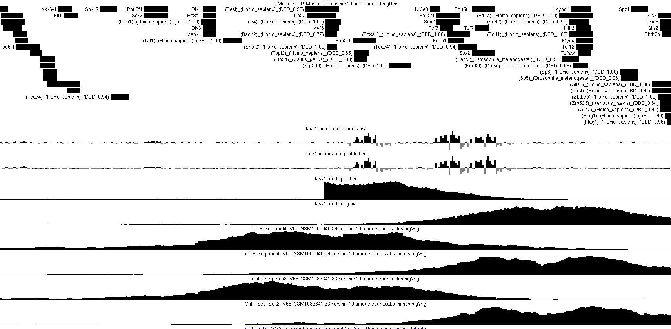

Slide 5
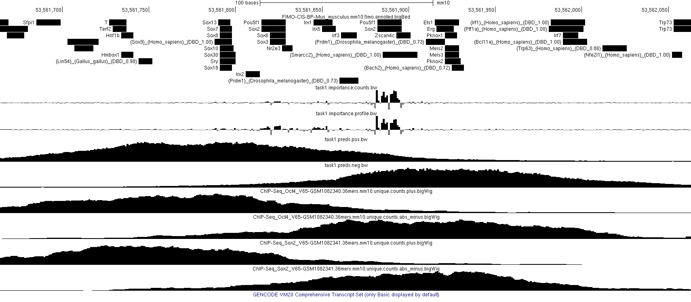

Slide 6
