Slide 1
Dataset stats

Slide 2
# | Exonic: | Intergenic: | Intronic:
2019-07-11-Fire-Cas9-CXCR4-0h | 0.92 | 0.02 | 0.06
2019-07-11-Fire-Cas9-CXCR4-48h | 0.90 | 0.03 | 0.07
2019-07-11-Fire-Cas9-CXCR5-0h | 0.93 | 0.02 | 0.05
2019-07-11-Fire-Cas9-CXCR5-48h | 0.91 | 0.03 | 0.06
2019-07-11-Fire-Cas9-FOXA1-0h | 0.93 | 0.02 | 0.05
2019-07-11-Fire-Cas9-FOXA1-48h | 0.93 | 0.02 | 0.05
2019-07-11-Fire-Cas9-GATA1-0h | 0.91 | 0.02 | 0.07
2019-07-11-Fire-Cas9-GATA1-48h | 0.93 | 0.02 | 0.05
2019-07-11-Fire-Cas9-GATA2-0h | 0.93 | 0.02 | 0.05
2019-07-11-Fire-Cas9-GATA2-48h | 0.93 | 0.02 | 0.05
2019-07-11-Fire-Cas9-GATA3-48h | 0.89 | 0.03 | 0.07
2019-07-11-Fire-Cas9-GATA4-0h | 0.91 | 0.02 | 0.06
2019-07-11-Fire-Cas9-GATA6-0h | 0.91 | 0.02 | 0.07
2019-07-11-Fire-Cas9-GATA6-48h | 0.93 | 0.02 | 0.05
2019-07-11-Fire-Cas9-MYOD-0h | 0.89 | 0.03 | 0.07
2019-07-11-Fire-Cas9-MYOD-48h | 0.92 | 0.02 | 0.05
2019-07-11-Fire-Cas9-SIX1-0h | 0.91 | 0.02 | 0.06
2019-07-11-Fire-Cas9-SIX1-48h | 0.91 | 0.03 | 0.07
2019-07-11-Fire-Cas9-SOX2-0h | 0.93 | 0.02 | 0.05
2019-07-11-Fire-Cas9-SOX2-48h | 0.92 | 0.02 | 0.05
2019-07-11-Fire-Cas9-no_guide-0h | 0.94 | 0.02 | 0.04
2019-07-11-Fire-Cas9-no_guide-48h | 0.90 | 0.03 | 0.06
2019-07-11-Fire-Cas9-scramble-0h | 0.92 | 0.02 | 0.06
2019-07-11-Fire-Cas9-scramble-48h | 0.90 | 0.03 | 0.07

Slide 3
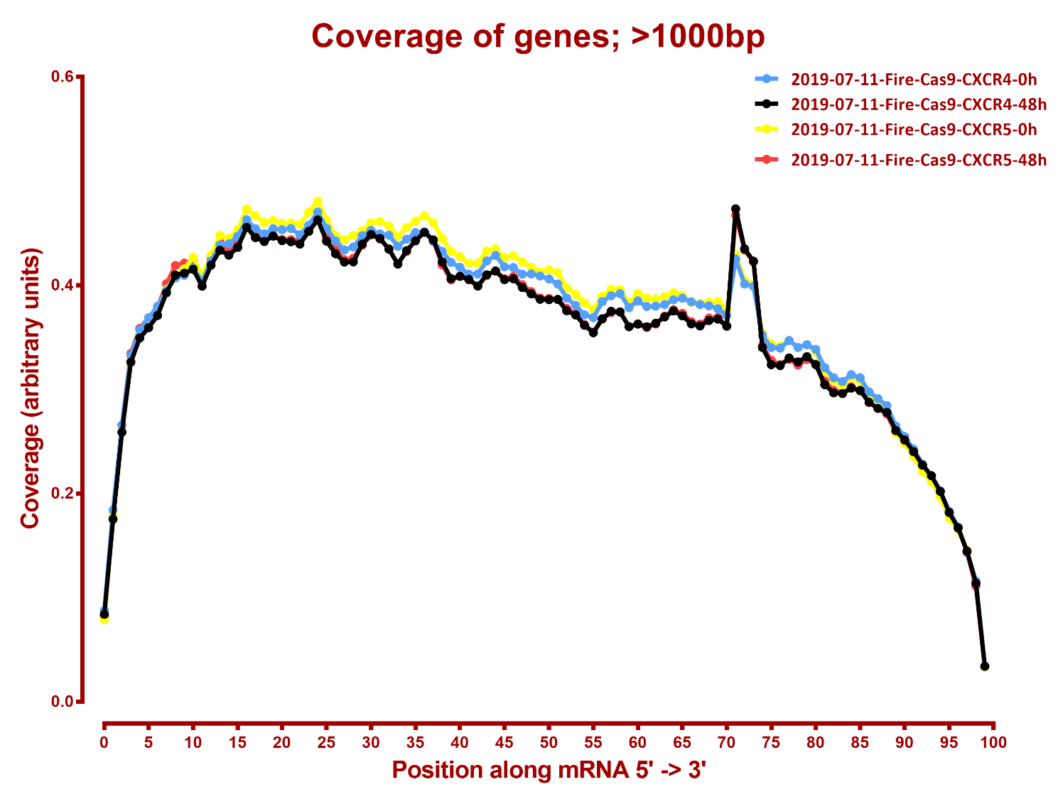

Slide 4
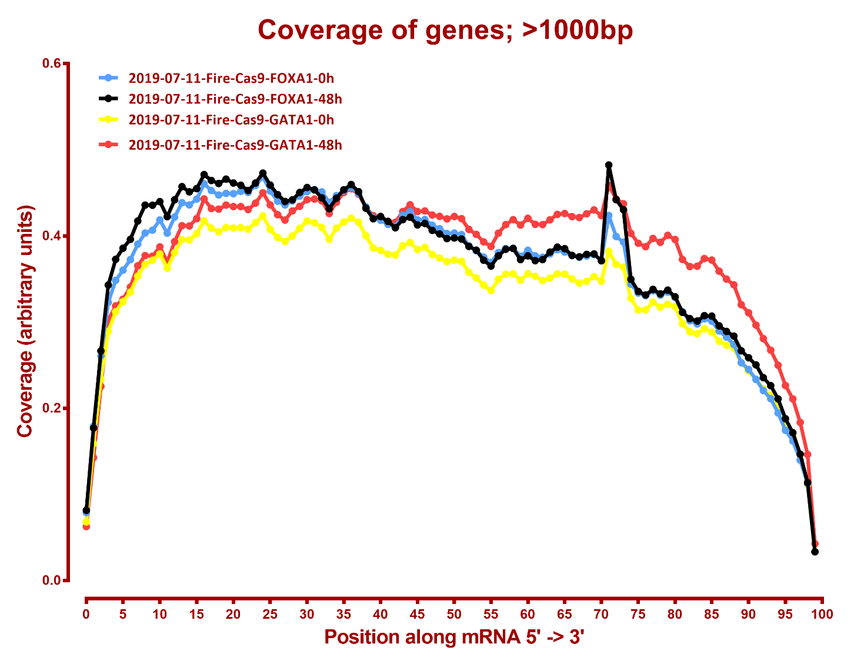

Slide 5
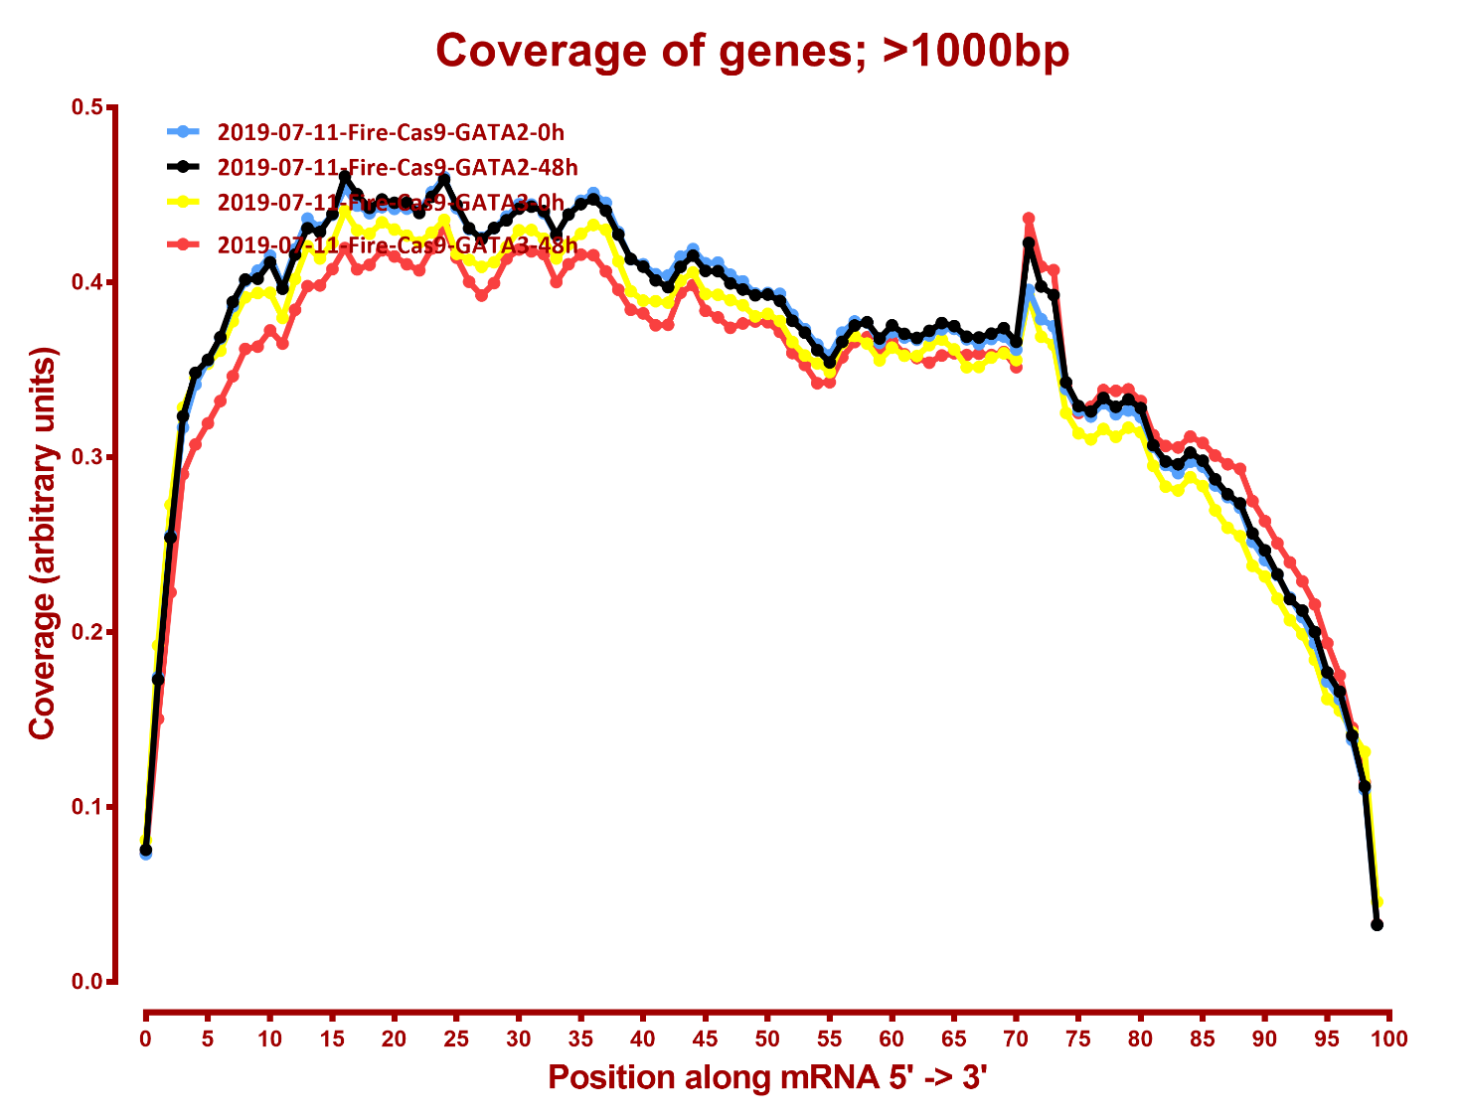

Slide 6
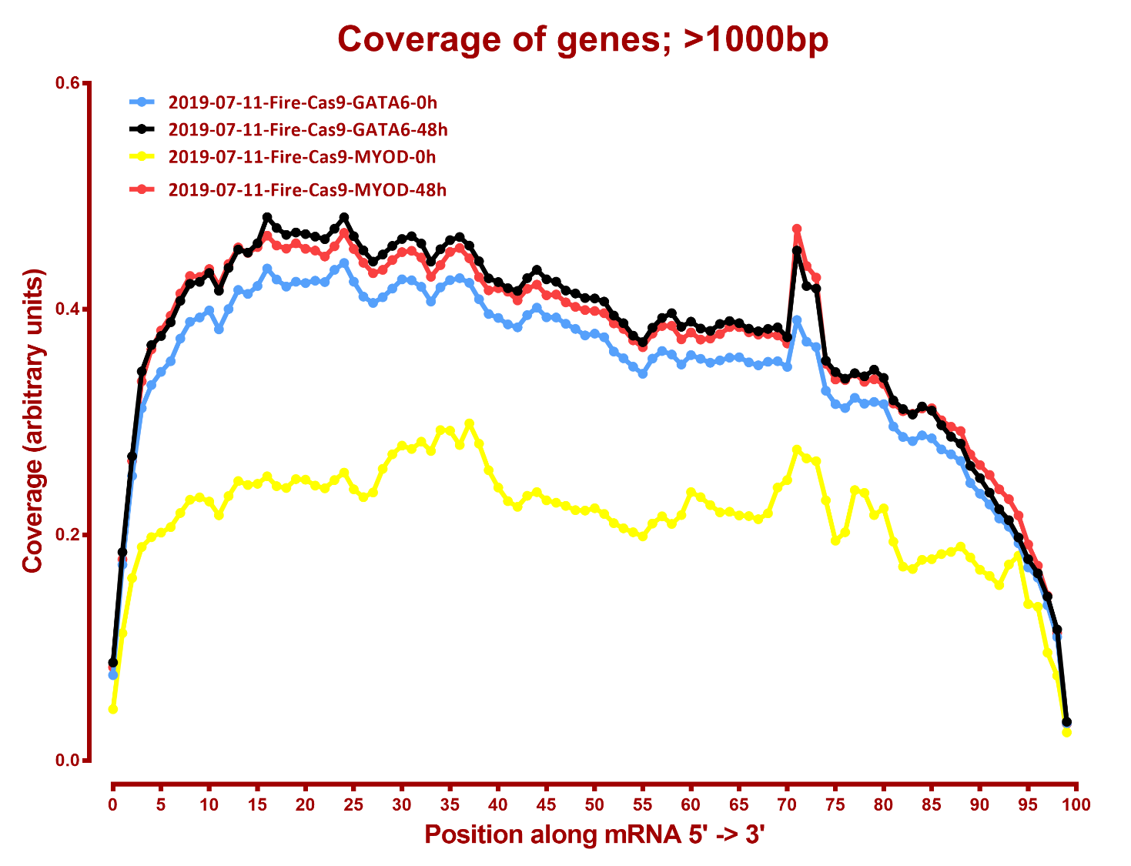

Slide 7
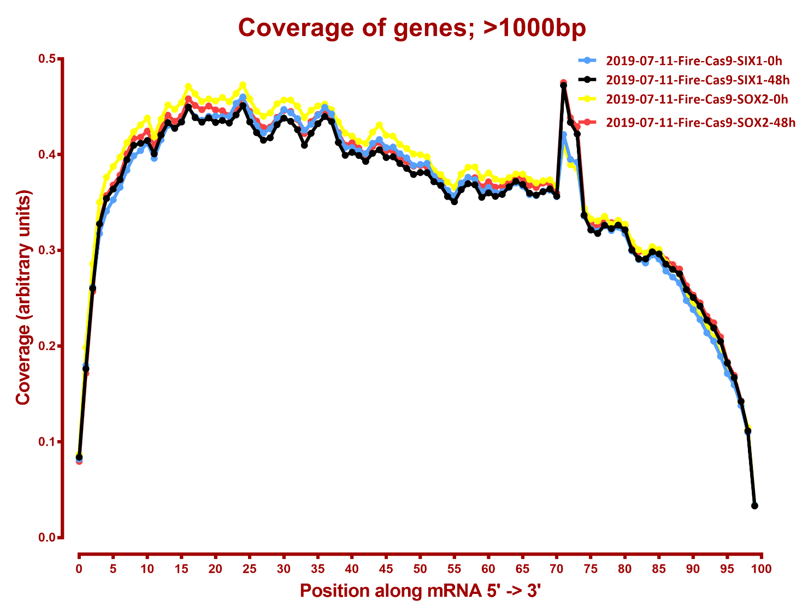

Slide 8
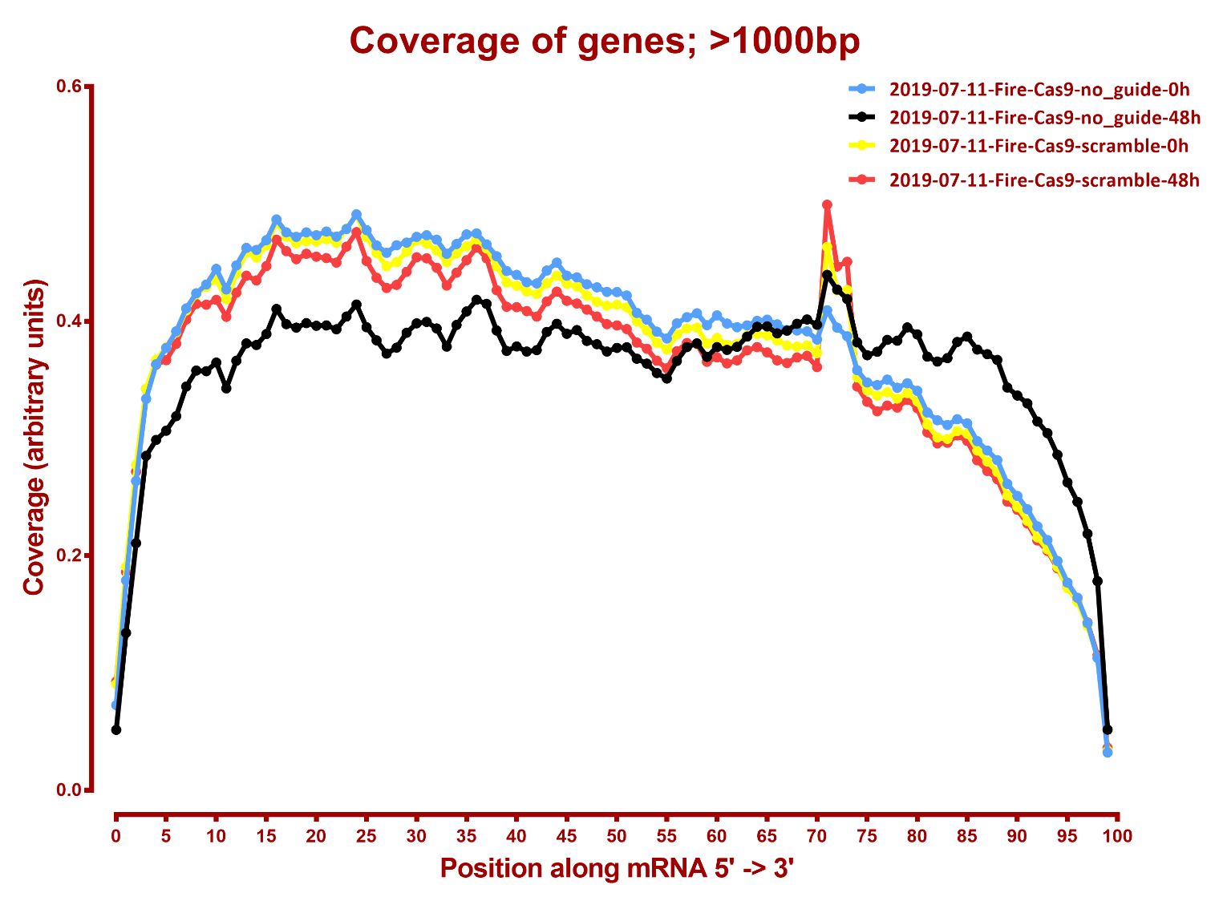

Slide 9
Induction:
# | CXCR4-0h | CXCR4-48h | CXCR5-0h | CXCR5-48h | FOXA1-0h | FOXA1-48h | GATA1-0h | GATA1-48h | GATA2-0h | GATA2-48h | GATA3-0h | GATA3-48h | GATA6-0h | GATA6-48h | MYOD-0h | MYOD-48h | SIX1-0h | SIX1-48h | SOX2-0h | SOX2-48h | no_guide-0h | no_guide-48h | scramble-0h | scramble-48h
MYOD1 | 0 | 1.57 | 0.2 | 0.83 | 0.75 | 0.32 | 0.43 | 0.17 | 0.74 | 0.99 | 0.72 | 0.72 | 0.72 | 0.9 | 0.25 | 55.7 | 1.73 | 0.73 | 0.22 | 0.48 | 0.55 | 1.23 | 0.55 | 0.24
CXCR5 | 0 | 0.42 | 0 | 11.2 | 0 | 0.11 | 0.12 | 0 | 0 | 0 | 0 | 0 | 0 | 0 | 0.12 | 0 | 0 | 0.09 | 0.28 | 0.09 | 0 | 0 | 0 | 0
CXCR4 | 5.68 | 234 | 5.4 | 3.36 | 3.32 | 2.61 | 4.52 | 0.85 | 4.94 | 4.15 | 5.41 | 2.53 | 4.97 | 3.03 | 3.77 | 2.18 | 4.49 | 3.01 | 4.69 | 3.44 | 3.21 | 1.98 | 4.78 | 5.34
FOXA1 | 6.04 | 6.79 | 5.67 | 8.49 | 5.41 | 5.66 | 7.24 | 5.03 | 8.47 | 7.84 | 7.79 | 5.81 | 8.15 | 6.72 | 5.52 | 4.44 | 7.45 | 8.13 | 9.12 | 19 | 7.65 | 5.17 | 6.59 | 4.39
GATA1 | 0 | 0 | 0 | 0 | 0 | 0 | 0 | 63.7 | 0 | 0 | 0 | 0 | 0.23 | 0.26 | 0 | 0 | 0.34 | 0.19 | 0.31 | 0.22 | 0.15 | 0 | 0.26 | 0
GATA2 | 23.8 | 28.7 | 23.5 | 25.4 | 23.6 | 21.3 | 17 | 25.2 | 23.6 | 33.1 | 22.5 | 24.9 | 24.4 | 26.8 | 14.9 | 28.8 | 23.5 | 43.5 | 22.7 | 22.6 | 17.3 | 14.9 | 21.3 | 21.7
GATA3 | 3.88 | 3.31 | 2.4 | 4.6 | 3.67 | 3.11 | 3.7 | 3.12 | 3.95 | 5.89 | 2.52 | 18.9 | 3.66 | 3.49 | 2.04 | 4.59 | 3.77 | 10.6 | 3.9 | 3.32 | 2.46 | 2.21 | 3.93 | 2.24
GATA6 | 8.23 | 11 | 14.1 | 12.7 | 13.4 | 11.7 | 13.3 | 11.6 | 16 | 17 | 14.3 | 13.9 | 15.9 | 41.3 | 12.8 | 9.29 | 15.6 | 20.8 | 16.3 | 11.9 | 12.3 | 10.1 | 13.6 | 5.88
SIX1 | 35.2 | 26.1 | 27.8 | 24.4 | 29.2 | 25.4 | 26.9 | 24.1 | 31.2 | 25.9 | 32.3 | 30.7 | 28.5 | 24.2 | 21.6 | 27.9 | 22.2 | 86.9 | 34.1 | 22.7 | 26 | 14.4 | 28.4 | 22.1
SOX2 | 3.62 | 4.73 | 3.52 | 4.57 | 5.93 | 64 | 7.1 | 3.09 | 6.45 | 4.18 | 6.86 | 5.89 | 5.99 | 4.58 | 5.25 | 2.63 | 7.19 | 4.19 | 7.33 | 3.49 | 5.66 | 2.09 | 6.47 | 2.73
Note: looks like there is a switch between SOX2 and FOXA1

Slide 10
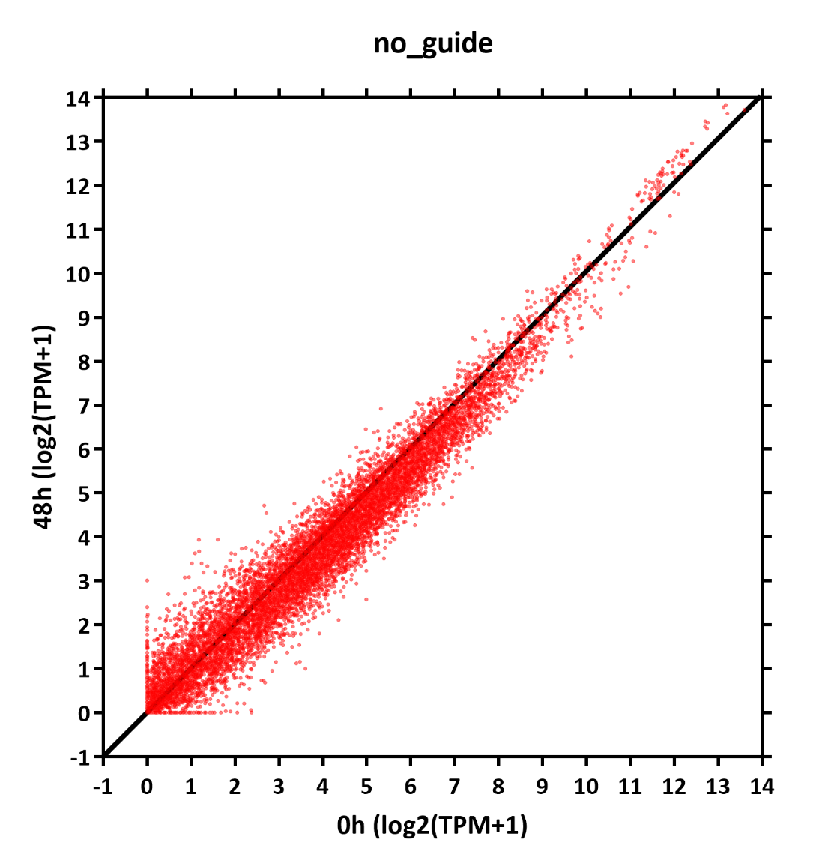

Slide 11
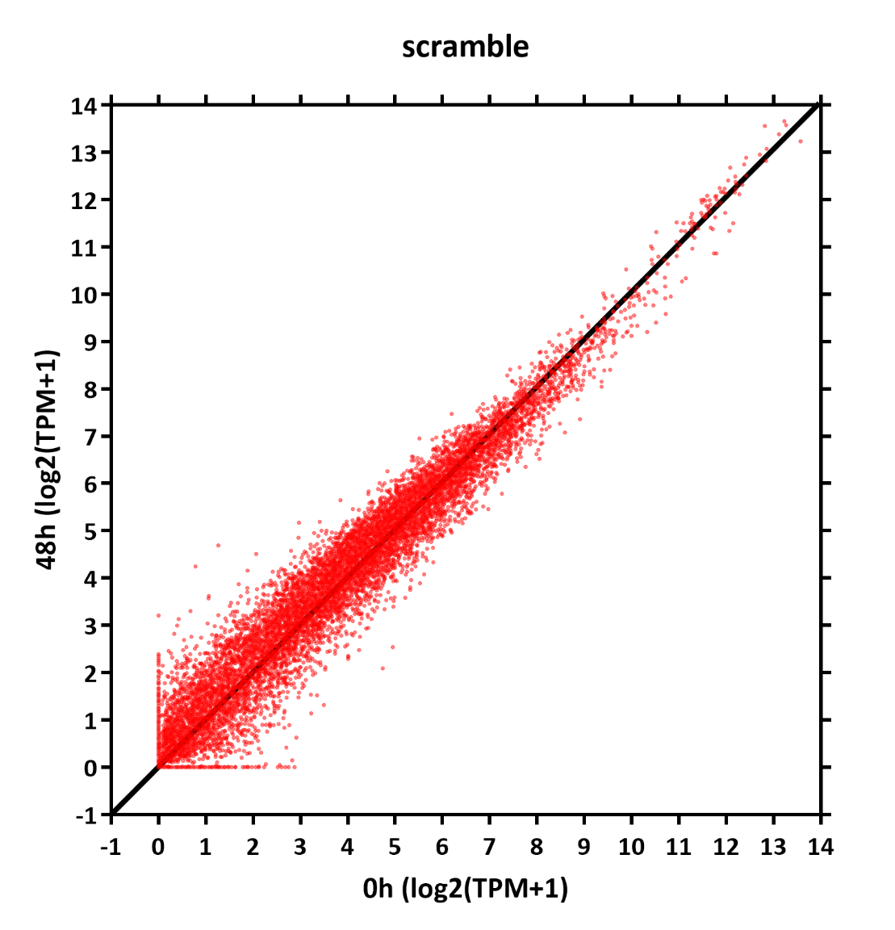

Slide 12
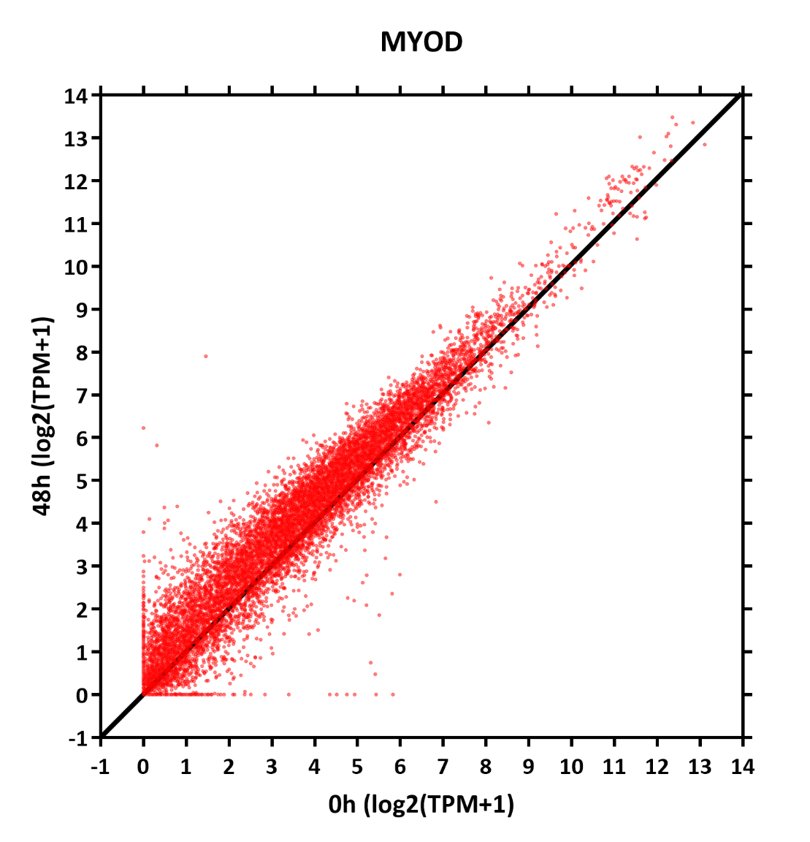

Slide 13
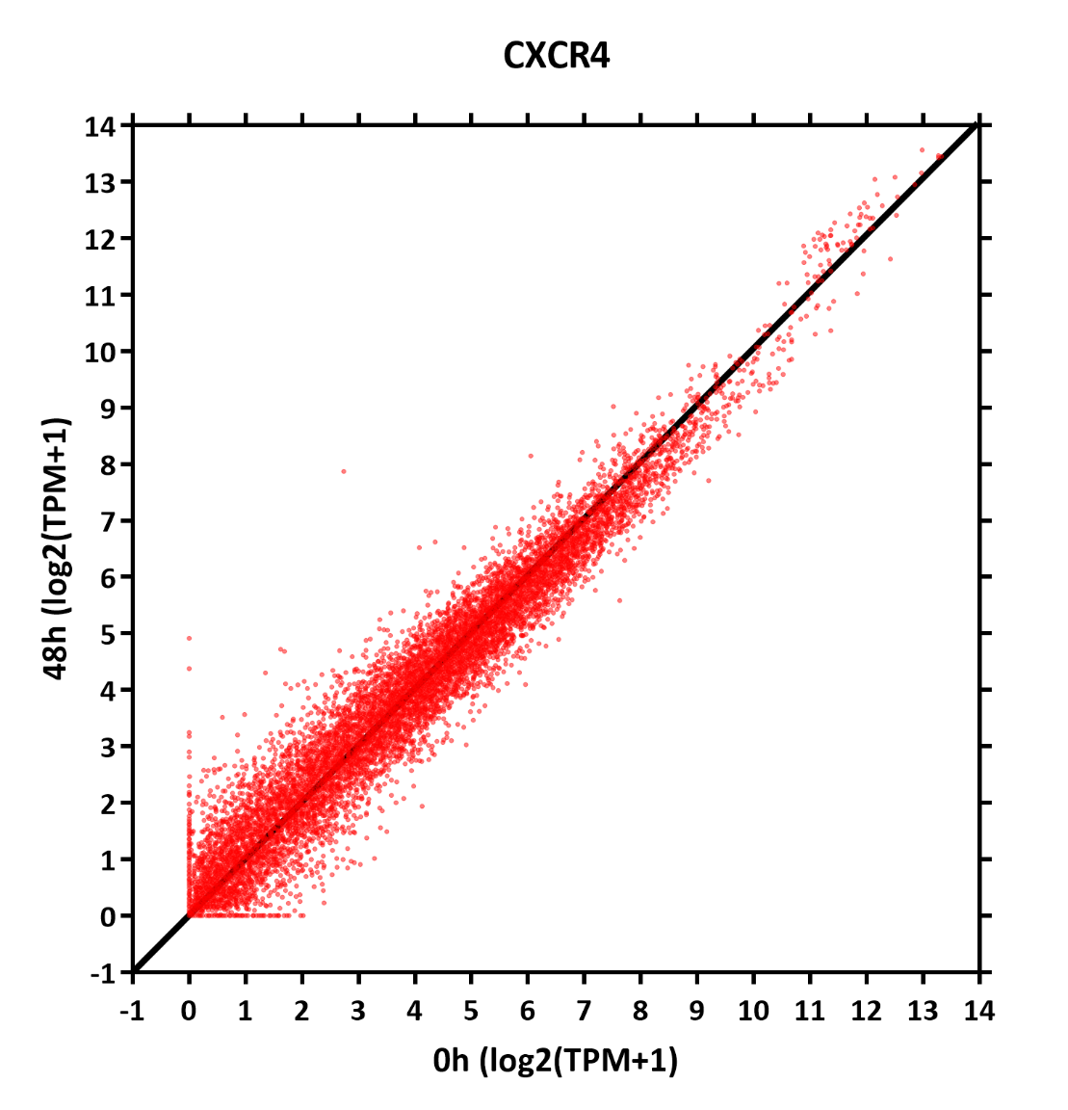

Slide 14


Slide 15


Slide 16
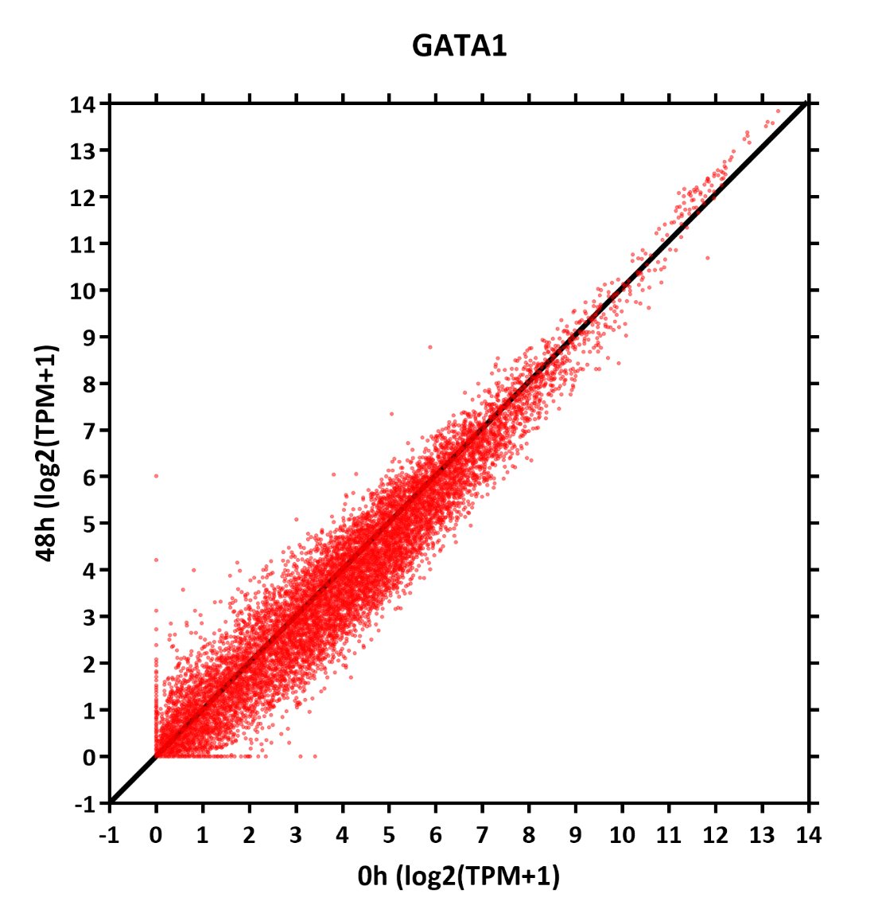

Slide 17


Slide 18


Slide 19


Slide 20
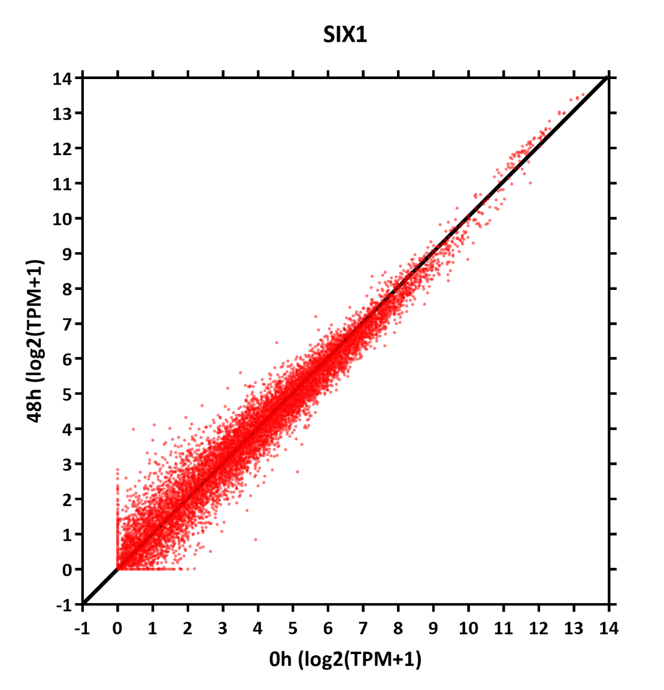

Slide 21


