Slide 1
Dataset stats

Slide 2
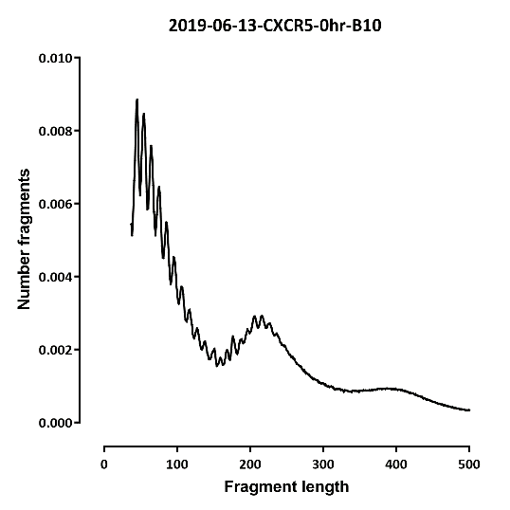
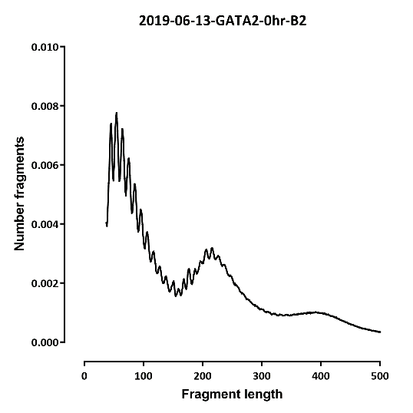
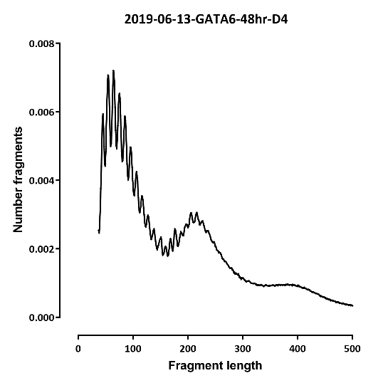
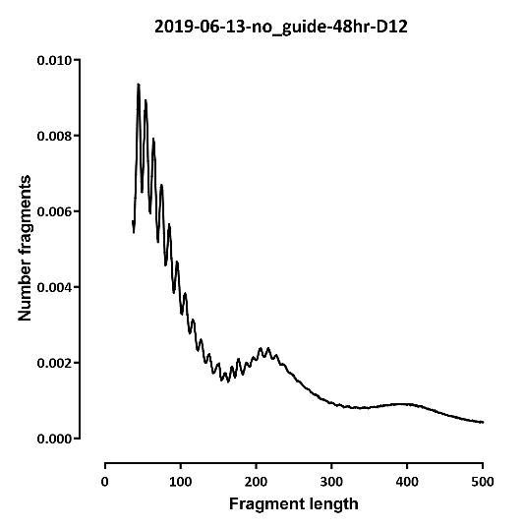
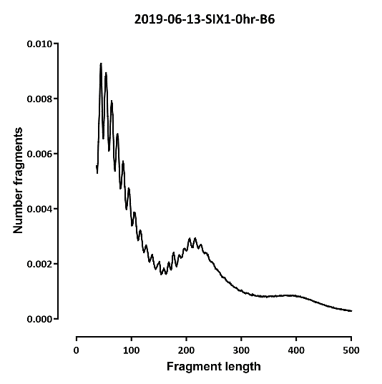
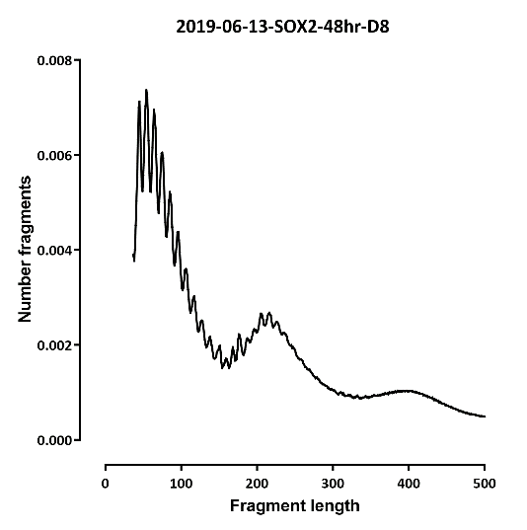
Fragment length

Slide 3
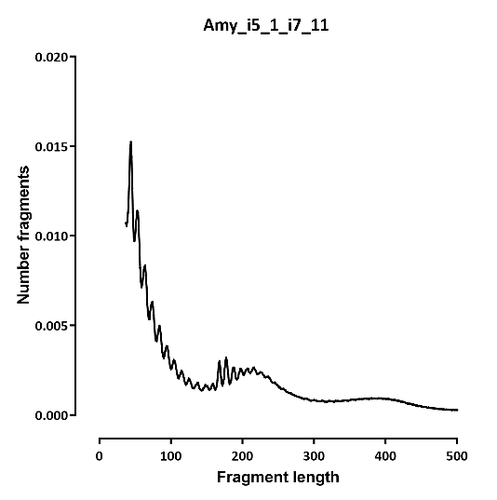

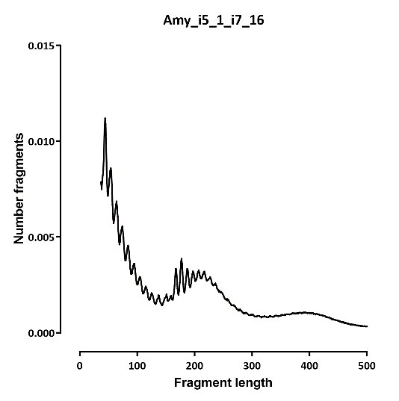
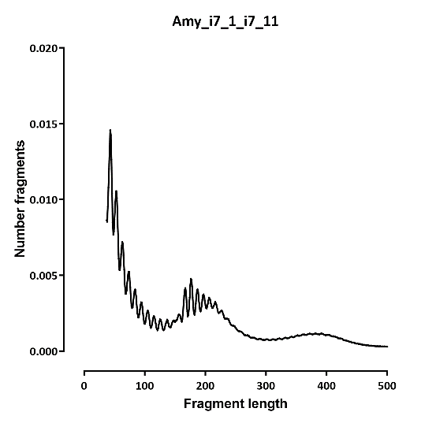
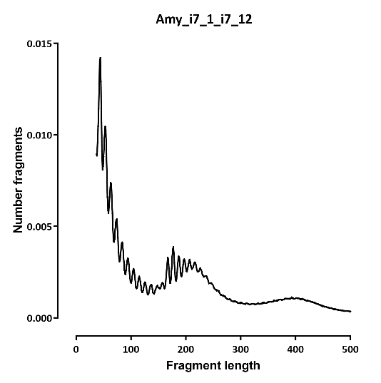
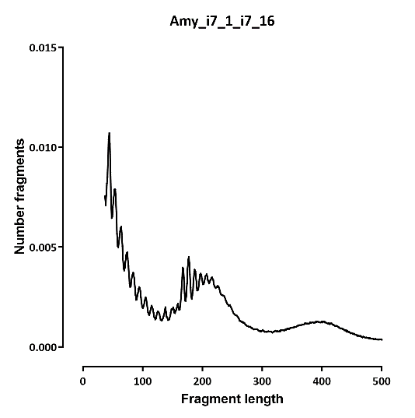
Fragment length

Slide 4
Differential peaks

Slide 5
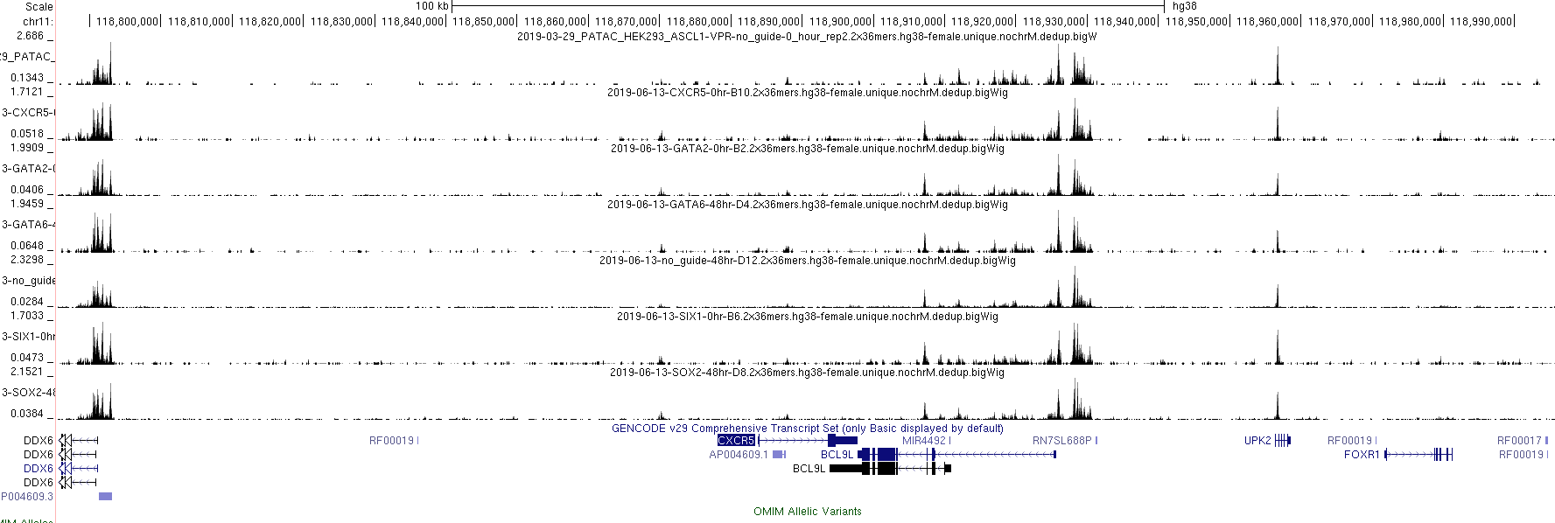

Slide 6
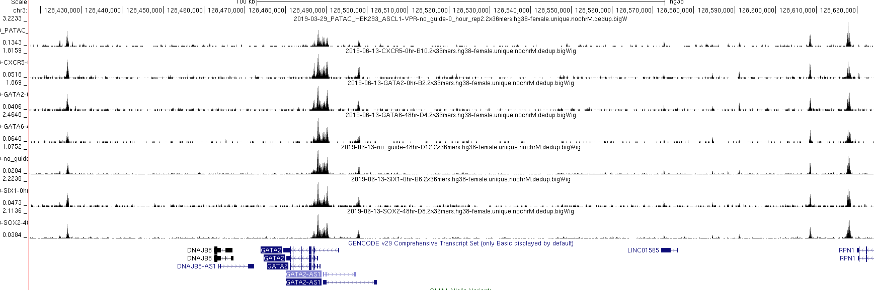

Slide 7
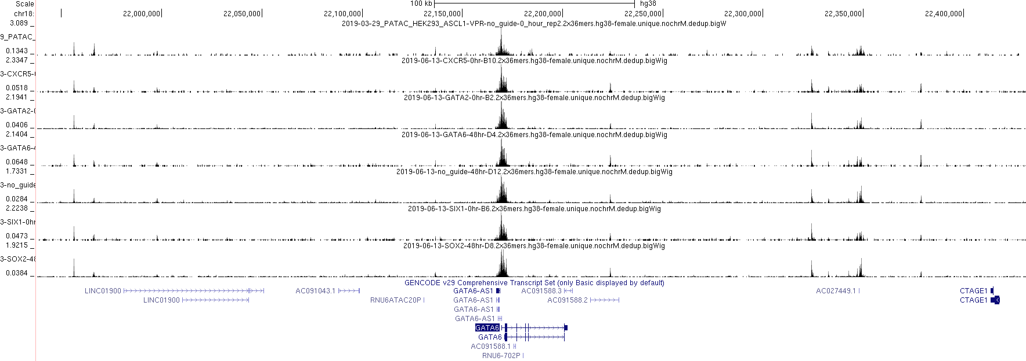

Slide 8
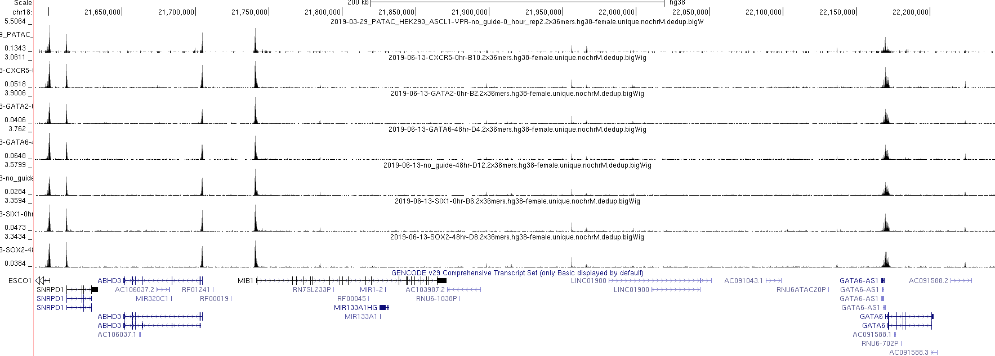

Slide 9
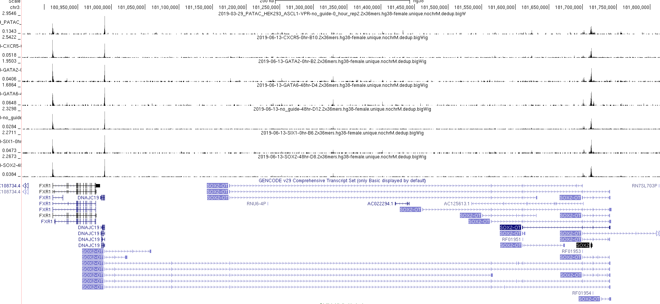

Slide 10
Well summary:
 | 1 | 2 | 3 | 4 | 5 | 6 | 7 | 8 | 9 | 10 | 11 | 12
A | 106,831,916 | 25,080 | 323 | 17 | 57,898,324 | 104,747 | 230 | 488 | 54,228,151 | 12,557 | 350 | 1,211
B | 3 | 34,724,334 | 13 | 0 | 1 | 30,531,116 | 18 | 0 | 2 | 27,940,628 | 18 | 0
C | 791 | 41 | 48,088,972 | 44 | 284 | 6 | 50,962,664 | 316 | 264 | 86 | 47,455,856 | 535
D | 0 | 0 | 34 | 22,766,672 | 0 | 0 | 35 | 41,367,261 | 12 | 0 | 27 | 53,853,202

