Slide 1
Dataset stats

Slide 2
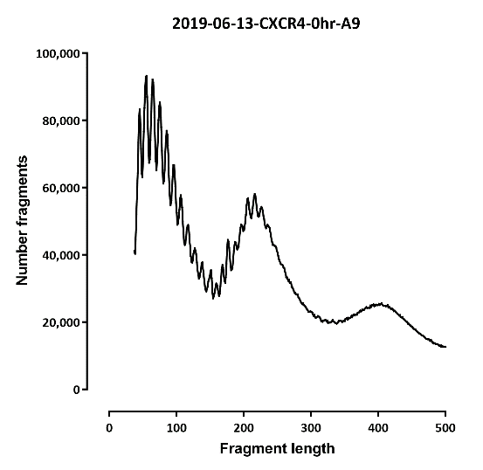
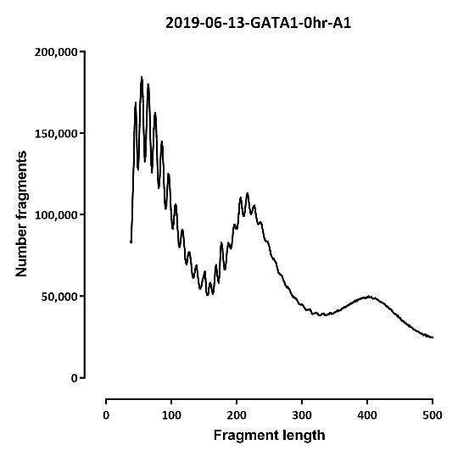
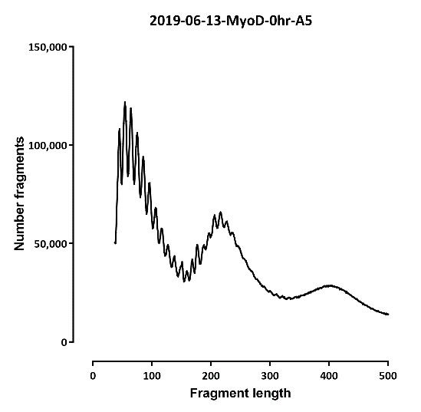
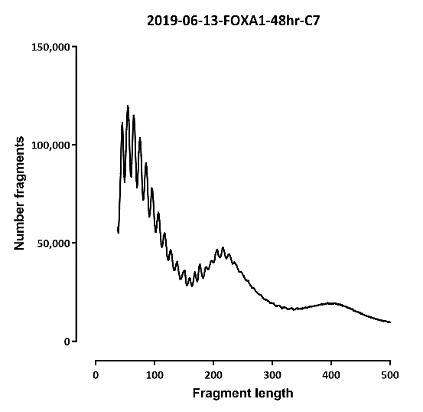
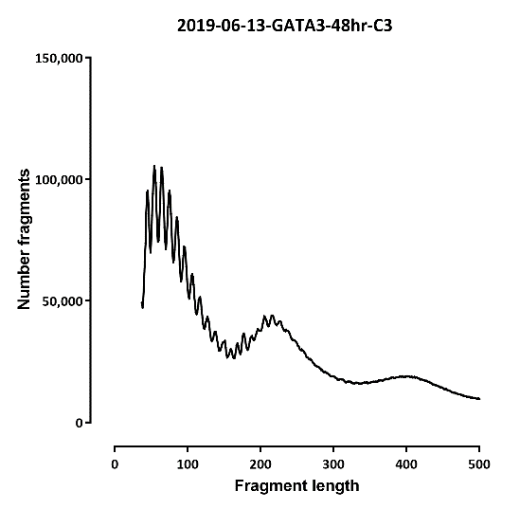
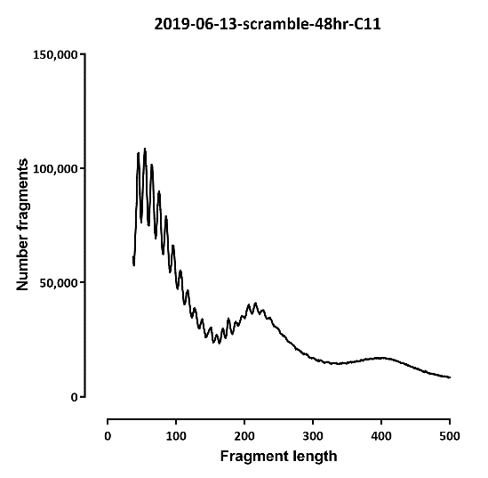
Fragment length

Slide 3
Differential peaks
Number differential ATAC peaks
A | B | p-adj
 |  | up in B vs A | down in B vs A
0hr | FOXA1-48hr | 12 | 16
0hr | GATA3-48hr | 7 | 11
0hr | scramble-48hr | 6 | 6

Slide 4
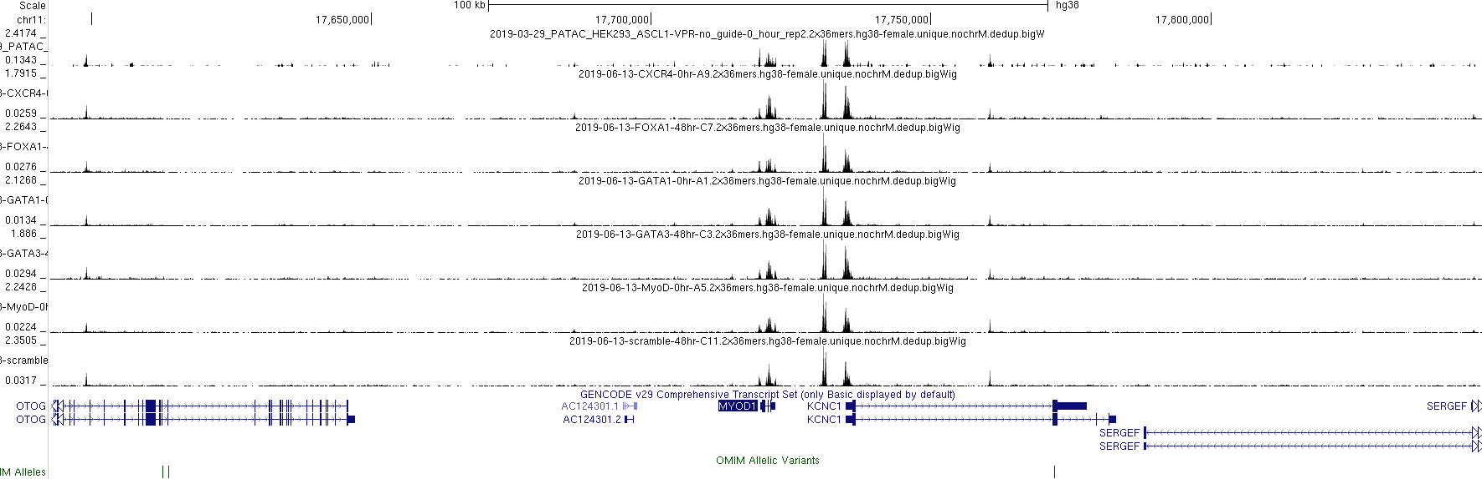

Slide 5
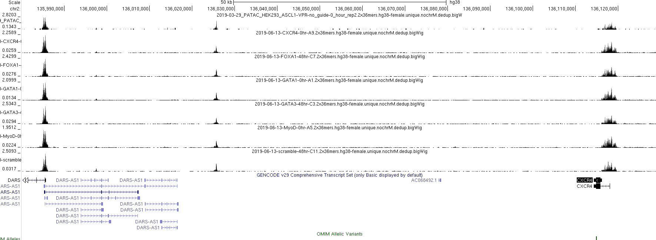

Slide 6
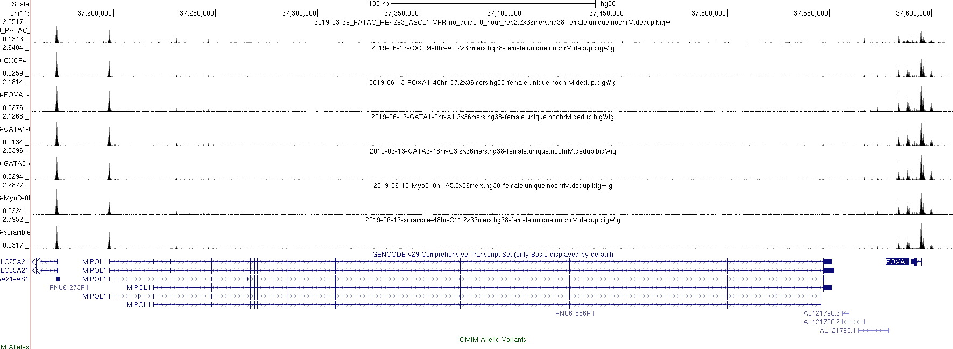

Slide 7
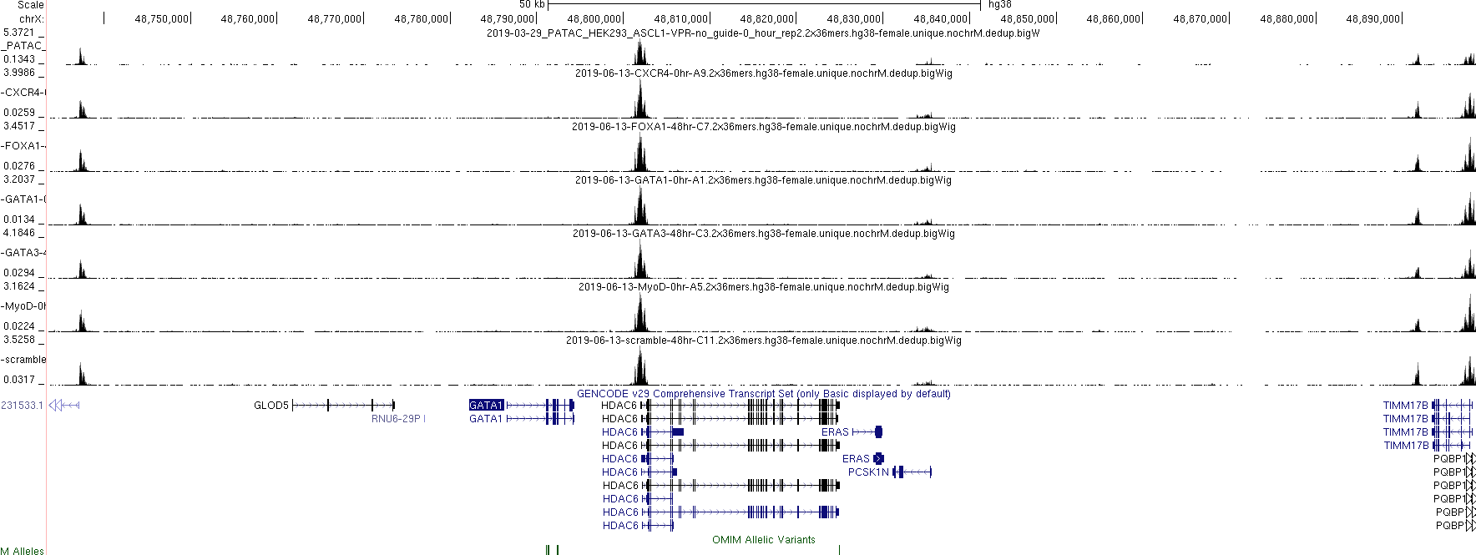

Slide 8
