Slide 1
Dataset stats
Note: these will need quite a bit deeper sequencing
 | Raw fragments | SSB01 mapping reads | SSB01 mapping fraction
L550-embryos_CC7_SSB01_rep1 | 6,628,608 | 60,154 | 0.907%
L551-embryos_CC7_SSB01_rep2 | 2,546,337 | 27,572 | 1.083%
L552-embryos_CC7_Apo_rep1 | 2,206,132 | 2,882 | 0.131%
L553-embryos_CC7_Apo_rep2 | 3,200,828 | 4,372 | 0.137%
L558-embryos_CC7_SSB01_rep3 | 6,291,806 | 3,120 | 0.050%
L559-embryos_CC7_Apo_rep3 | 1,279,673 | 1,934 | 0.151%

Slide 2
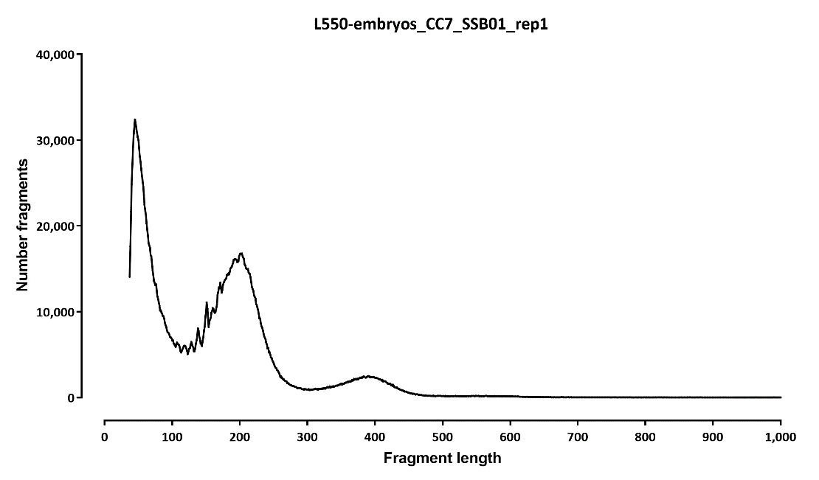
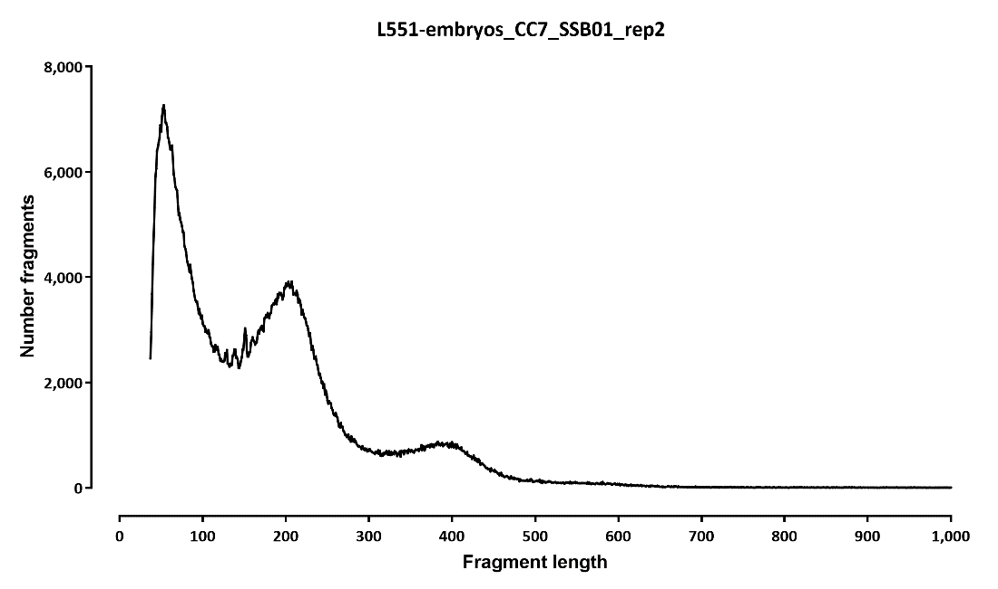

Slide 3
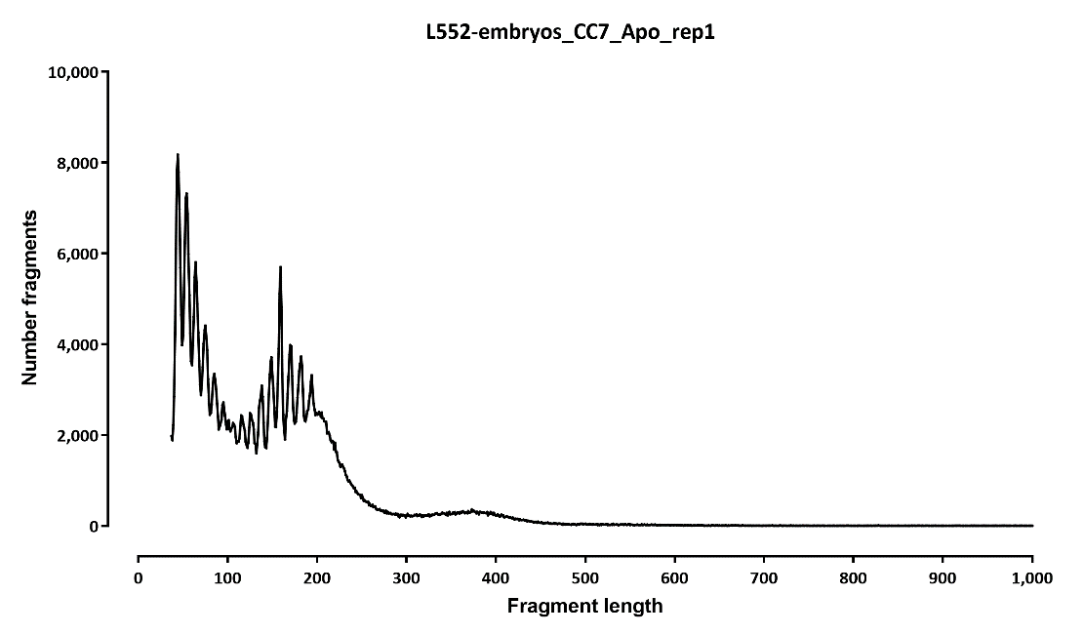
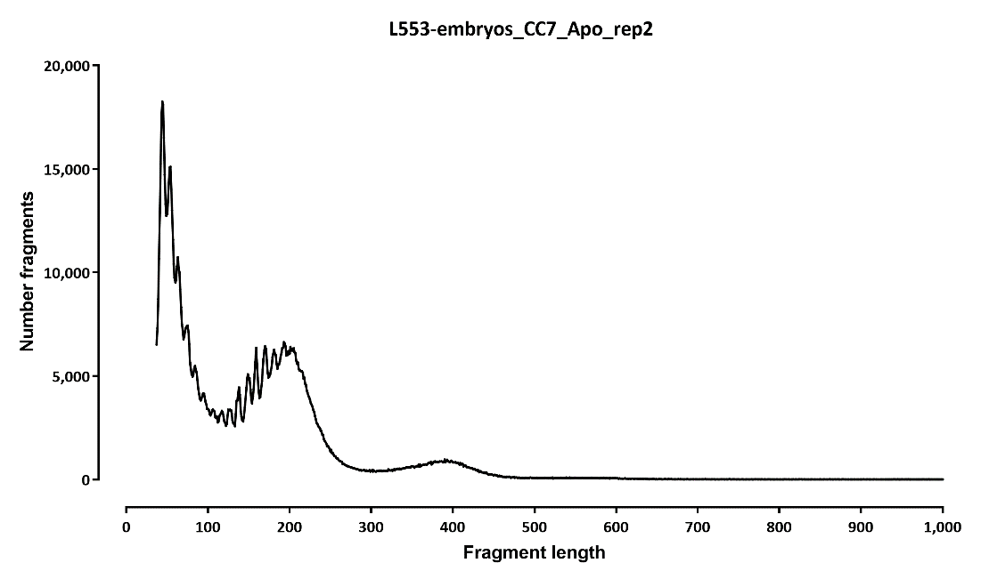

Slide 4
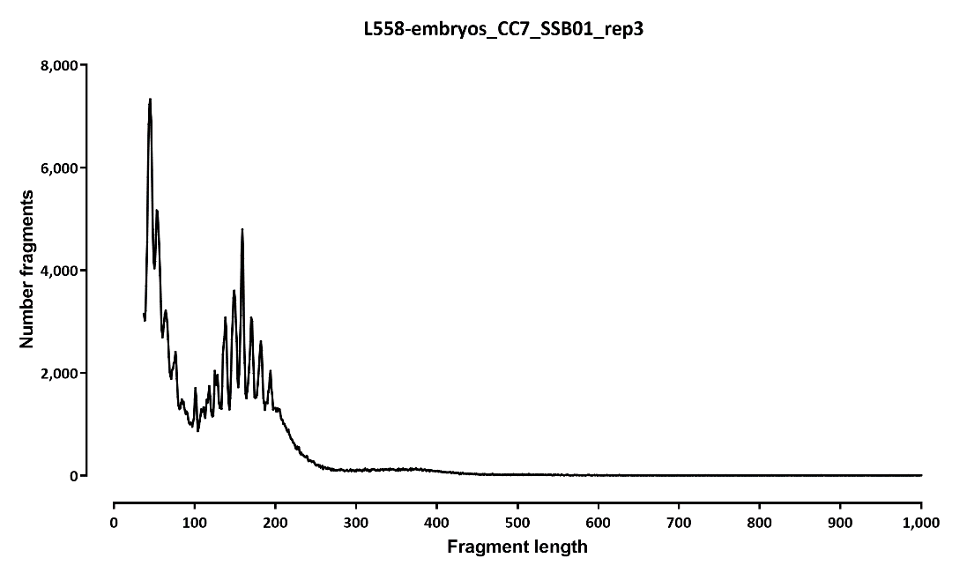
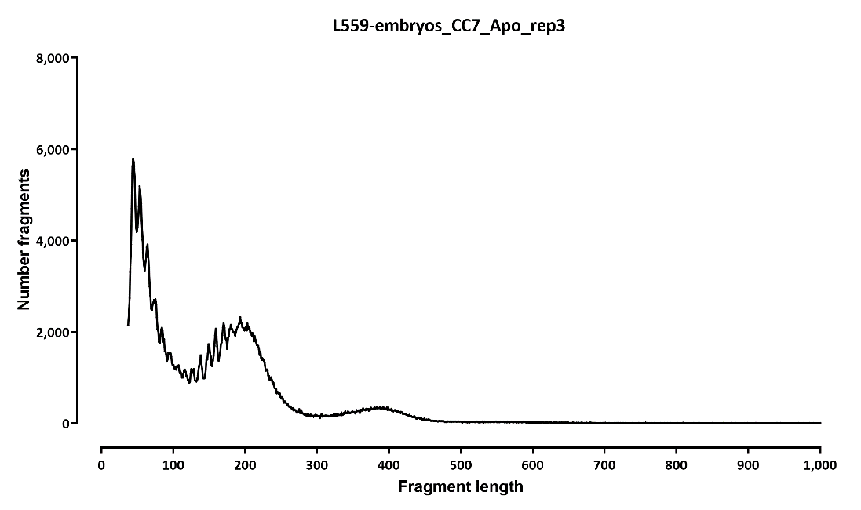

Slide 5
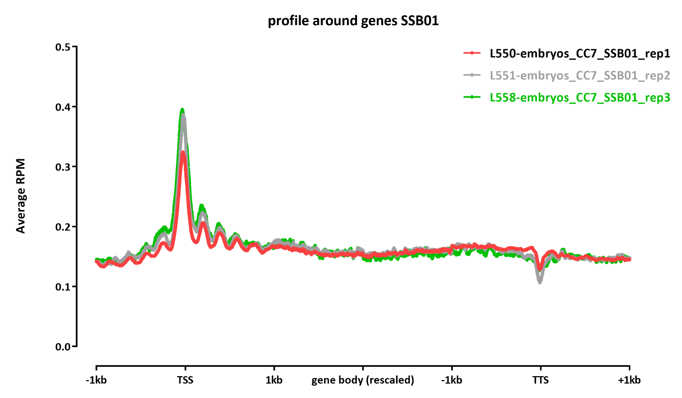

Slide 6
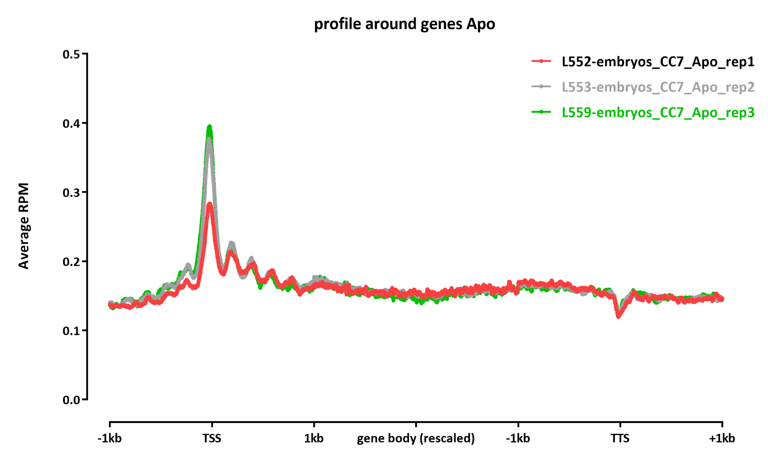

Slide 7
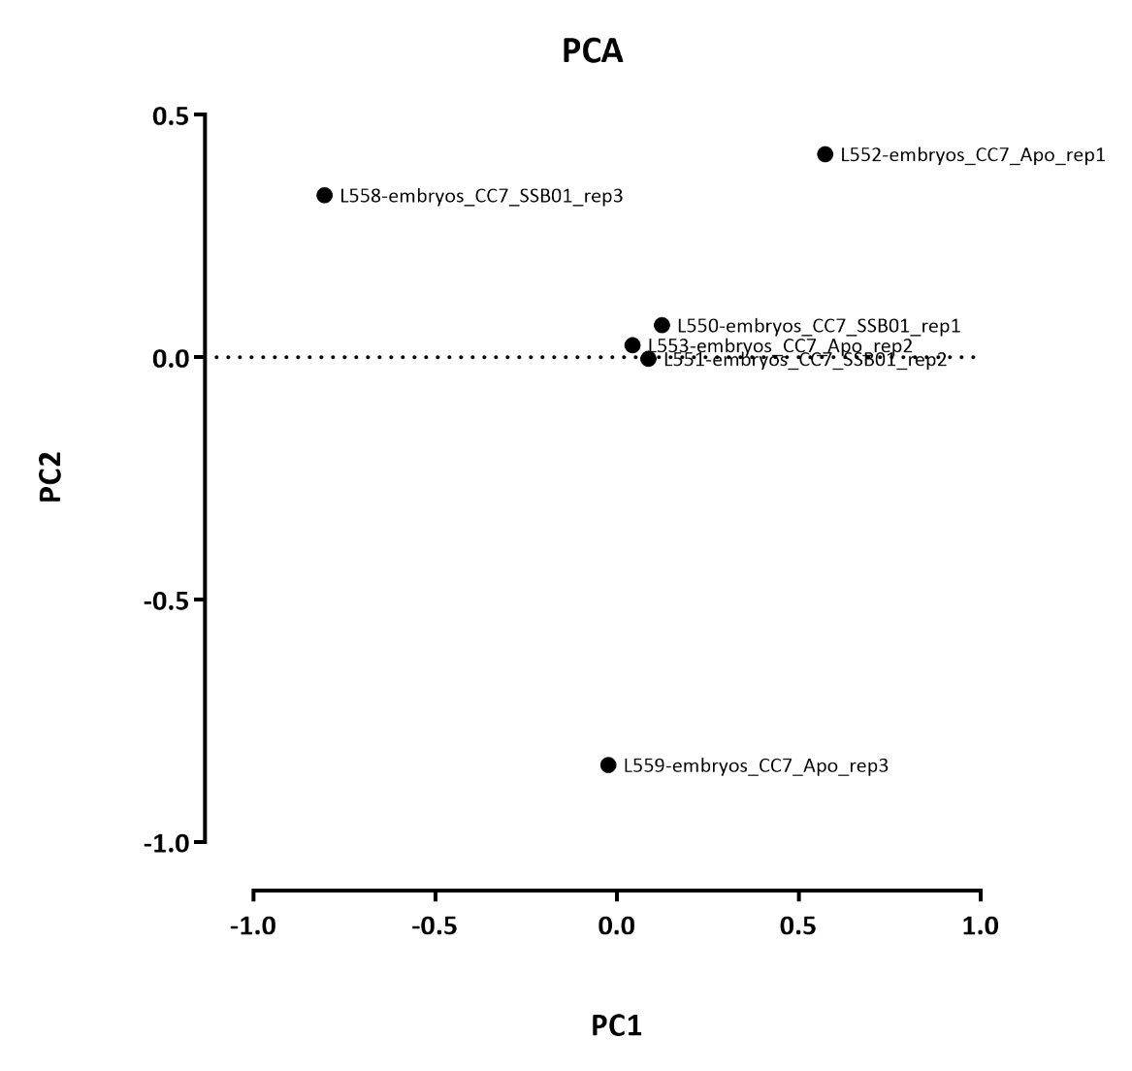

Slide 8
 | Number differential ATAC peaks
 | A | B | p-adj |  | p-adj
 |  |  | up in B vs A | down in B vs A | up in B vs A | down in B vs A
all reps | Apo | SSB01 | 0 | 0 | 98 | 136
first 4 reps | Apo | SSB01 | 0 | 0 | 42 | 69

Slide 9
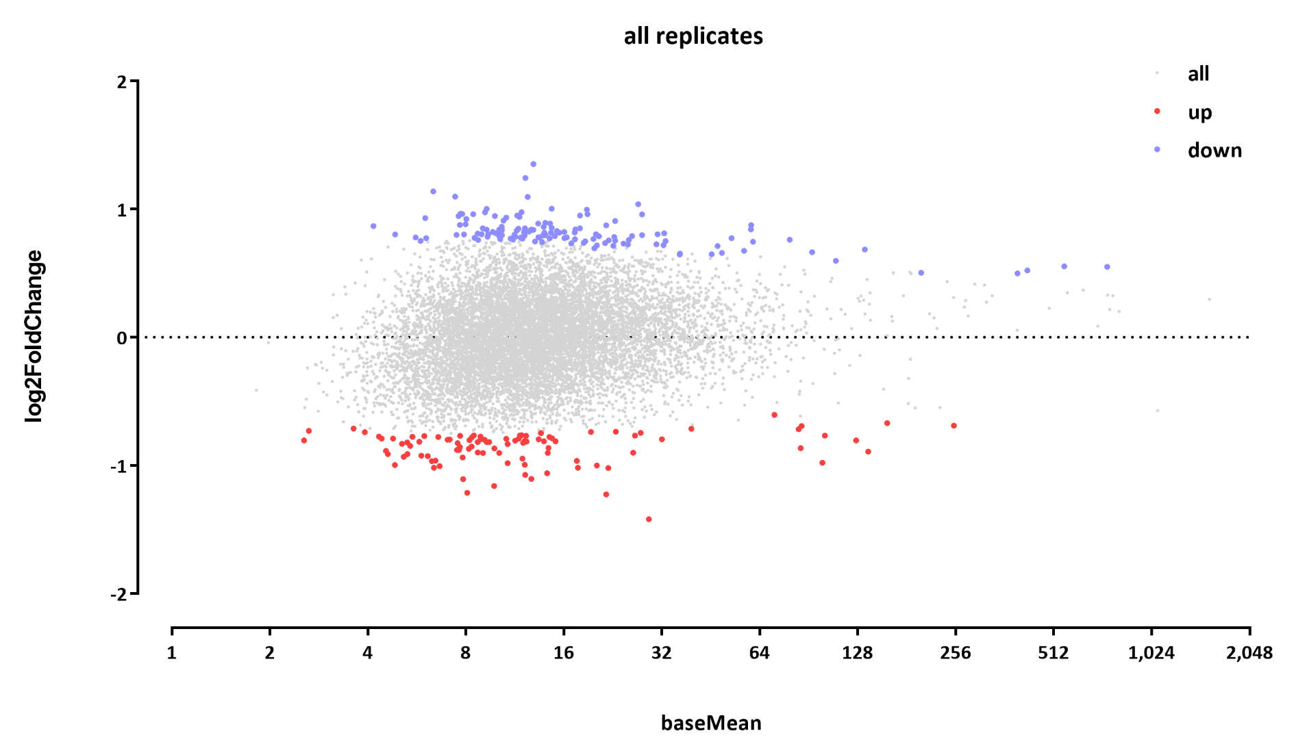
Using all replicates

Slide 10
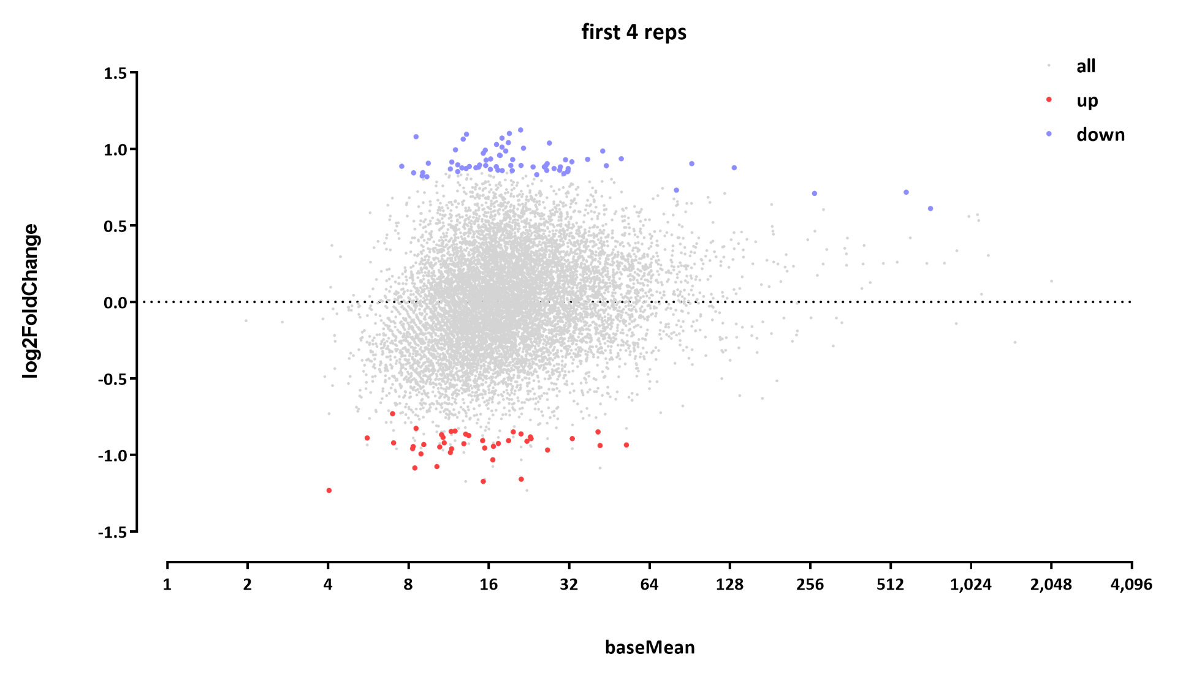
Using just the first set of two reps per condition:

