Slide 1
Characterizing non-coding regulatory elements using CRISPRi screens
21-06-21

Slide 2
Tools you will find handy
Bedtools
Samtools
Bowtie2

Slide 3
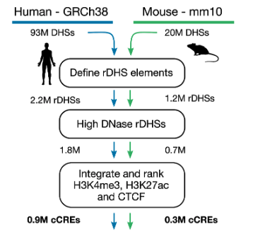
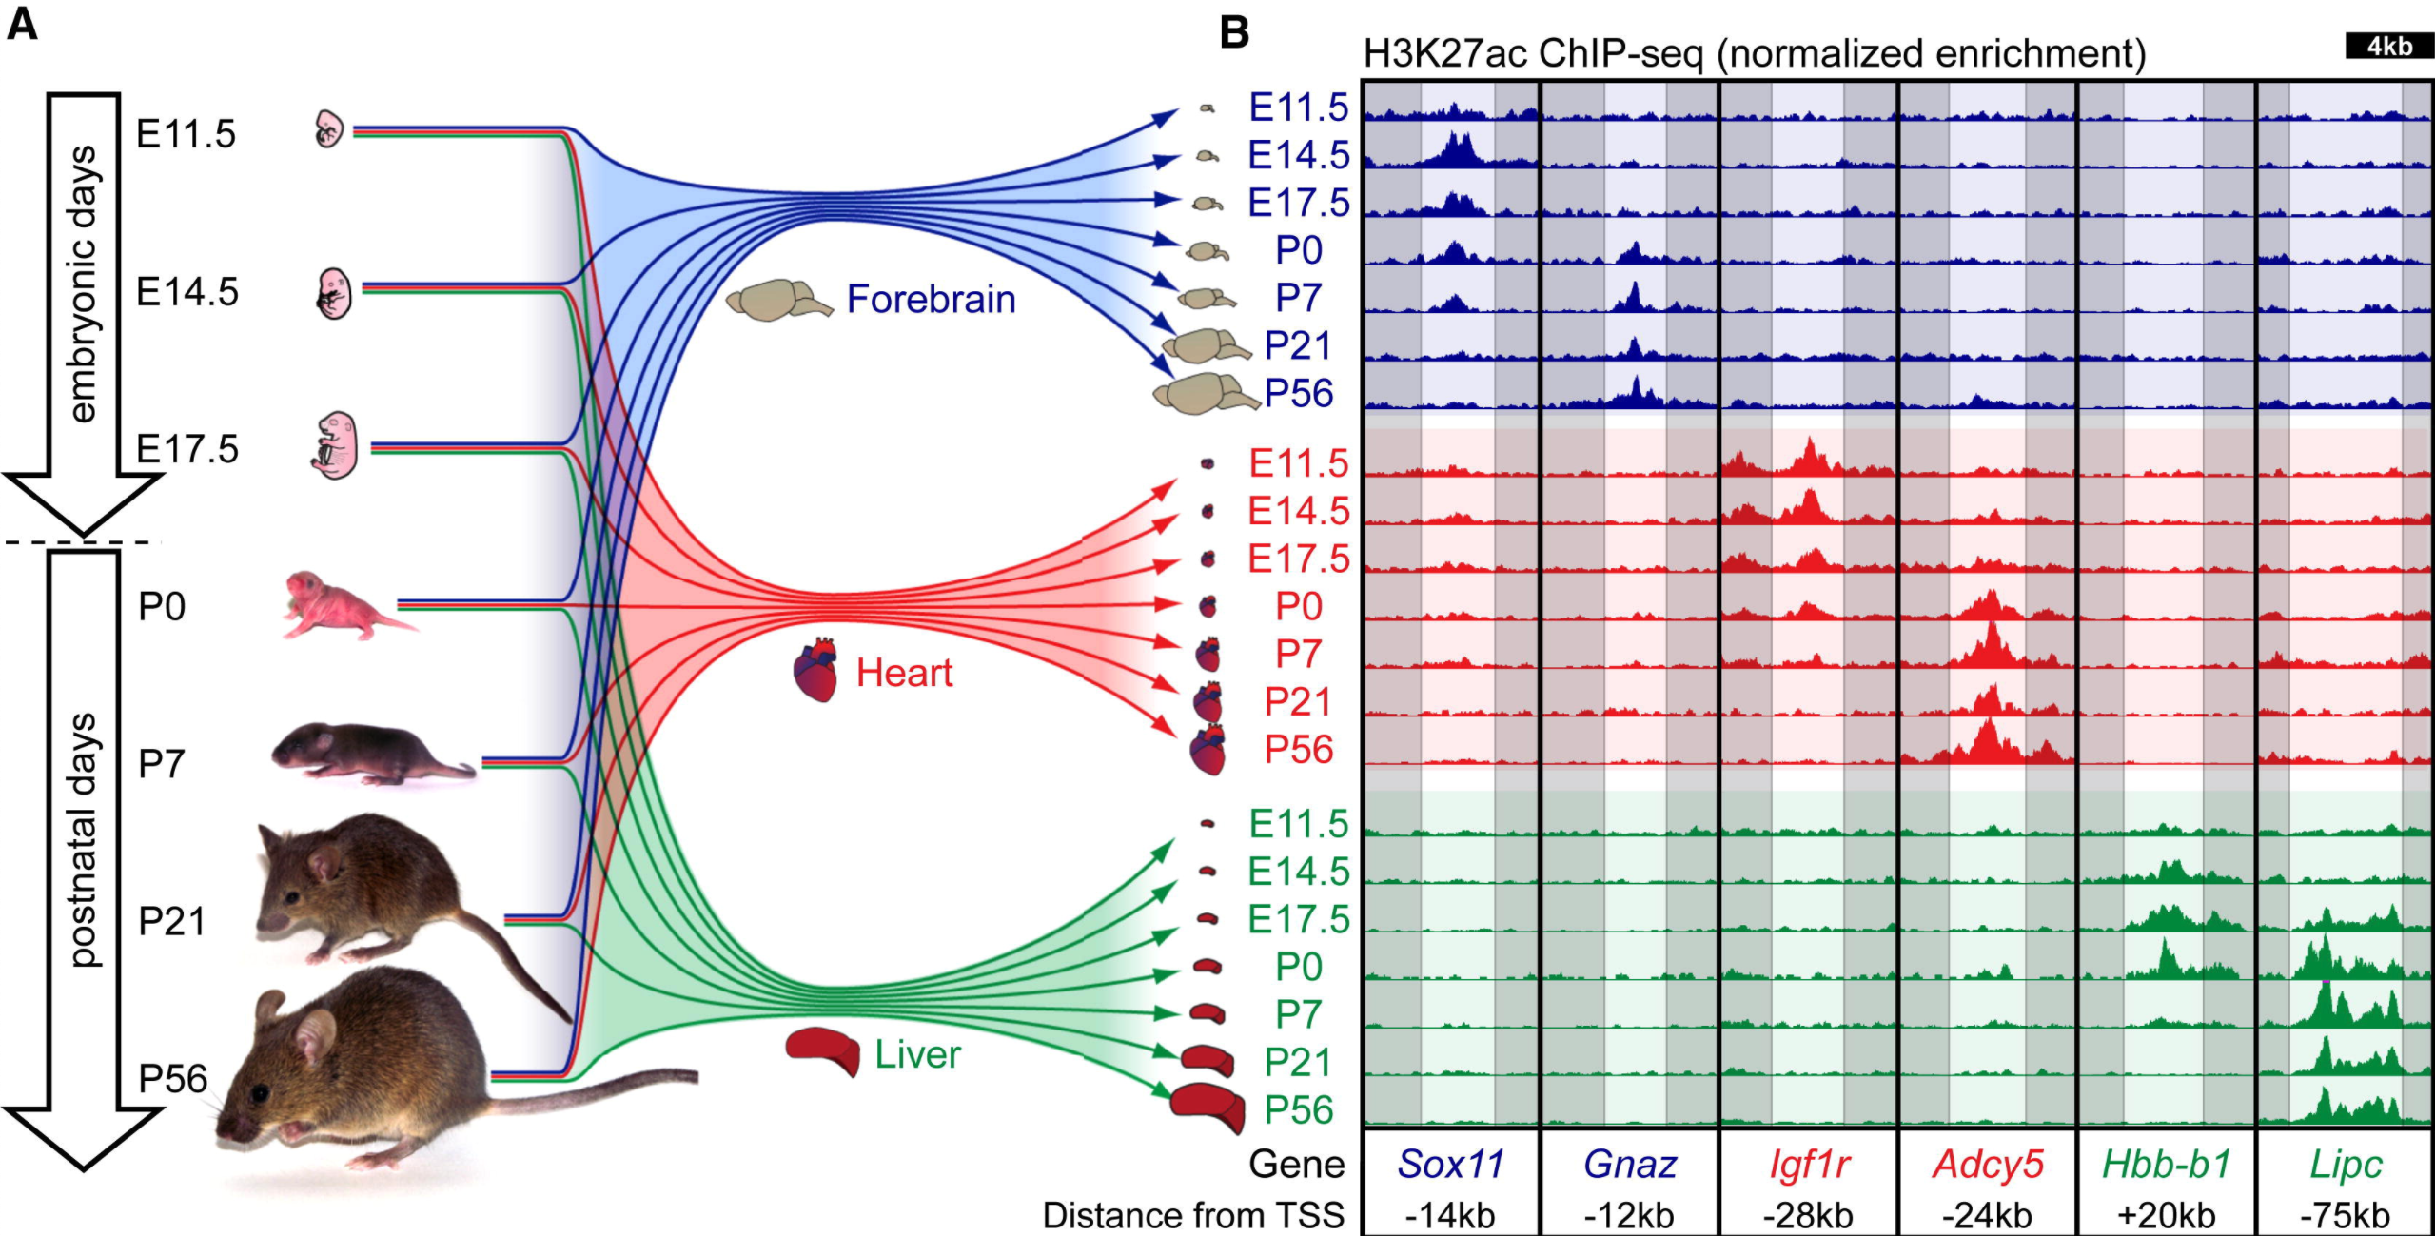
There are millions of (candidate cis-regulatory elements) cCREs catalogued in humans, but most lack functional characterization
What’s needed:
Large datasets of characterized cCREs to improve predictive models and our understanding of gene regulation!
Target?
Strength?
https://screen.encodeproject.org/
Nord…Visel, Cell 2013
Notes:
The majority of the human genome is non-protein coding, and contains the potential for regulatory activity. Understanding which of these non-coding regions have regulatory function is difficult, since so much of their function is spatiotemporally controlled, as illustrated by this diagram, where we see various enhancers – one type of regulatory element that’s often associated with the epigenetic mark H3K27ac – turning on at different levels across developmental time and tissues. Not only that, but enhancers can act on their target genes from a distance, making even the link between an enhancer and its target gene a very difficult challenge. However, its important that we tackle this question, as regulatory elements are crucial for most developmental and cellular processes and are also a prominent site for trait-altering variants.

Slide 4
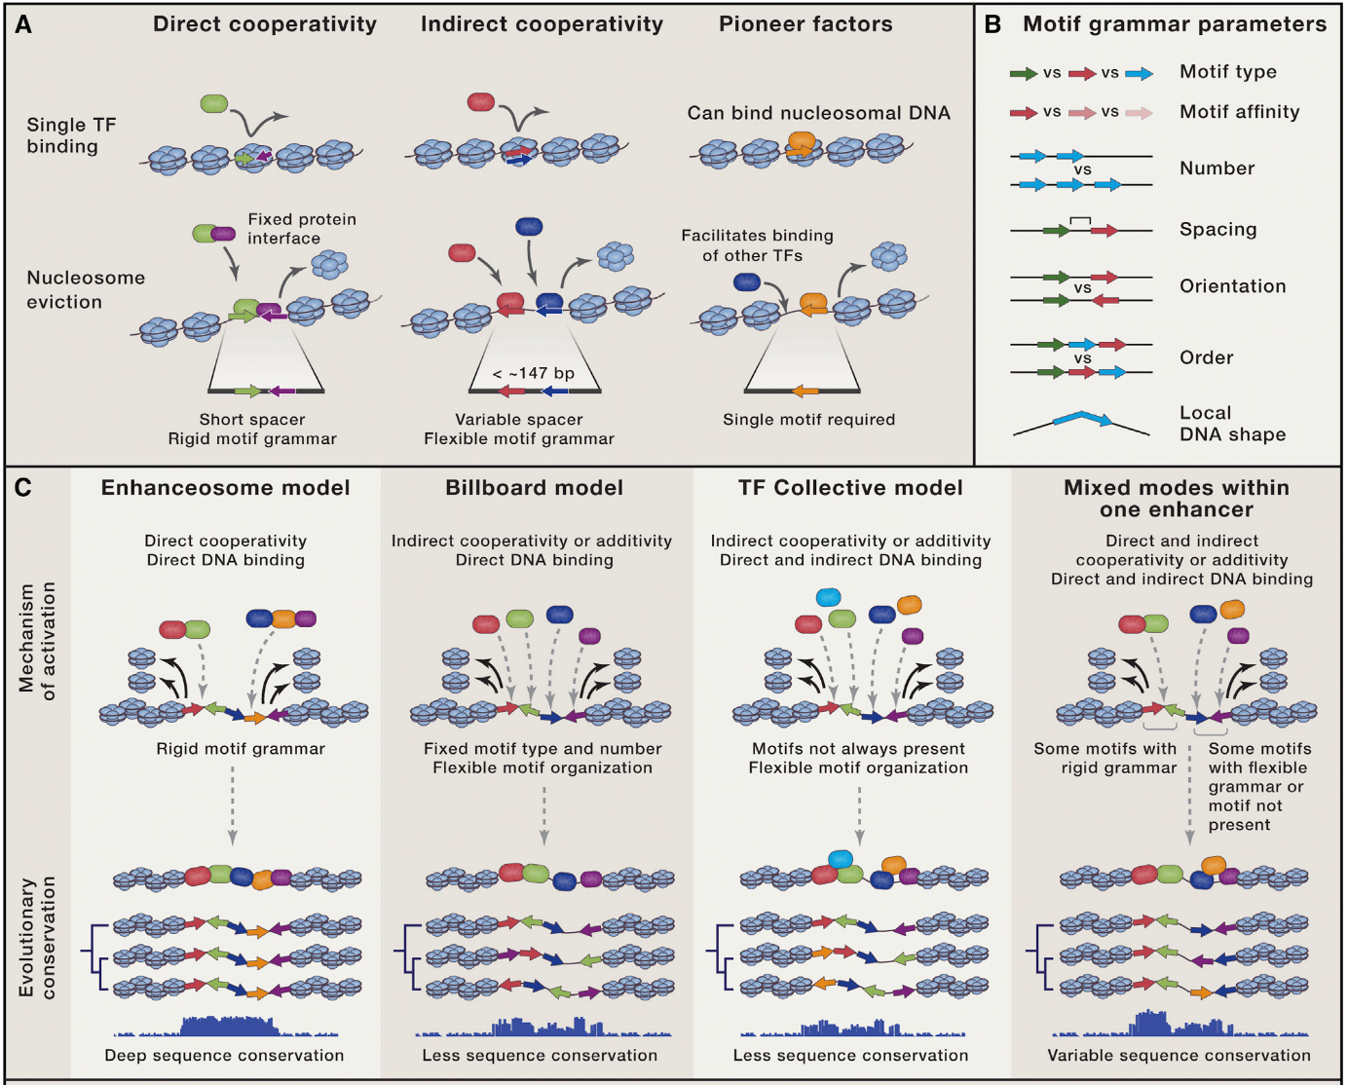
Enhancers are diverse collections of transcription factor binding sites
Long…Wysocka, Cell 2016
Notes:
Much of what we know about enhancers comes from detailed studies at a few sites. Historically, enhancers have been defined as DNA elements that control transcription independent of their orientation and distance to their target gene. That’s a very operational or practical definition of what an enhancer is. Empirically, enhancers are comprised of transcription factor binding motifs, and the protein complexes that assemble at enhancers can act independently or cooperatively to affect their functions.

Slide 5
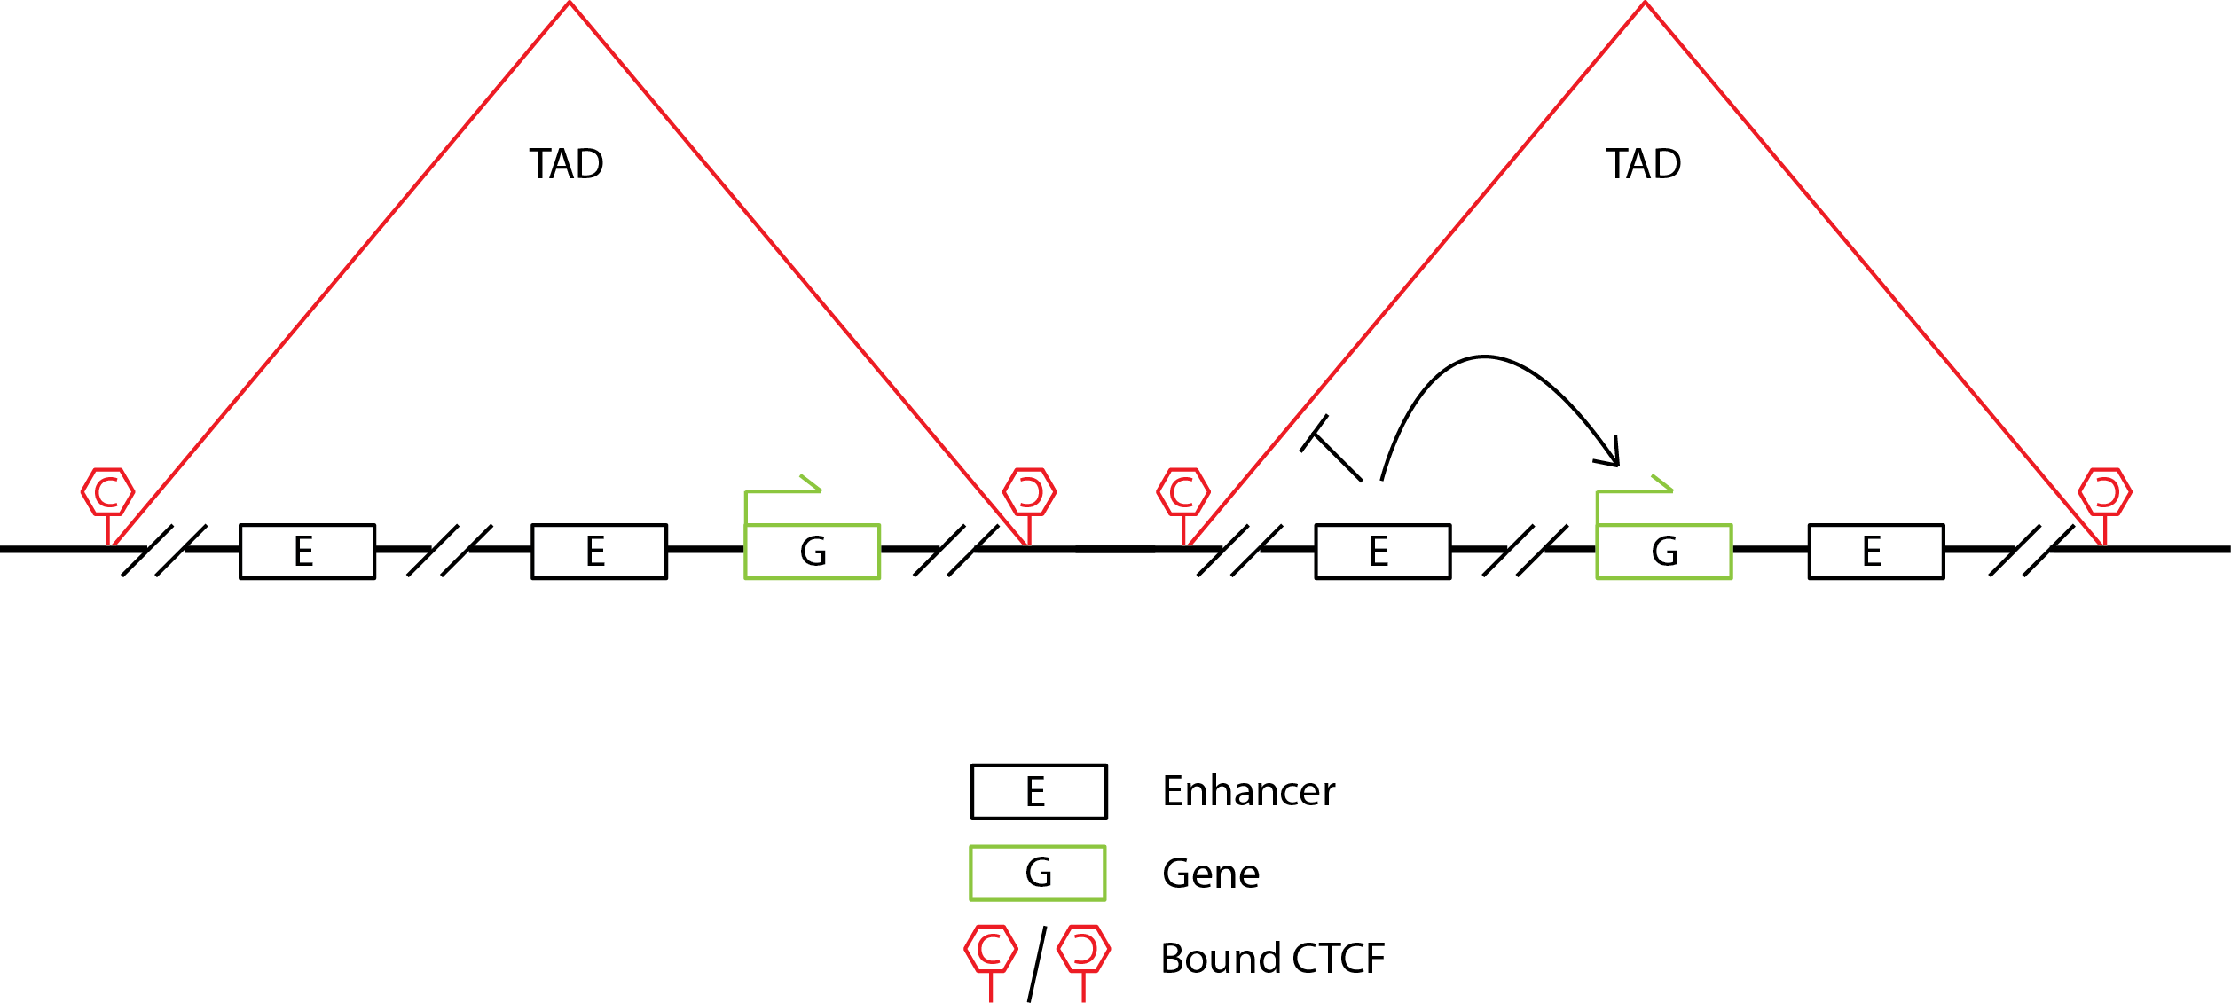
Chromatin architecture can partially constrain E-P interaction space
Notes:
That was all about how enhancers function, but one of the most important questions is how enhancers select their targets. As they can regulate genes at great distances of a Mb or more away, a given enhancer has quite a few options for targets. Currently we are unable to perfectly predict enhancer-gene associations. However, there are some features we’ve identified that at least narrow down the search space.
Through Hi-C, we have observed that genes and their enhancers are often located within topologically associated domains, or TADs. Sequences within a TAD are more likely to interact with other sequences within the same TAD, and do not contact regions outside the TAD as often. The boundaries of these TADs are bound by CTCF, a transcription factor that cooperates with other proteins to transiently bring distant regions of DNA into closer proximity.
Sometimes, CTCF can also bind near enhancers or promoters within TADs, giving rise to sub-TAD interactions – these can further define regulatory element interactions.
While still under heavy skepticism, some evidence suggests that other TFs can mediate long-distance interactions between two bound regions – though these also tend to rely in part on CTCF.
It is important to note that topological interactions are insufficient to determine target specificity or relative interaction frequency. I.e. an enhancer in a TAD does not regulate all the promoters within the TAD, and two enhancers within a TAD that regulate the same promoter may have different interaction frequencies. There are also many instances of enhancers that regulate genes across TAD boundaries, both while the TAD boundary is still present, and in cases where the TAD boundary is deleted.

Slide 6
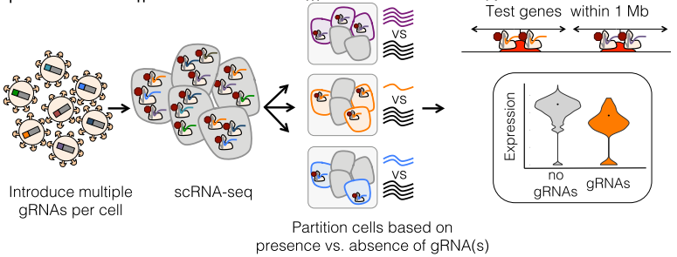
Characterizing E-P links at large scales with crisprQTL
~6000 Tested cCREs
~300K single cells
664 E-P links
Gasperini…Shendure, Cell 2019
Notes:
While Flow-FISH is an excellent technique for investigating all regulatory elements at a few genes of interest, there is still a need for large-scale E-P mapping. The shendure lab developed crisprQTL, in which cells are superinfected with upwards of 30 sgRNA targeting different enhancers. Using scRNA-seq, they can detect which sgRNA are expressed in a given cell, as well as how the genes around the targeted enhancers change in expression. This allows them to measure E-P links at a large scale, and in this paper they tested 6000 cCREs by sequencing 300,000 single cell transcriptomes, and identified 664 E-P links.

Slide 7
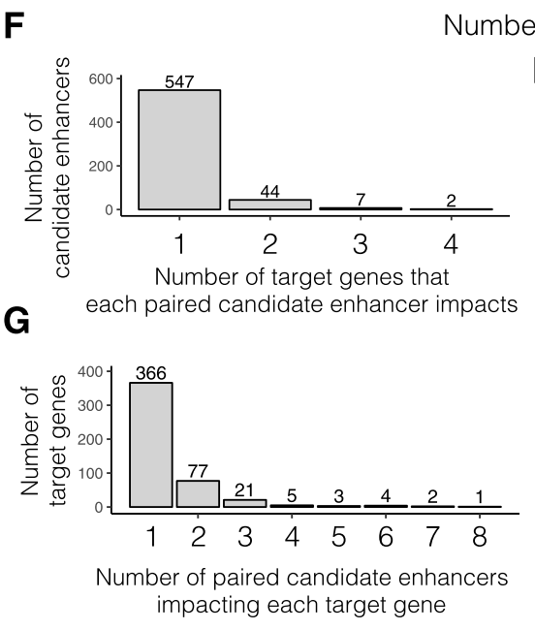
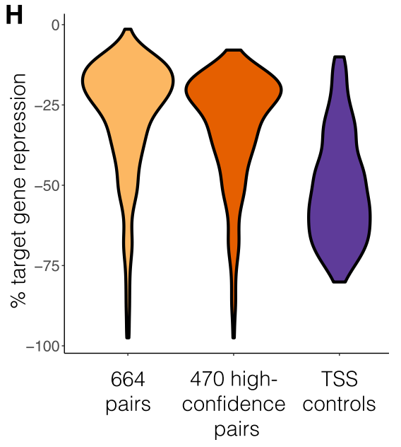
Most enhancers are weak, target few genes; genes have few enhancers
Gasperini…Shendure, Cell 2019
Notes:
We’ve learned lots of general principles from the experiment. Most enhancers are weak, having less than a 20% effect on their target gene’s expression when perturbed -- though other enhancers run the whole range. Additionally, most genes only have one enhancer that appreciably affects its expression when perturbed individually. Most enhancers also only interact with one or two genes.

Slide 8
Most enhancers are within 100kb of their target, and a third of enhancers skip their nearest gene!
Gasperini…Shendure, Cell 2019
Notes:
Perhaps most interestingly, the results suggest that the majority of enhancers are relatively closeby to their promoters. While assigning enhancers to their closest gene is as good a guess as any, over a third of their characterized enhancers skipped the closest gene. So the rules of enhancer-promoter targeting are very much still up in the air.

Slide 9
Cheaply and efficiently characterizing 1~10K cCREs with phenotypic CRISPR screens
Method | CRISPR scRNA-seq | CRISPR Selection Screens
Pros | Somewhat scalable Measures expression levels Any element can be targeted | Highly scalable Cheap and easy to run Diverse phenotypes allow most genes to be targeted
Cons | Expensive Low coverage Sensitivity depends on gene expression levels | Indirect phenotypic measurement Sensitivity varies by gene and phenotype

Slide 10
Several other ENCODE groups have recently performed large-scale cCRE screens
12K H3K27ac+ cCREs
55K pgRNA
~450 hits
112K DHS+ cCREs
1.1 million gRNA
I don’t trust their analysis

Slide 11
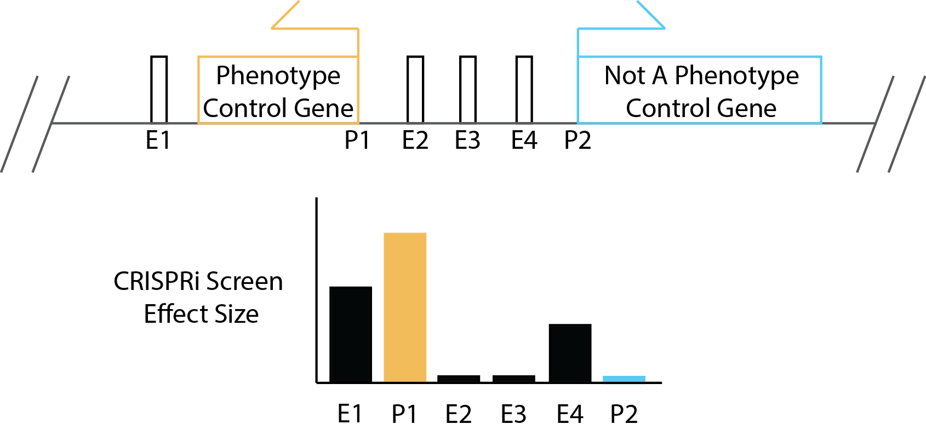
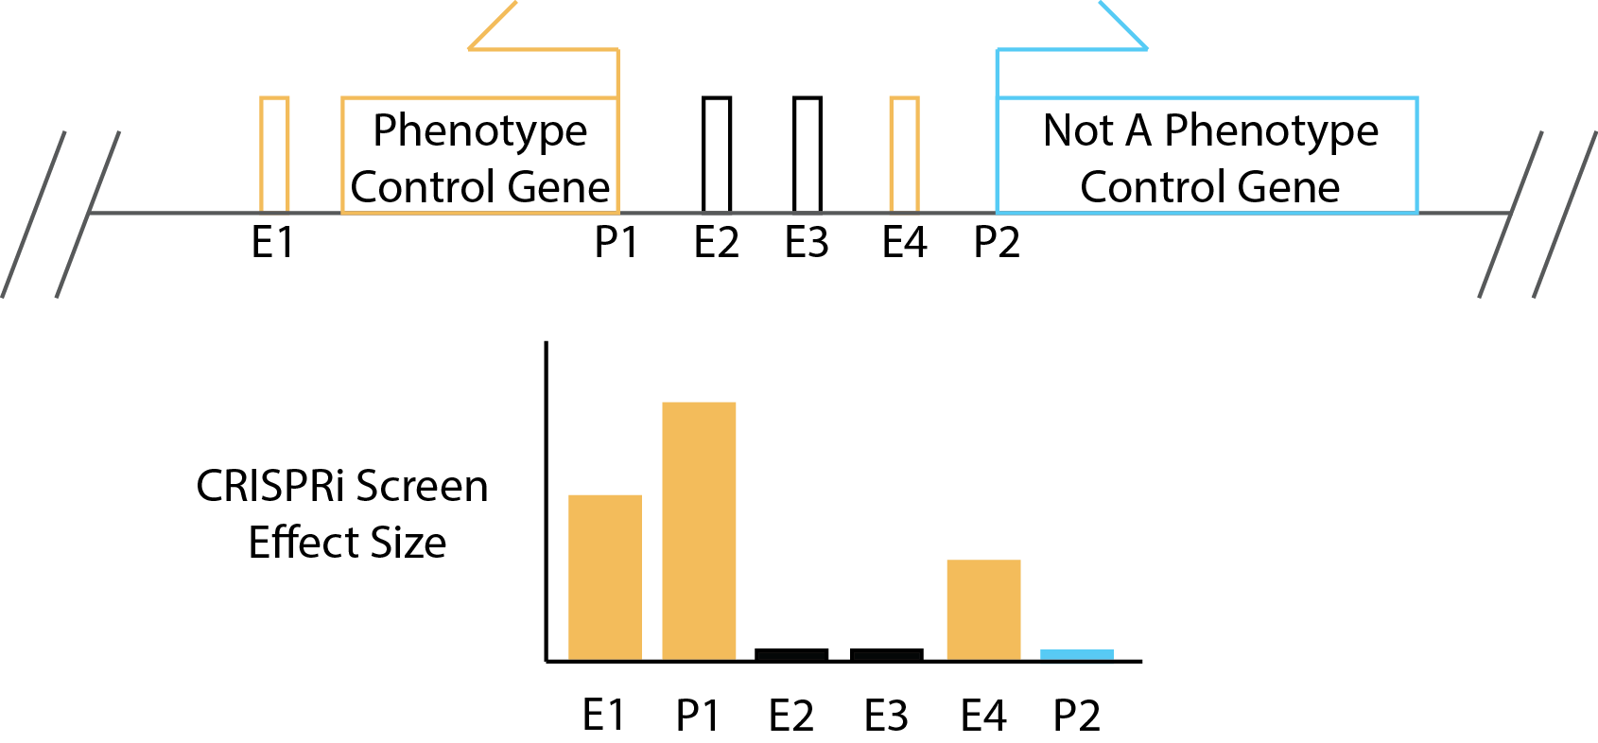
Characterizing and inferring enhancer-gene links with phenotype-driven CRISPR screens
Enh1 and Enh4 can be reasonably linked to P1
Enh1 may be a stronger enhancer than Enh4
Enh2 and Enh3 cannot be assigned to either gene
HiC can support interactions
Notes:
These screens can both identify functional enhancers, as well as potentially map them to their target promoters. To explain how with a toy model, here we have a locus with 2 genes. One is known to control a phenotype, for example cell growth, and the other does not. This information comes from prior genome-wide CRISPR screens, which there now exist quite a few across the literature for a myriad of phenotypes. In this locus, we also have 4 enhancers. The question is which enhancers regulate which genes. If we perturb each enhancer, and measure their effects on growth, if enhancers 1 and 4 have phenotypes, we can infer that they regulate promoter one. We can also infer, based on their effect sizes, that enhancer 1 is stronger than enhancer 4. We cannot make claims about what enhancers 2 or 3 do – they could regulate promoter 2, regulate neither gene, or be too weak to sensitively detect. But this is the model we’ll work with.

Slide 12
Important assumptions
Some enhancers have a “business” end, but a broad repressive effector (like the KRAB domain) should be able to work across broad regions
CRISPR effect sizes will be stronger the closer the gRNA is to the business end, but most gRNA within a narrow window (+/- 100 bp) should have some consistent effect size
The very act of dead Cas9 sitting on a gene’s body can affect its transcription!
Most enhancers are weak enhancers with <20% effects on their target gene’s expression
The relationship between a growth gene’s expression level and its effects on growth will vary from gene to gene, and can be buffered if the change in expression is less than some threshold amount
Most enhancers are located closer than further from their target genes (within +/- 100 kb, though there are examples of links out to +/- 2 Mb)
If only 1 or 2 gRNA have significant/strong effects, it is possible that those effects are confounded by off-target events, or are effect-scoring artifacts

Slide 13
CRISPRi cCRE Screen v3: Minimizing false negatives by optimizing cCRE and sgRNA selection rules
Select phenotype and nominate genes Top 420 essential/growth genes
Summit
Summit
Identify summits, expand by +/- 150 bp, and target each independently
If expanded summits overlap, only target the stronger one
DHS
Nominate CREs Find DHS⁺ peaks within +/- 100kb of TSS
Peak
Pick gRNA
Pick 8-15 gRNA per CRE
Threshold on specificity
Pick every n^{th} sgRNA to ensure spacing along the distribution of sgRNA
Apply sequence filters
If at least 8 gRNA passing filter cannot be picked, discard the CRE
Add controls
Add 10 gRNA/TSS using published, model-supported sgRNA libraries
Add 6750 Safe-targeting negatives
Notes:
So what’s the design of these libraries?

Slide 14
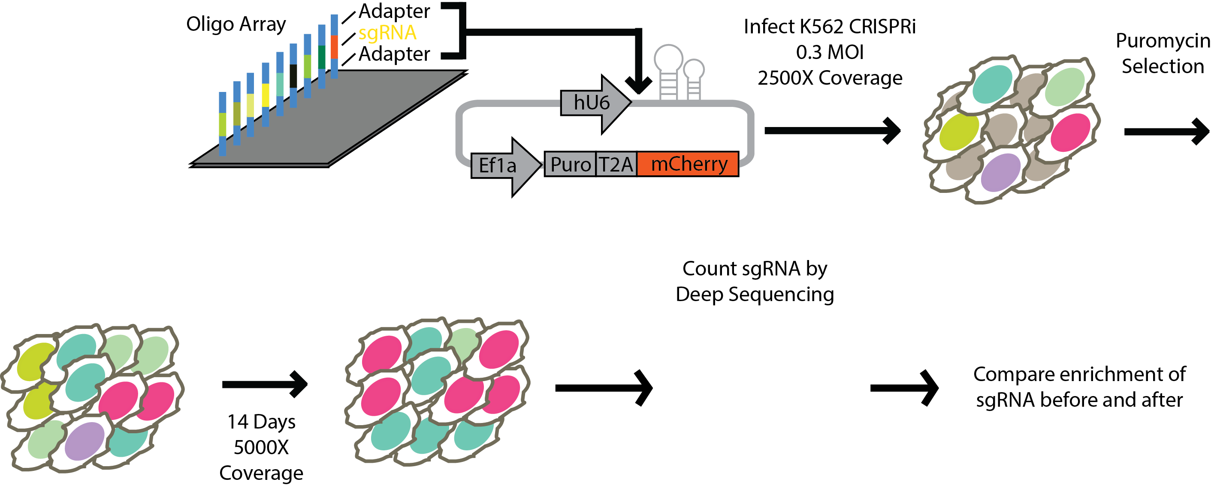
~120,000 sgRNA Library
7500 DHS summits:
Proximal promoter cCREs
Distal cCREs (enhancers)

Slide 15
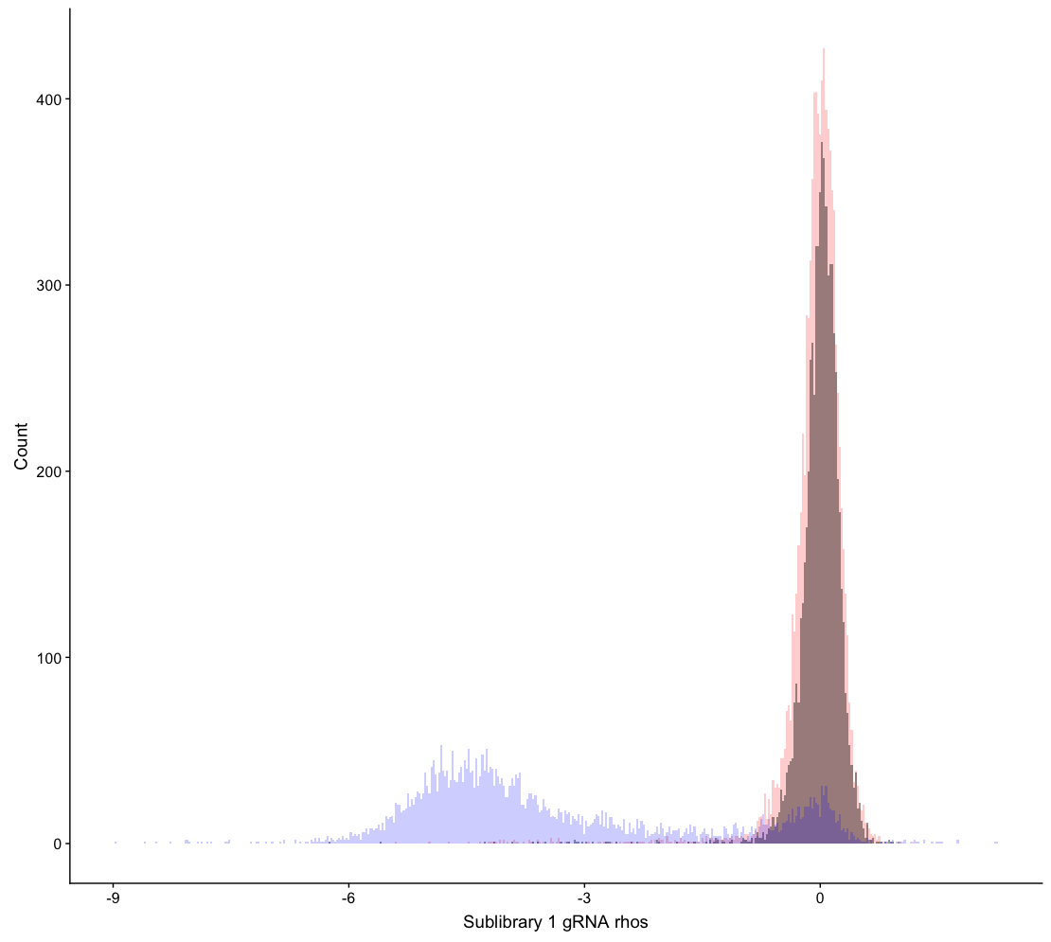
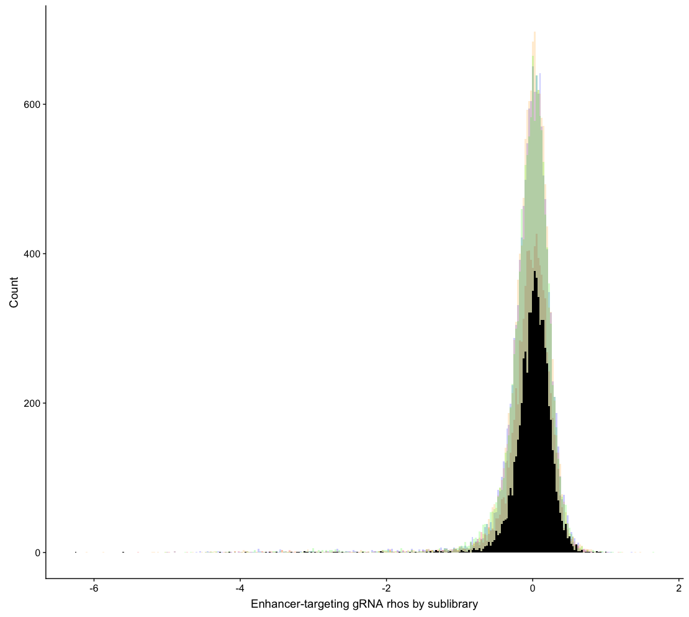
Calculating effects by sublibrary; ineffective gRNA have similar scores & effective gRNA are spread out
Pos_promoter
Enhancer
Safe
Enhancer distributions across sublibraries look similar!

Slide 16
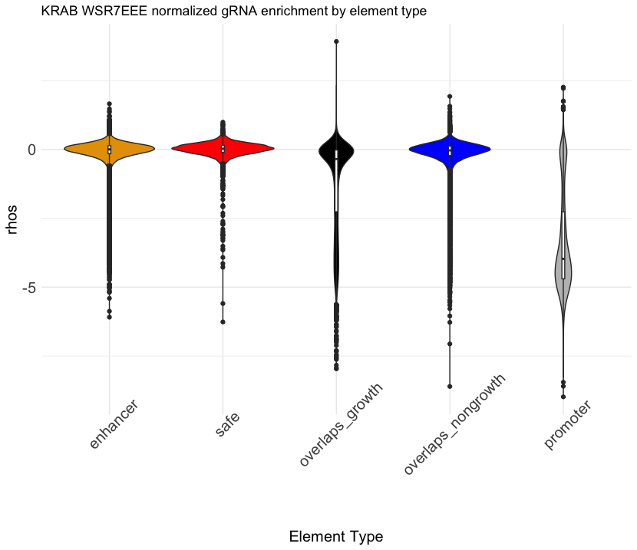

Slide 17
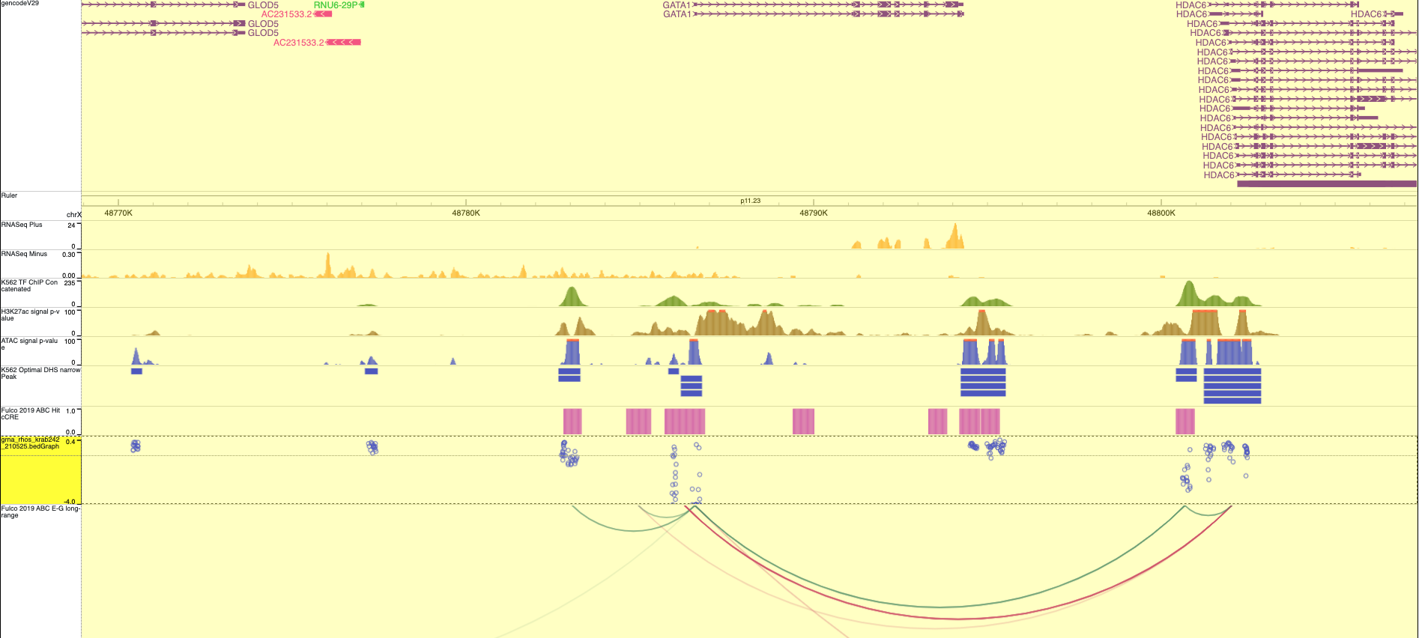
eGATA1 enhancer
eHDAC6 enhancer is labeled as overlaps_nongrowth_TSS
Refine TSS annotations with CAGE?
Narrow TSS window to TSS +/- 500 bp?

Slide 18
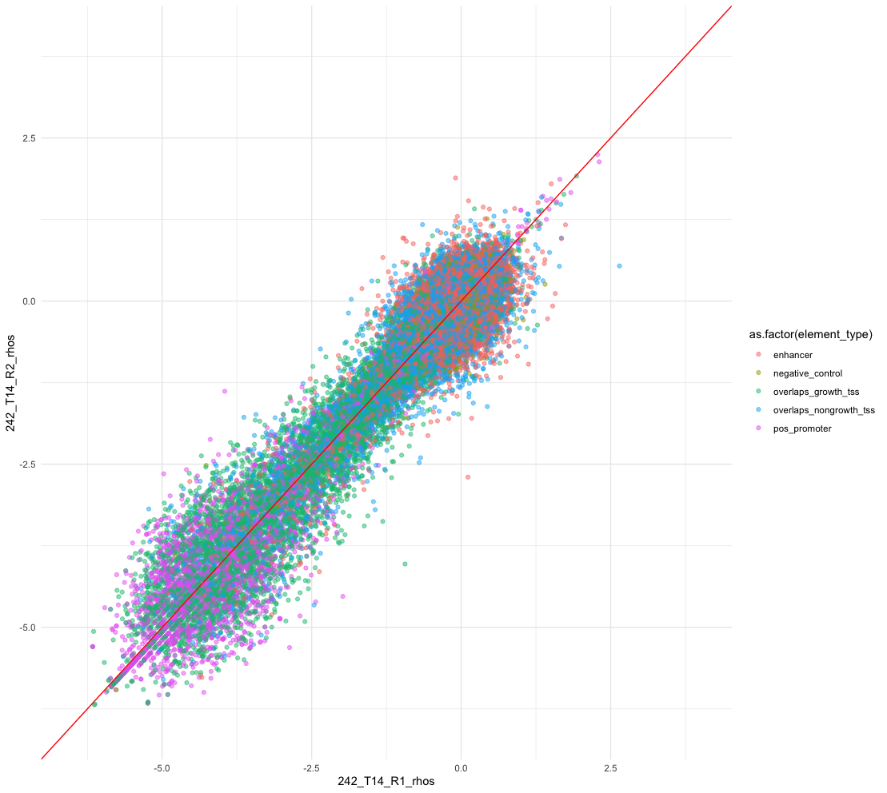
Drop initial low, pseudocount of 10 for final low count gRNA
 | Enhancer | Overlaps Non-Growth TSS | Overlaps Growth TSS | Positive Promoter
Total # Elements | 3523 | 2817 | 1177 | 420
FDR10 | 570 | 902 | 939 | 414
FDR10 & Third best effect < Safe – 2 SD | 54 | 284 | 812 | 413
FDR10 & Mean Effect < Safe – 2 SD | 18 | 119 | 708 | 414
Some weird outliers are cleaned up!
Even more hits, probably due to the safe gRNA distribution being tightened! From StDev 0.2953 (pseudo10) to 0.2949 (dropinitial_pseudo10)

Slide 19
Using the Fisher Method to combine p values
First calculate BH-corrected p values
Combine with Fisher Method
Apply the BH correction over the combined p values
 | Enhancer | Overlaps Non-Growth TSS | Overlaps Growth TSS | Positive Promoter
Total # Elements | 3523 | 2817 | 1177 | 420
FDR10 | 570 → 380 | 902 → 724 | 939 → 907 | 414 → 413
FDR10 & Third best effect < Safe – 2 SD | 54 → 47 | 284 → 268 | 812 → 811 | 413 → 412
FDR10 & Mean Effect < Safe – 2 SD | 18 → 18 | 119 → 113 | 708 → 707 | 414 → 413
The combined p value reduces hits, though this may just be due to additional correction step. It’s hard to say whether it increases precision. Still, we already had too many hits in the first place.

Slide 20
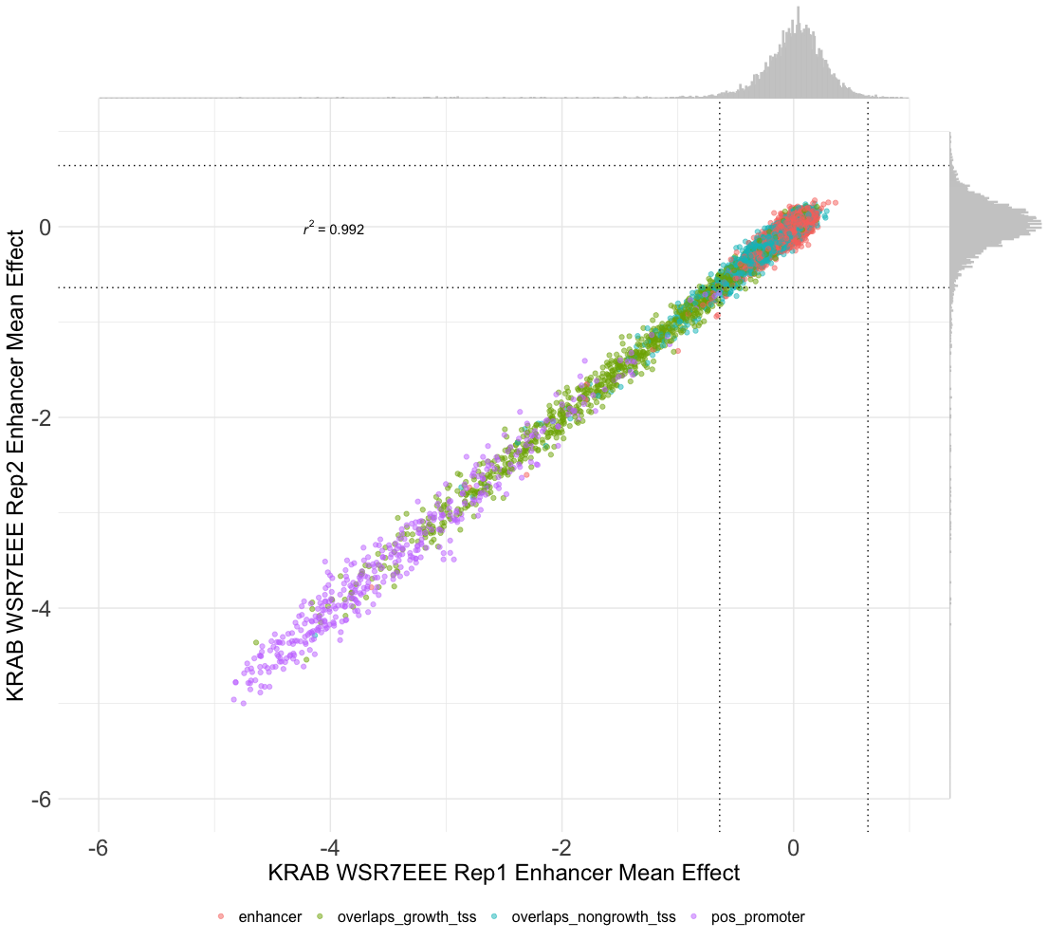
Effects are reproducible across technical replicates

Slide 21
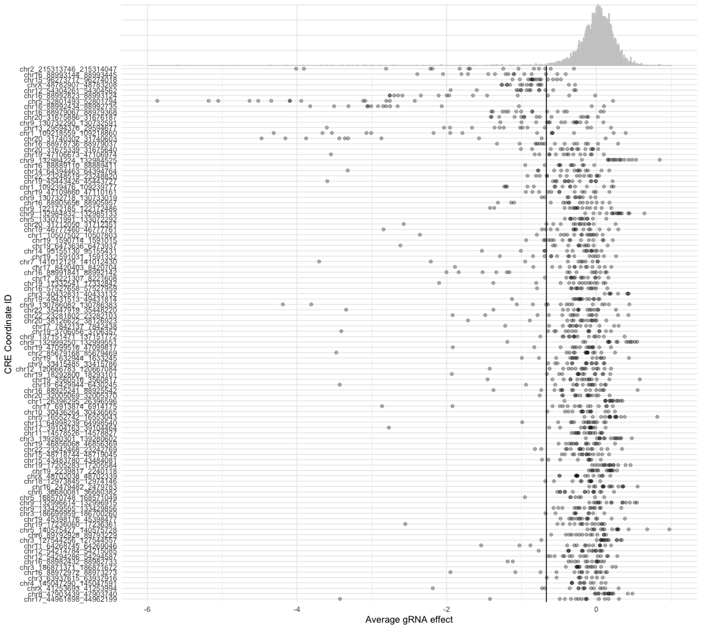
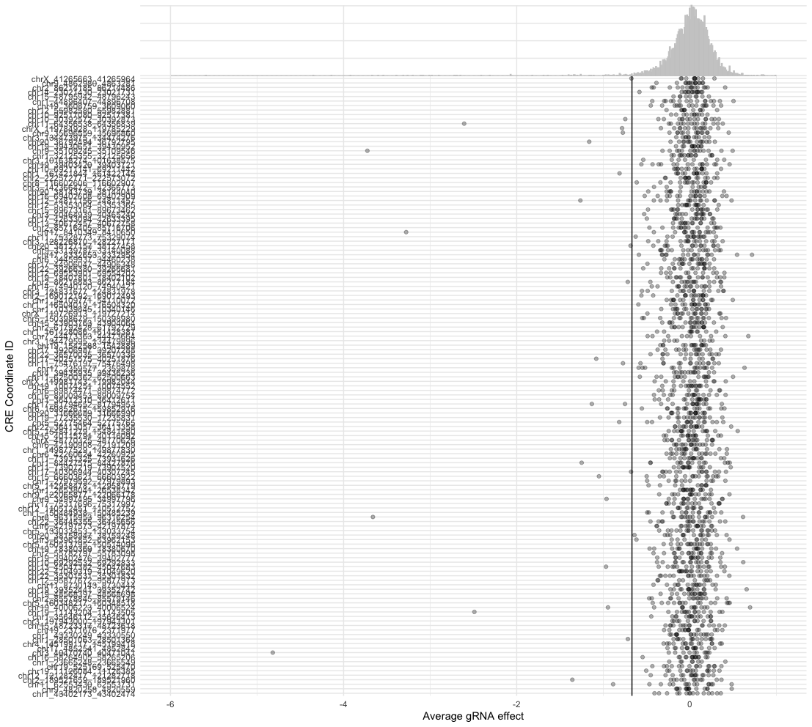
Inspecting the most significant vs insignificant enhancers
Most significant elements
Least significant elements

Slide 22
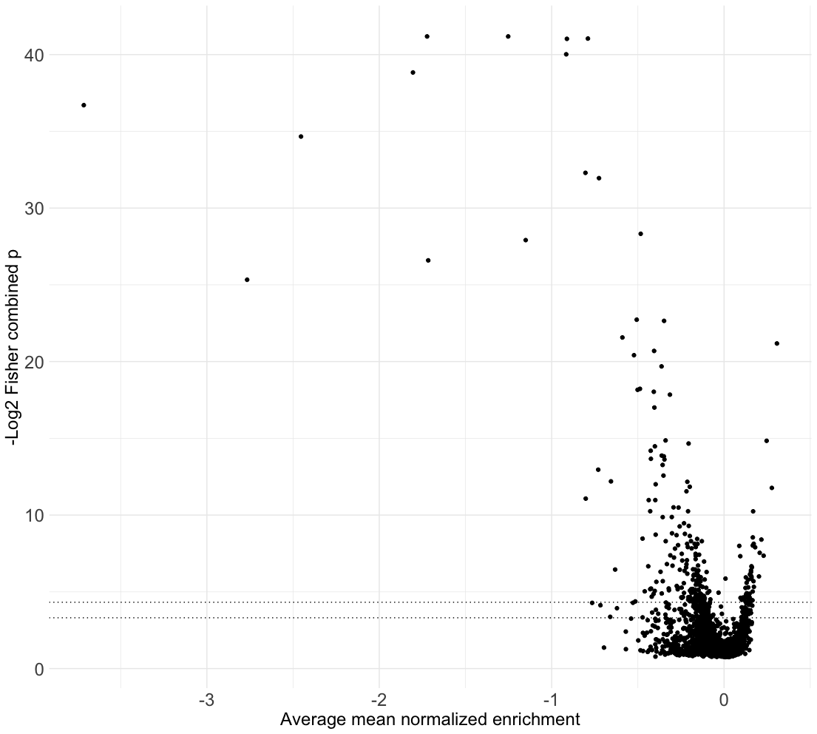
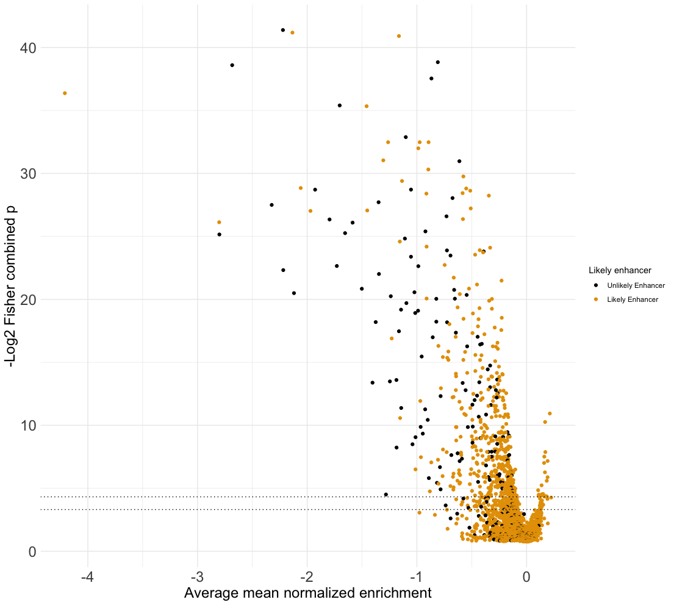
Rescoring with the Fisher combined p value, and recovering likely cCREs from TSS-overlapping elements
eGATA1
eHDAC6
If DHS overlaps a top ~2500 growth gene (FDR25), it is an “Unlikely Enhancer”

Slide 23
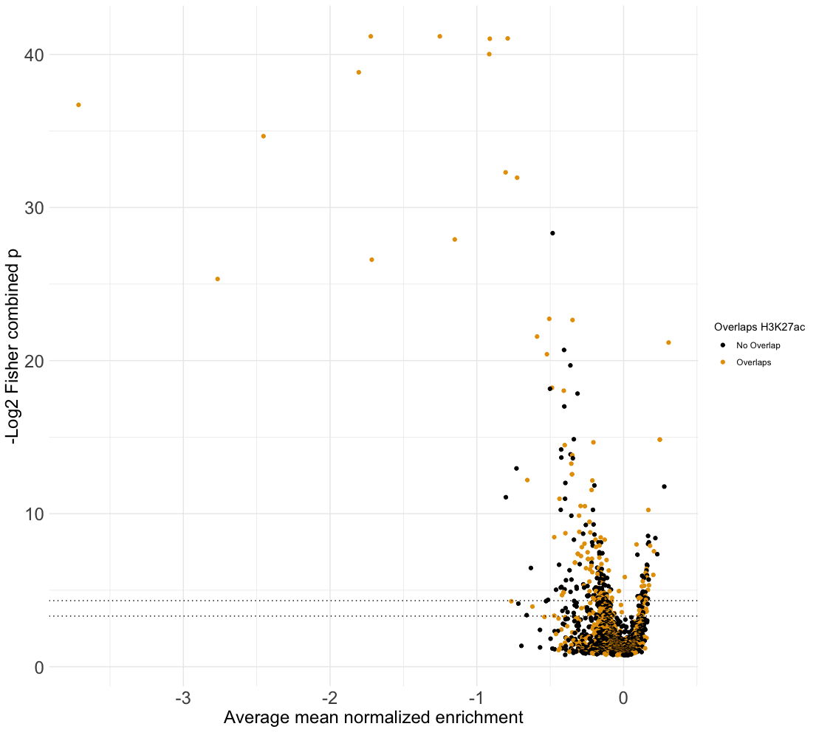
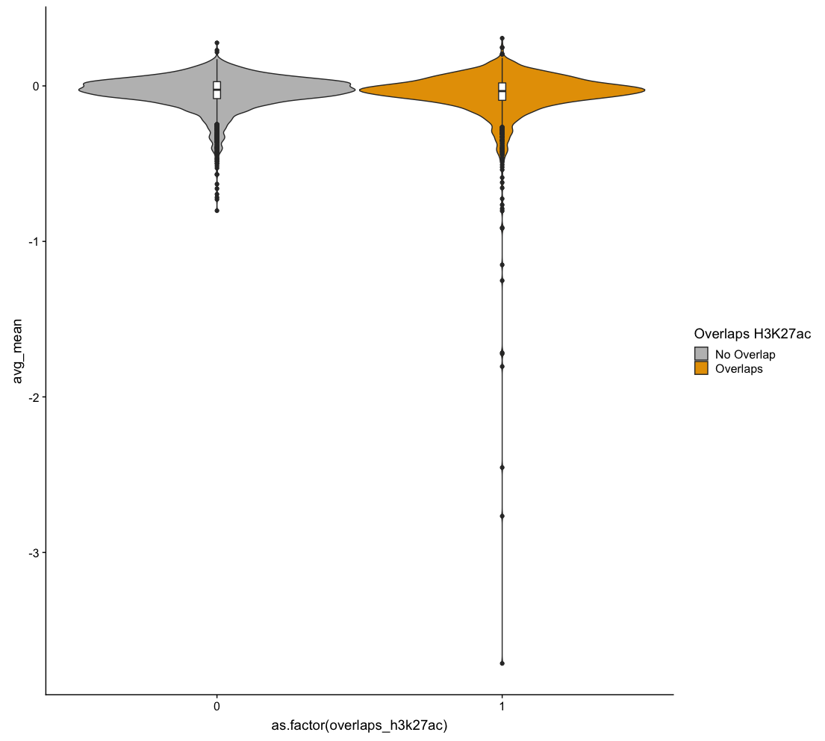
1310/3523 of our DHS enhancers overlap H3K27ac peaks, and are maaarginally but significantly stronger in bulk (strongest elements are very much H3K27ac-overlapping)
KS test p-value: 0.00561
MWU test p-value: 0.0102
Welch t-test p-value: 0.000525

Slide 24
Current challenges in interpretation
How exactly do we define the set of growth vs non-growth genes?
Can we extract more enhancers from the overlaps_nongrowth_tss hits? How might we distinguish them from “simple” promoter effects?
If a region within a gene’s body has an effect when targeted by CRISPRi, how do we tell if it’s a real enhancer or just a dCas9 roadblock effect?
If only 1-2 out of 15 gRNA have an effect, is this because we had too few gRNA around the ”business” end of the enhancer?

Slide 25
Tiling screen design: Selecting cCREs and sgRNA
Target ~50 significant cCREs from a previous cCRE screen (round 2)
+ Positive control cCREs from MYC, HDAC6, and GATA1 tiling screens
+ Promoter-targeting controls against growth genes within 300 kb of cCREs
DHS-H3K27ac peak expansion
Include all gRNA without specificity filters
[Black border] Initial sig CRE
Expand peak to include DHS
Further expand to include additional adjacent H3K27ac or DHS regions
H3K27ac
DHS
Notes:
Made as a somewhat last-minute rush – in hindsight, would have slopped the reagents to expand them by a few kb to extend the tiling region – perhaps at the least giving regions the same considerations as superenhancers which can be stitched by 12 kb.

Slide 26
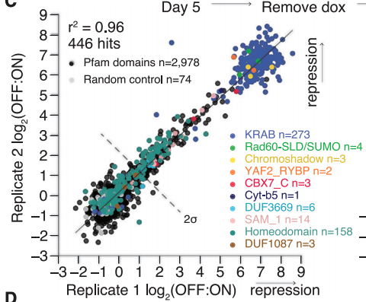
Selecting effective and alternative repressor effectors
Testing:
Pooled dCas9 Alone
Pooled dCas9 KRAB
Pooled dCas9 WSR7EEE KRAB (Better protein stability)
Pooled dCas9 “Top” KRAB (from another ZNF, higher activity)
Pooled dCas9 RYBP (RING1 and YY1-binding protein)
Clonal dCas9 KRAB
Tycko et al., Cell 2020

Slide 27
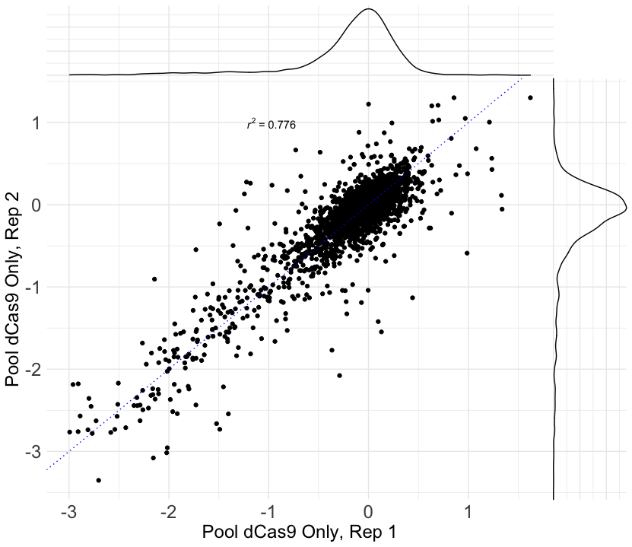
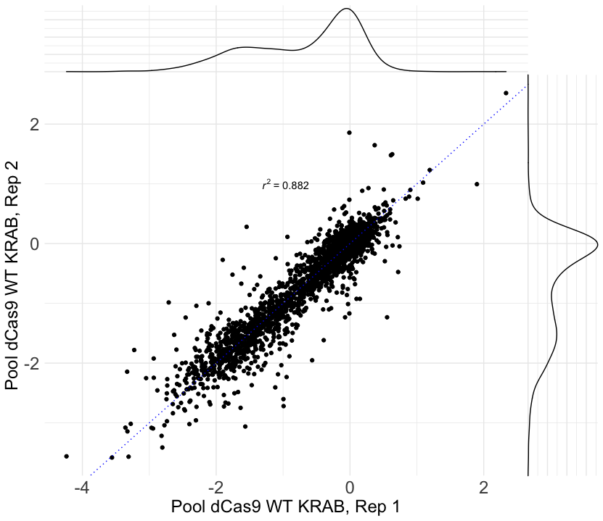
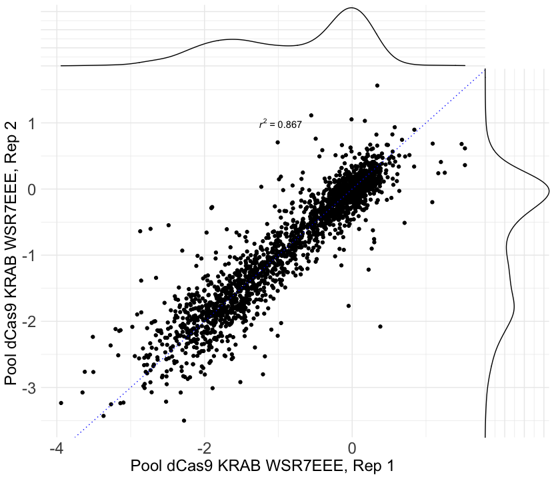
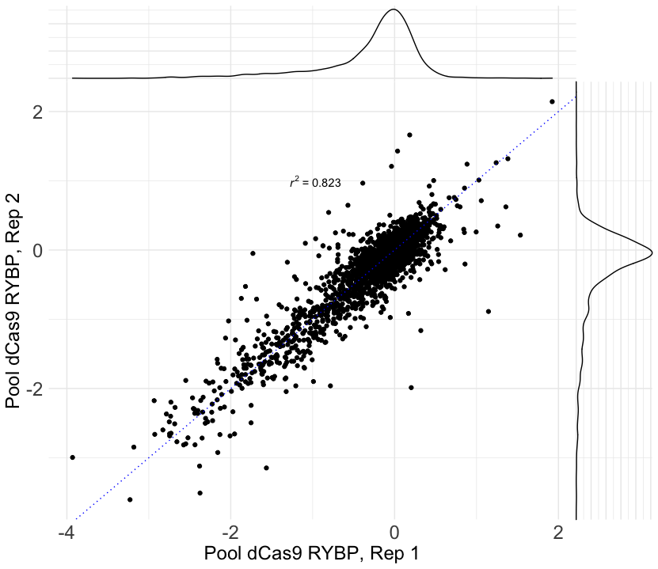
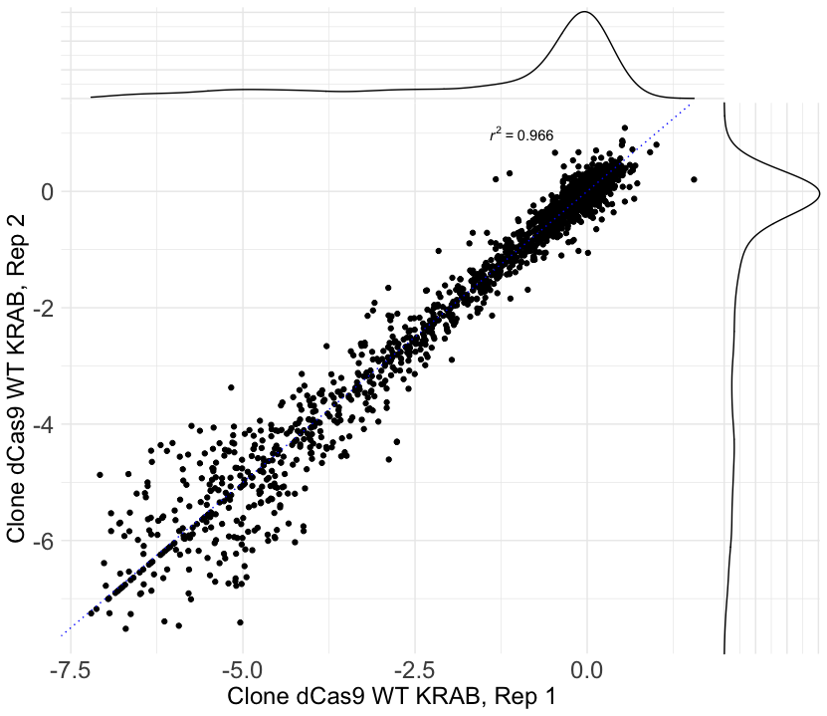
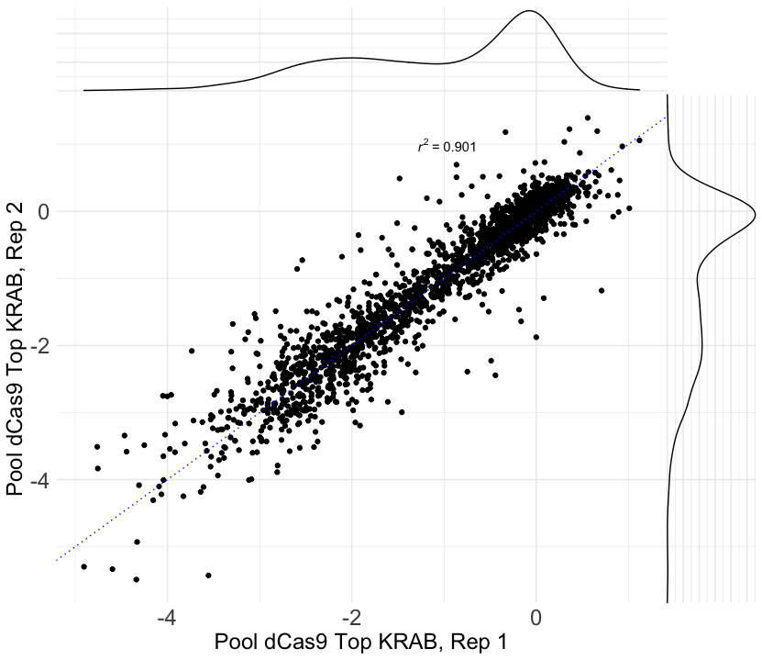
The alternative repressor lines function effectively and reproducibly at promoters

Slide 28
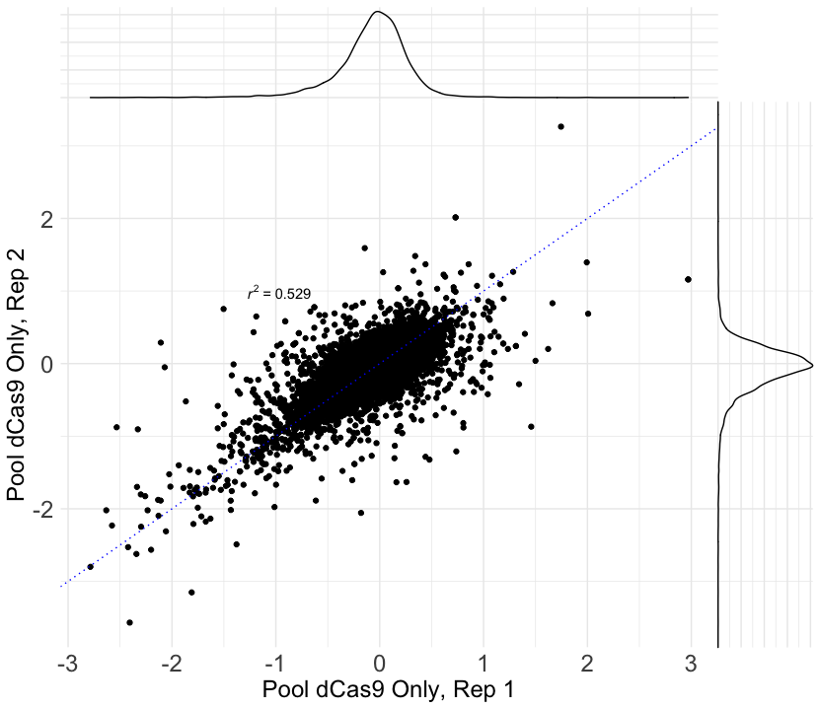
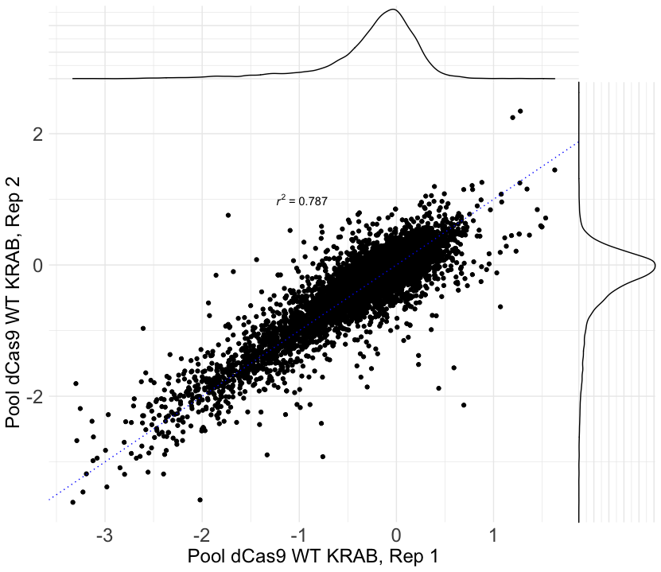
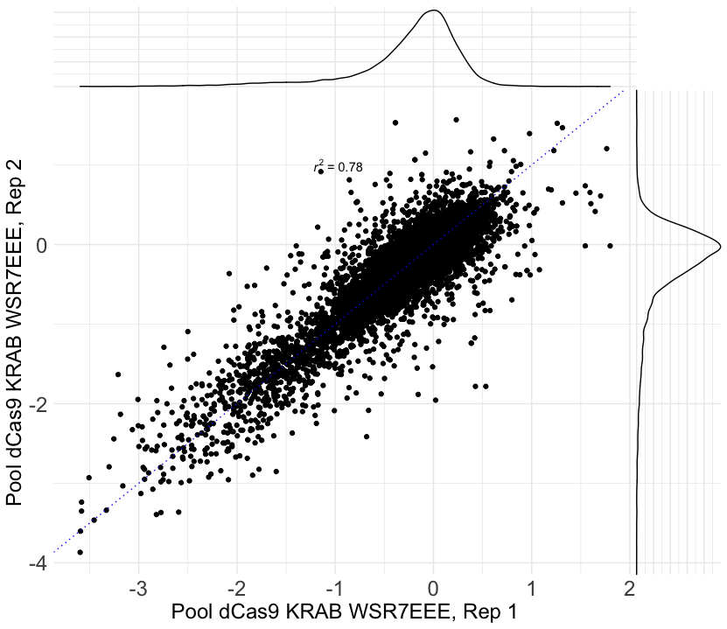
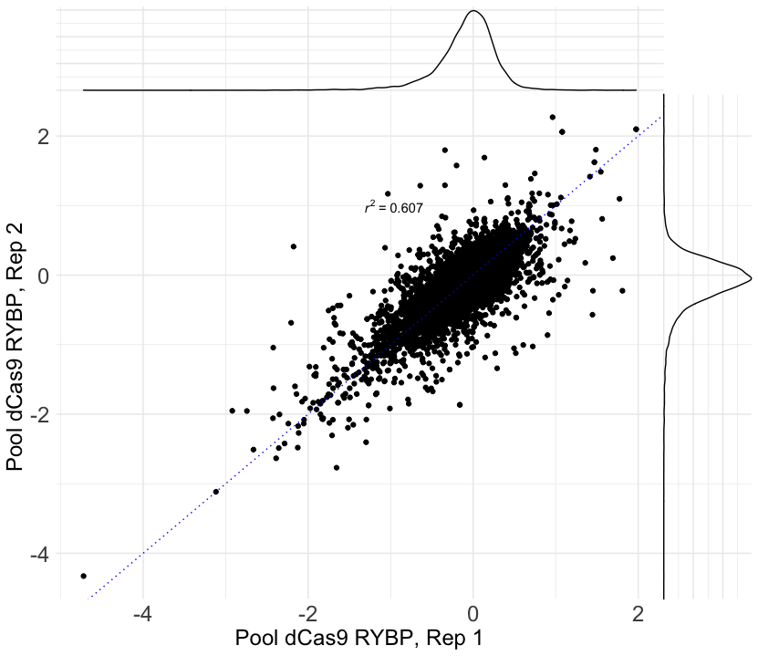
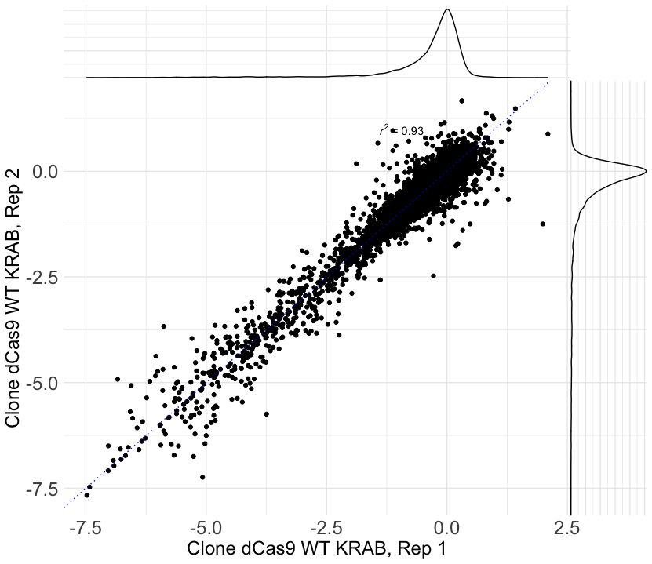
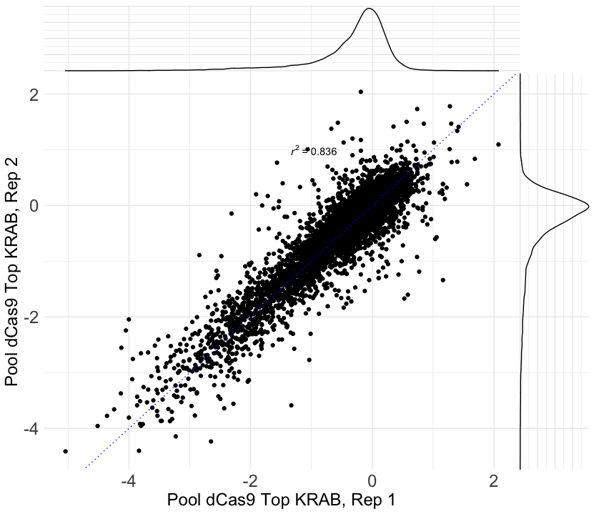
Effects at significant enhancers are noisier but still fairly reproducible

Slide 29
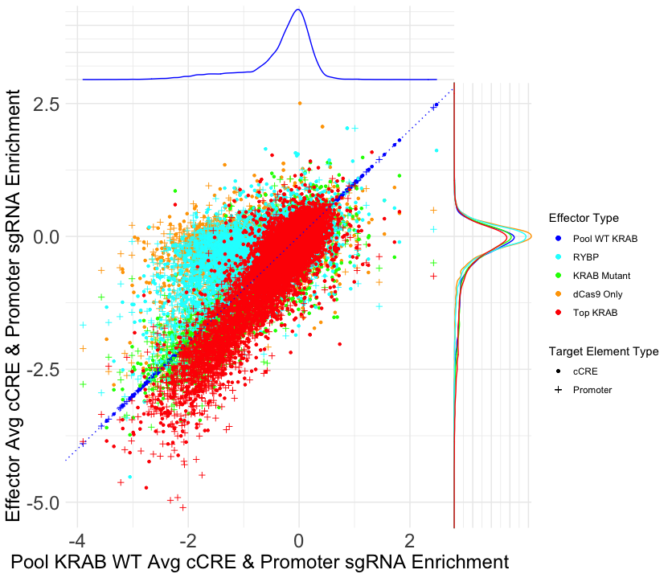
Pooled KRAB lines have similar performance, dCas9 alone and RYBP are weaker. There are appreciable effects at both promoters and enhancers

Slide 30
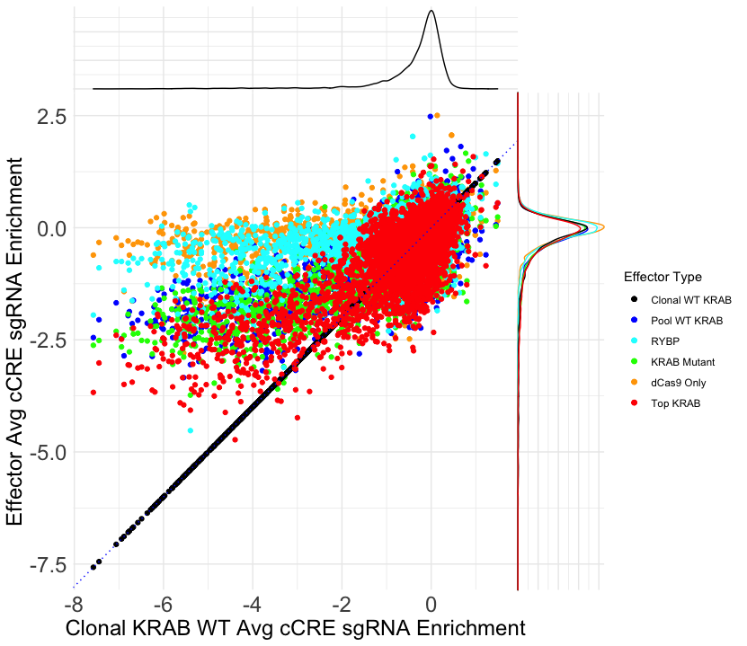
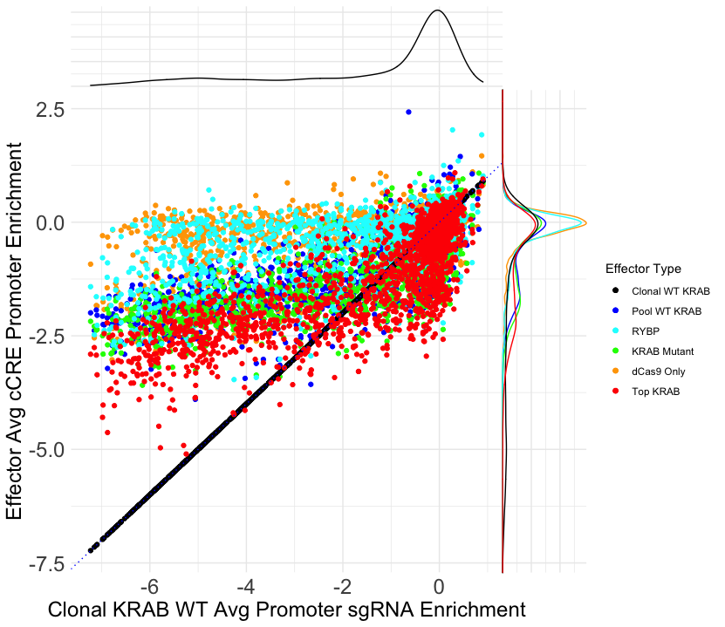
The clonal KRAB line is much stronger than the pooled lines at most targets... But is weaker at many others
cCRE-targeting sgRNA
Promoter-targeting sgRNA

Slide 31
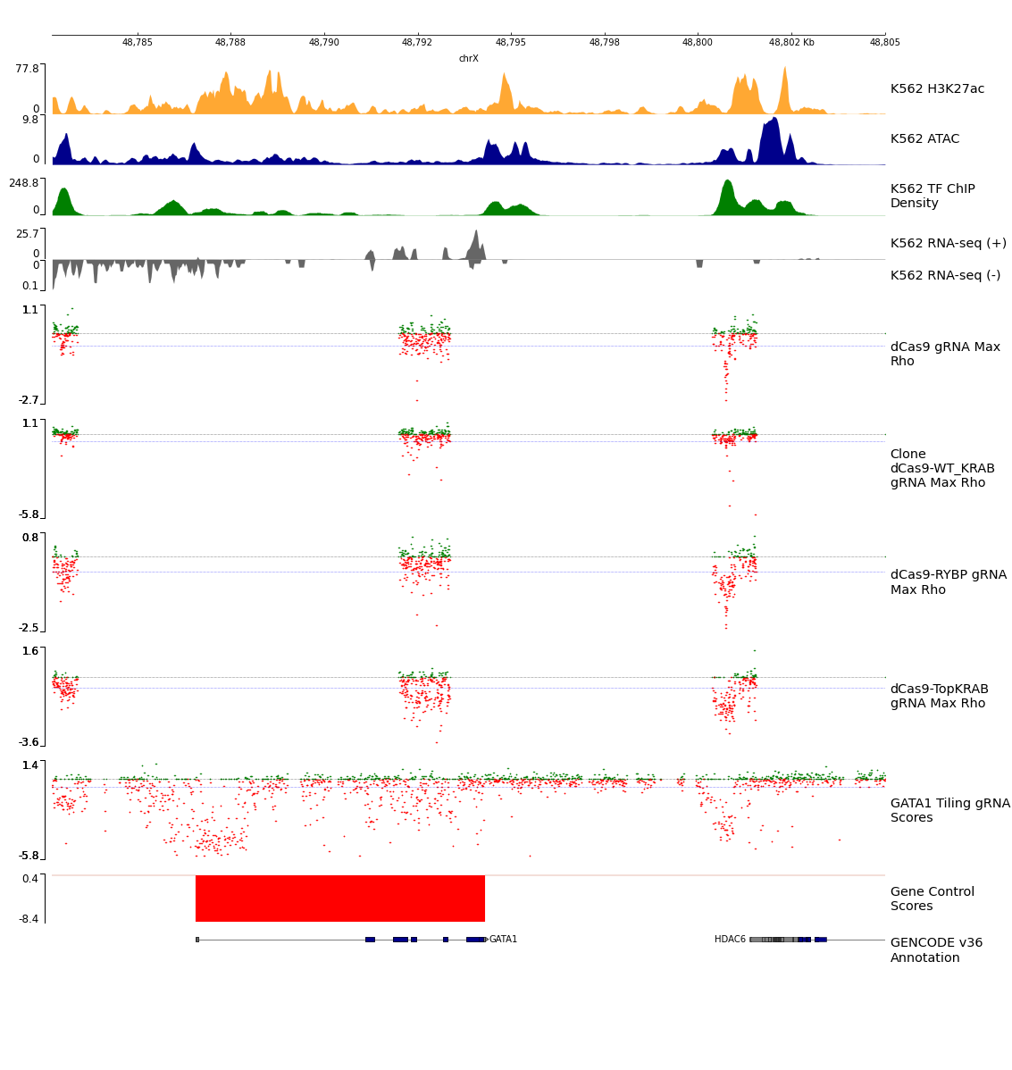
Positive control GATA1 enhancers give signal in effector pools sgRNA filtered for CFD >= 0.2 Blue line is safe mean – 2 SD Black line is effect size == 0
Notes:
Names are at the start

Slide 32
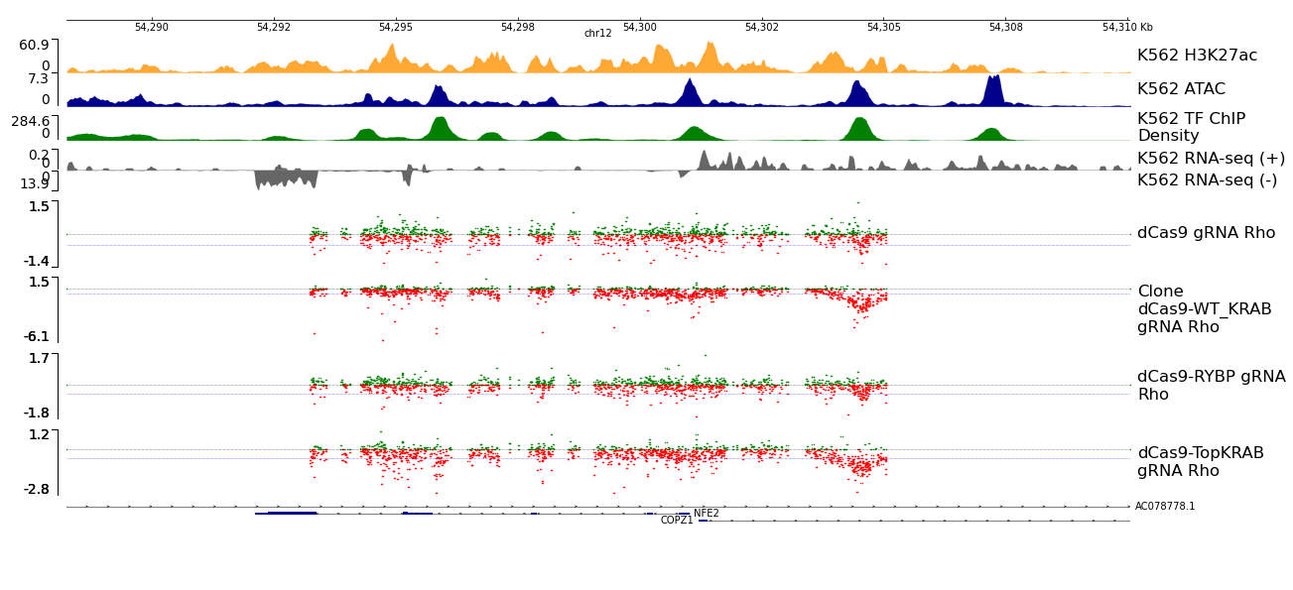
Example tiled locus.
COPZ1 is a mild growth gene
Notes:
COPZ1 is a moderate effect essential gene
pyGenomeTracks --tracks k562_hg38_effector.ini --region chr12:54288252-54310065 --o again_slop5000_chr12-54288252-54310065.png --width 46 --height 21

Slide 33
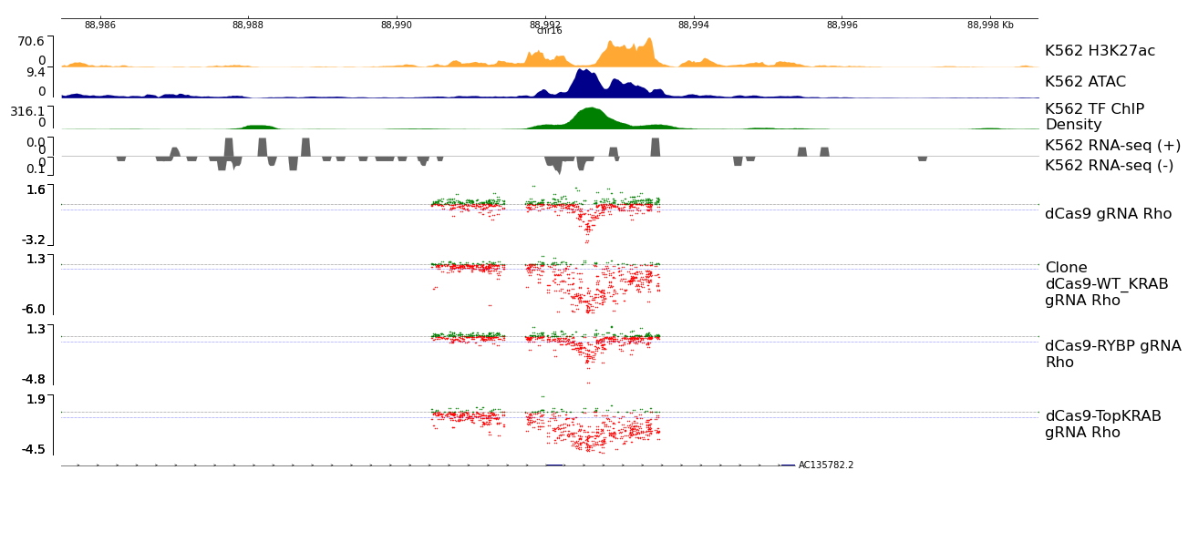
Another example locus
Gene is not a growth gene
Notes:
pyGenomeTracks --tracks k562_hg38_effector.ini --region chr16:88985480-88998654 --o again_slop5000_chr16-88985480-88998654.png --width 46 --height 21

Slide 34
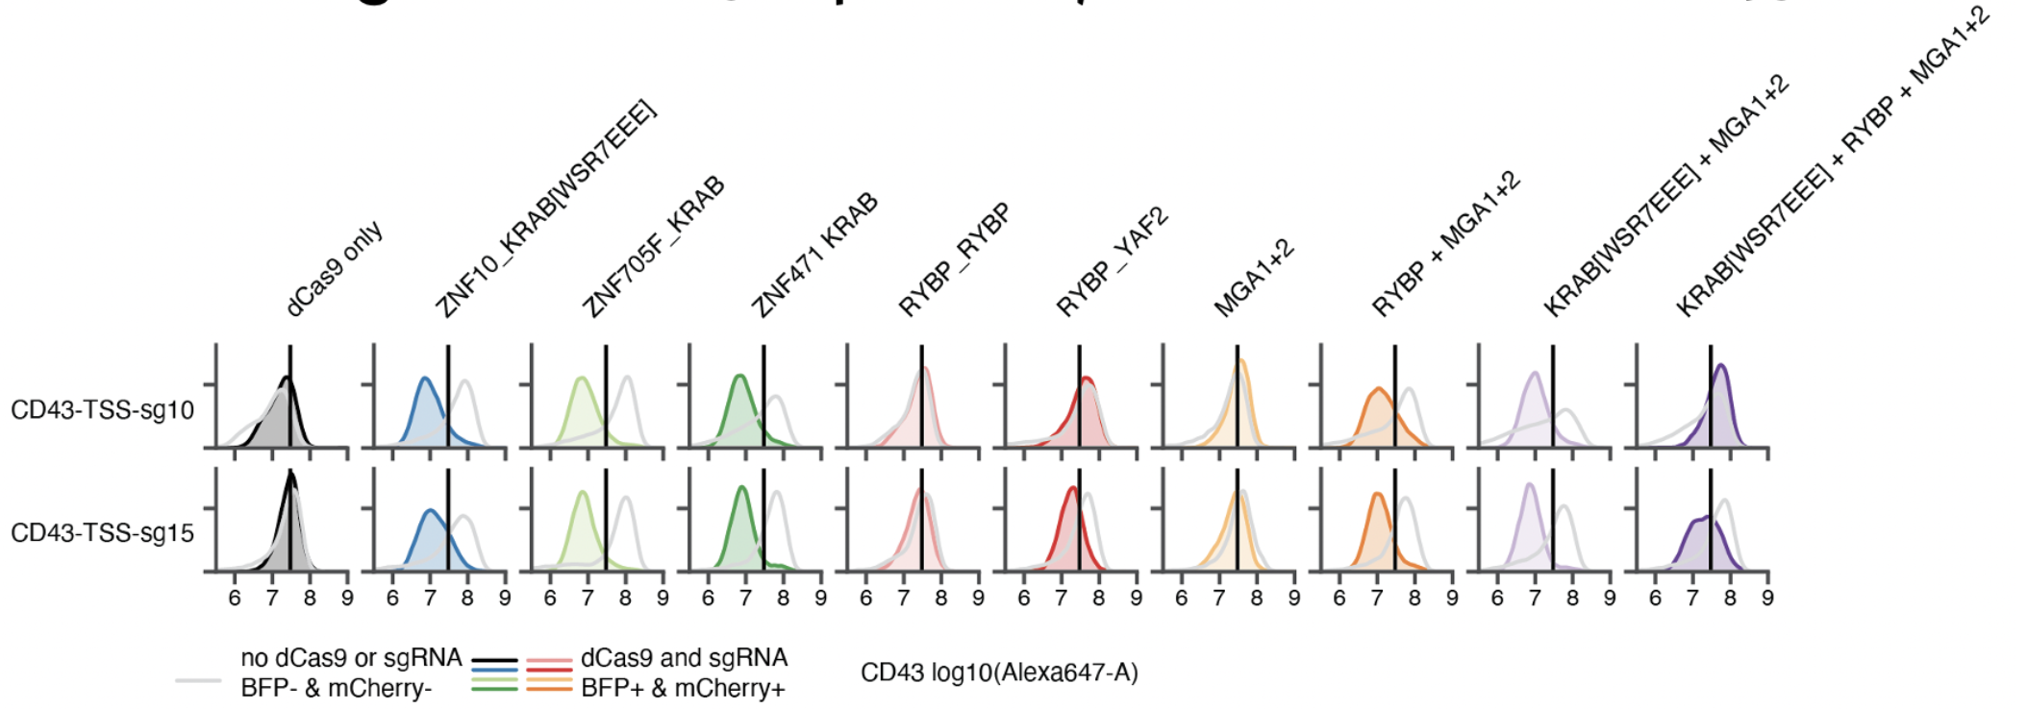
Ongoing and upcoming screens
15 guide DHS screens at ~7500 DHS summits within +/- 100 kb of 420 growth genes
Test in 4 dCas9-repressor lines
Mutant KRAB, RYBP, Mutant KRAB + MGA1+2, RYBP + MGA1+2

Slide 35
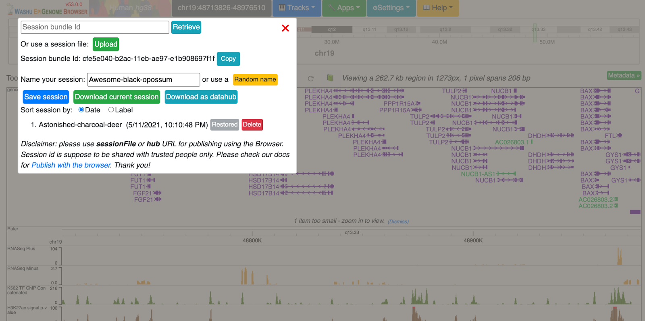
View browser tracks
Browser Tracks
http://epigenomegateway.wustl.edu/browser/
Hg38
Apps → Session
Session bundle id: cfe5e040-b2ac-11eb-ae97-e1b908697f1f
Click [Restore] on the most current session

Slide 36
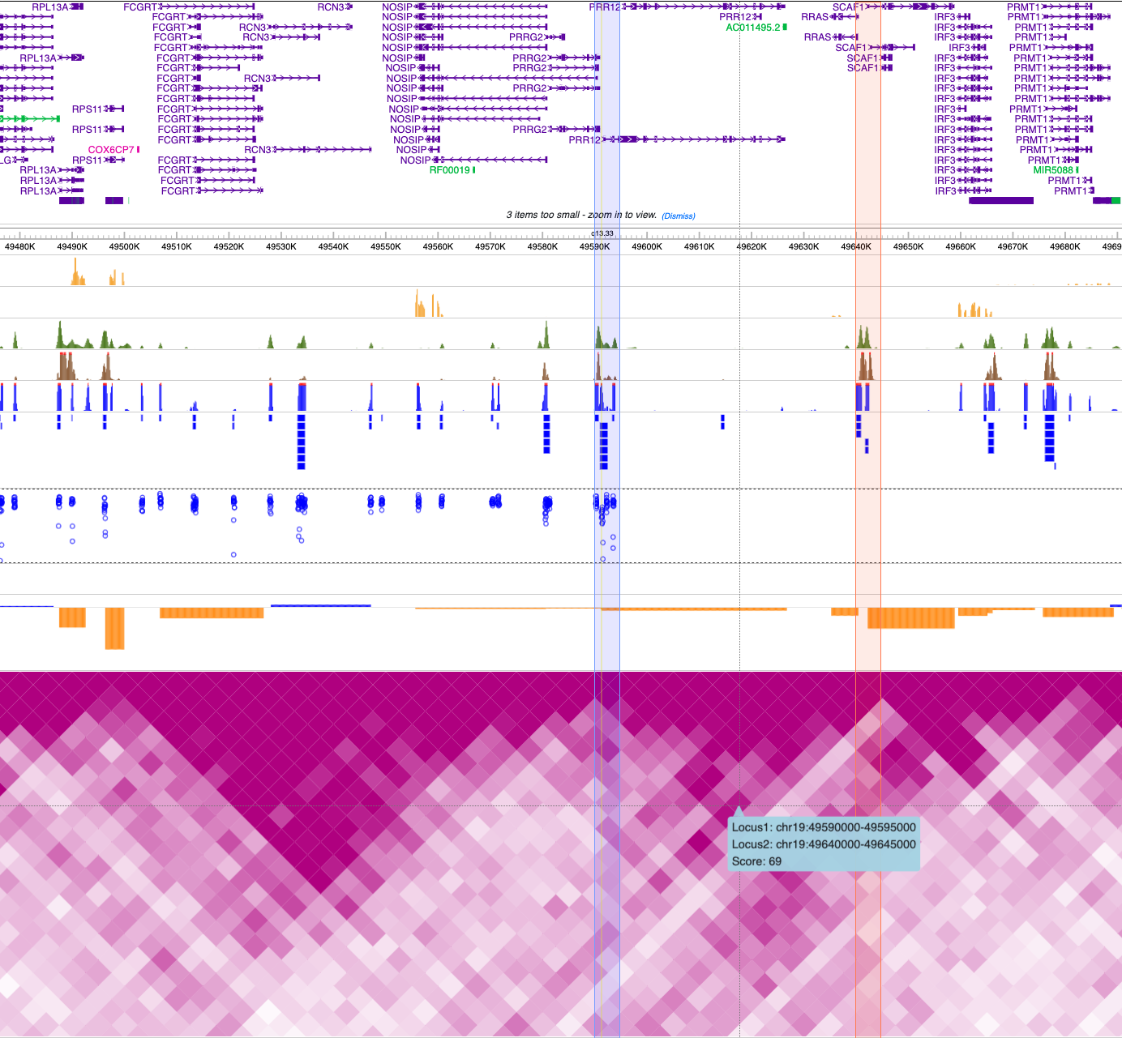
Possible P-P interaction
The DHS of interest is close to the PRR12 promoter, but has a much stronger effect than the promoter.
HiC links potentially supports a connection to two nearby growth genes (SCAF1/51Kb and RPS11/95Kb)
RNA
ChIP
H3K27ac
ATAC

Slide 37
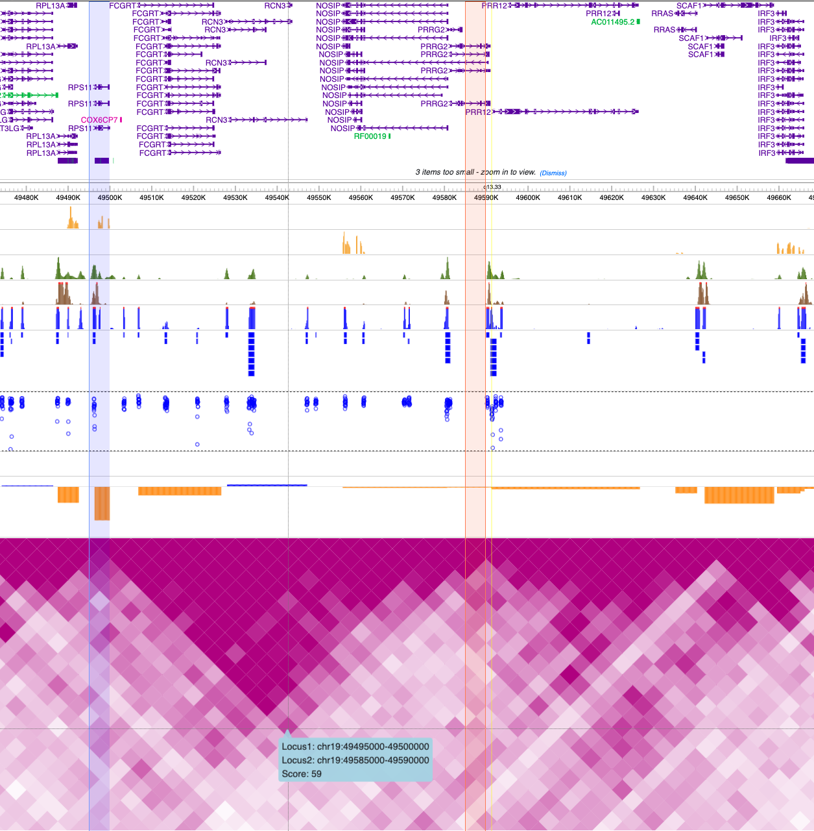
Same cCRE, but another putative growth gene nearby with loose, slightly-shifted HiC support

Slide 38
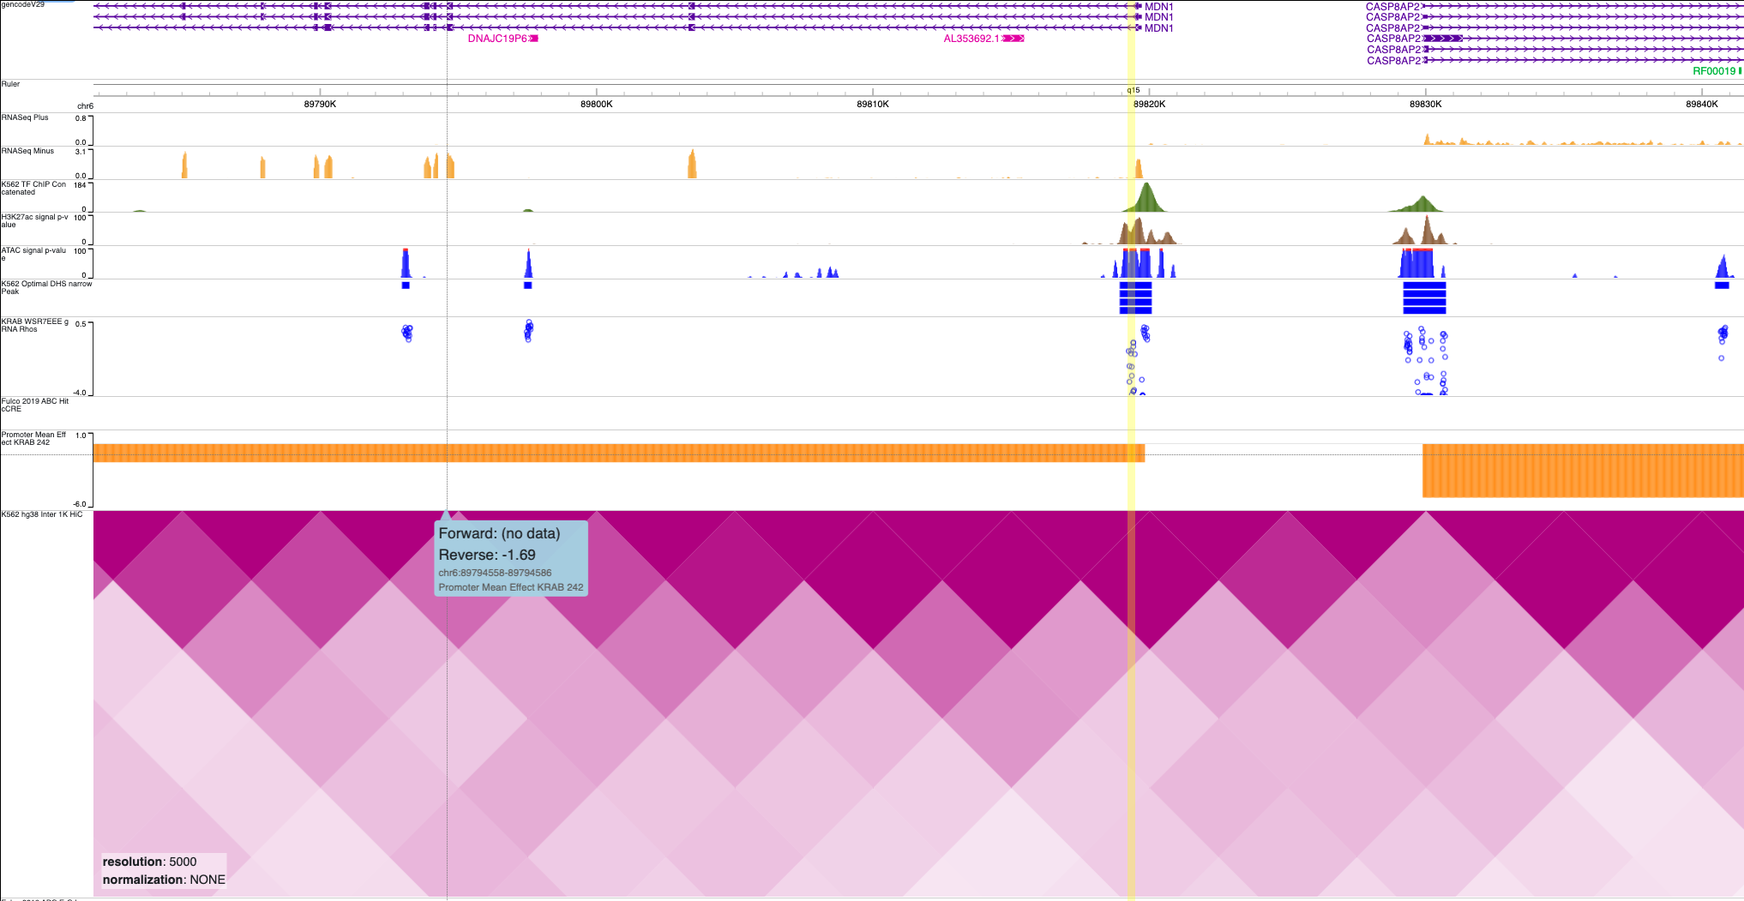
Ambiguous case. cCRE near MDN1 promoter is much stronger than the promoter CRISPRi. Closeby to CASP8AP2, a much stronger growth gene. – THIS IS A GROWTH GENE

Slide 39
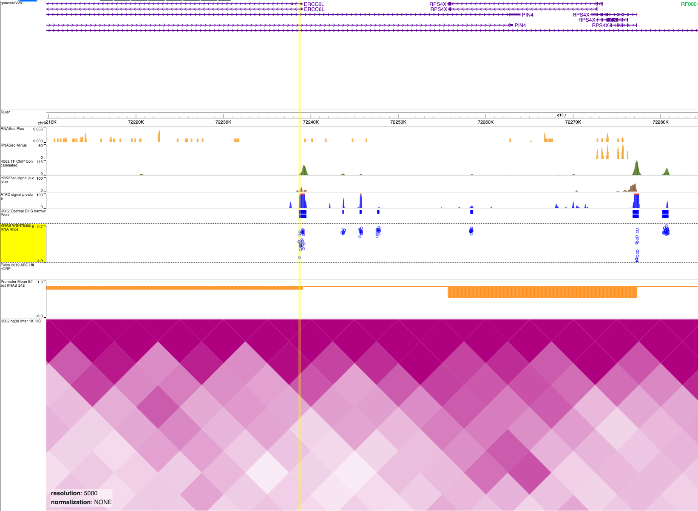
Another case of a weak promoter effect from the GW CRISPRi screen, but strong effects targeting the TSS-overlapping DHS
Nearby to a strong growth gene, RPS4X

Slide 40
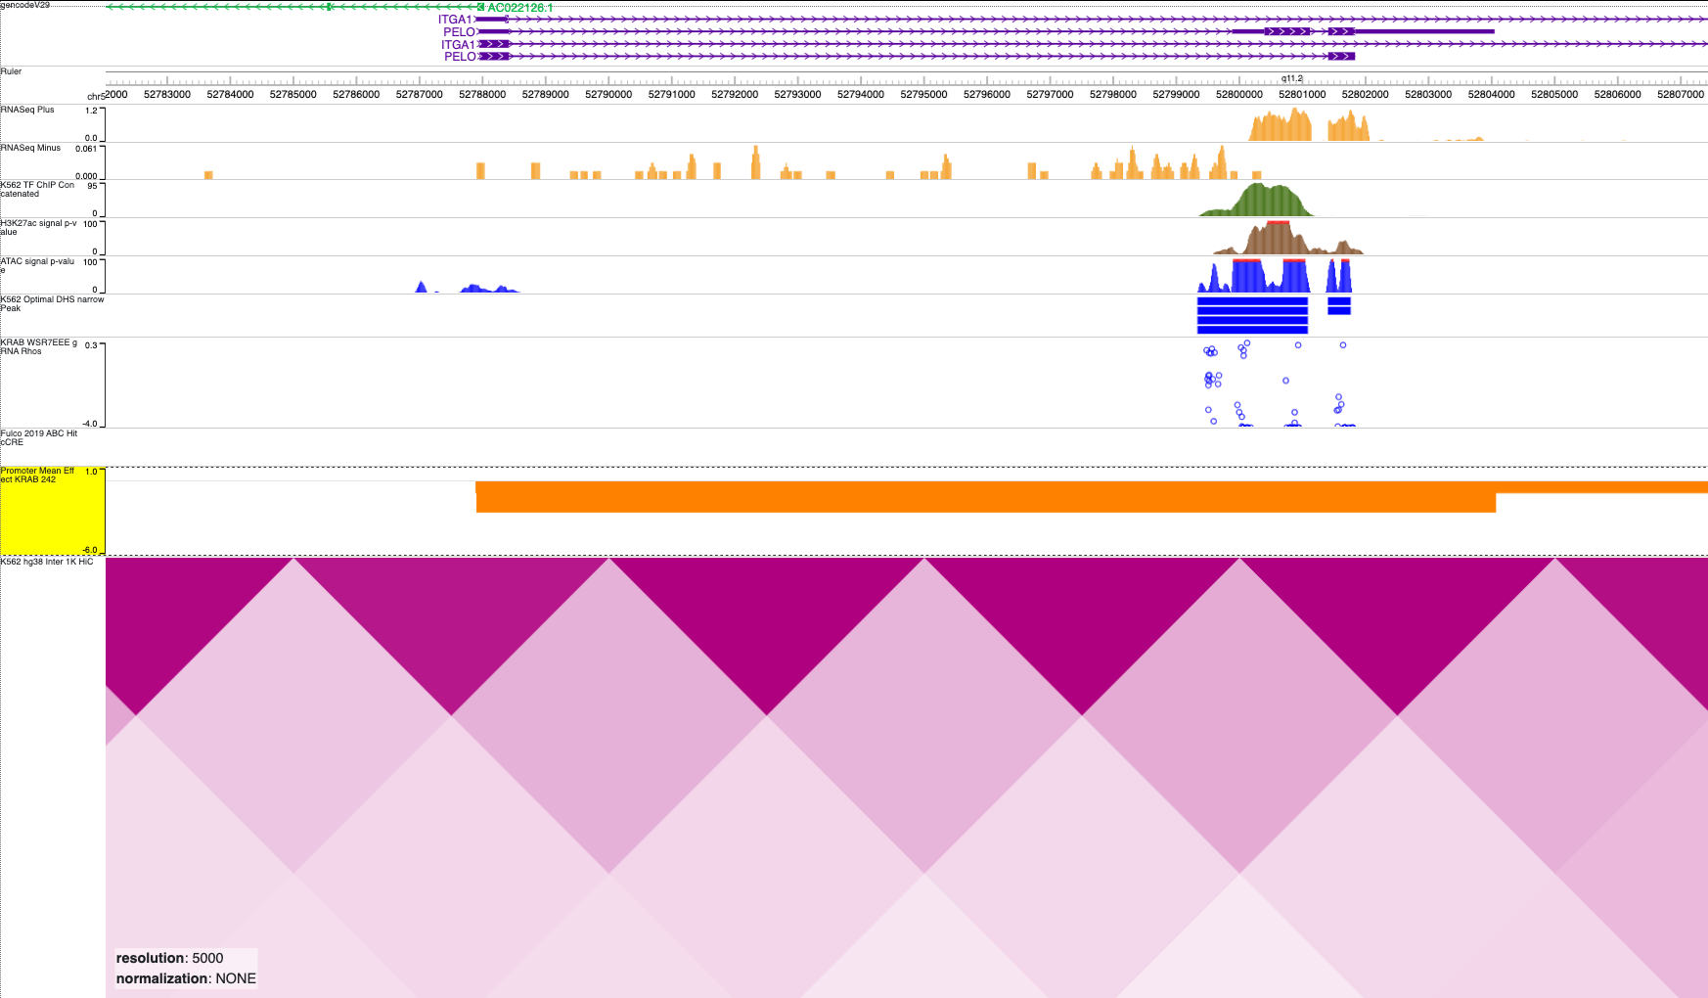
Enhancer cluster with multiple strong hits at the 3’ UTR of PELO – It’s possible this is a misannotation and th enhancer cluster is in fact at the TSS (PELO has a very strong effect, in the orange bar below, it’s being averaged out by ITGA1’s weak effect due to their gene bodies overlapping)

Slide 41
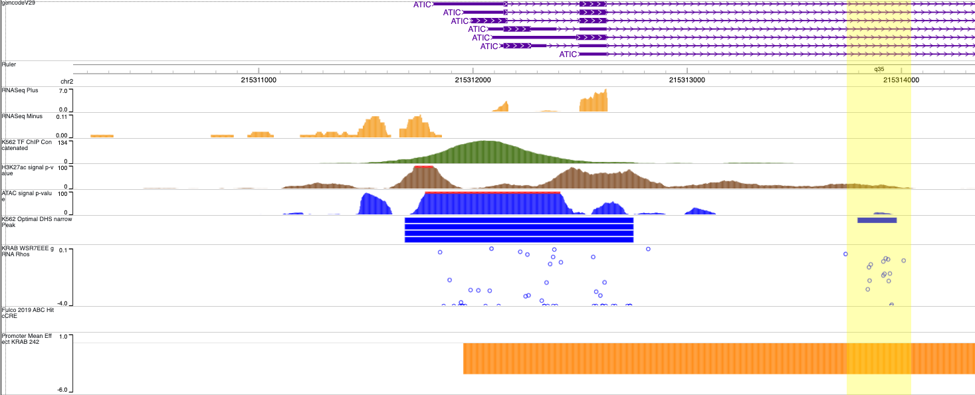
Intronic enhancer, or just a gene body effect?

Slide 42
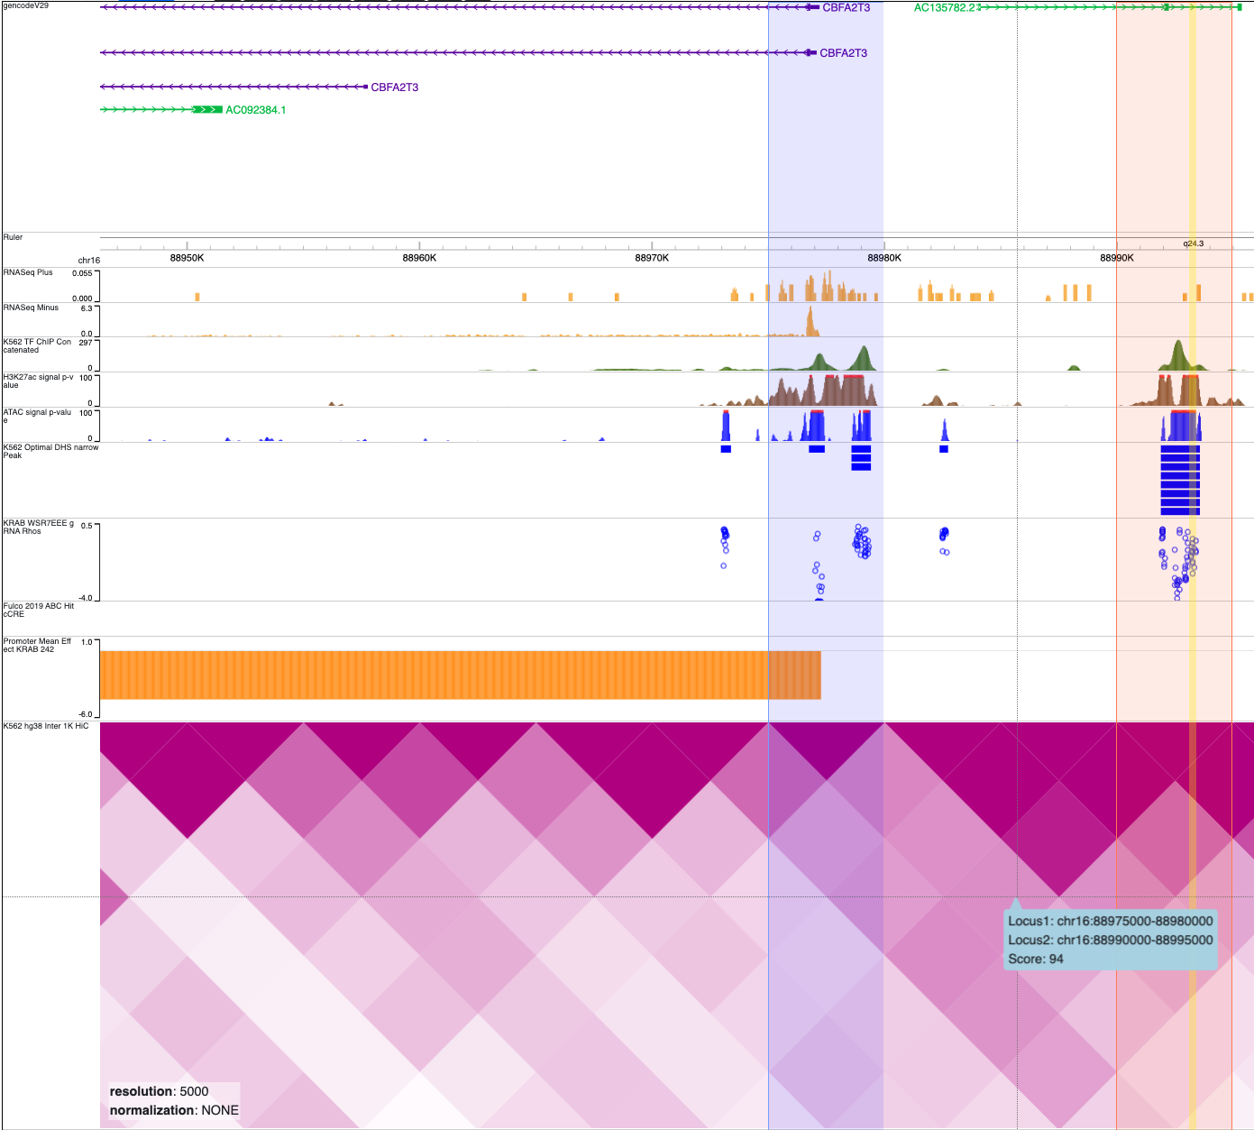
Enhancer cluster overlapping lncRNA has strong effects and HiC link to the nearby growth gene CBFA2T3 - Another DHS in AC135782.2 has very weak effects, suggesting it is potentially a cis and not trans effect

Slide 43
HiC supports a contact between a weak enhancer and the nearby NR2F2 gene. May be confounded by the presence of multiple ncRNA nearby...
cCRE

Slide 44
Intronic enhancer has ABC-supported link to COPZ1
cCRE

Slide 45
Intronic enhancer in the amplified BCL2L1 gene
cCRE

Slide 46
Very weak but highly reproducible enhancer in ABL1 intron – closest adjacent growth gene is EXOSC2
cCRE

Slide 47
Intronic enhancer, still somewhat near the TSS

Slide 48
A more distal intronic enhancer

Slide 49
Upcoming plans
Some of the loci shown are confident hits and good for validation, but will continue to look through loci
For validations: Some likely promoter cCREs, one or two of the ncRNA-overlapping ones, and other enhancers – ideally some with more interesting biology (eg. with skipped/bystander genes)
Validate with qPCR and some with SHARE-seq
Begin TF motif enrichment and other analyses
What are the best databases for TF motifs? What should I be wary of?
Ideally I want to feed in enhancer coordinates and get the motifs present (with some kind of a score on the quality of the motif?). Does a bed file exist?
I imagine most motifs can’t be unambiguously assigned a TF, but to a family of TFs. Are such analyses useful? Anything to be wary of?
Anyone want to work with me on this analysis?
Notes:
Jasper
- Might not have bed
Trans factor
HOMER: low precision
- Fine for small scale locus
Looking for stronger motifs

